Slide 1
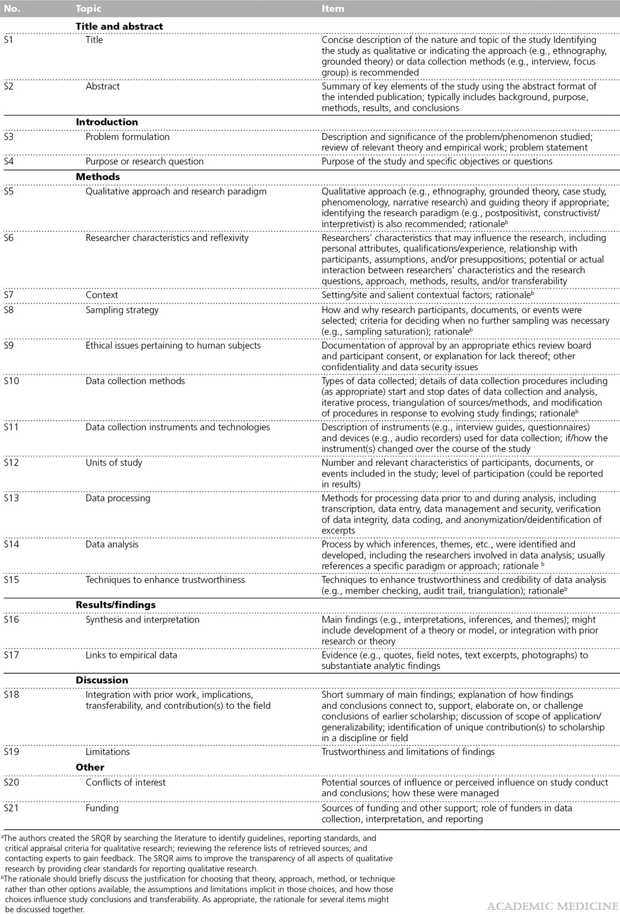

Table 1
Standards for Reporting Qualitative Research: A Synthesis of Recommendations
O’Brien, Bridget C.; Harris, Ilene B.; Beckman, Thomas J.; Reed, Darcy A.; Cook, David A.
Academic Medicine89(9):1245-1251, September 2014.
doi: 10.1097/ACM.0000000000000388
Standards for Reporting Qualitative Research (SRQR)a

Slide 2
Lines 1 - 3
Lines 22 - 54
Lines 67 – 148
Lines 142 - 148
Lines 153 - 156
Lines 161-162
Lines 152 - 158
Lines 155 – 156, 159 – 160
Lines 162 – 167, 170 - 171
Lines 159 – 160
Lines 173 – 183, 190 - 196
Lines 201 - 228
Lines 164 - 167
Lines 184 – 197, 437 - 438
Lines 171 – 172
Lines 237 - 284
See table 1 ( 216 – 217), table 2 (227 – 228), table 3 (243 – 244) and figure 1 (283- 284)
Lines 296 - 361
Lines 365 - 382
Lines 428 - 430
Lines 431 - 433

