Slide 1
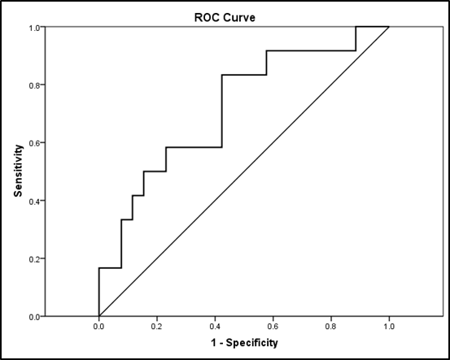
Integrated urinary biomarkers can predict early acute kidney injury in children undergoing chemotherapy
HYPOTHESIS: KIM-1, NGAL, L-FABP and VNN-1 could be early biomarkers for cytotoxic treatment induced AKI.
Diagnostic accuracy of 24h/baseline urine biomarkers’ adjusted according to urine creatinine concentration for AKI status by using ROC curve analysis
DESIGN & OUTCOMES:
sCr
uKIM-1
uNGAL
uL-FABP
uVNN-1
Variable(s) | AUC (95thCI) | SE | P
uL-FABP/uCr 24h/baseline | 0.48 (0.29-0.67) | 0.097 | 0.900
uNGAL/uCr 24h/baseline | 0.55 (0.34-0.76) | 0.106 | 0.615
uKIM-1/uCr 24h/baseline | 0.63 (0.45-0.81) | 0.092 | 0.209
uVNN-1/uCr 24h/baseline | 0.57 (0.38-0.76) | 0.096 | 0.470
Model from binary logistic regression analysis (urinary 24h/baseline ratios of L-FABP+NGAL+KIM-1+VNN-1) | 0.718 (0.540-0.896) | 0.091 | 0.031
38 pediatric patients with malignant tumours
Urine samples taken at
baseline, 2h, 6h, 24h
Serum samples taken at
baseline, 2h, 6h, 24h, 48 h
AKI
n=12
Chemotherapy
ROC analysis for diagnostic accuracy in AKI prediction of model of tested parameters (urinary 24h/baseline ratios
L-FABP+NGAL+KIM-1+VNN-1)
non-AKI n=26
Ifosfamid (IFO)/Cisplatin (CIS)
CONCLUSION: Changes in urinary NGAL/Cr, KIM-1/Cr, L-FABP/Cr and VNN-1/Cr ratios, 24 h after chemotherapy can be utilized to predict AKI in children. The use of model of integrated urine biomarkers could be promising in prediction of AKI in patients receiving chemotherapy.
Milosevski-Lomic G. et al. 2023

