Slide 1
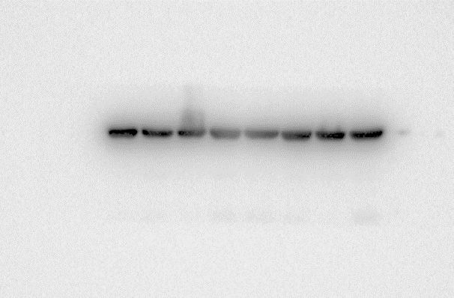
Uncropped Western blot
Fig1A
C3
CFH/FHL-1
β-actin

Slide 2
Fig3A
FLAG
CFH
Β-actin
Fig6A
CD68
Β-actin

