Slide 1
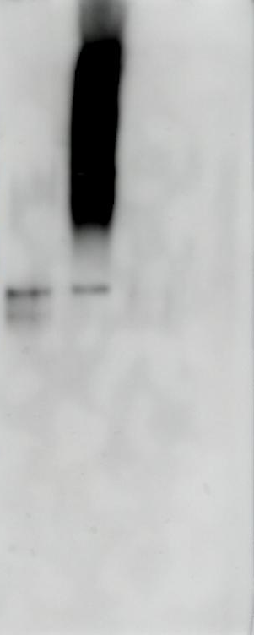
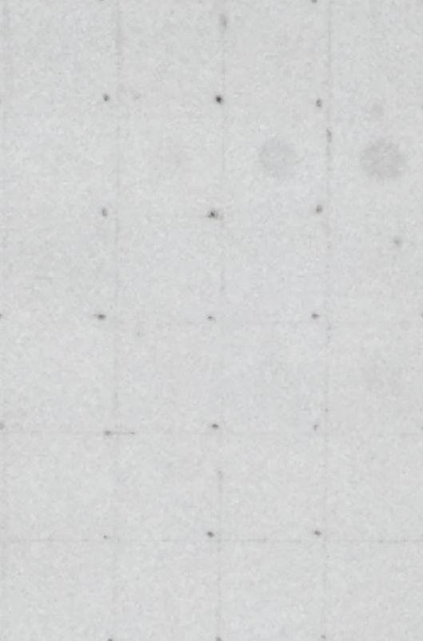
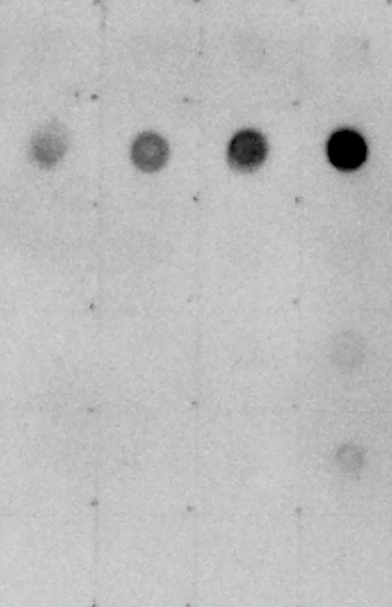
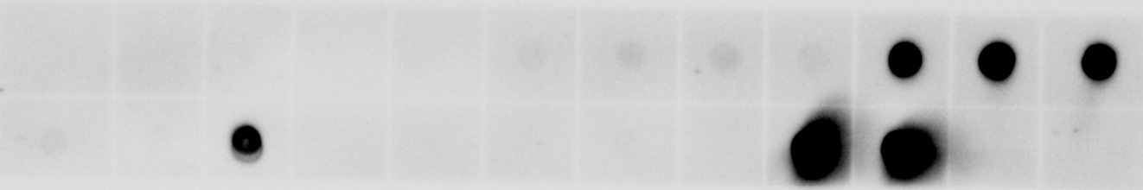
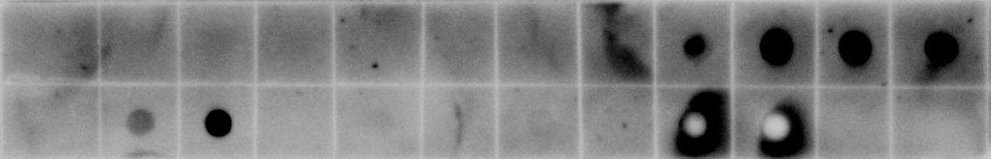
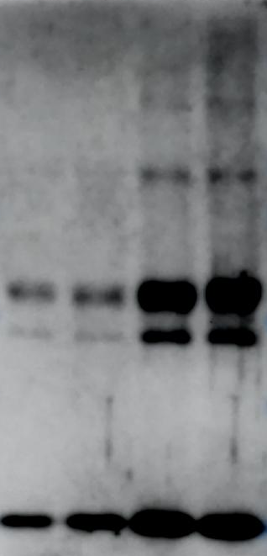
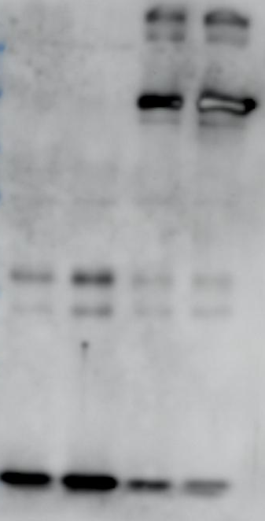
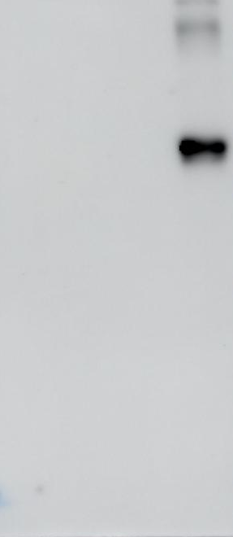
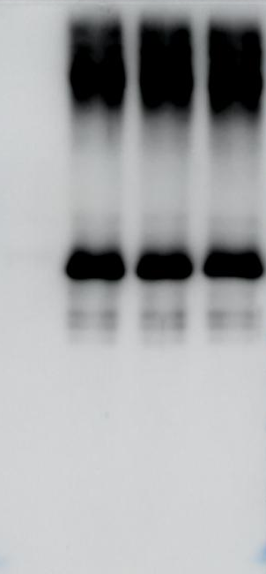
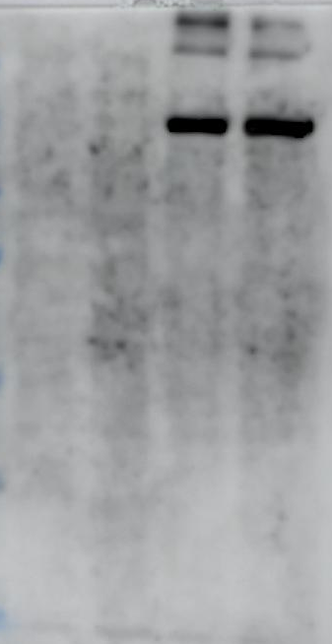
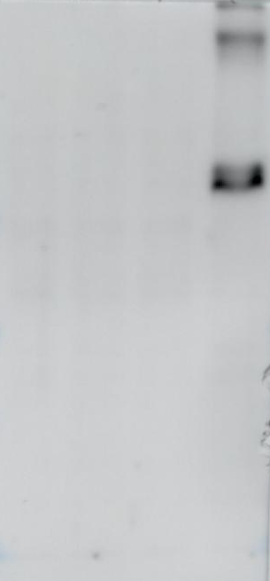
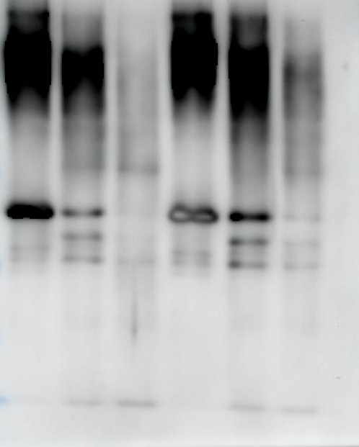
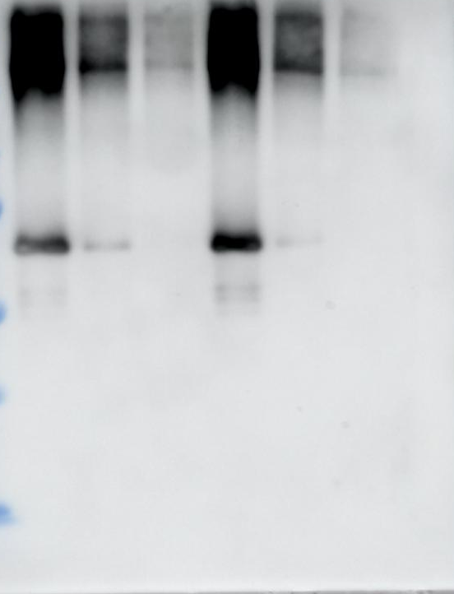
Yoo et al. 2023, Additional file 1. Uncropped blots
a
Figure 1b
b
c
Figure 1c
Figure 1d
250 -
150 -
100 -
75 -
50 -
37 -
25 -
d
Figure 1e
e
Figure 1f
f
Figure 1h
Figure 1h
Figure 1h
g
Figure 1h
h
Figure 1h
Figure 1h
IP: FLAG
Input (Media)
Input (Lysate)
250 -
250 -
250 -
250 -
250 -
250 -
150 -
150 -
150 -
150 -
150 -
150 -
100 -
100 -
100 -
100 -
100 -
100 -
75 -
75 -
75 -
75 -
75 -
75 -
50 -
50 -
50 -
50 -
50 -
50 -
37 -
37 -
37 -
37 -
37 -
37 -
25 -
25 -
25 -
25 -
25 -
25 -
Tau
FLAG
Myc
Tau
FLAG
Myc
i
Figure 4b
j
Figure 5b
250 -
250 -
150 -
150 -
100 -
100 -
75 -
75 -
50 -
50 -
37 -
37 -
25 -
25 -

