Slide 1
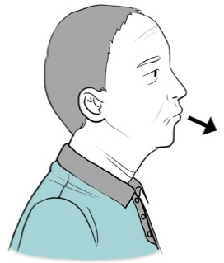
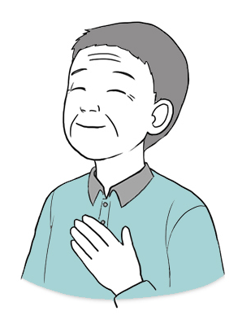
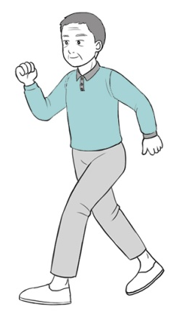
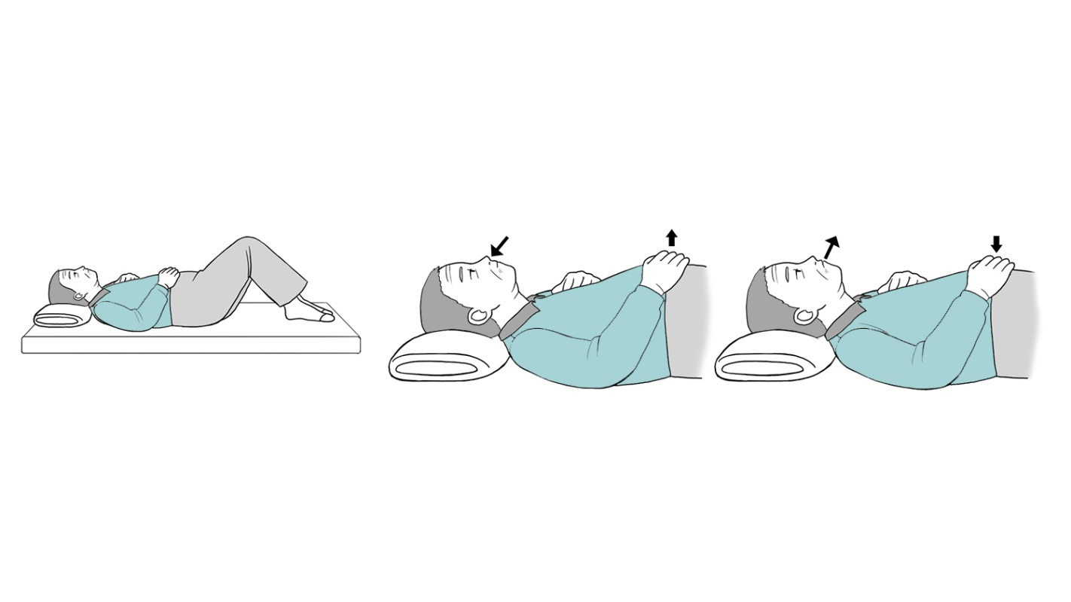

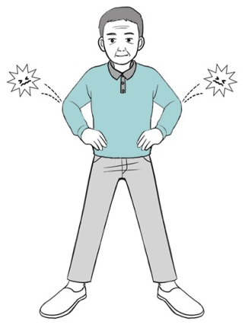
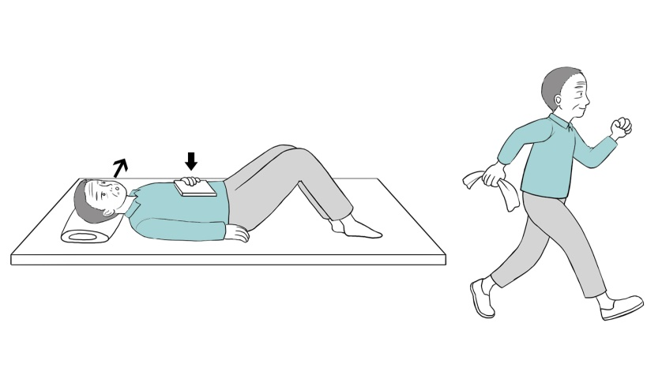
Program for pulmonary rehabilitation
Program for pulmonary rehabilitation
01
Introduction
02
Methods for effective breathing
What is pulmonary rehabilitation?
Pursed-lip breathing
Pulmonary rehabilitation is a comprehensive treatment including exercise, education, and nutritional support. It enables patients to improve their physical and emotional statuses.
During expiration, breathe with softly purse lips with concentration. After that, slowly increase the intensity of the pursed lip, until expiration time takes twice as much as the inspiration time. Be careful because breathing with a barely pursed lip can aggravate dyspnea.
Effects of pulmonary rehabilitation
Abdominal breathing
Improvement in dyspnea
Improved quality of life and exercise capacity
In the supine position, put one hand on your chest and one on the abdomen. Perform inspiration through the nose while confirming abdominal distension with your hand.
Breath out slowly with your abdomen relaxed and lip pursed. Be careful because barely distended abdomen can aggravate dyspnea.
Training for diaphragm
After being able to abdominally breathe in an effective manner, exercise through the same process with a weighted material, such as a book, on your abdomen. Through this process, you can train your diaphragm.
Maintenance of health by physical and emotional activities
Prevention of complication and reduction in medical expenses
- 1 -
- 2 -

Slide 2
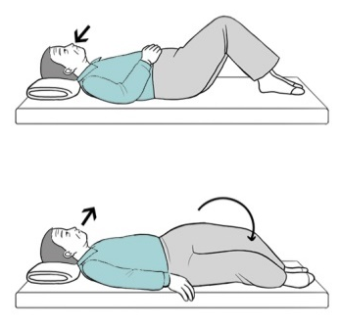
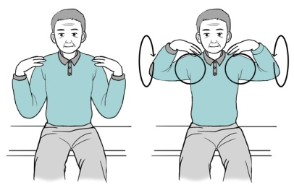
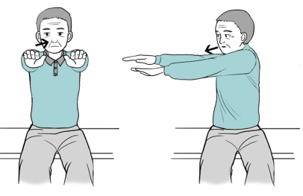
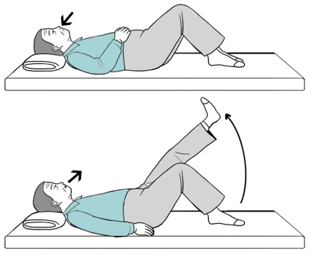
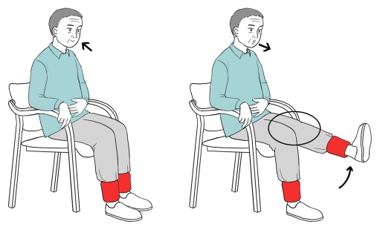
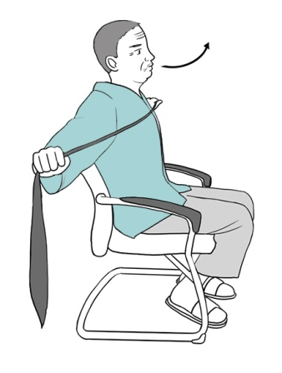

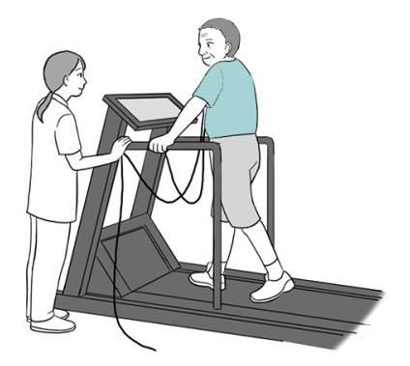

Program for pulmonary rehabilitation
Program for pulmonary rehabilitation
03
Exercise for pulmonary rehabilitation
04
Muscle training
Stretching
Muscle training for lower extremity
Put your hands on your shoulders and rotate each elbow back and forth.
Extend your arms forward, inhale through your nose, and then exhale through your mouth while twisting your torso to the left (right). Then inhale back to the starting position.
In the supine position, raise both knees. Inhale through your nose and exhale through your mouth, tilting both knees to the left (right). Then inhale back to the starting position.
In the supine position, keep your knees up. Inhale through your nose and exhale through your mouth, raising one leg. Then inhale back to the starting position. Once you get used to it, you can increase the strength by wearing sandbags on both ankles. In this case, the intensity of exercise is more appropriate than maintaining a “moderately intense“ level.
Muscle training for upper extremity
Aerobic exercise
Stretch your legs in the sitting position, hang a rubber band on the soles of your feet and hold them with both hands. Inhale through your nose and exhale through your mouth, pulling the band towards you. Then inhale back to the starting position.
Hold the rubber band with both hands in the sitting position. Inhale and exhale to stretch the rubber bands on both sides. Then inhale back to the starting position.
The intensity of aerobic exercise is more appropriate than maintaining a “moderately intense” level. If manageable, exercise for more than 20 minutes with prescribed intensity. If you feel exhausted during the exercise, achieve the goal after taking rest.
- 3 -
- 4 -

Slide 3
Exercise diary
05
Prescription for exercise
Aerobic exercise
Promise
I will perform pulmonary rehabilitation more than ______ minutes and _____ times per week.
Type
Walking (treadmill)
Indoor bicycle
Date | Abdominal breathing | Aerobic exercise | Exercise for lower limb muscle | Exercise for upper limb muscle | More than 30 minutes
m d
m d
m d
m d
m d
m d
m d
m d
m d
m d
m d
m d
m d
m d
m d
m d
m d
m d
m d
m d
m d
Velocity
( )km/h
Time
10 min
20 min
30 min
40 min
50 min
60 min
Exercise for muscle
Type
Upper extremity
Lower extremity
Intensity
Sandbag ( ) kg
Frequency
5 times X 3 sets
10 times X 3 sets
15 times X 3 sets
- 5 -
- 6 -

