Slide 1
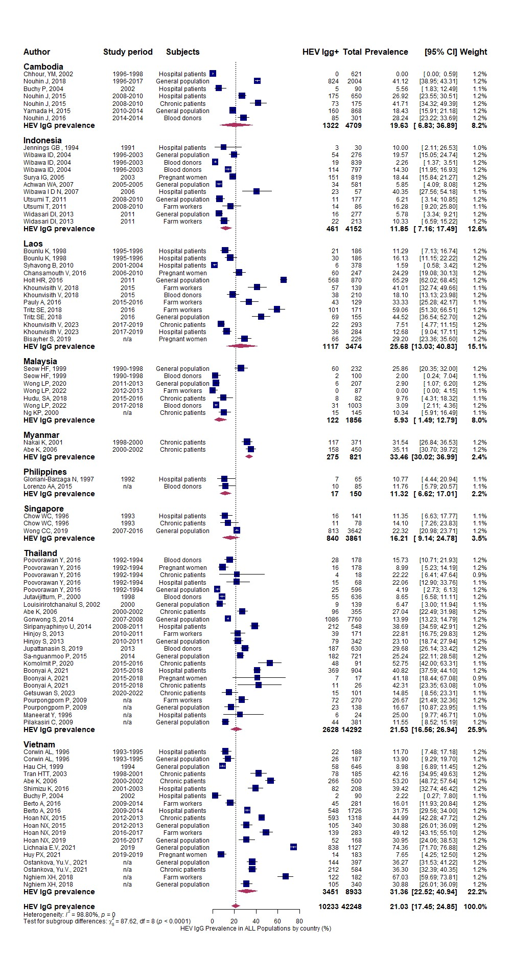
Supplementary Figure 1: Forest plot showing meta-analysis of anti-HEV IgG prevalence by countries of Southeast Asia, with authors, years of study, and study population type.

Slide 2
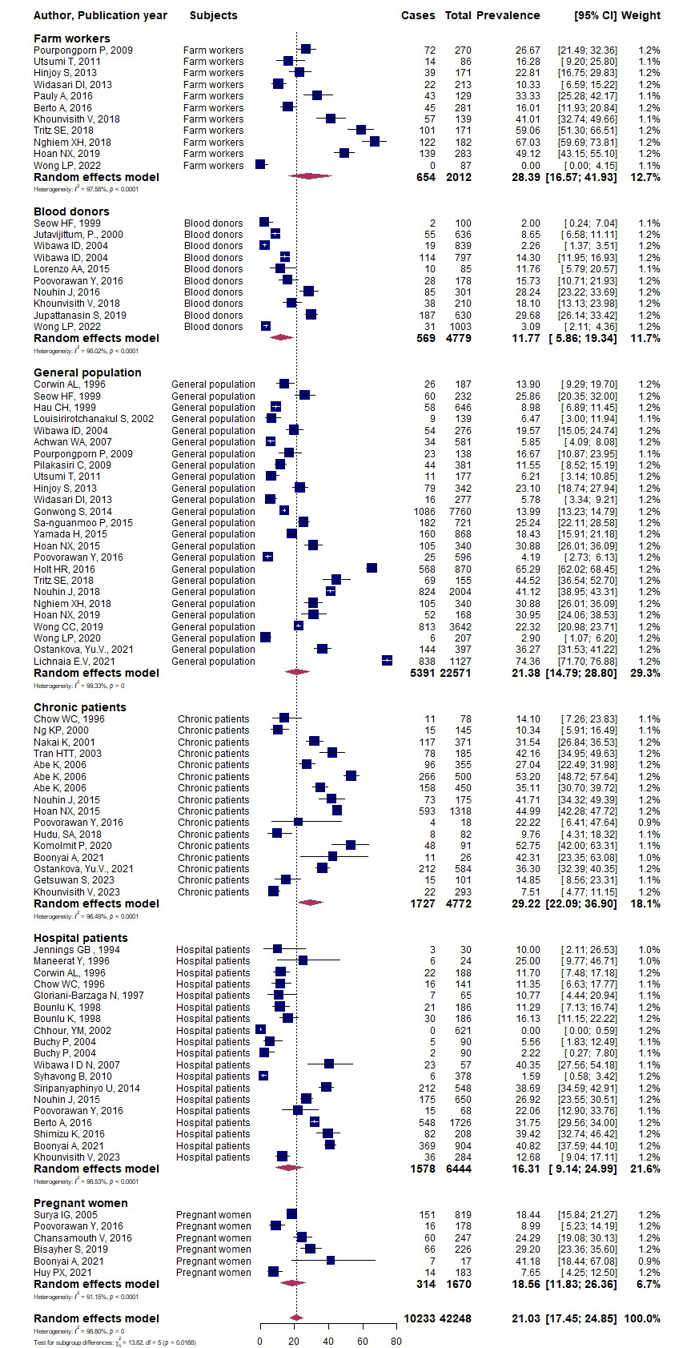
Supplementary Figure 2: Forest plot showing meta-analysis of anti-HEV IgG prevalence by the study population in Southeast Asia.

Slide 3
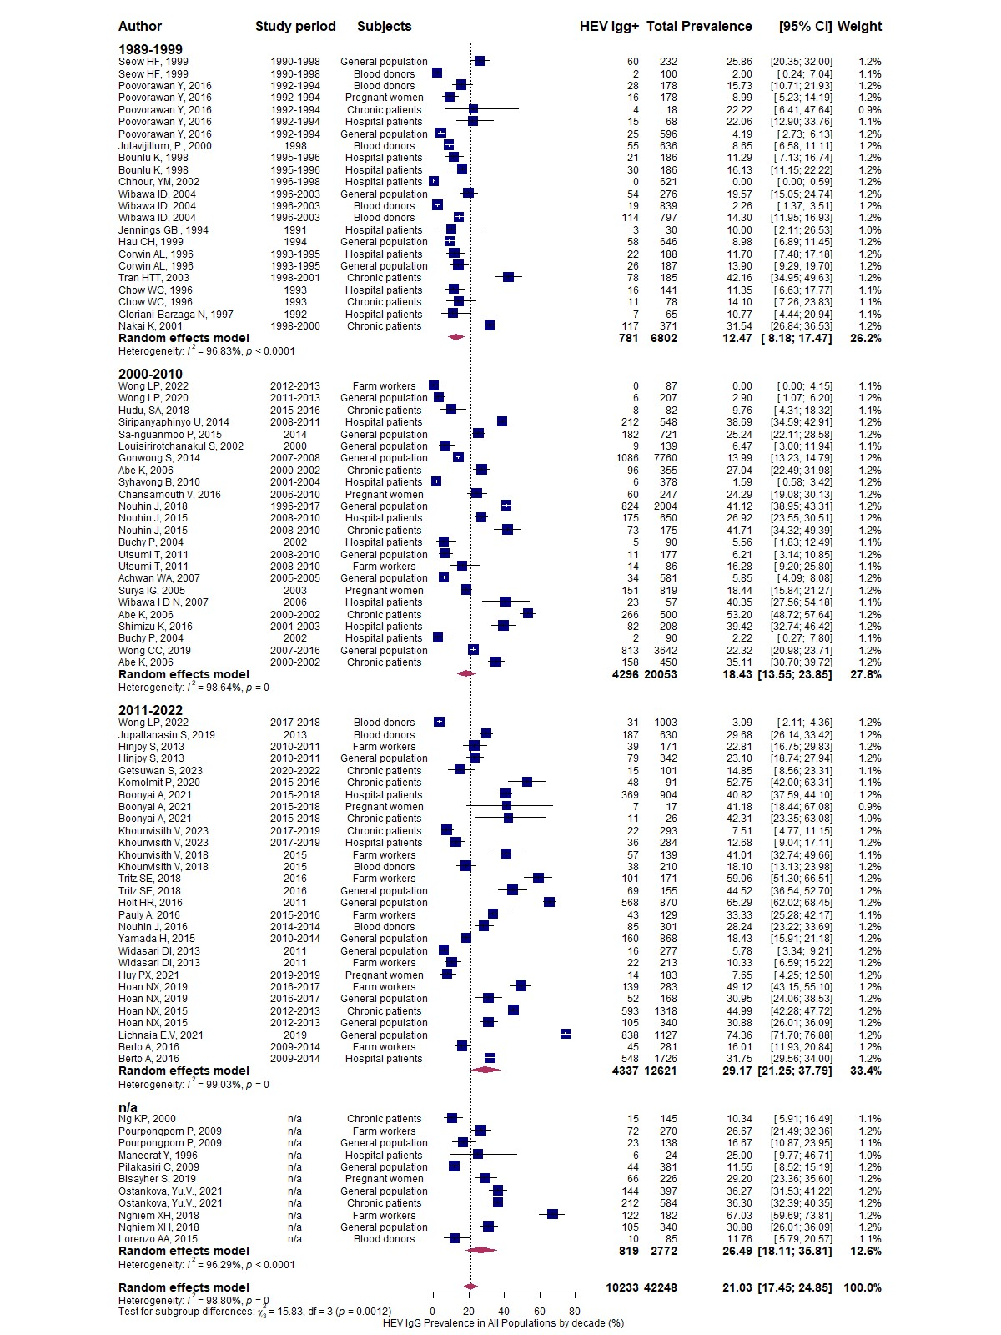
Supplementary Figure 3: Forest plot showing meta-analysis of anti-HEV IgG prevalence divided by decades among the study population of Southeast Asia.
n/a – studies which does not include the study period information

Slide 4
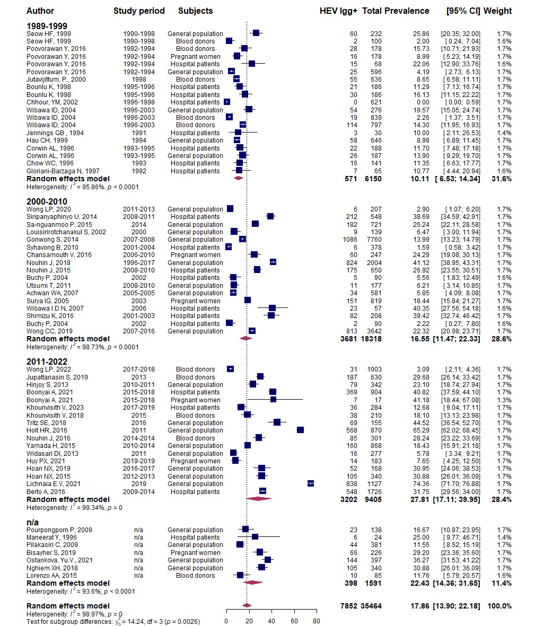
Supplementary Figure 4: Forest plot showing meta-analysis of anti-HEV IgG prevalence among the low-risk groups of acquiring HEV among the population of Southeast Asia.

Slide 5
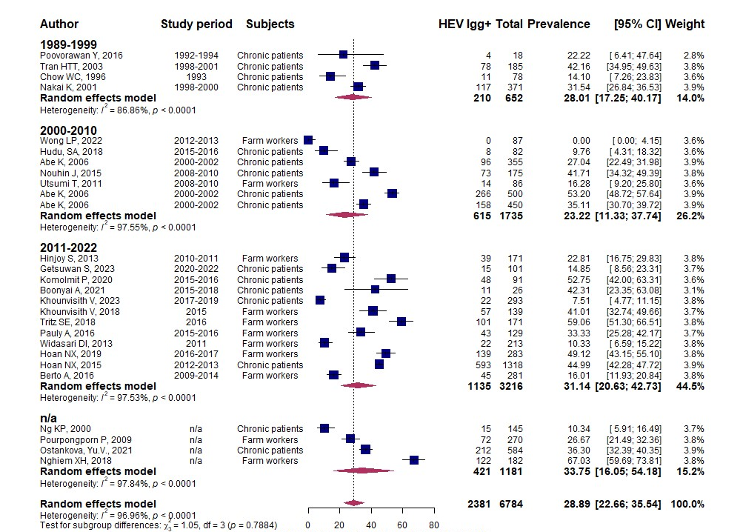
Supplementary Figure 5: Forest plot showing meta-analysis of anti-HEV IgG prevalence among the high-risk groups of acquiring HEV among the population of Southeast Asia.

Slide 6
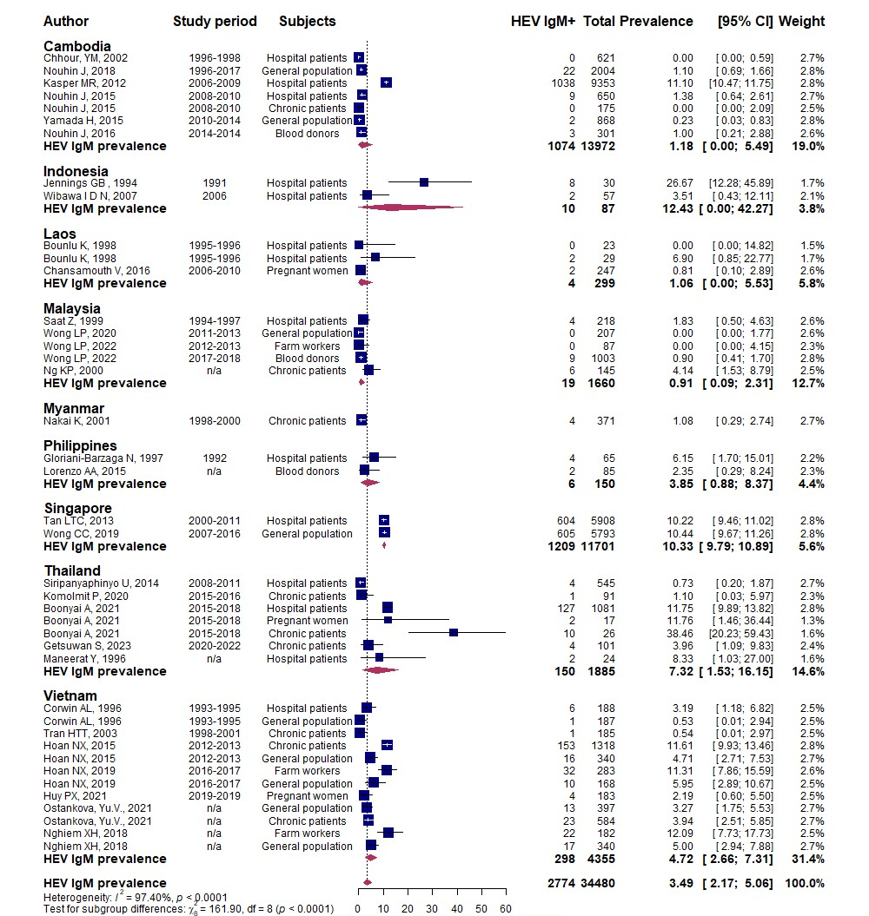
Supplementary Figure 6: Forest plot showing meta-analysis of anti-HEV IgM prevalence by countries of Southeast Asia, with authors, years of study, and study population type.

Slide 7
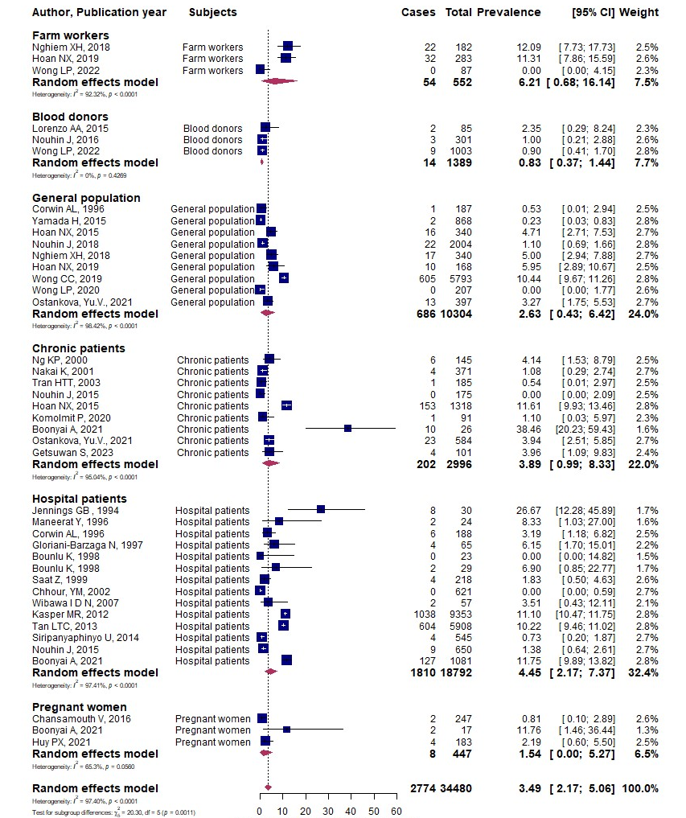
Supplementary Figure 7: Forest plot showing meta-analysis of anti-HEV IgM prevalence by the study population in Southeast Asia.

Slide 8
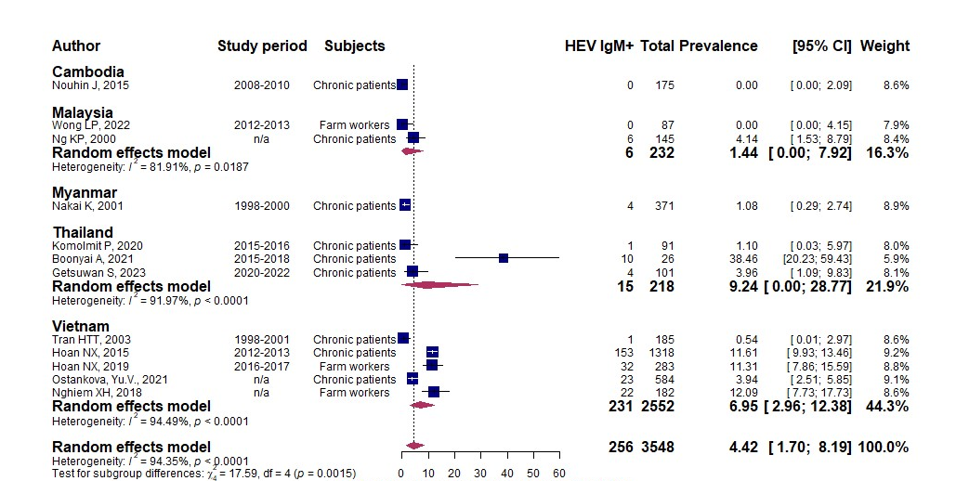
Supplementary Figure 8: Forest plot showing meta-analysis of anti-HEV IgM prevalence among the high-risk groups of acquiring HEV among the population in Southeast Asia.

Slide 9
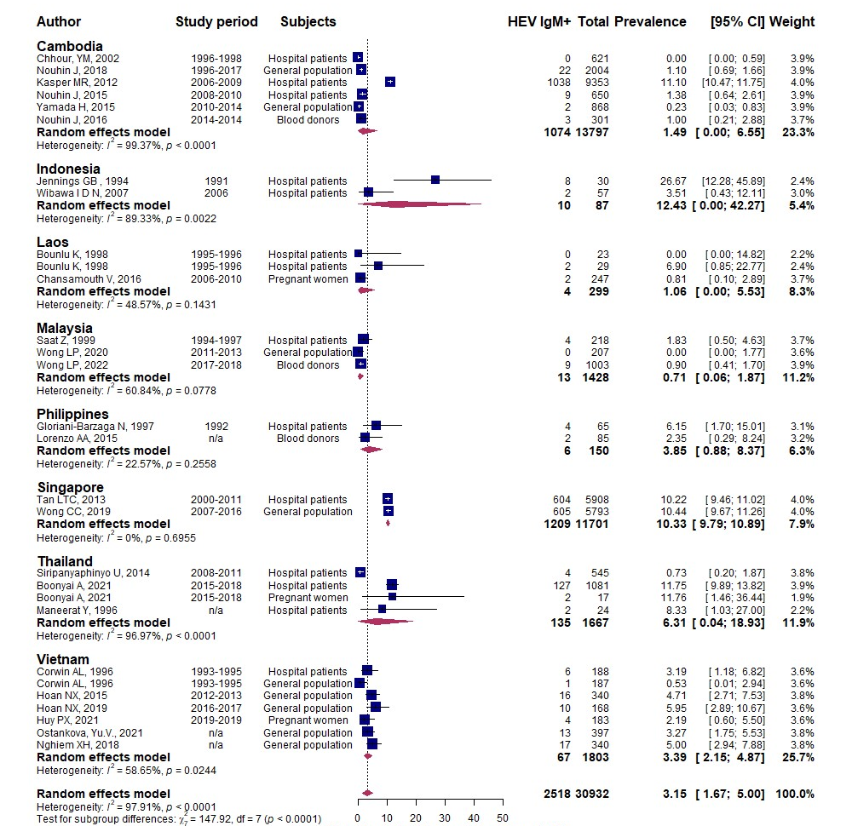
Supplementary Figure 9: Forest plot showing meta-analysis of anti-HEV IgM prevalence among the low-risk groups of acquiring HEV among the population of Southeast Asia.

Slide 10
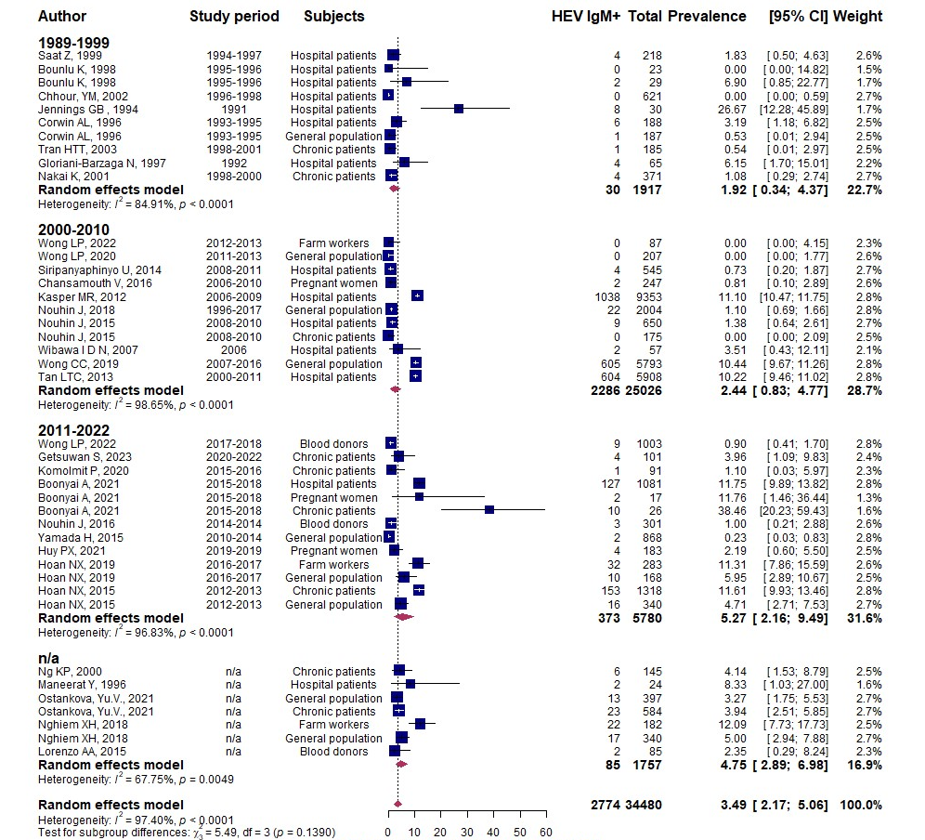
Supplementary Figure 10: Forest plot showing meta-analysis of anti-HEV IgM prevalence divided by decades among the study population of Southeast Asia.
n/a – studies which does not include the study period information

Slide 11
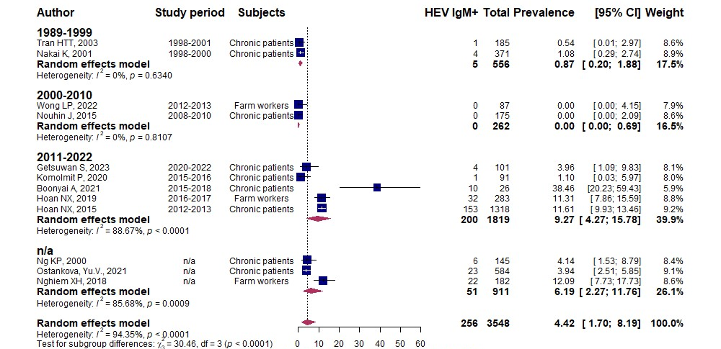
Supplementary Figure 11: Forest plot showing meta-analysis of anti-HEV IgM prevalence divided by decades among the high-risk of acquiring HEV population of Southeast Asia.
n/a – studies which does not include the study period information

Slide 12
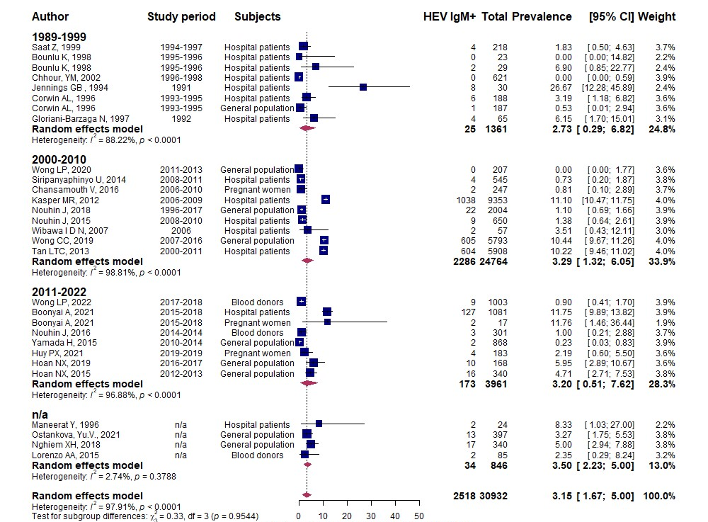
Supplementary Figure 12: Forest plot showing meta-analysis of anti-HEV IgM prevalence divided by decades among the low-risk of acquiring HEV population of Southeast Asia.
n/a – studies which does not include the study period information

Slide 13
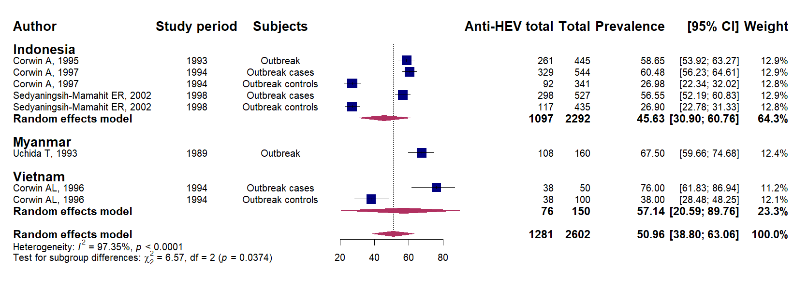
Supplementary Figure 13: Forest plot showing meta-analysis of anti-HEV total Ig prevalence in the outbreak settings in Southeast Asia.

