Slide 1
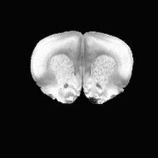
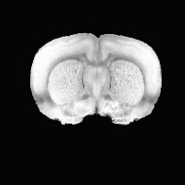
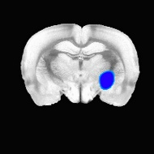
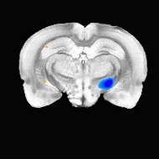
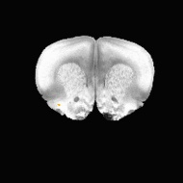
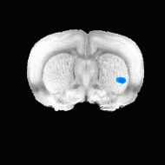
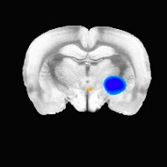
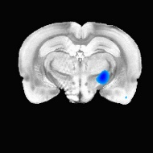
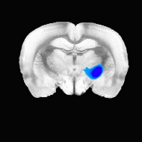
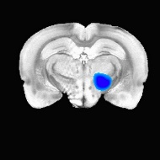

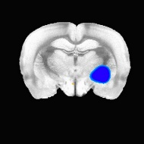
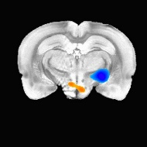

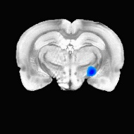
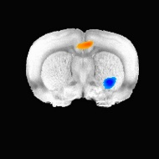
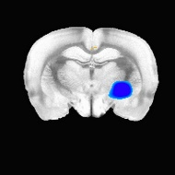
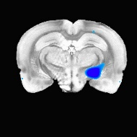
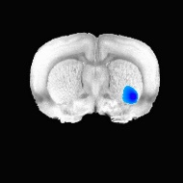
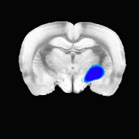

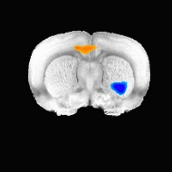

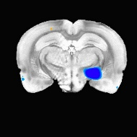
A
Control
CamKII-Sham
C
I
C
I
PS 7
PS 7
2 mm
0.5 mm
-2 mm
-4 mm
2 mm
0.5 mm
-2 mm
-4 mm
PS 14
PS 14
I.C
C
I
PV-Sham
C
I
hSyn-Sham
PS 7
PS 7
2 mm
0.5 mm
-2 mm
-4 mm
2 mm
0.5 mm
-2 mm
-4 mm
PS 14
PS 14
B
+4
z
-4
C
Supplementary Fig.1. FDG-microPET images of the control and sham-stimulation groups.
(A) Color-coded maps showing activation patterns in each cell type sham-stimulation group (3dLME in AFNI, p < 0.01). The microPET image analysis was performed between pre-stimulation images (PS -1) and stimulation images (PS7 or PS14). (B-C) Changes of regional NMA (% change from the PS -1) in the control and sham-stimulation groups at PS 7 and PS 14. (Two-way ANOVA with Dunn’s multiple comparisons, B, F (27, 260) = 0.3919, p = 0.9975; C, F (27, 260) = 0.7379, p = 0.8263). All Data represent the mean ± S.E.M. C, Contralesional; I, Ipsilesional; I.C., Internal capsule.

Slide 2
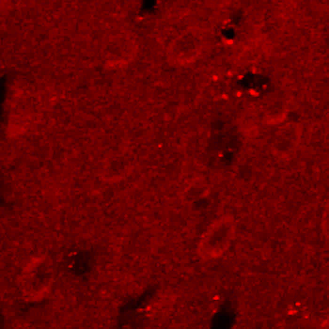
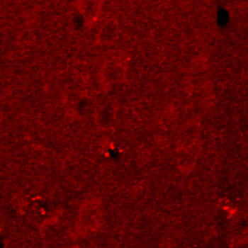
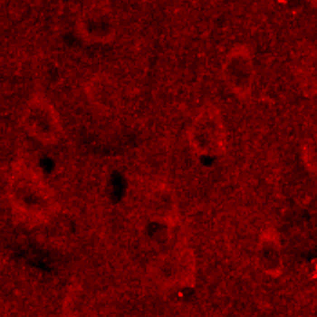
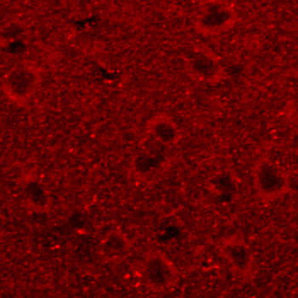
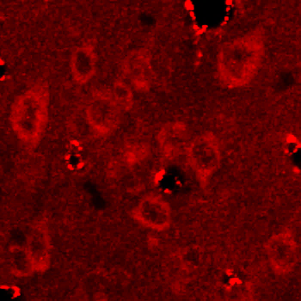
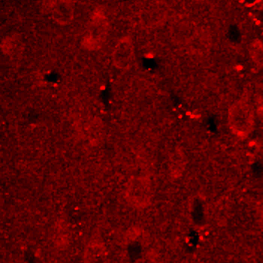
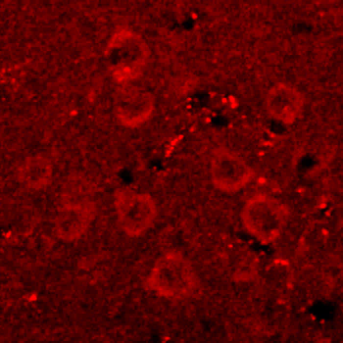
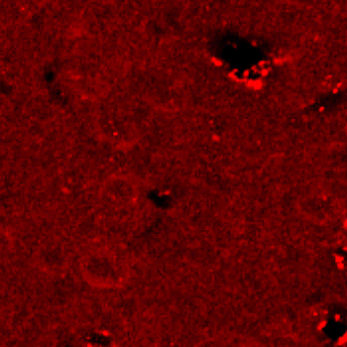
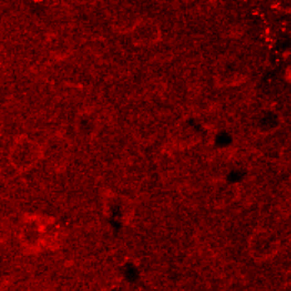
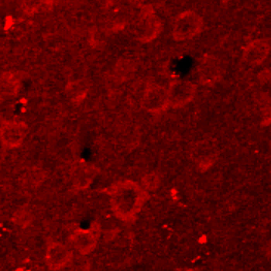
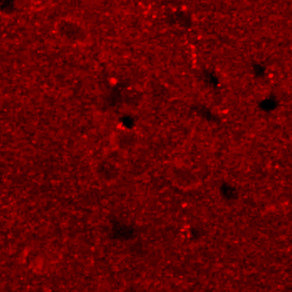
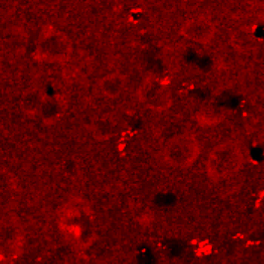
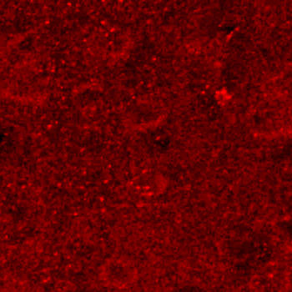
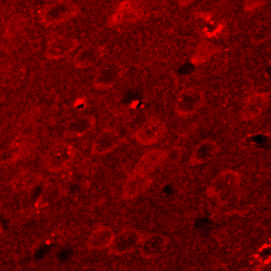
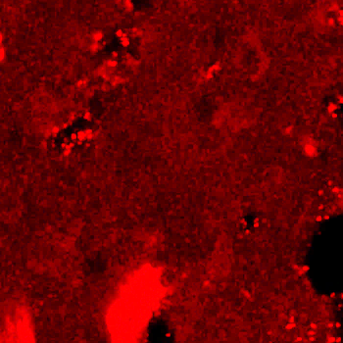
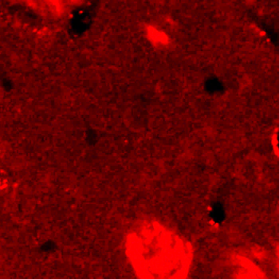
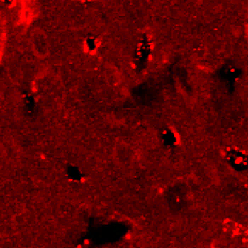
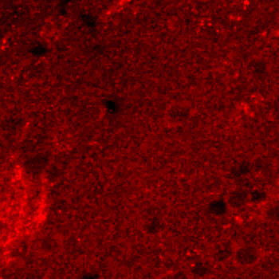
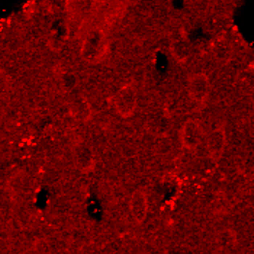
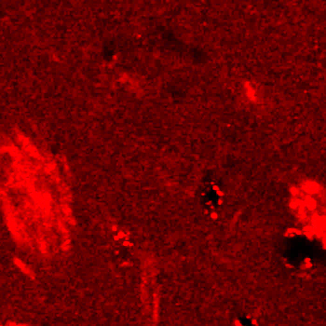
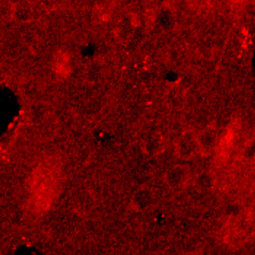
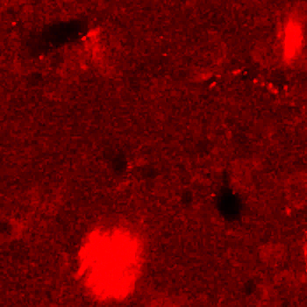
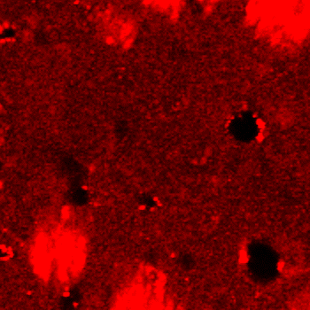
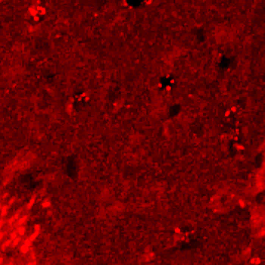
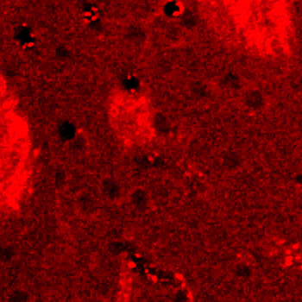
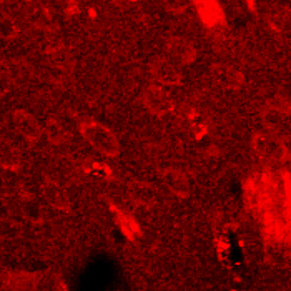
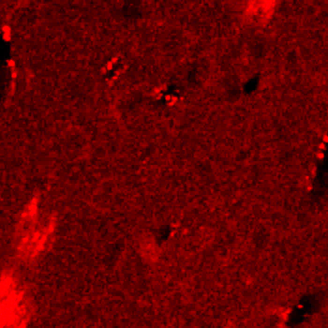
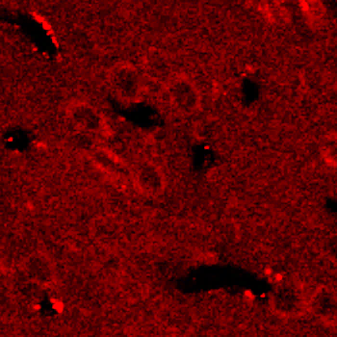
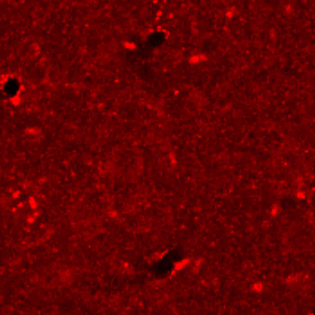
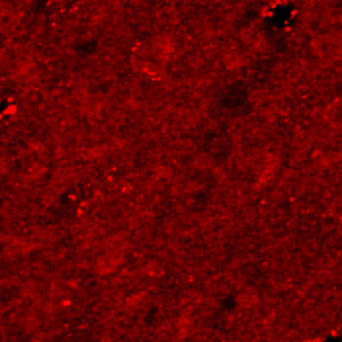












A
Control
CamKII-Sham
CamKII-Stim
PV-Sham
PV-Stim
hSyn-Sham
hSyn-Stim
I. Motor
I. Sensory
I. Striatum
C. Striatum
I. Thalamus
C. Thalamus
B
C
D
Supplementary Fig. 2. Patterns of BDNF expression for all group.
(A) Representative images of BDNF expression in six different ROIs for all groups, including the control, sham and optogenetic stimulation groups. (B-D) Quantification of BDNF intensity in six different ROIs for all groups (Two-way ANOVA with Tukey`s multiple comparisons, B, F (10, 811) = 2.054, p = 0.0258; C, F (10, 869) = 2.243, p = 0.0139; D, F (10, 864) = 1.893, p = 0.0427). All Data represent the mean ± S.E.M. *p < 0.05, **p < 0.01, ***p < 0.001. Scale bars: 100 µm.

