Slide 1
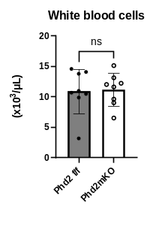
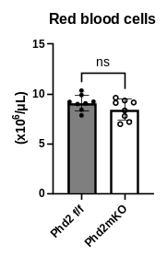
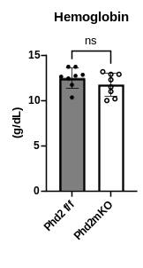
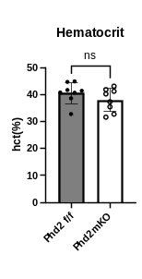
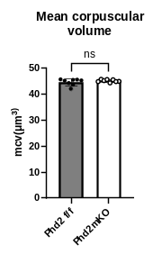
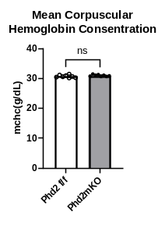
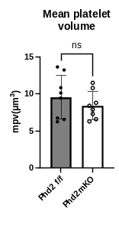
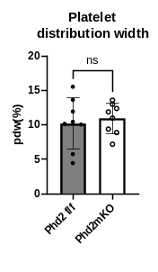
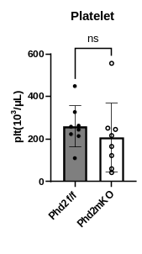
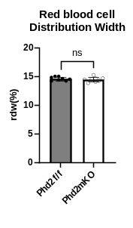
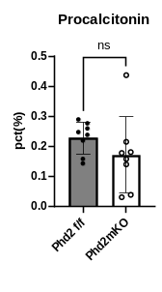
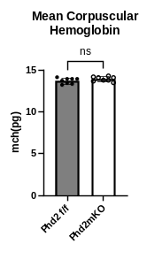
Figure.S1
(a)
Figure.S1
(a) All information on blood analysed from mice of the respective genotype.

Slide 2
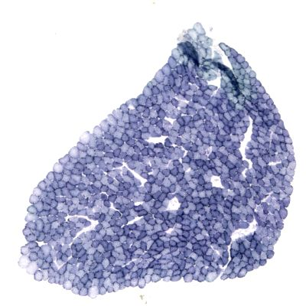
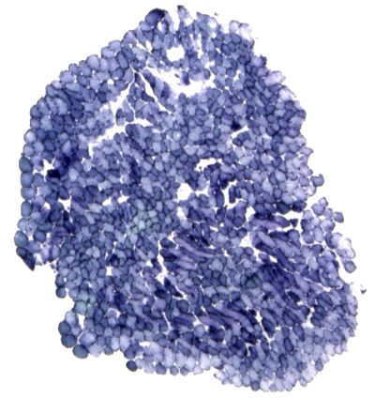
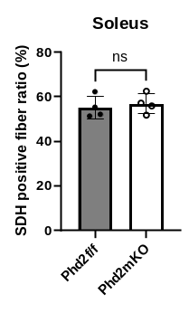
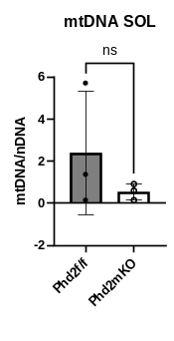
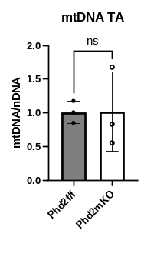
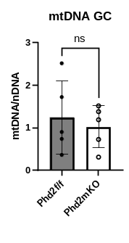
Figure.S3
(a)
(b)
Phd2 f/f
Phd2 mKO
(c)
Figure.S3
(a) Staining diagram of succinate dehydrogenase (SDH) activity in SOL. (b) Percentage of myofibres with active SDH in SOL. (c) Comparison of mitochondrial content in SOL, TA and GC by quantification (mitochondrial DNA/nuclear DNA).

Slide 3
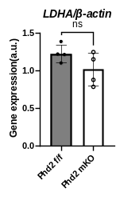
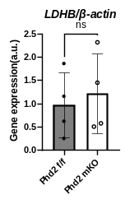
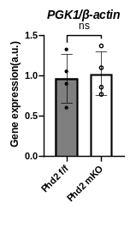
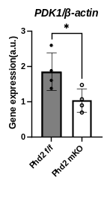
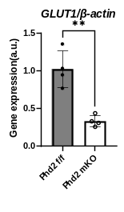
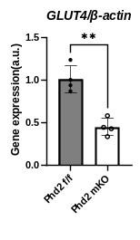
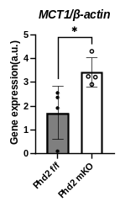
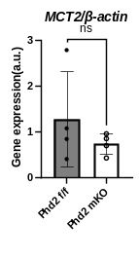
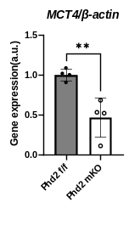
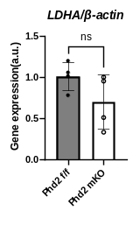
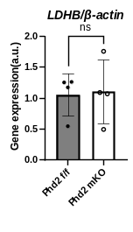
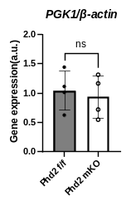
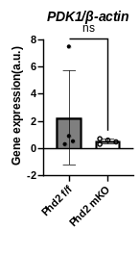
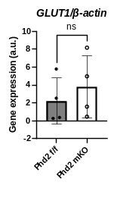
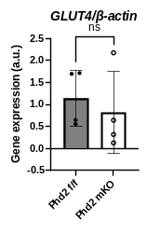
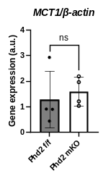
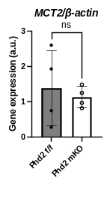
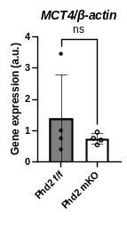
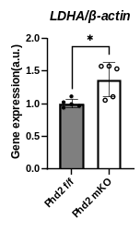
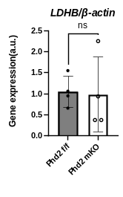
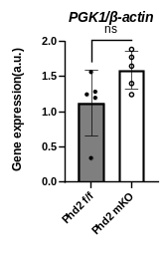
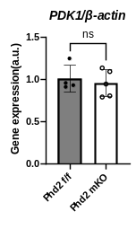
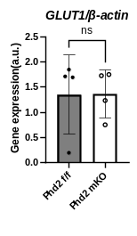
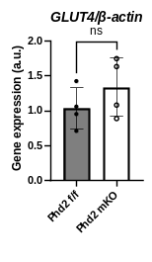
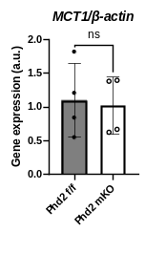
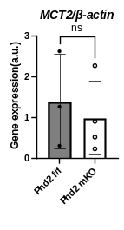
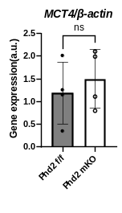
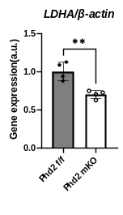
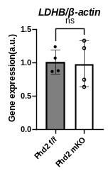
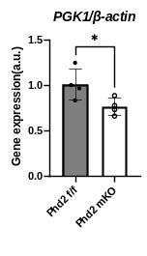
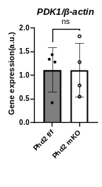
Figure.S4
(a)
(b)
(c)
(d)
Figure.S4
mRNA transcript levels of genes related to glycolysis and lactate production (LDHA, LDHB, PGK1, PDK1, GLUT1, GLUT4, MCT1, MCT2, MCT4) measured in GC and liver and in samples immediately after endurance running test. (a) mRNA transcript levels in GC muscle under normal conditions. (b) mRNA transcript levels in liver under normal conditions. (c) mRNA transcript levels in GC muscle immediately after endurance running test. (d) mRNA transcript levels in the liver immediately after the endurance running test.

Slide 4
Figure.S5
(a)
 | Forward | Reverse
Phd2 | 5'-CAAATGGAGATGGAAGATGC-3' | 5'-TCAACTCGAGCTGGAAACC-3'
Cre | 5'-GATATCTCACGTACTGACGG-3' | 5'-TGACCAGAGTCATCCTTAGC-3'
LDHA | 5'-AAGTCTTCCCCGTGTCCTAG-3' | 5'-CCACACCATCTCAACACCAC-3'
LDHB | 5'-CTAAGCACCGTGTGATTGG-3' | 5'-ATTCAGTTCCTGGAGGGAG-3'
PGK1 | 5'-TGGATGAGGTGGTGAAAGCC-3' | 5'-GCACAGCAAGTGGCAGTGTC-3'
PDK1 | 5'-CTGTGATACGGATCAGAAACCG-3' | 5'-TCCACCAAACAATAAAGAGTGCT-3'
GLUT1 | 5'-CCCCCCAGAAGGTTATTGAG-3' | 5'-CCAACAGGTTCATCATCAGC-3'
GLUT4 | 5'-CTGTAACTTCATTGTCGGCATGG-3' | 5'-AGGCAGCTGAGATCTGGTCAAAC-3'
MCT1 | 5'-TGGTTGTCTGTCTGGTTGC-3' | 5'-CAGTGGTCGCTTCTTGTAG-3'
MCT2 | 5'-TTCAACACCACCTCCAGTC-3' | 5'-CAGCATAATAGTCCTCCCAC-3'
MCT4 | 5'-AGCCCAGTGTTCCTTTGTG-3' | 5'-ACAGCAGTTGAGCAGTAGG-3'
β-actin | 5'-CTGGGTATGGAATCCTGTGG-3' | 5'-GTACTTGCGCTCAGGAGGAG-3'
Figure.S5
(a) A list of primers used in this study is provided.

