Slide 1
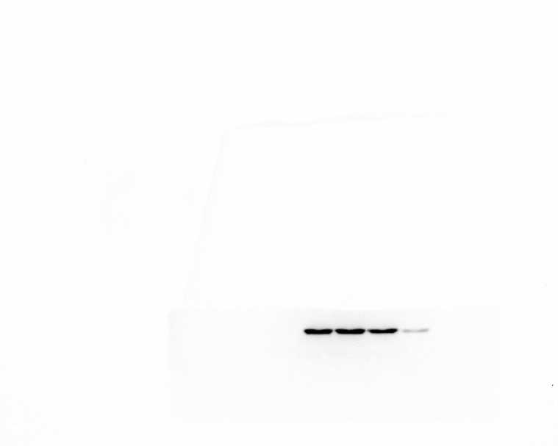
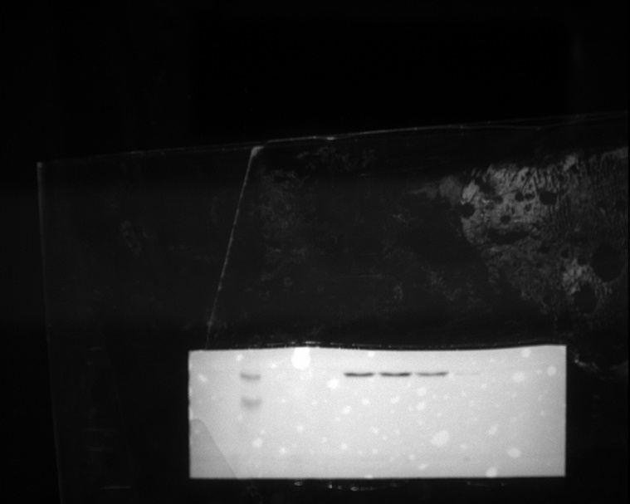
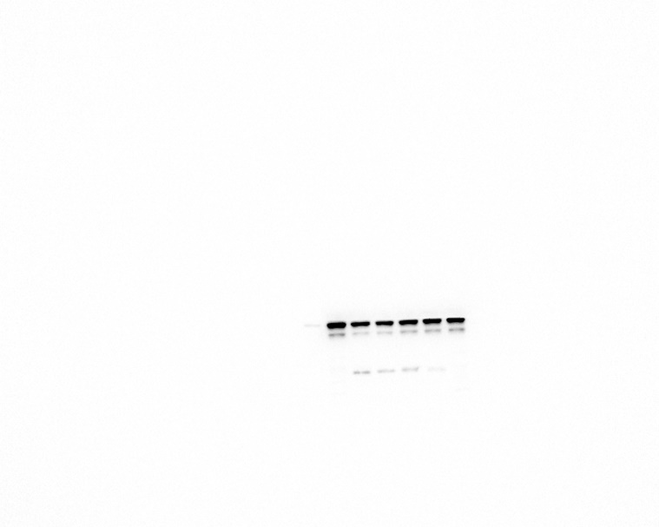
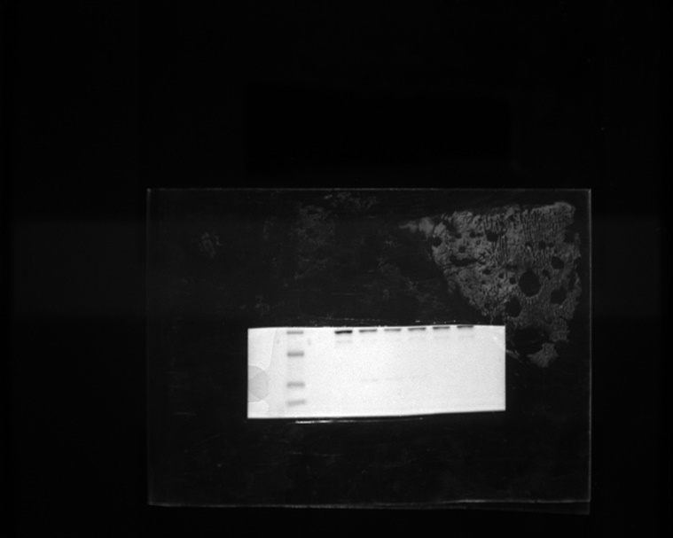
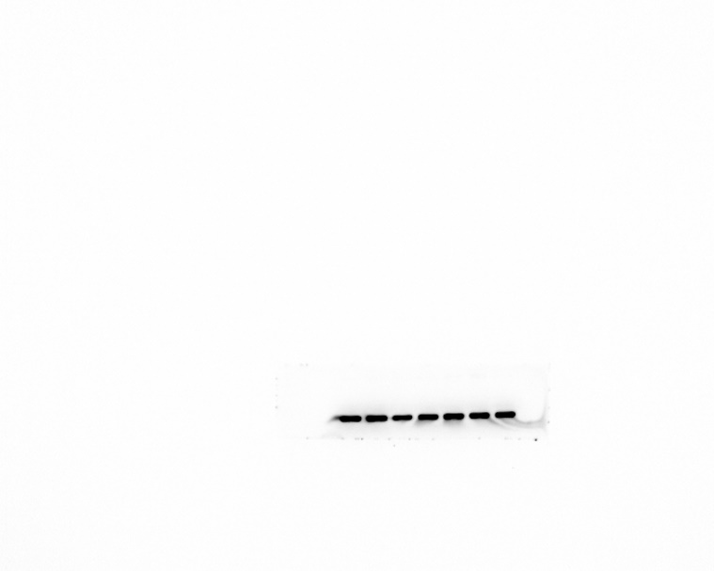
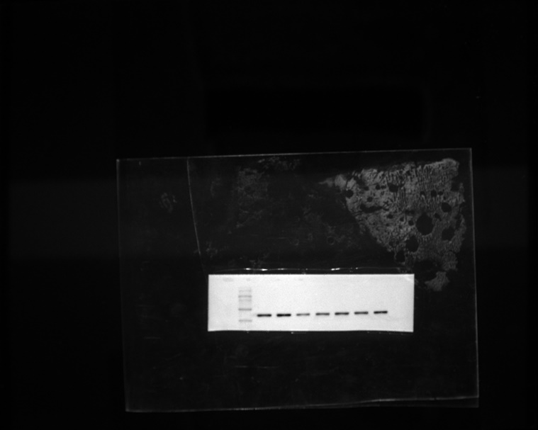
Fig. 1 AP specifically reduces NLRP3 inflammasome activation
C
IL-1β
Pro-IL-1β
α-tubulin

Slide 2
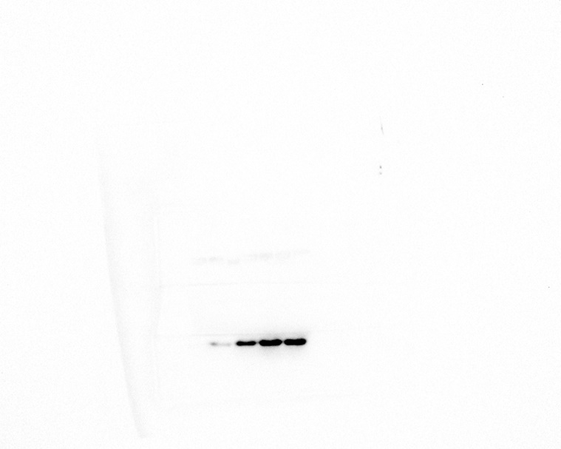
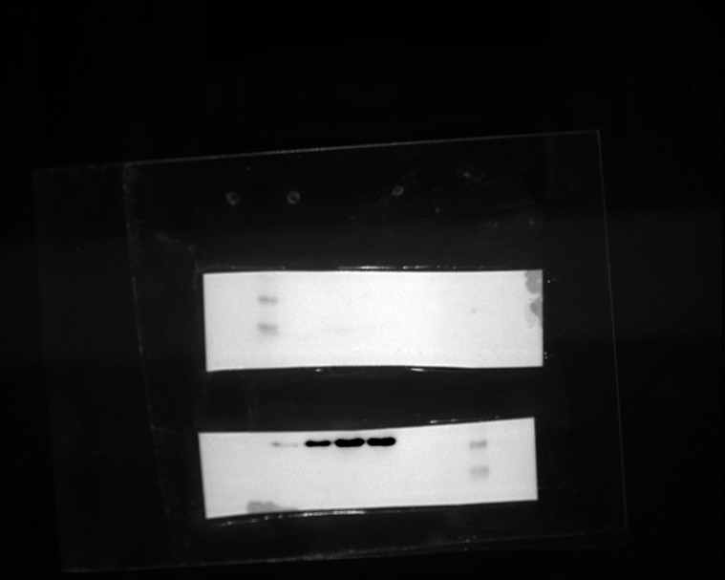
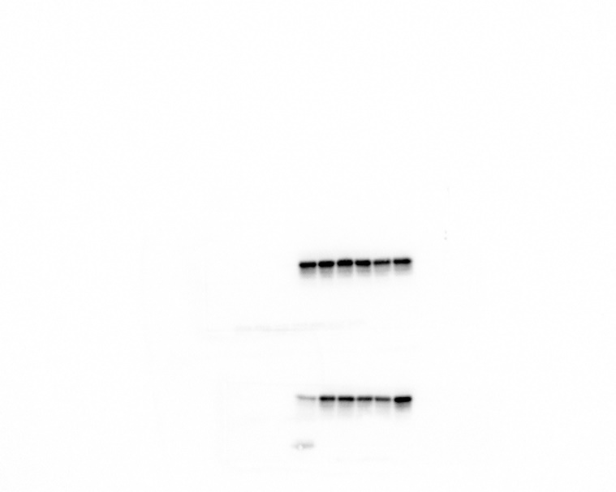
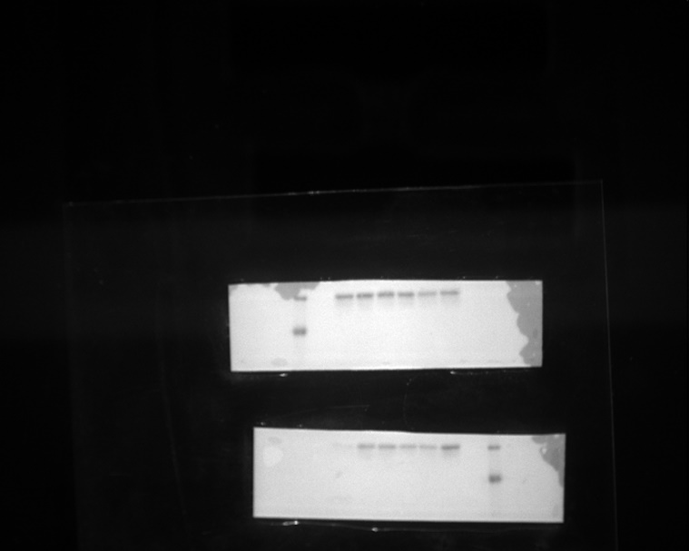
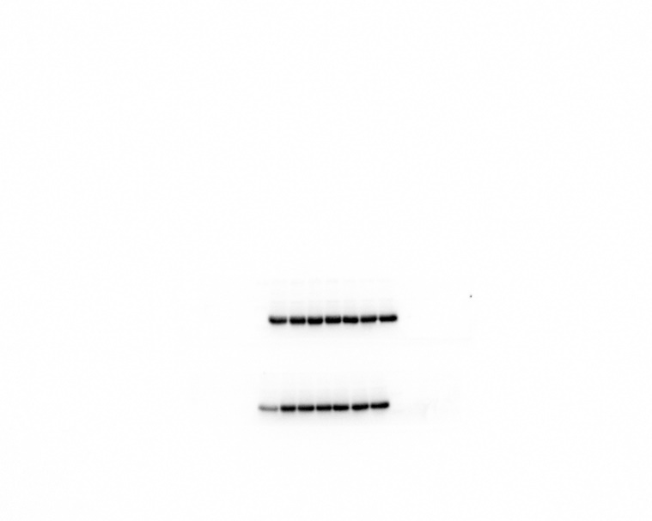
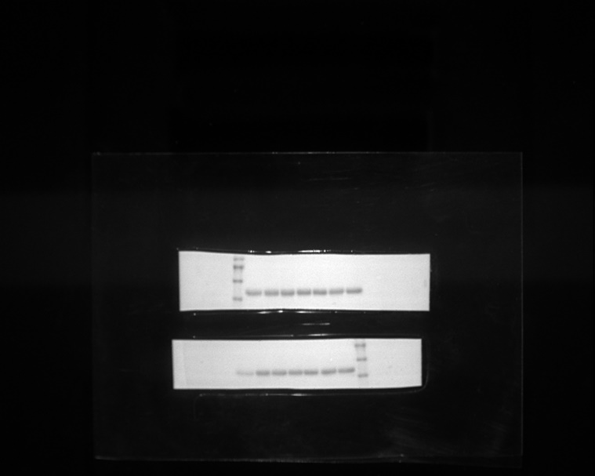
Fig. 1 AP specifically reduces NLRP3 inflammasome activation
D
IL-1β
Pro-IL-1β
α-tubulin

Slide 3
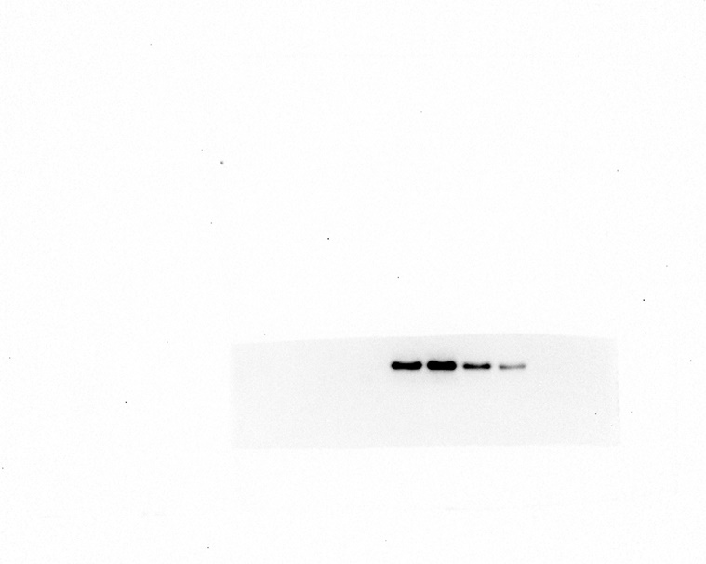
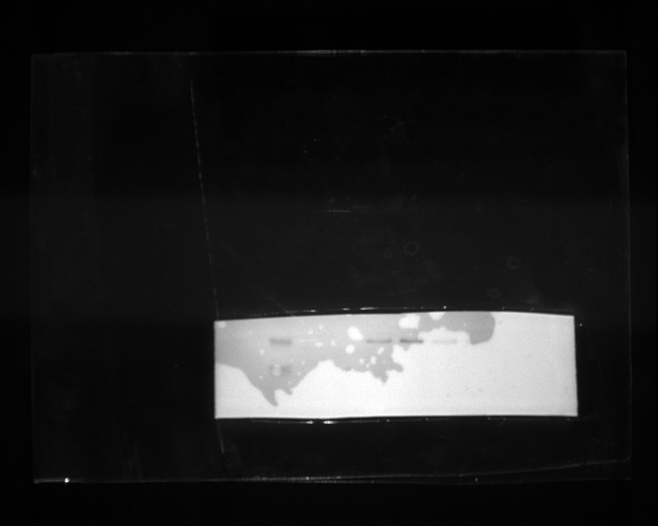
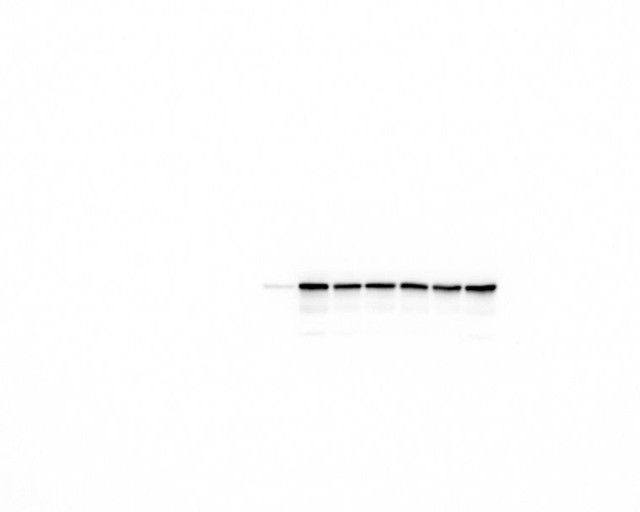
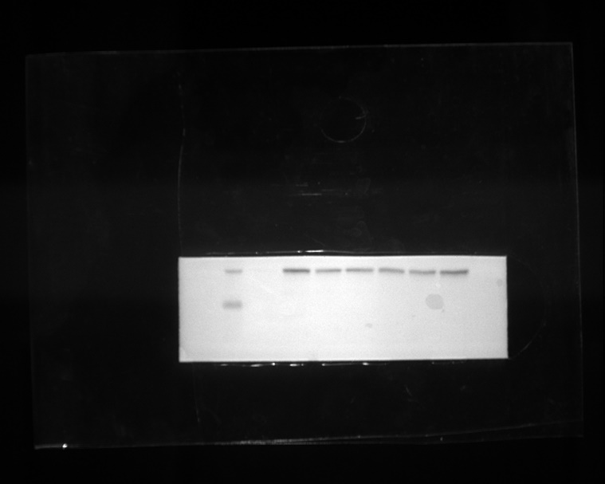
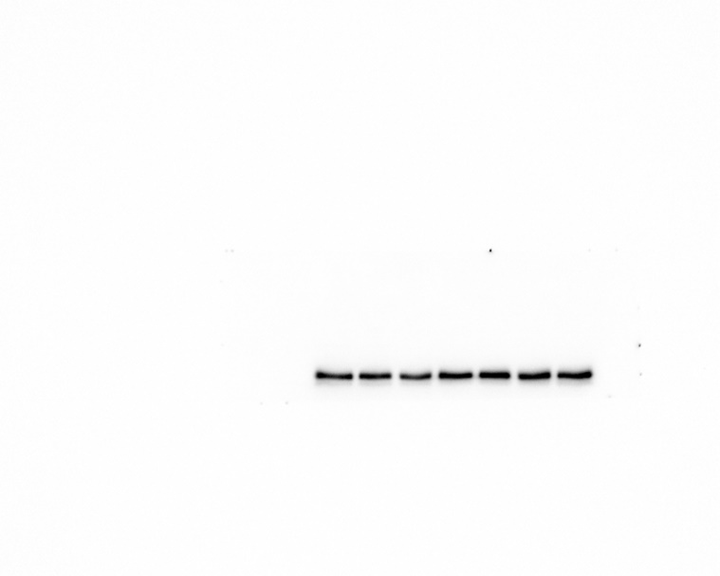
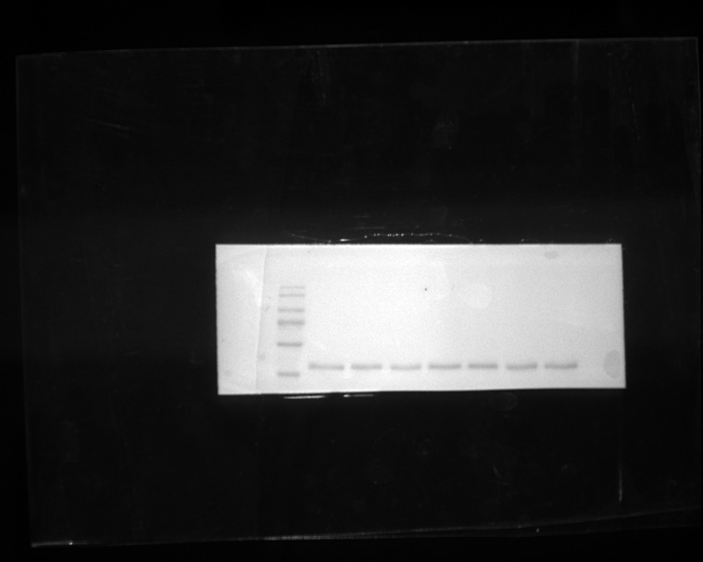
Fig. 1 AP specifically reduces NLRP3 inflammasome activation
E
IL-1β
Pro-IL-1β
α-tubulin

Slide 4
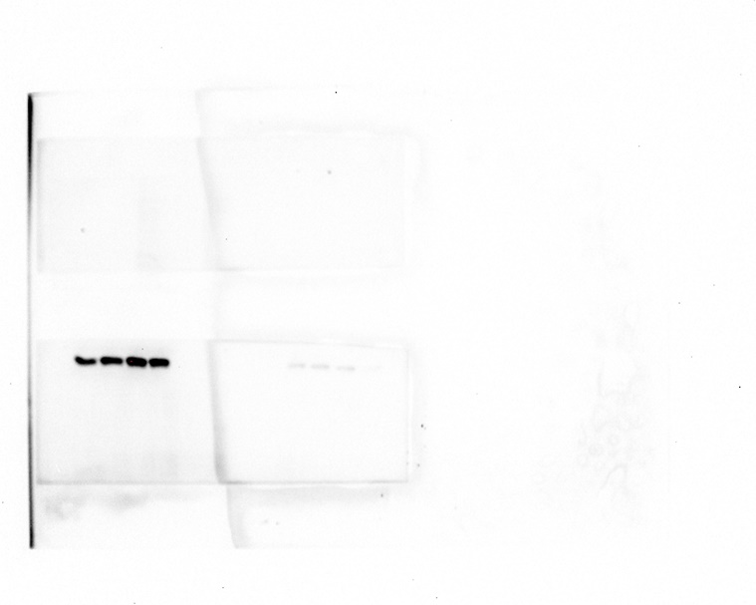
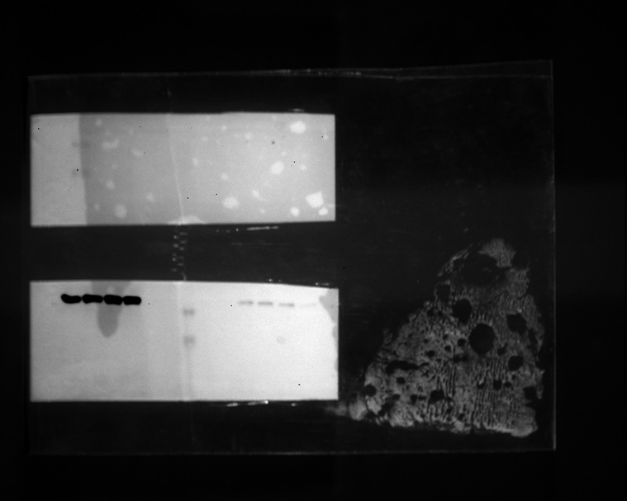
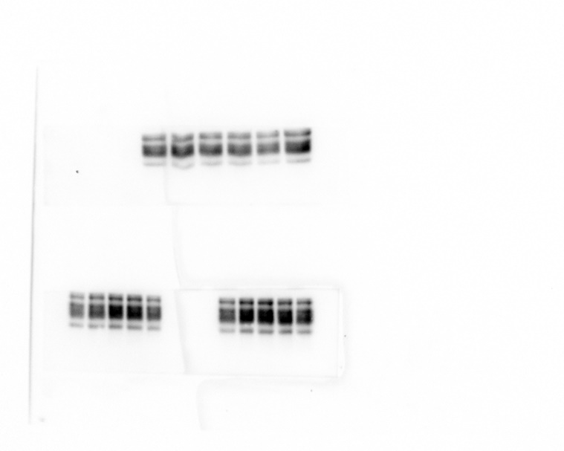
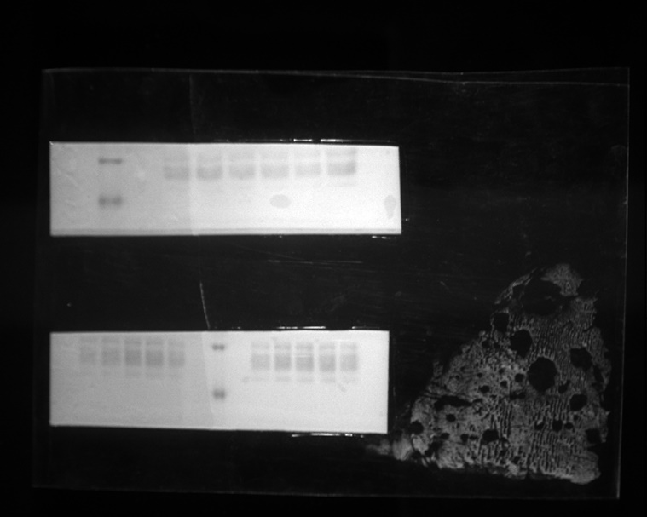
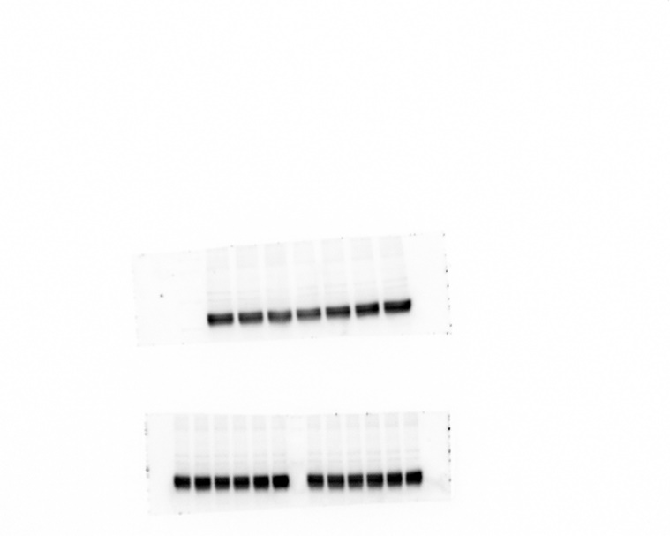
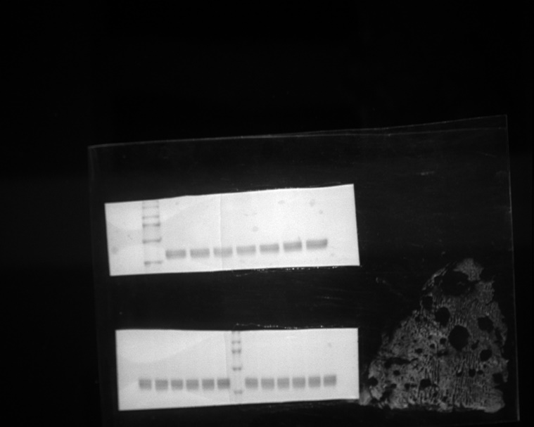
Fig. 1 AP specifically reduces NLRP3 inflammasome activation
F
IL-1β
Pro-IL-1β
α-tubulin

Slide 5
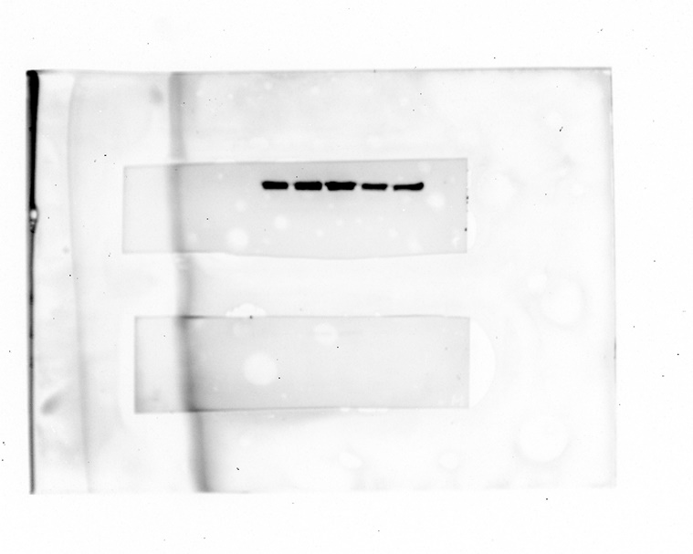
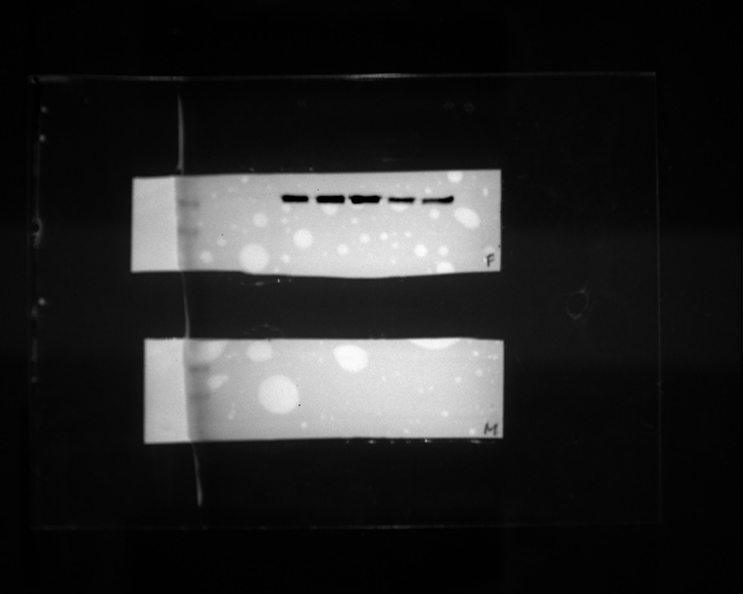
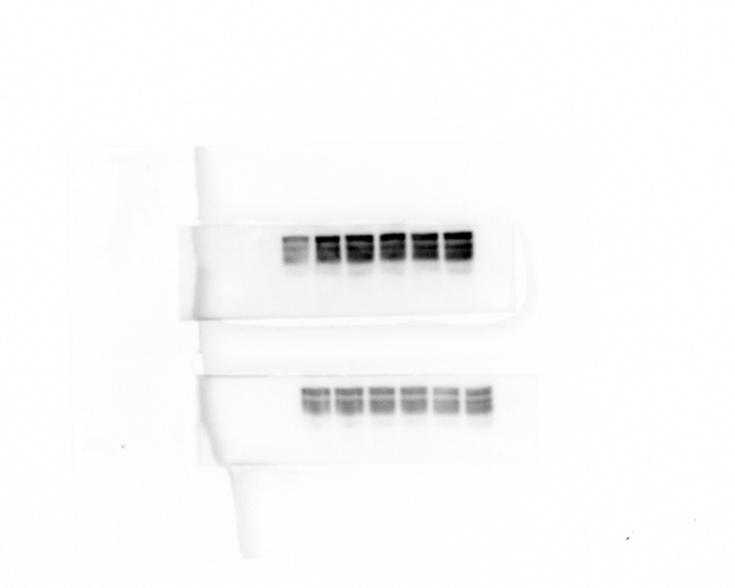
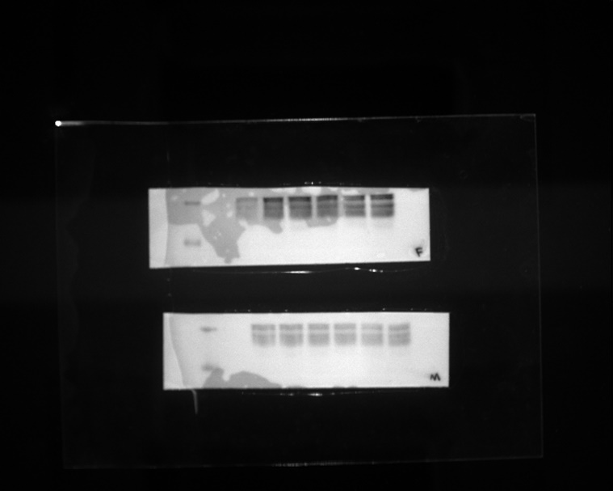
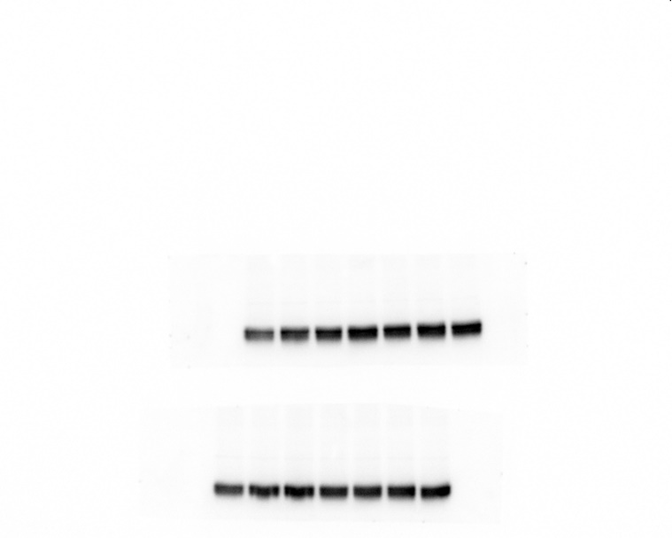
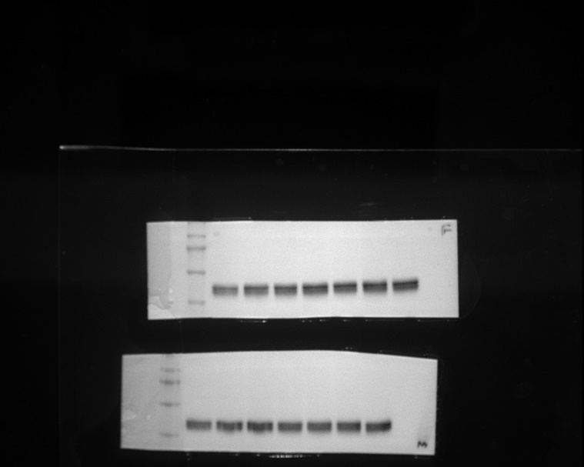
Fig. 1 AP specifically reduces NLRP3 inflammasome activation
G
IL-1β
Pro-IL-1β
α-tubulin
Notes:
Fig. 1 AP specifically reduces NLRP3 inflammasome activation
Cell viability assays of (a) J774A.1 cells and (b) differentiated THP-1 cells treated with AP (10 μg/mL, 50 μg/mL, 100 μg/mL) for 2 h. Cell viability was analyzed by EZ-Cytox, measured at a wavelength of 450 nm. Ns: not significant. (c–e) Western blots of IL-1β in the supernatants (Sup), and pro-IL-1β and α-tubulin in the soluble lysates (Lys) of treated cells. LPS-primed J774A.1 cells were treated with AP for 2 h and activated for 30 min with nigericin (10 μM) (c) or ATP (5 mM) (d) with or without MCC950, an NLRP3-specific inhibitor. (e) Differentiated, and LPS-primed THP-1 cells were treated with AP for 2 h and activated for 30 min with nigericin (10 μM) with or without MCC950. (f–g) LPS-primed J774A.1 cells were treated with AP for 2 h and activated for 3 h with transfection of dsDNA (2 μg/mL) (f) or flagellin (1.25 μg/mL) (g) using Lipofectamine™ 2000

Slide 6
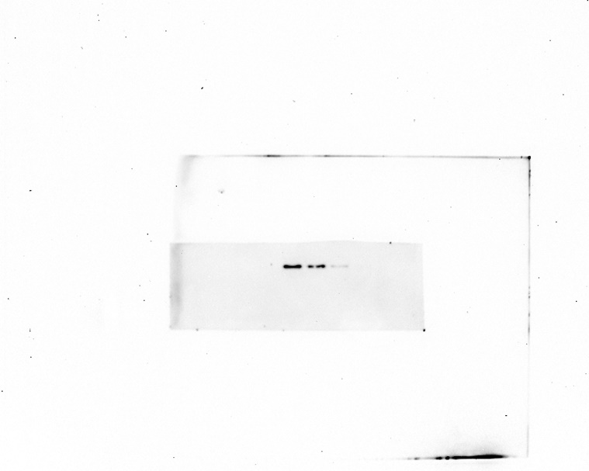
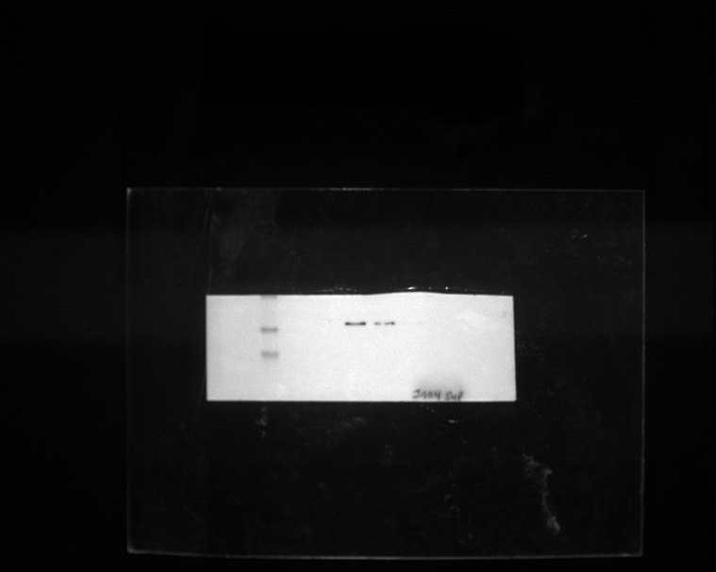
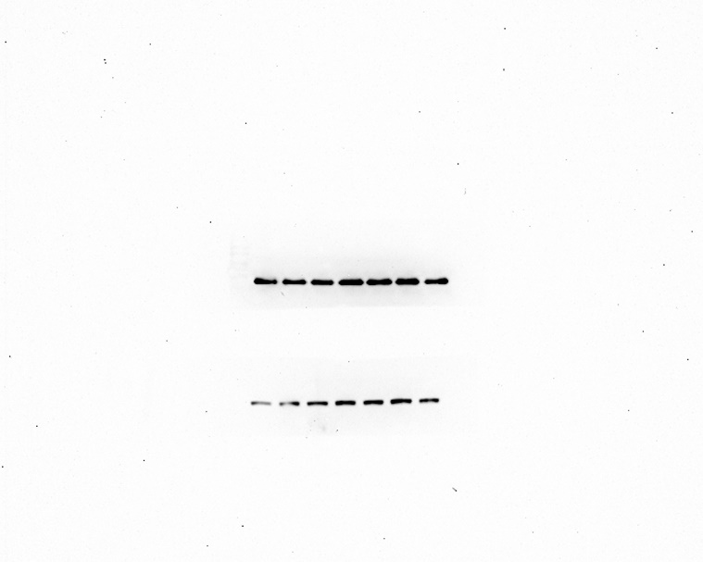
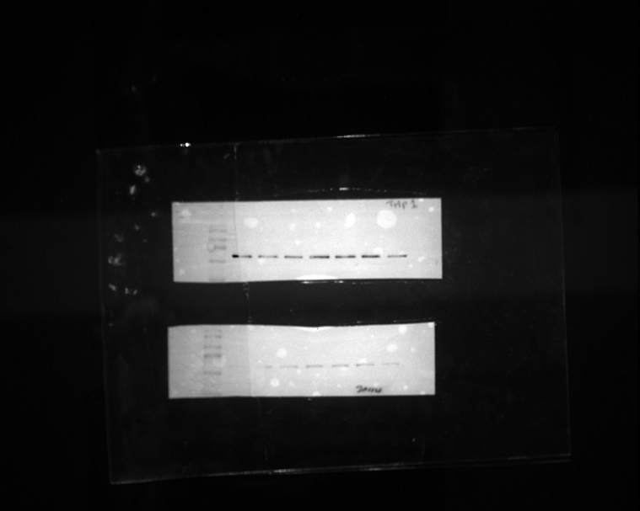
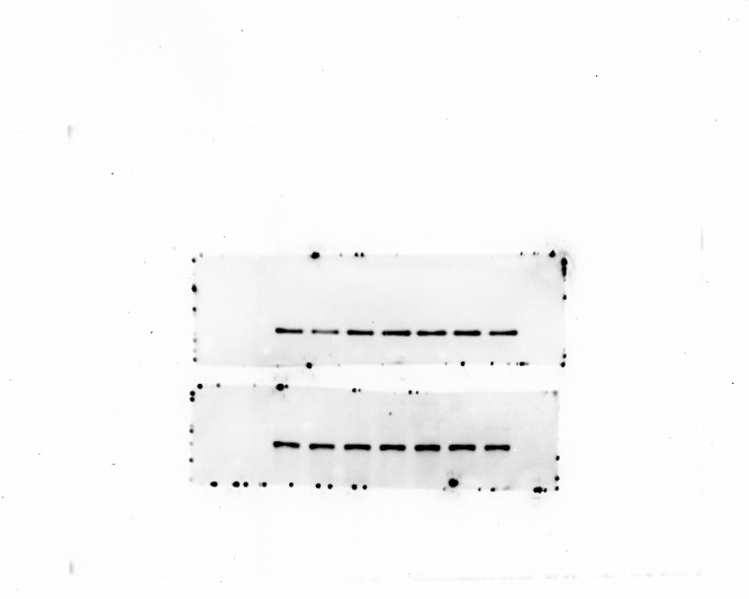
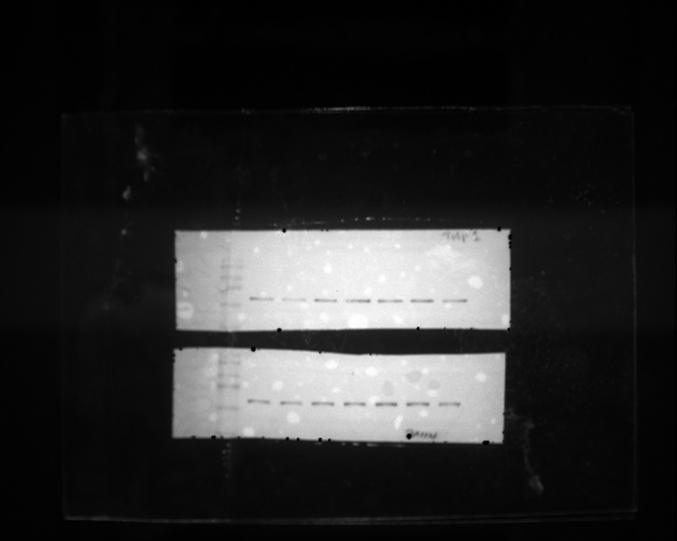
Fig. 2 AP does not affect the NF-κB signaling pathway
B
IL-1β
p-NF-κB
NF-κB

Slide 7
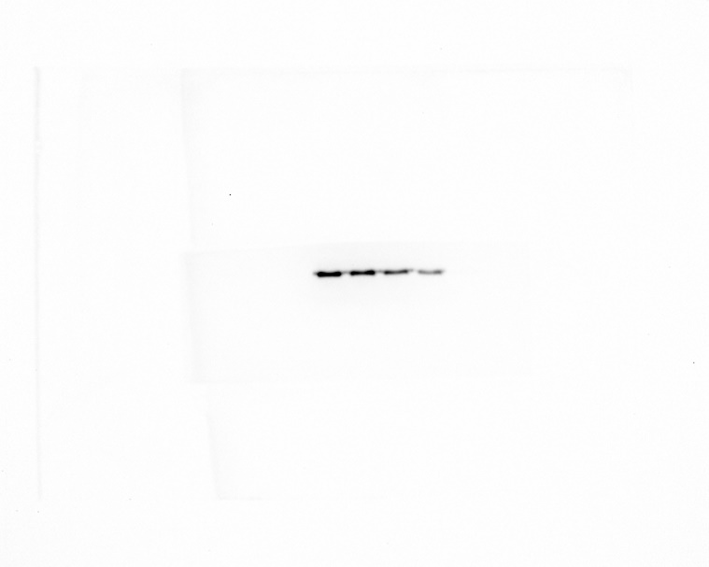
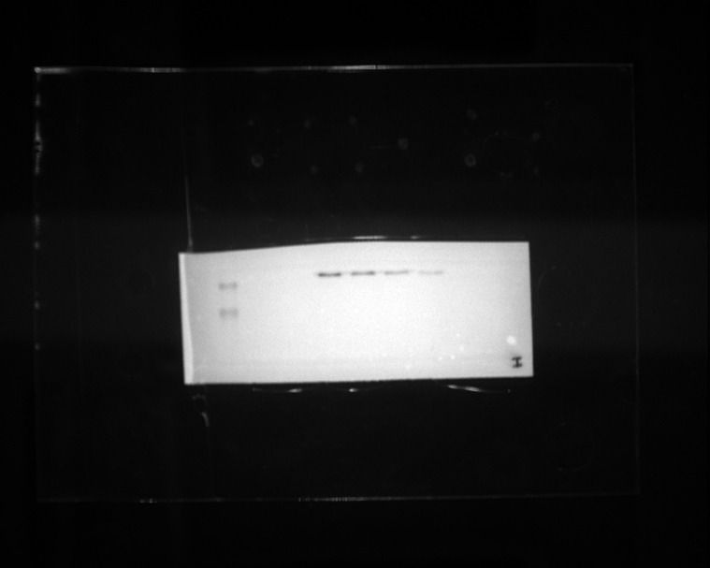
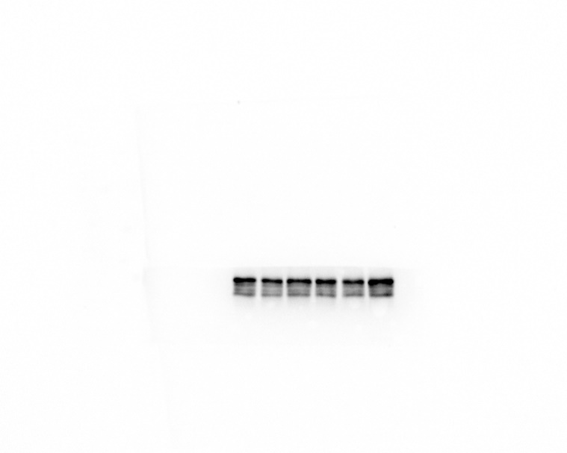
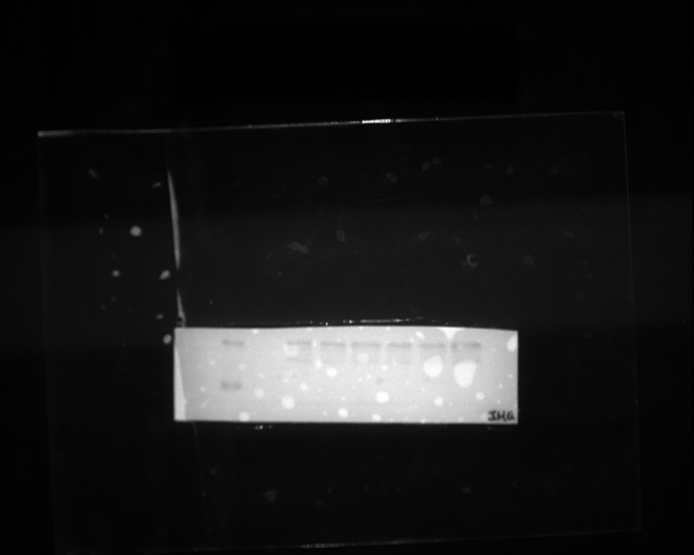
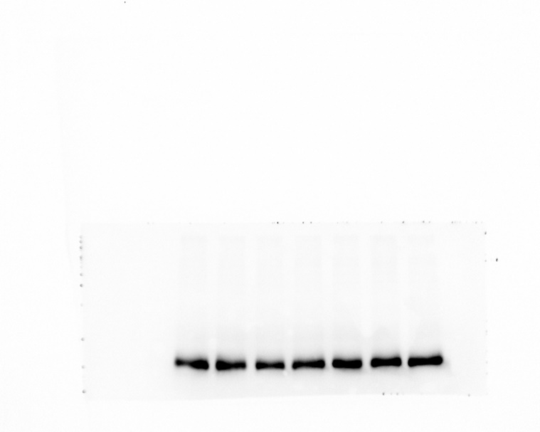
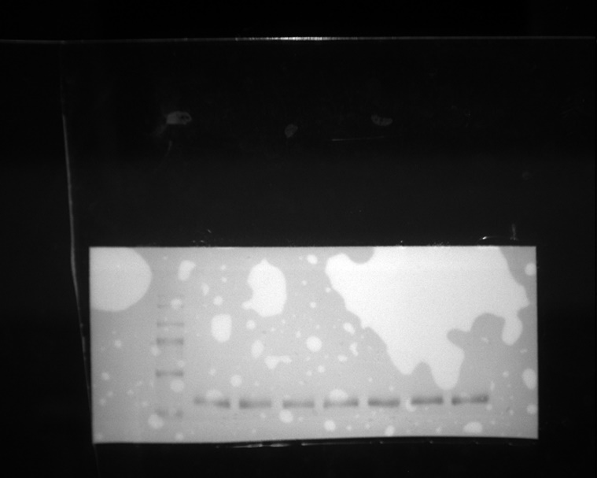
Fig. 3 AP inhibits NLRP3 inflammasome, regardless of K+ efflux and ROS
A
IL-1β
Pro-IL-1β
α-tubulin

Slide 8
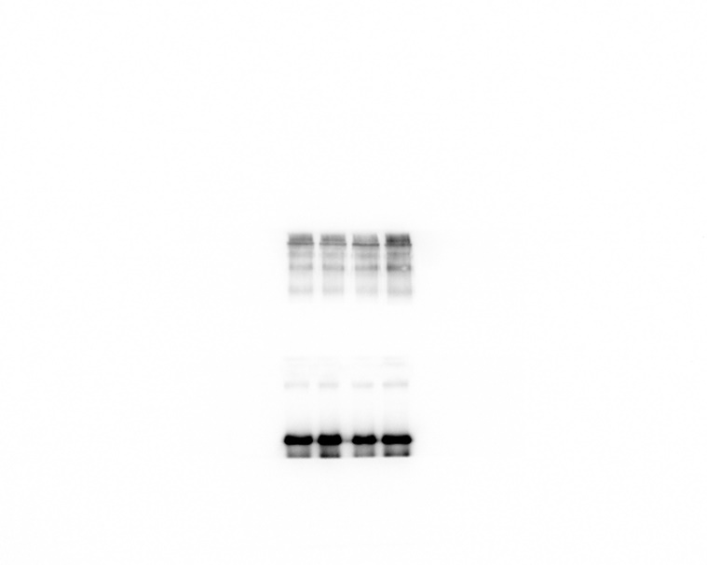
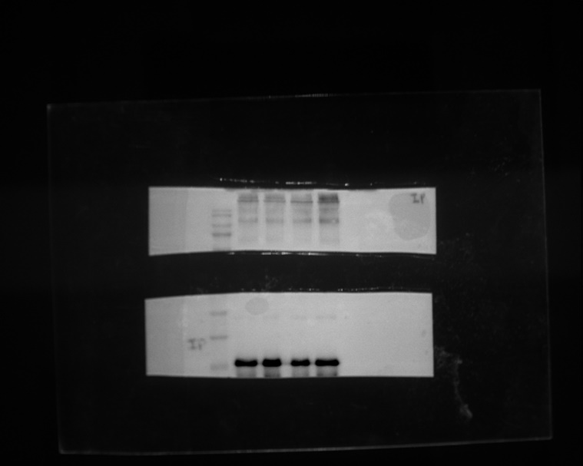
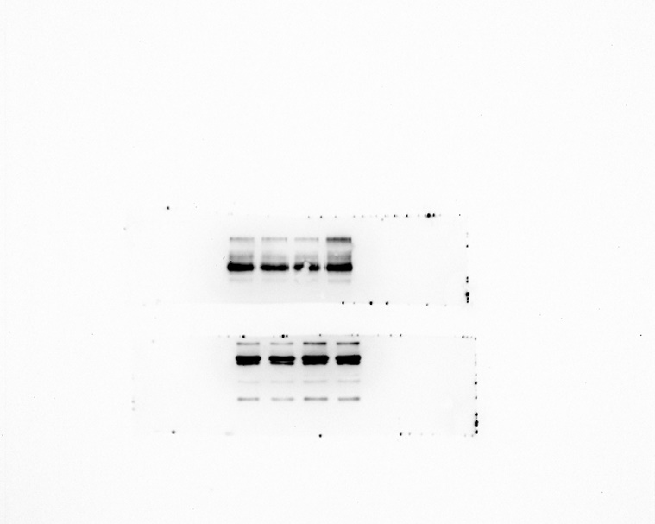
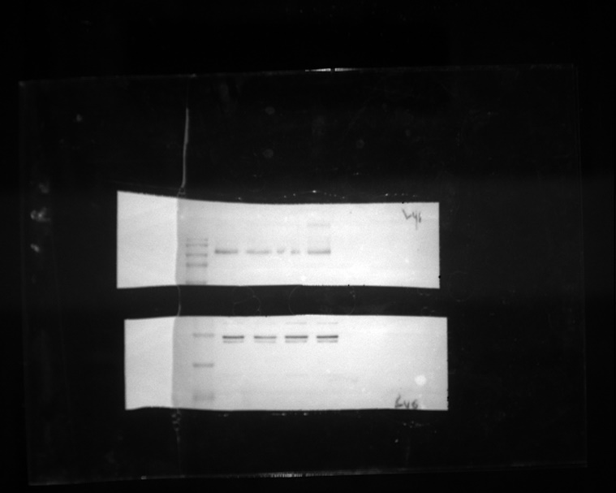
Fig. 4 AP blocks NLRP3 inflammasome assembly by hindering ASC oligomerization
A
IP
Input

Slide 9
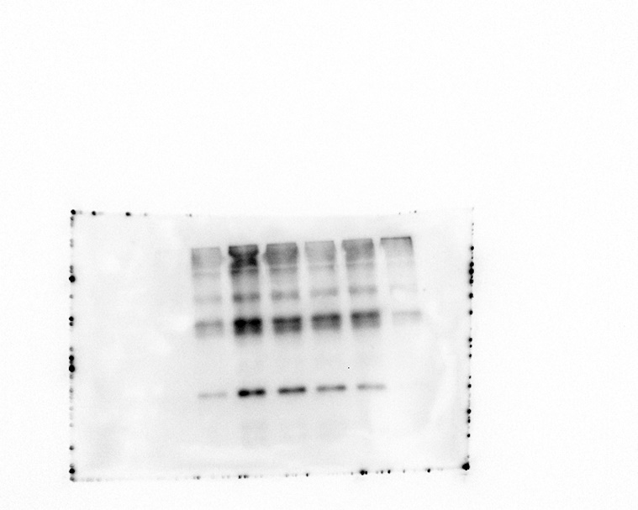
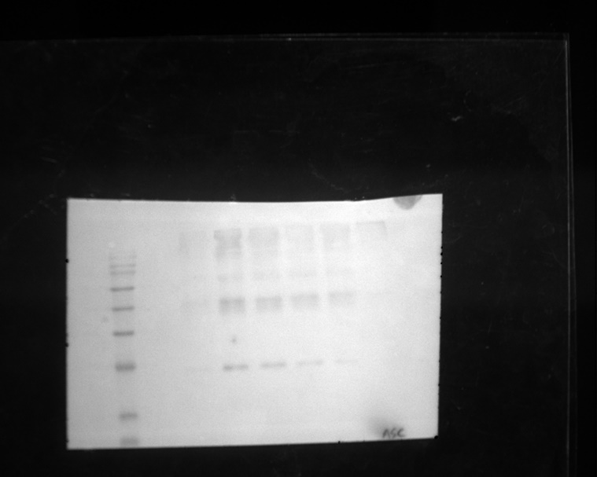
Fig. 4 AP blocks NLRP3 inflammasome assembly by hindering ASC oligomerization
C
ASC

