Slide 1
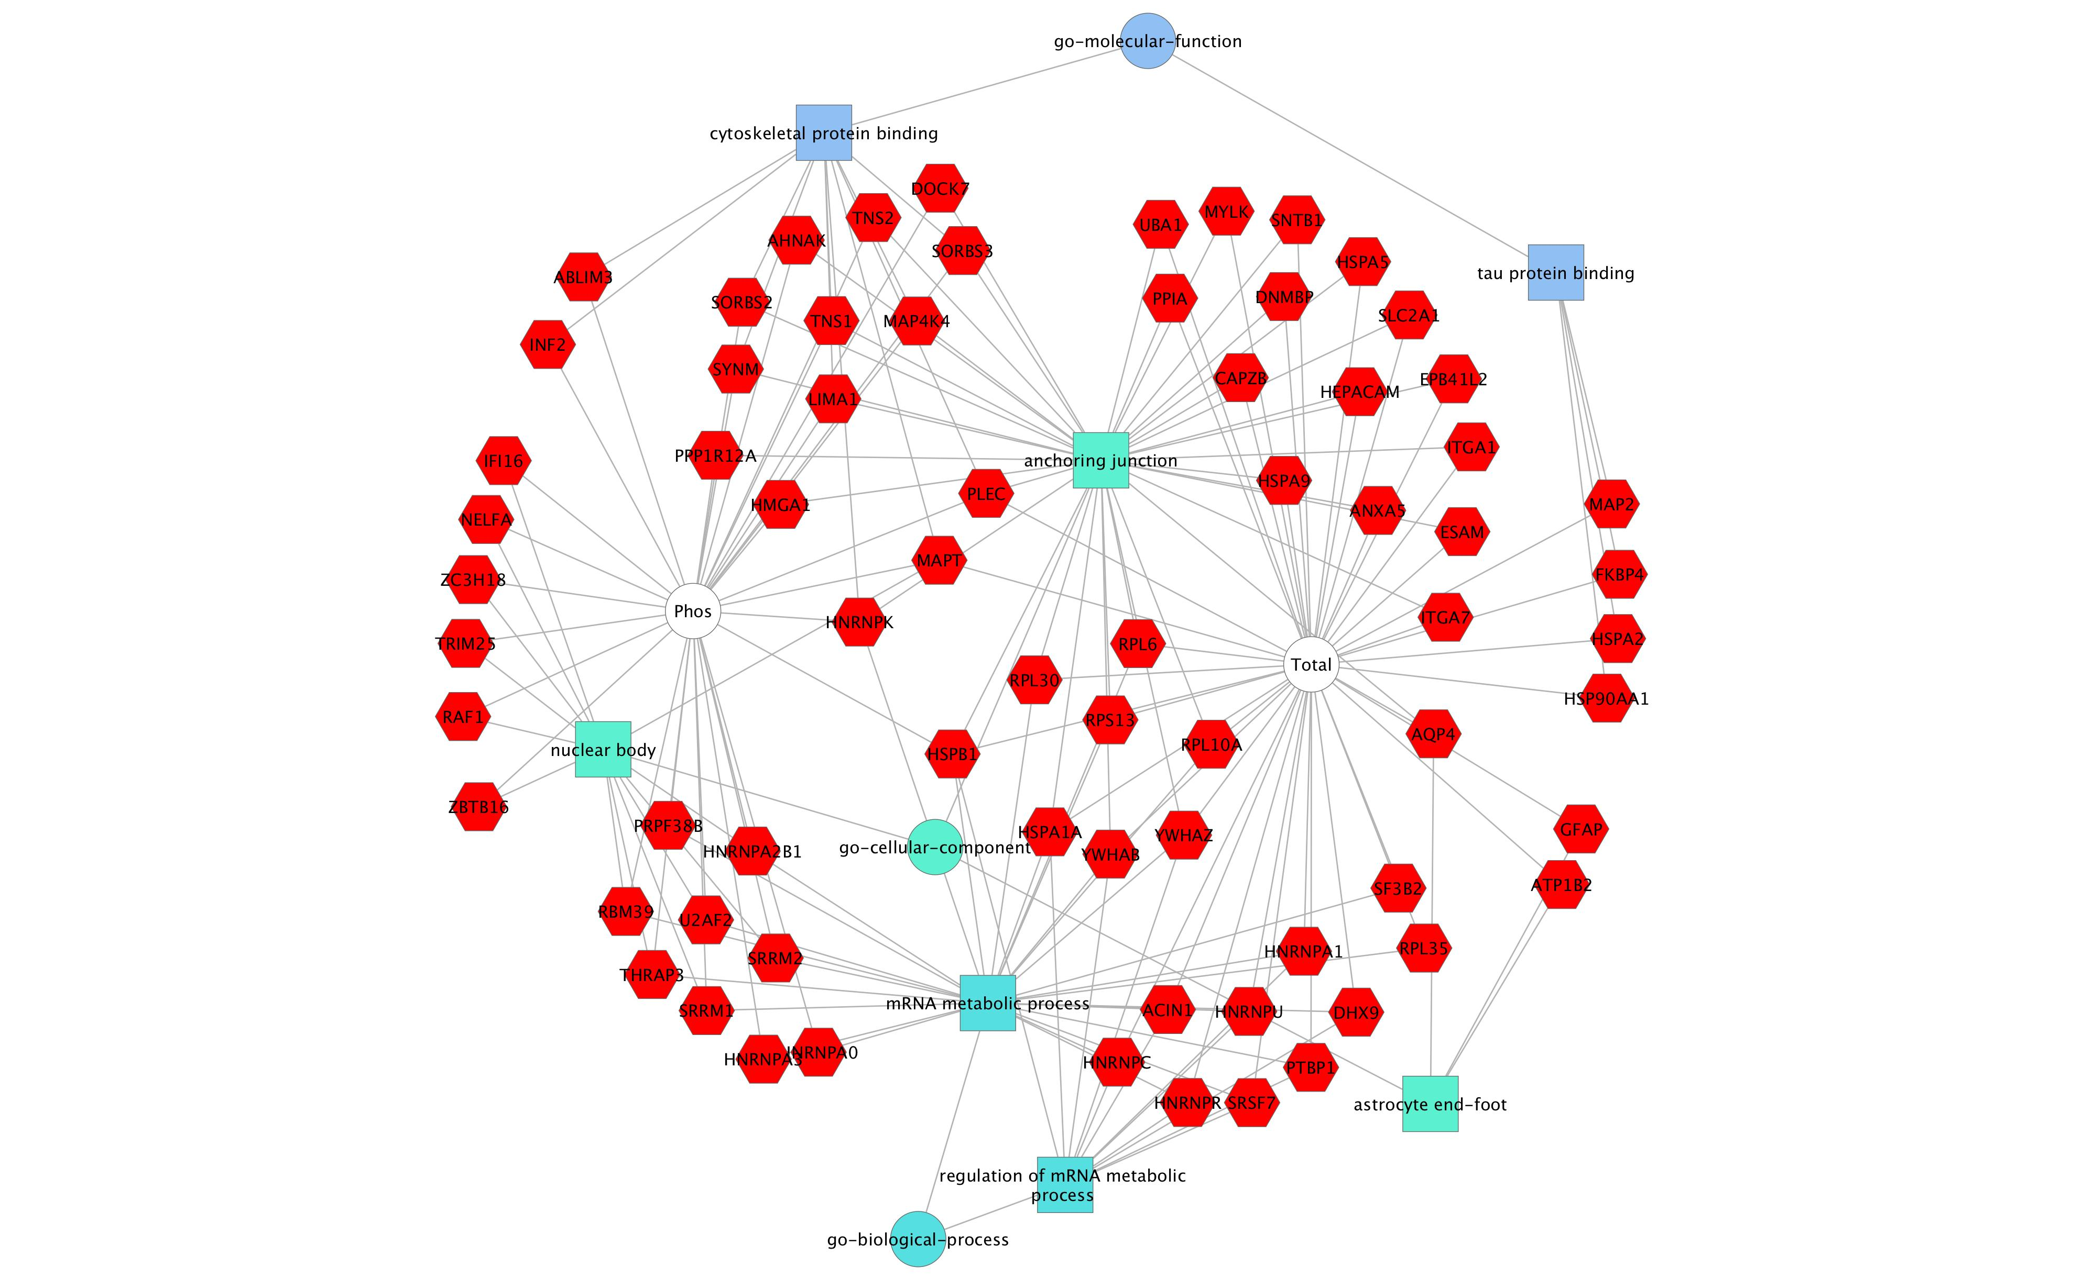
Supplement Figure 1A

Slide 2
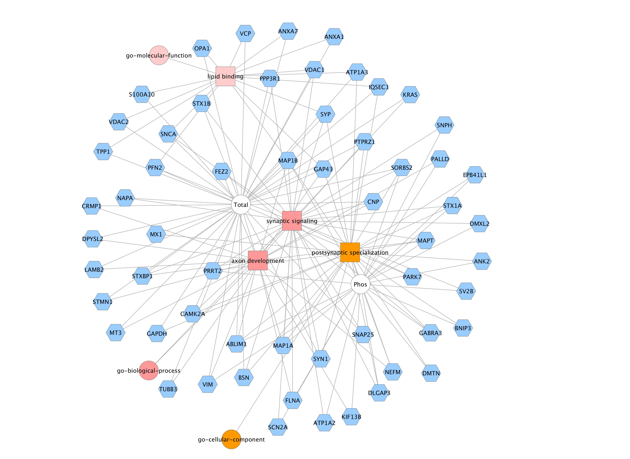
Supplement Figure 1B

Slide 3
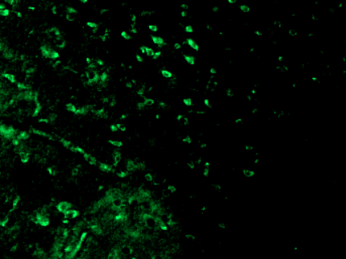
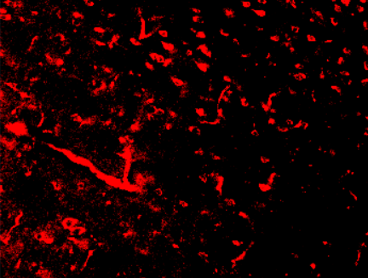
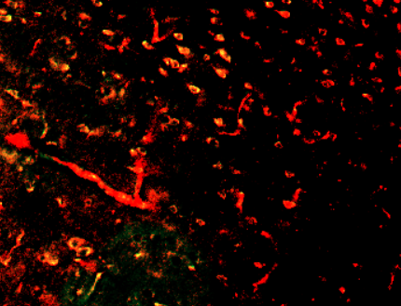
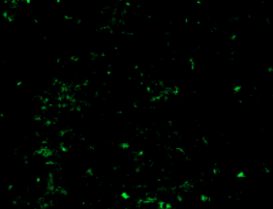
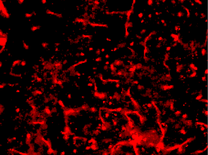
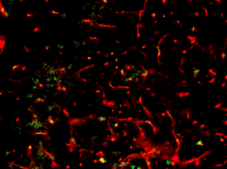
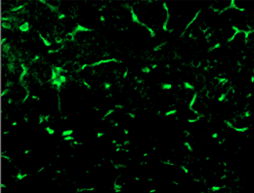
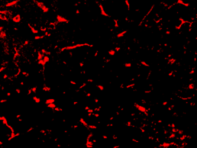
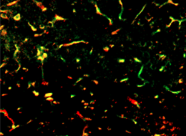
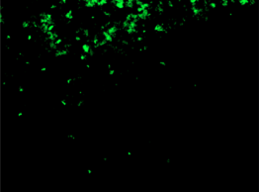
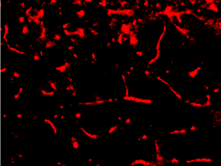
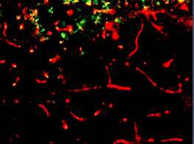
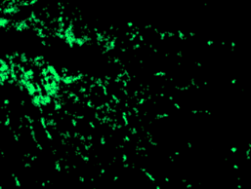
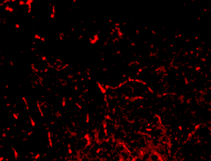
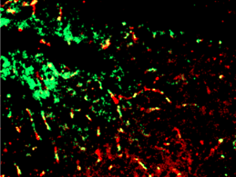
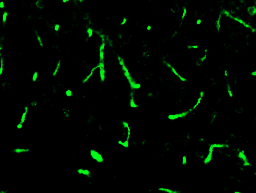
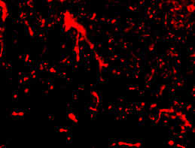
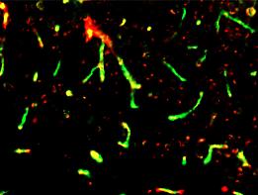
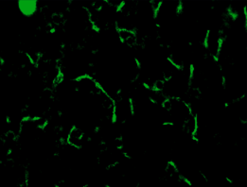
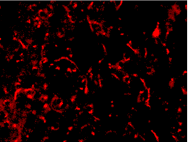
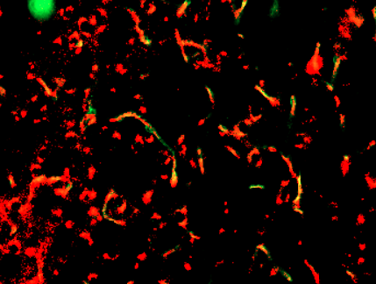
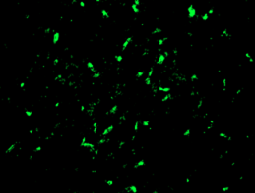
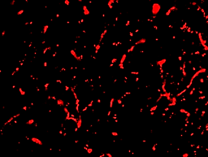
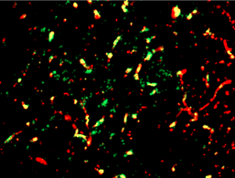
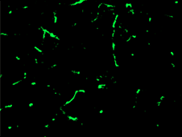
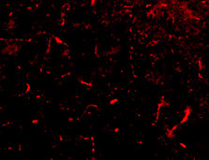
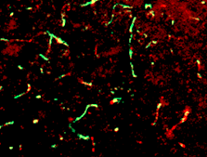
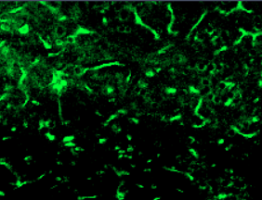
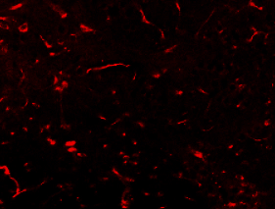
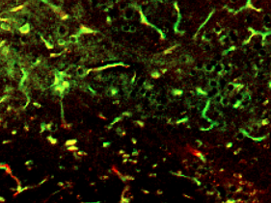
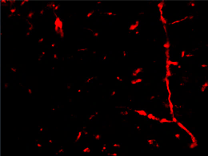
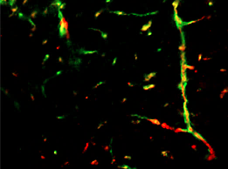
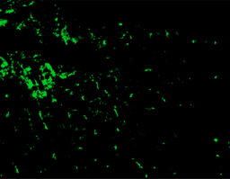
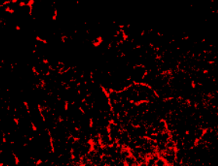
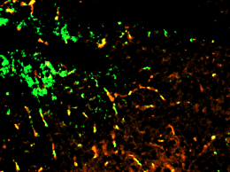
LIMA1
CD31
Merge
LIMA1
CD31
Merge
Supplement Figure 2A
PBS
PBS
mCRP
mCRP
ApoE^{-/-}
ApoE2
ApoE4+mCRP
ApoE4+mCRP
PBS
PBS
mCRP
mCRP
ApoE3
ApoE4
ApoE4+mCRP
ApoE2+mCRP

Slide 4
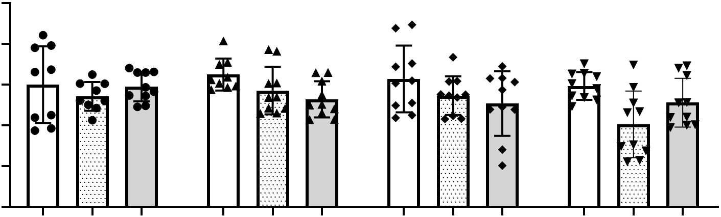
Supplement Figure 2B
1.0
0.8
*
0.6
CD31 /DAPI
0.4
0.2
0.0
i.P Treatment
PBS
+
-
-
+
-
-
+
-
-
+
-
-
mCRP
-
+
+
-
+
+
-
+
+
-
+
+
ApoE4 protein
-
-
+
-
-
+
-
-
+
-
-
-
ApoE2 protein
-
-
-
-
-
-
-
-
-
-
-
+
ApoE^{-/-}
ApoE2
ApoE3
ApoE4

Slide 5
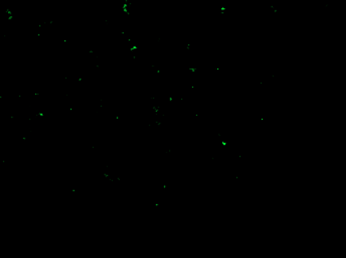
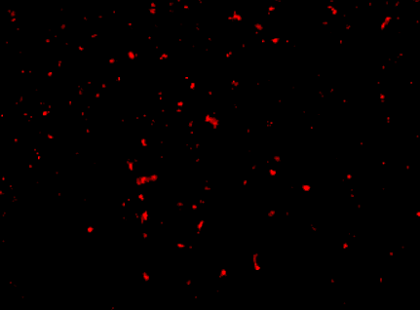
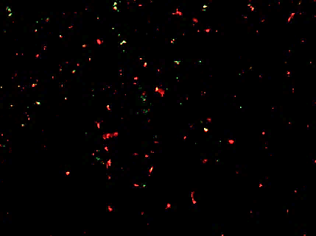
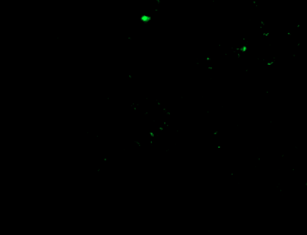
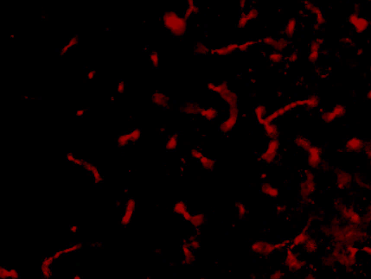
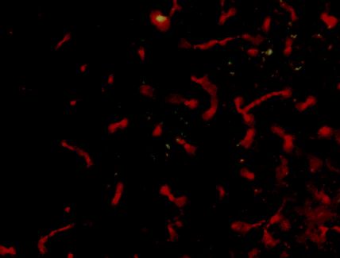
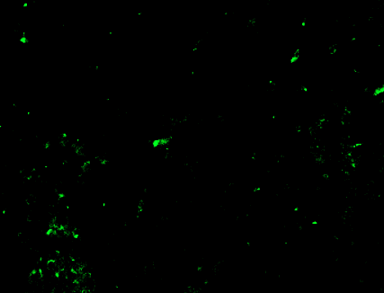
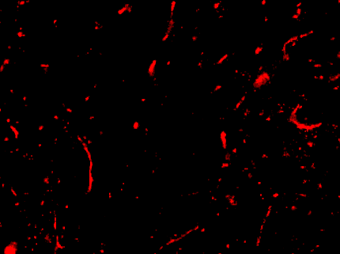
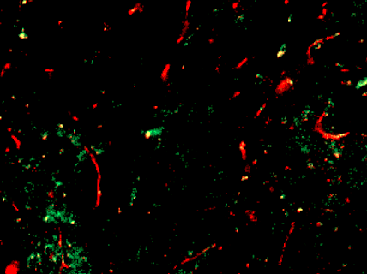
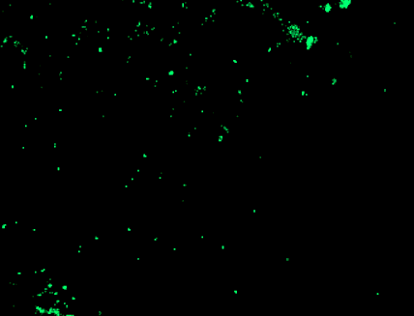
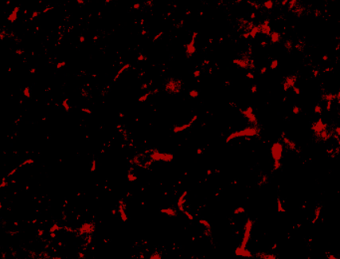
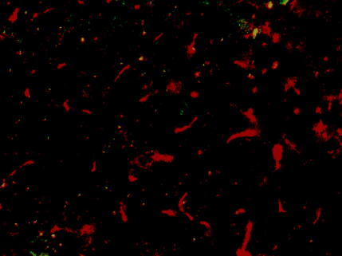























pCD31
Lima1
Merge
pCD31
Lima1
Merge
Supplement Figure 2C
PBS
PBS
mCRP
mCRP
ApoE^{-/-}
ApoE2
ApoE4+mCRP
ApoE4+mCRP
PBS
PBS
mCRP
mCRP
ApoE3
ApoE4
ApoE4+mCRP
ApoE2+mCRP

Slide 6

Supplement Figure 2D
2.5
**
*
2.0
pCD31 /DAPI
1.5
1.0
0.5
0.0
i.P Treatment
PBS
+
-
-
+
-
-
+
-
-
+
-
-
mCRP
-
+
+
-
+
+
-
+
+
-
+
+
ApoE4 protein
-
-
+
-
-
+
-
-
+
-
-
-
ApoE2 protein
-
-
-
-
-
-
-
-
-
-
-
+
ApoE^{-/-}
ApoE2
ApoE3
ApoE4

Slide 7































Supplement Figure 3A
VE-Cadherin
Lima1 (EPLIN)
Merge
VE-Cadherin
Lima1 (EPLIN)
Merge
PBS
PBS
mCRP
mCRP
ApoE^{-/-}
ApoE2
ApoE4+mCRP
ApoE4+mCRP
PBS
PBS
mCRP
mCRP
ApoE3
ApoE4
ApoE4+mCRP
ApoE2+mCRP
The expression of VE-Cadherin and Lima1 in ApoE-/- 2/3/4 mouse cortex

Slide 8

Supplement Figure 3B
4
*
3
2
Lima1⁺ VE-Cadherin⁺ /DAPI (X10⁻²)
1
0
PBS
mCRP
PBS
mCRP
PBS
mCRP
PBS
mCRP
ApoE4+mCRP
ApoE4+mCRP
ApoE4+mCRP
ApoE2+mCRP
ApoE^{-/-}
ApoE2
ApoE3
ApoE4

Slide 9

Supplement Figure 3C
0.3
0.2
PLA (VE-Cadherin & Lima1) /DAPI
0.1
0.0
PBS
mCRP
PBS
mCRP
PBS
mCRP
PBS
mCRP
ApoE4+mCRP
ApoE4+mCRP
ApoE4+mCRP
APOE2+mCRP
ApoE^{-/-}
ApoE2
ApoE3
ApoE4
The expression of PLA (VE-Cadherin & Lima1) in ApoE2/3/4 -/- mouse cortex

Slide 10












Supplement Figure 3D
ApoE^{-/-}
ApoE2
ApoE3
ApoE4
PBS
PBS
mCRP
mCRP
mCRP+ApoE4
mCRP+ApoE2

