Slide 1
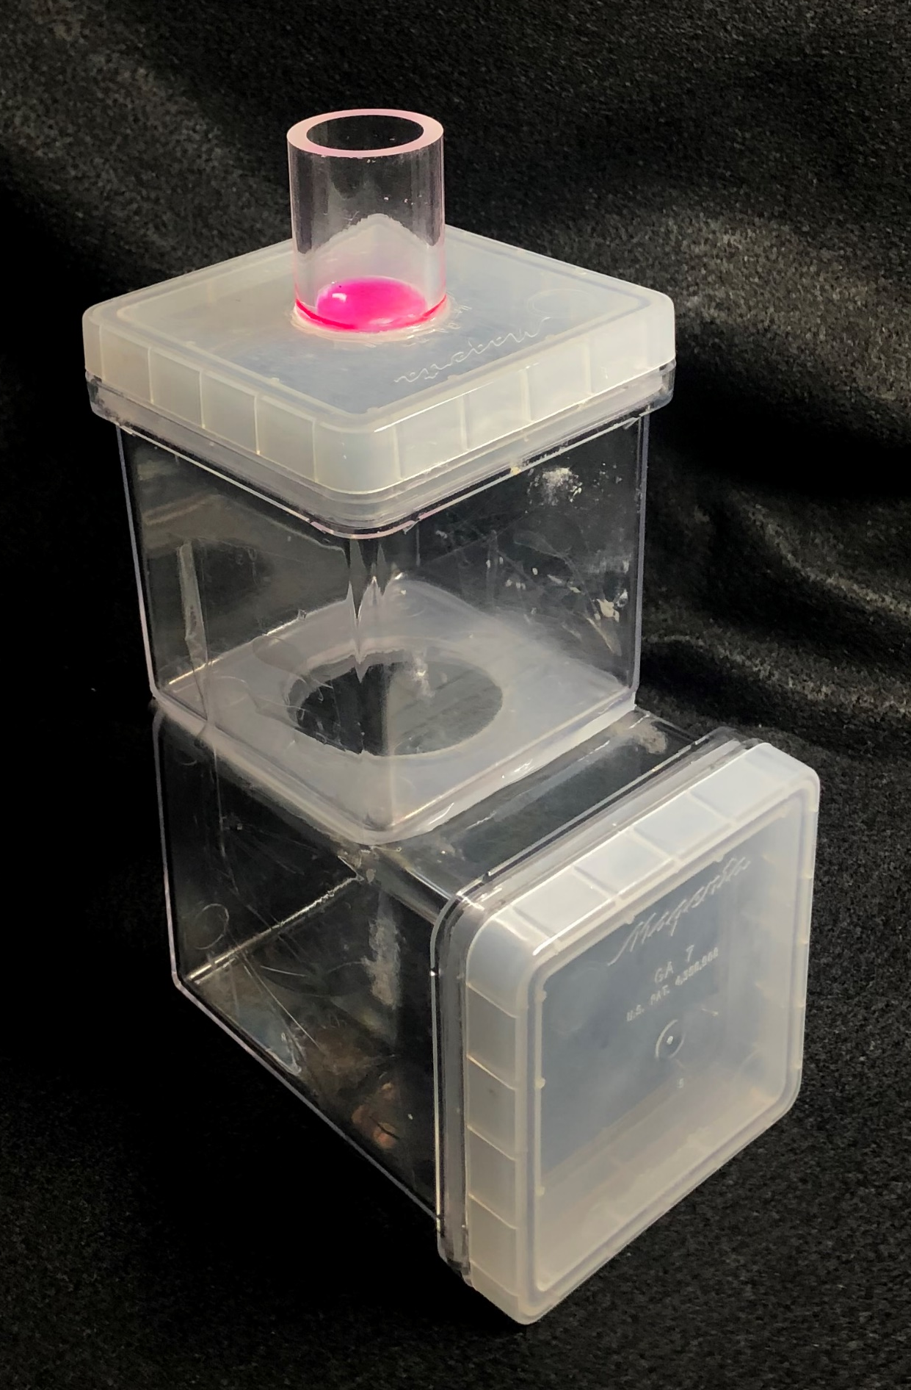
Fig. S1: Feeding assembly build with PTFE membrane cut-out under 1” acrylic tube inserted onto lid of GA7. Whiteflies were added to the central containers and dyed sucrose solution was added on-top of the membrane.

Slide 2
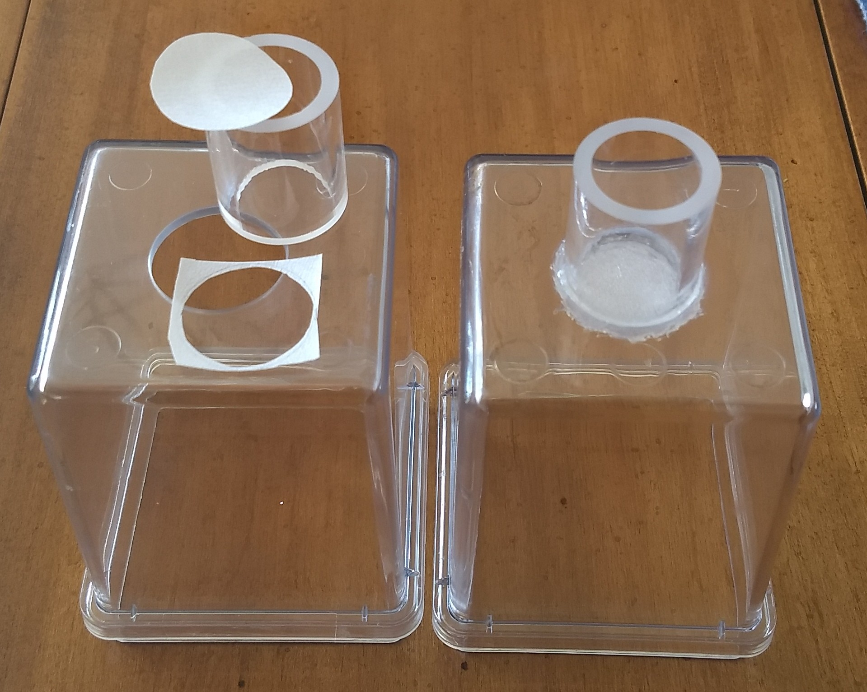
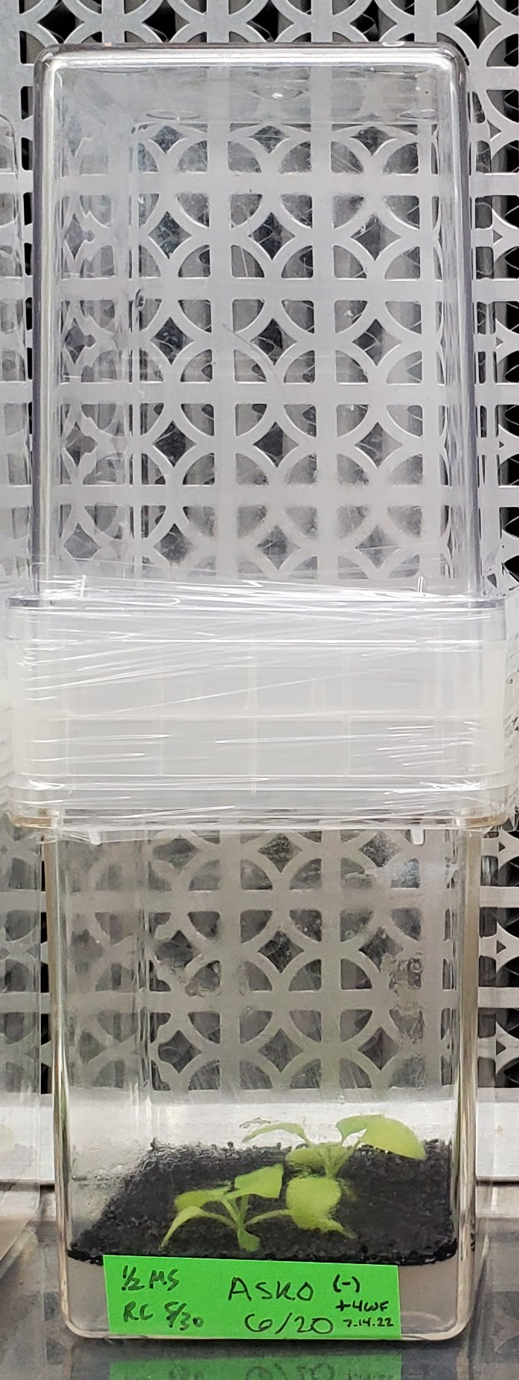
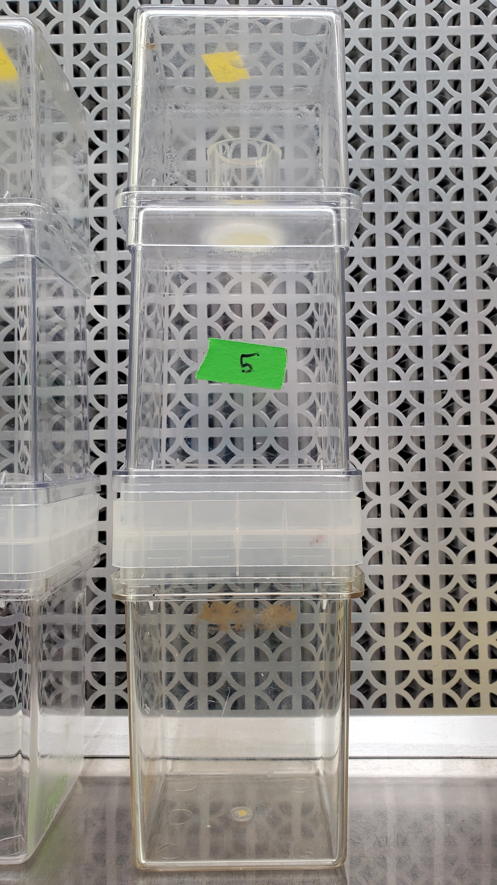
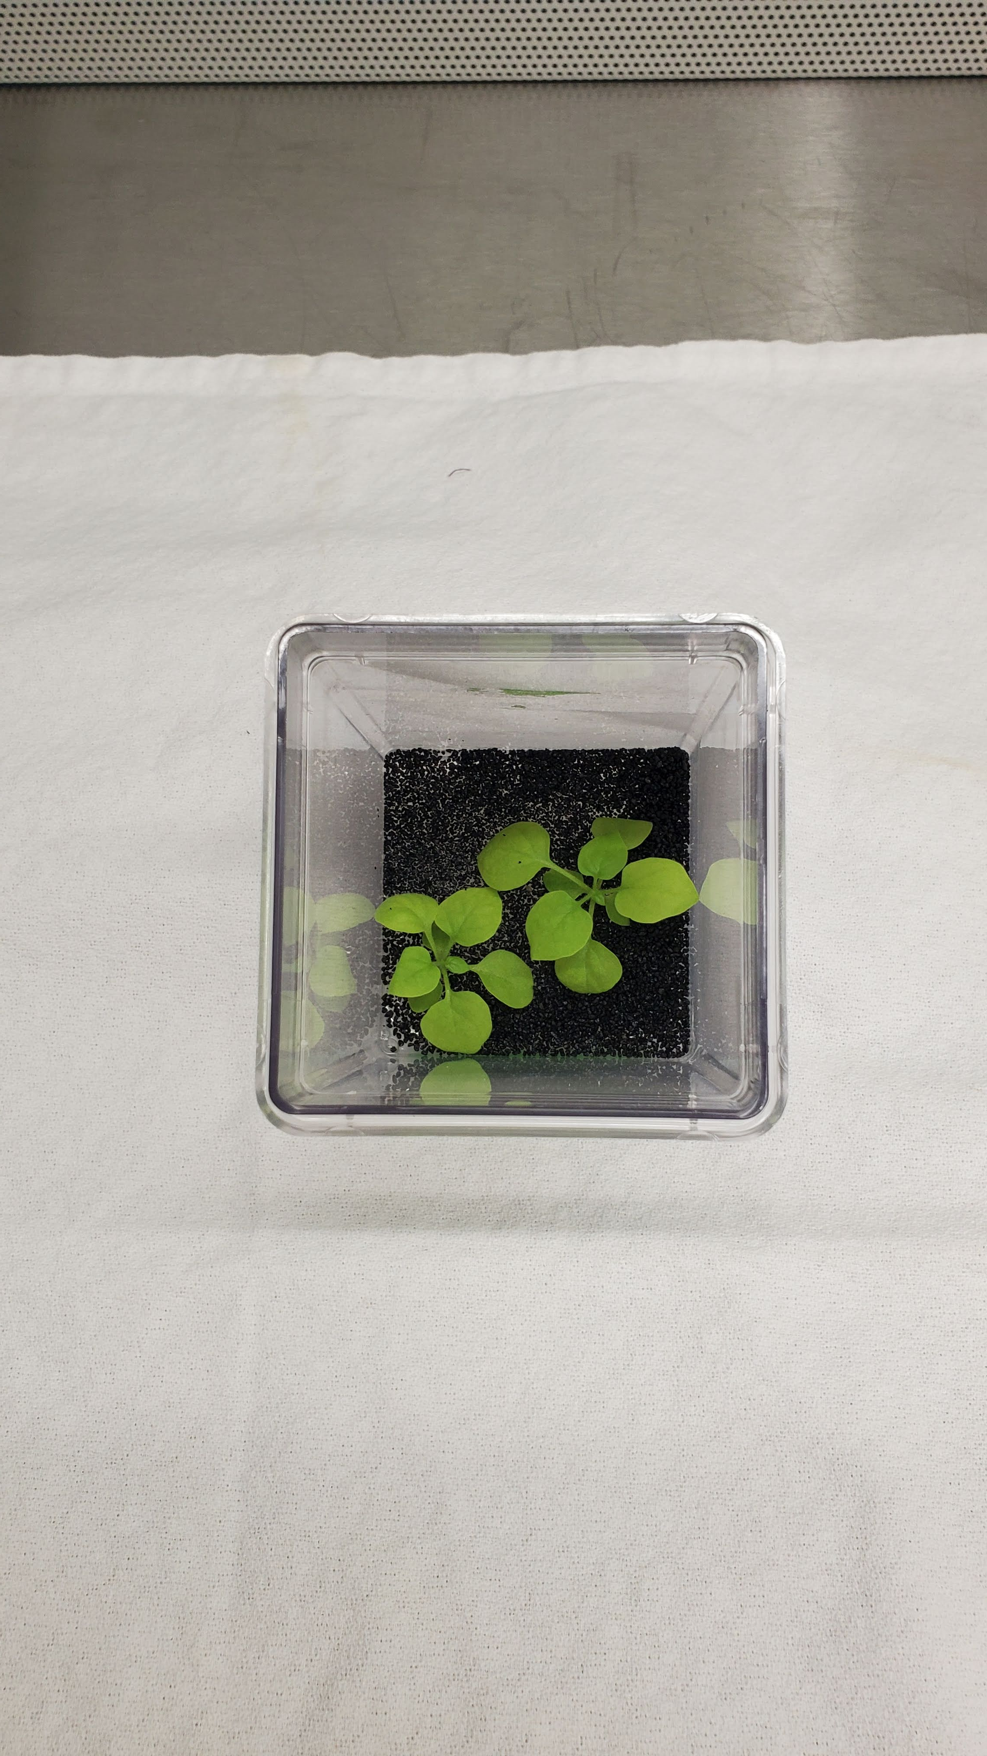
A
B
D
C
Fig. S2: Virus suspension feeding and transmission overview. A. Feeding assembly build with PTFE membrane cut-out under 1” acrylic tube inserted through polycarbonate GA7. B. Whiteflies feeding on filer-sterilized virus suspension in buffer and sucrose solution (and yellow food coloring to attract WF). top inverted GA7 slows evaporation of virus suspension. C. Picture of host N. benthamiana (ASKO) plants after condensation is removed and autoclaved black sand added to prepare for addition of whiteflies. D. ASKO host plant with virus containing whiteflies added for virus transmission.

