Slide 1
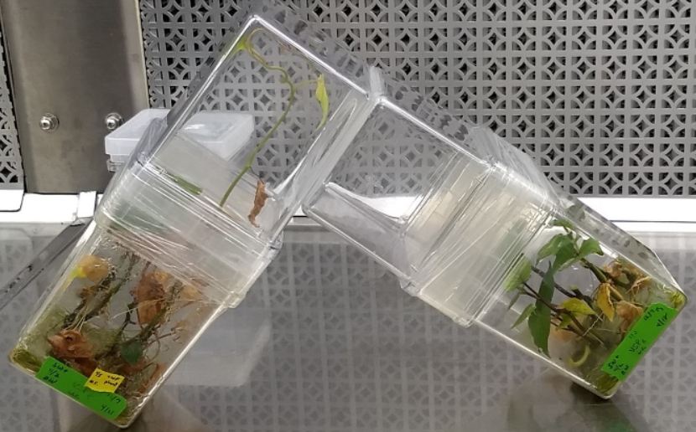
Fig. S1: L-Shaped Device. Early transfer prototype created by connecting two GA7 couplers together with a hole. The L-shape allows for fresh plants to be swapped in below easily.

Slide 2
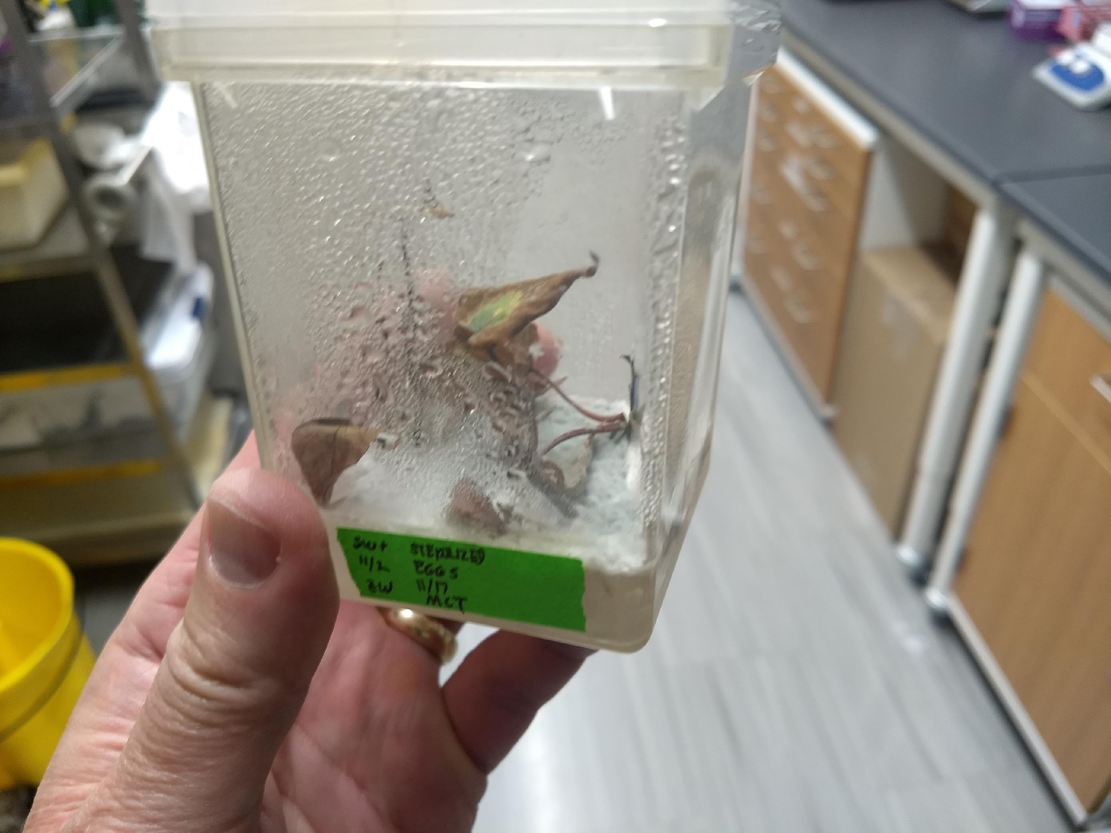
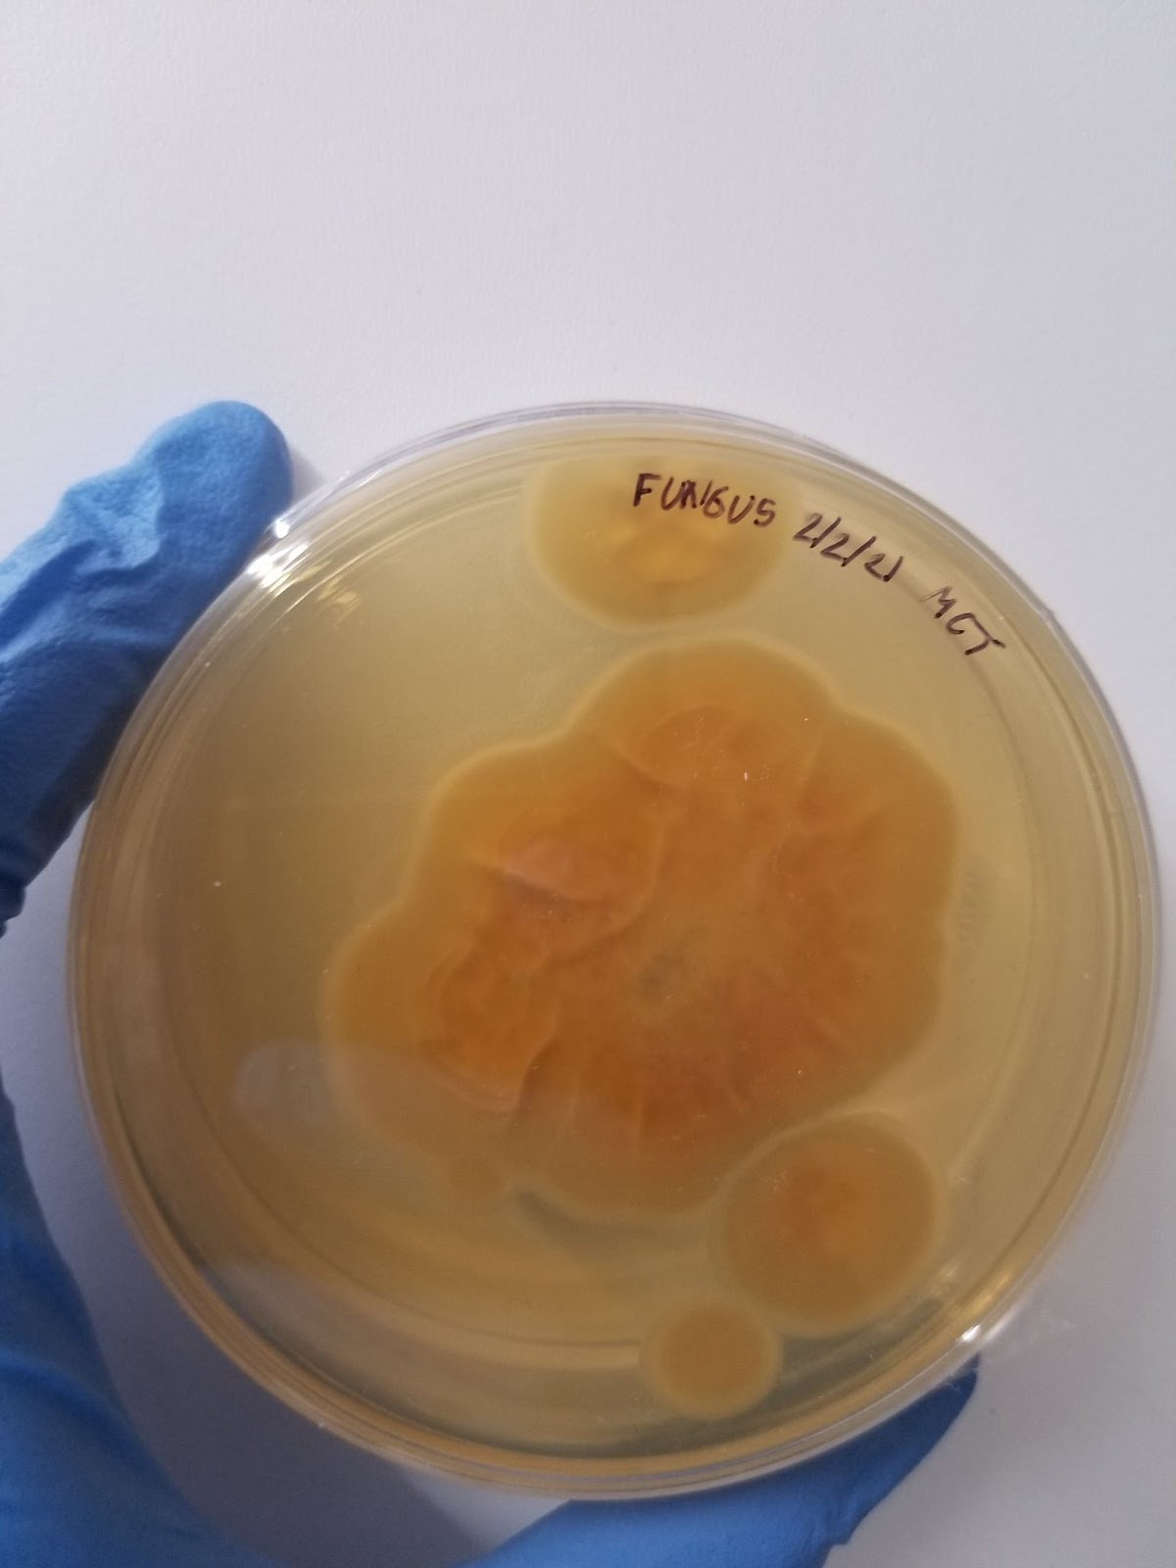
A
B
Fig. S2: Systemic Fungal Infection. (A) early transfer attempts were probe to fungal infection and as a result later methodology involved ‘outracing’ infection by only letting the whiteflies lay eggs for 1-3 days. (B) Systemic fungus grown on a PDA plate.

Slide 3
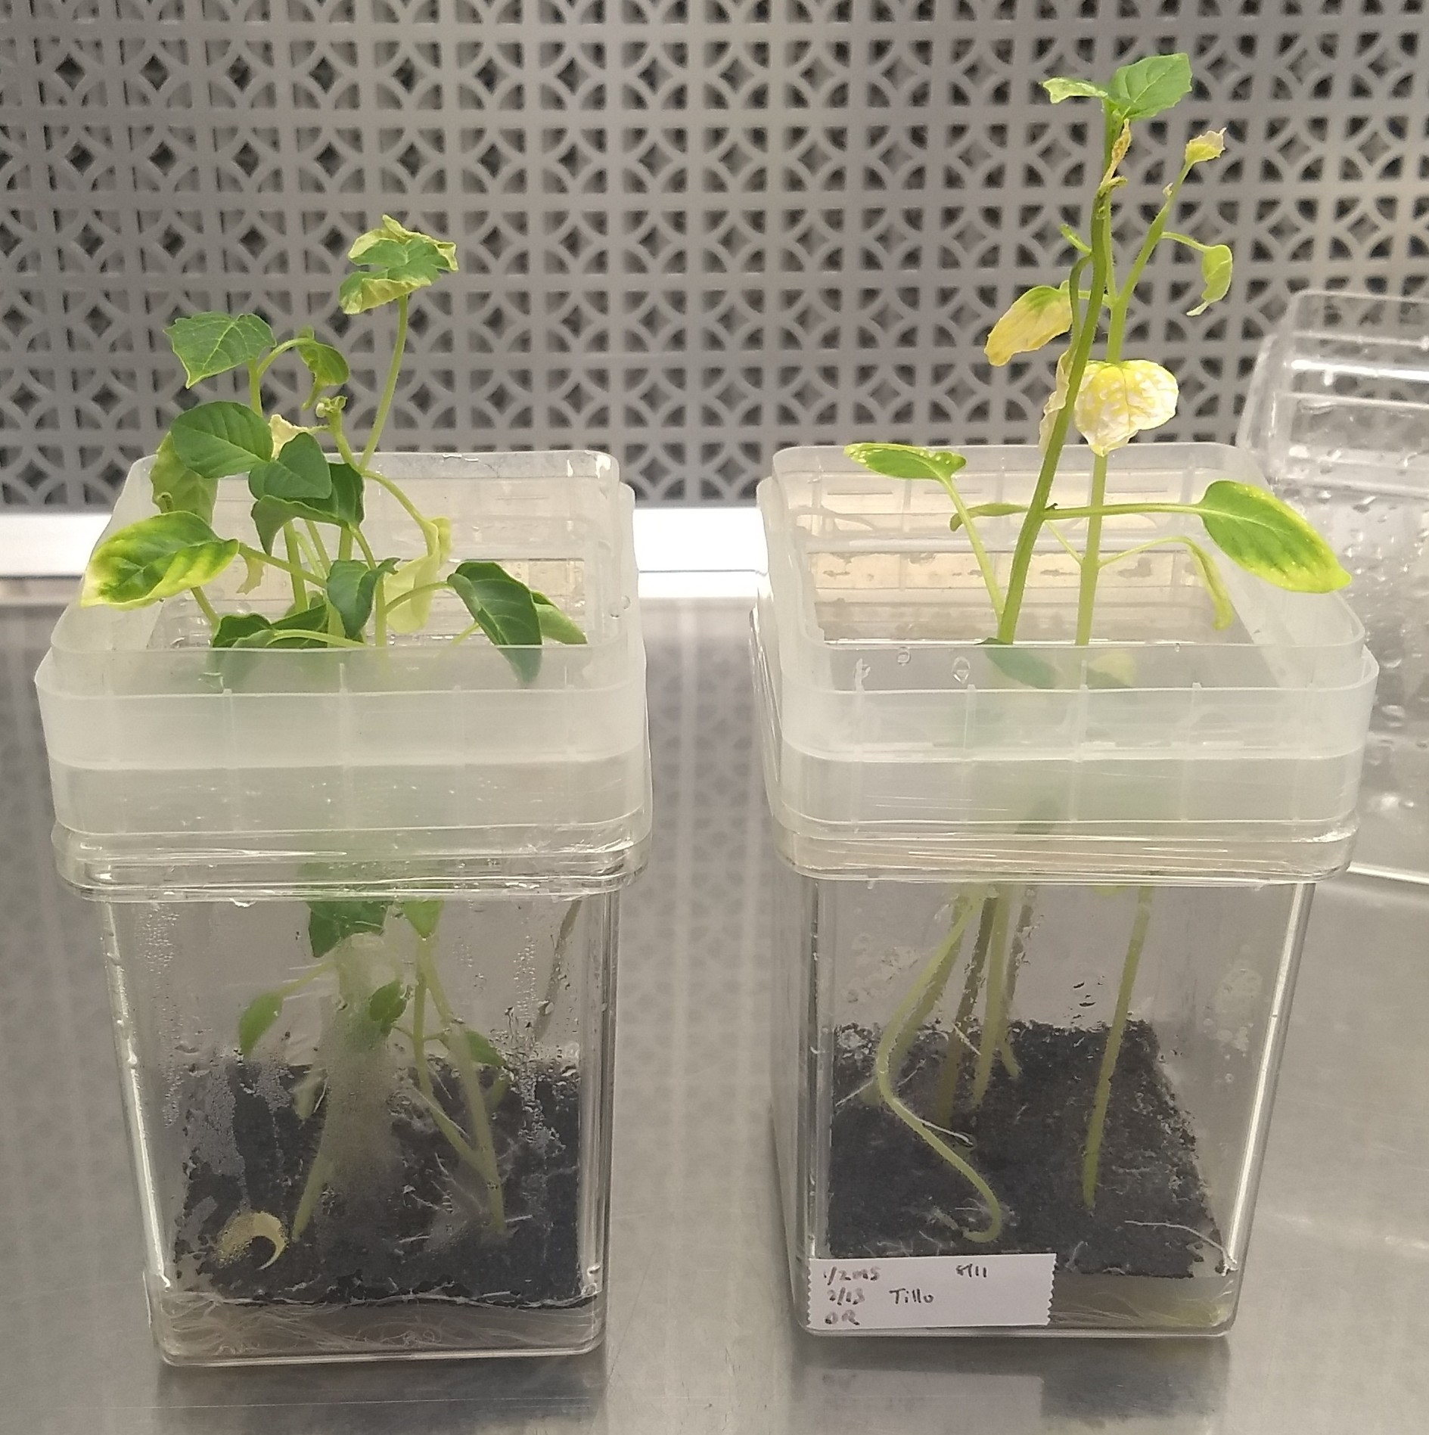
Fig. S3: Tomatillo height comparison. Tomatillo (left) grown on a gyratory shaker while tomatillo (right) was grown in normal laboratory conditions. Shaking reduced leaf senescence and only mildly reduced the height but the retention of initial leaves resulted in a higher whitefly count.

Slide 4
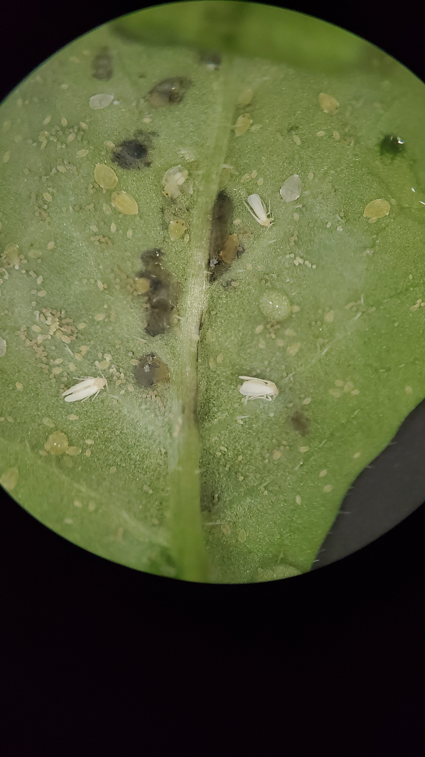
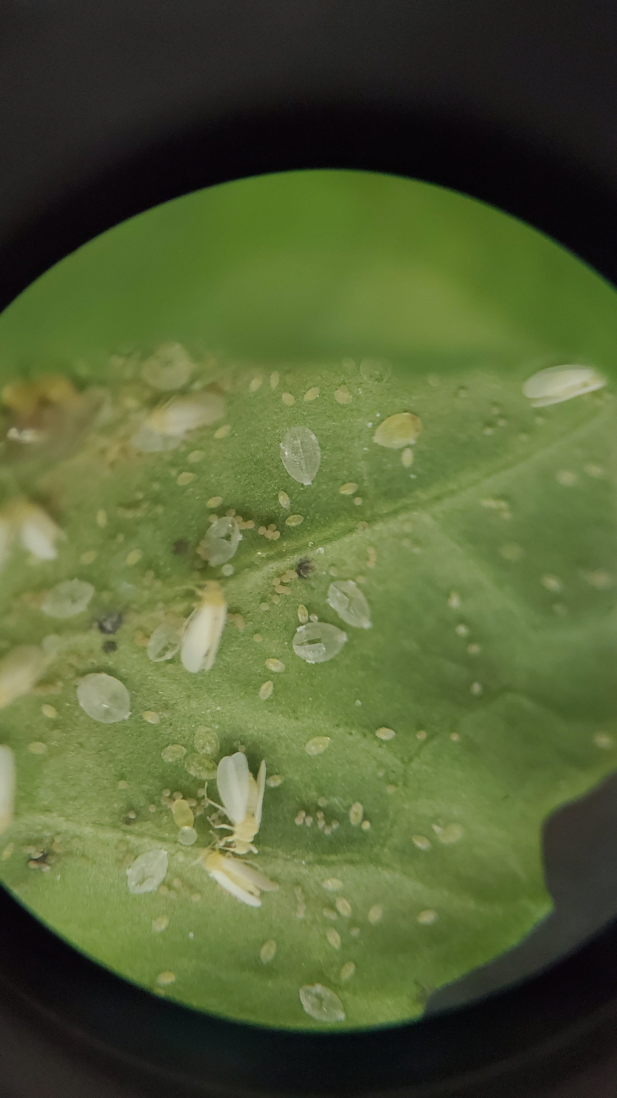
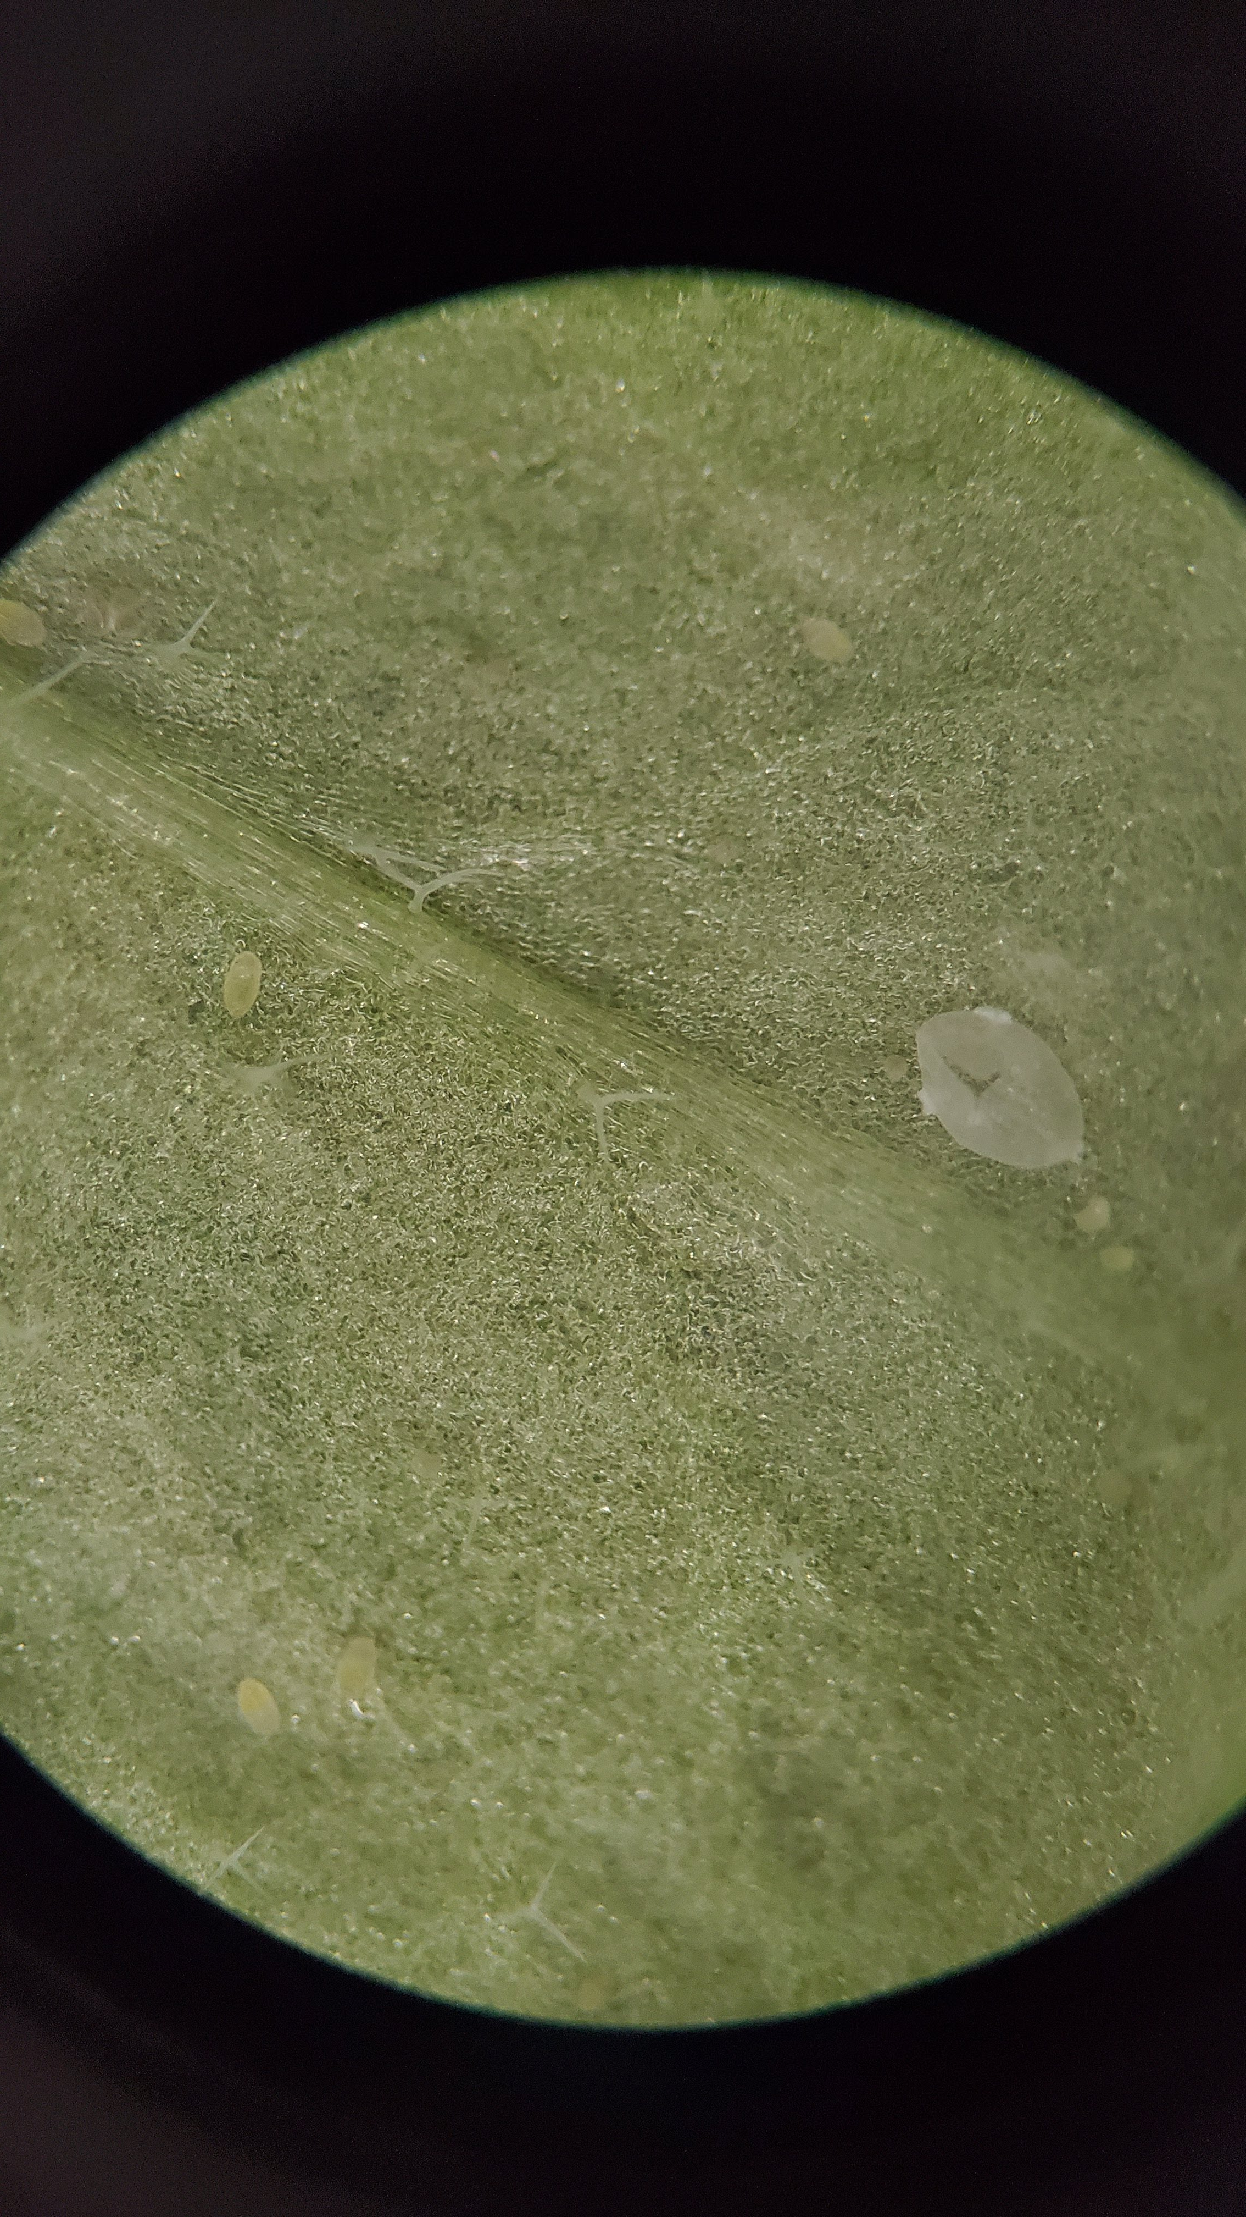

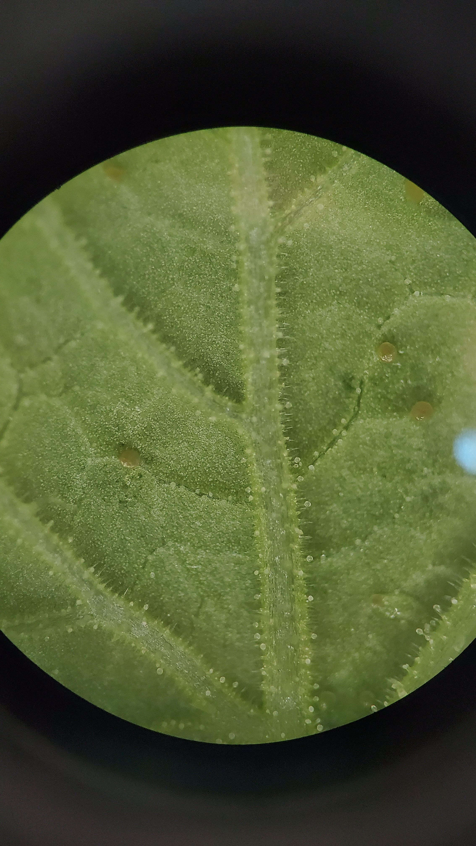
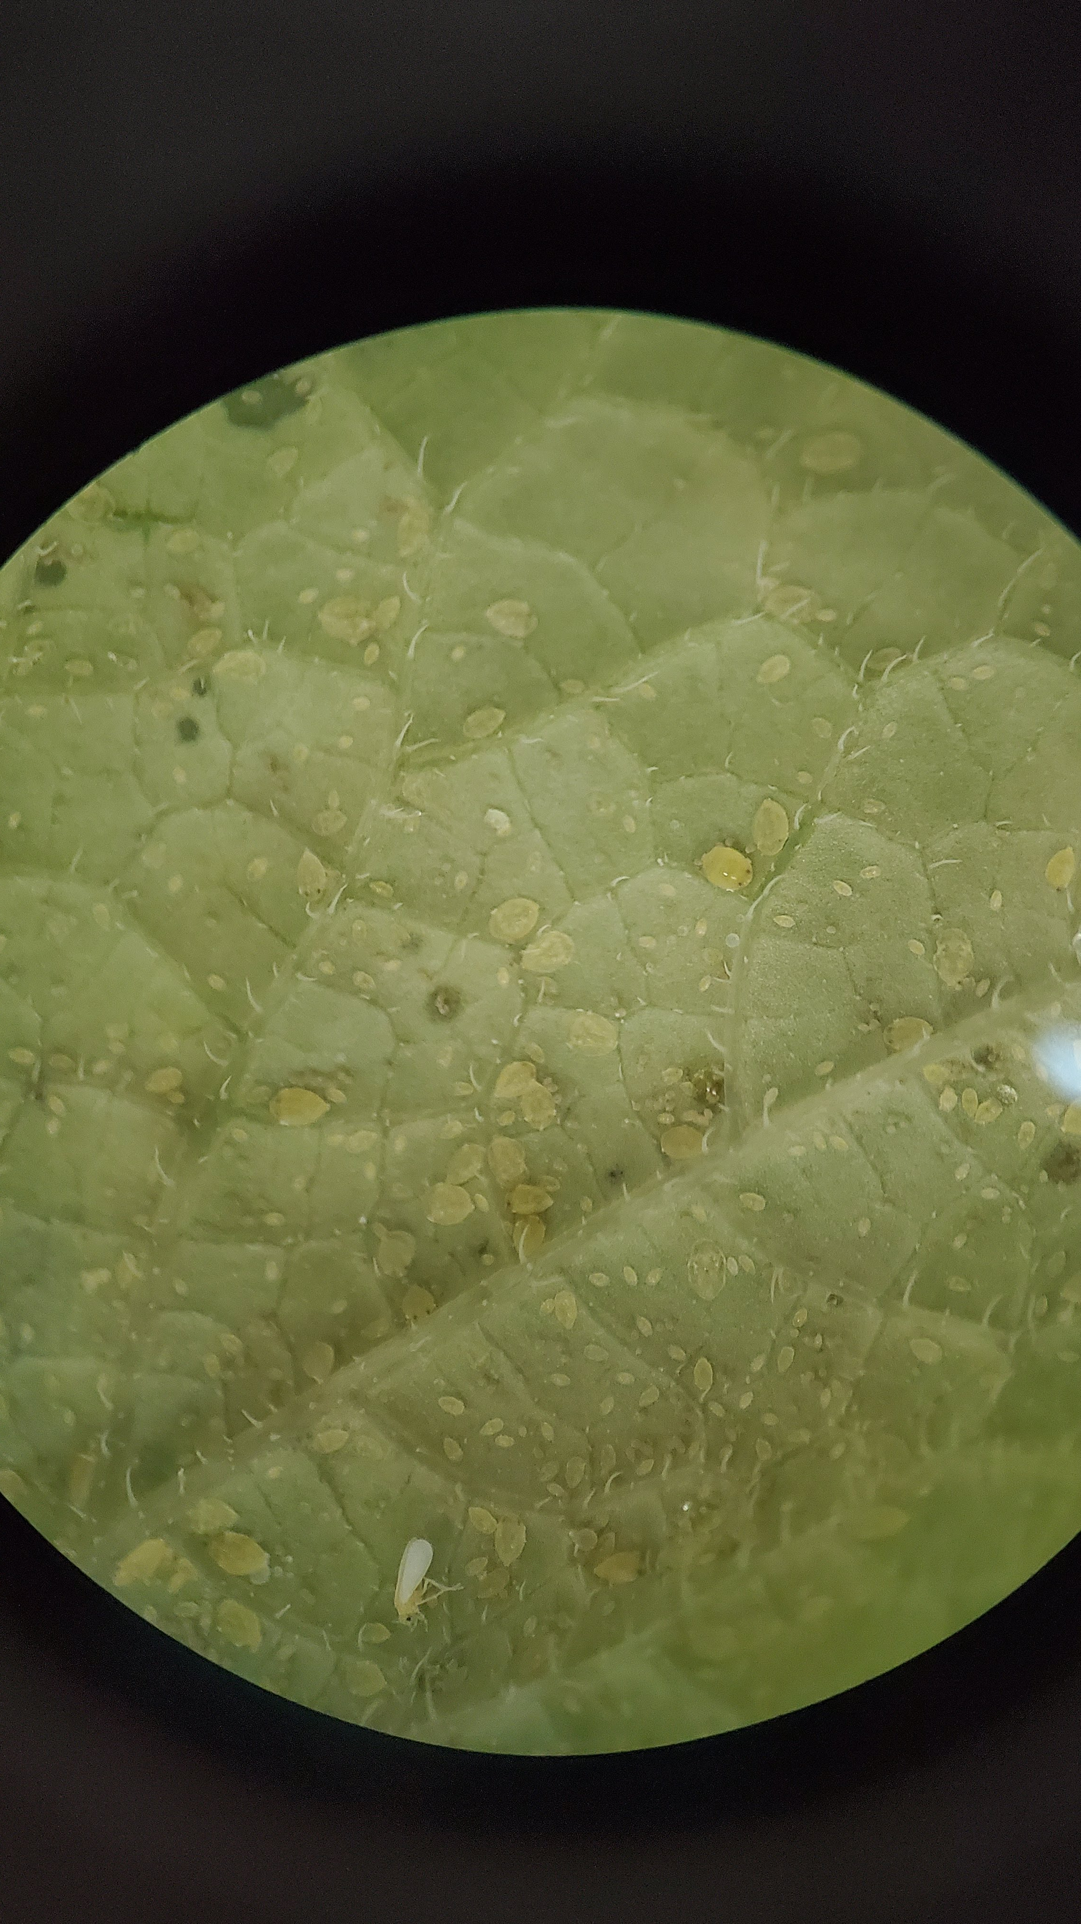
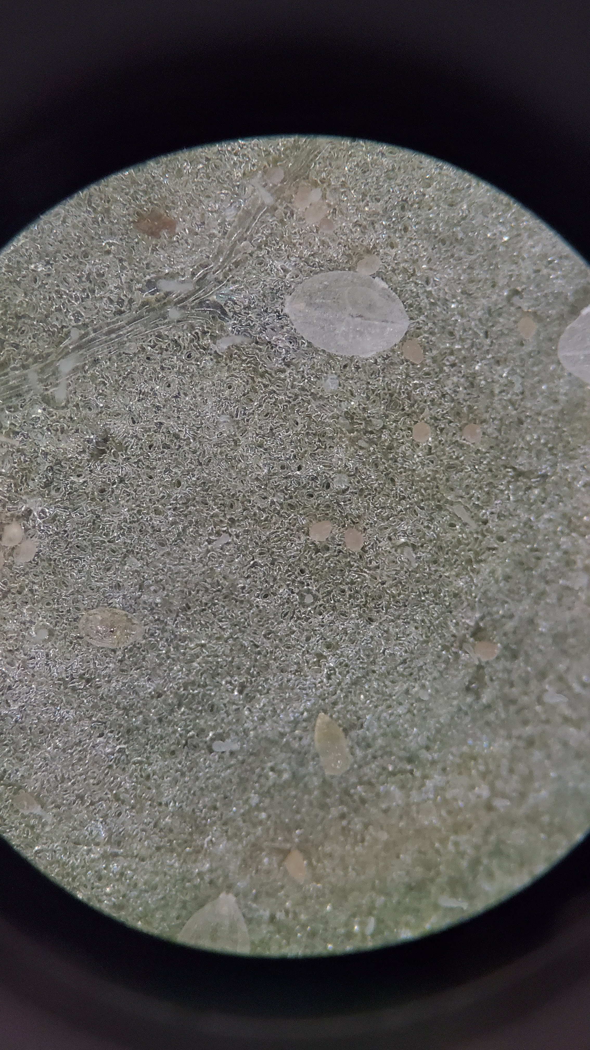
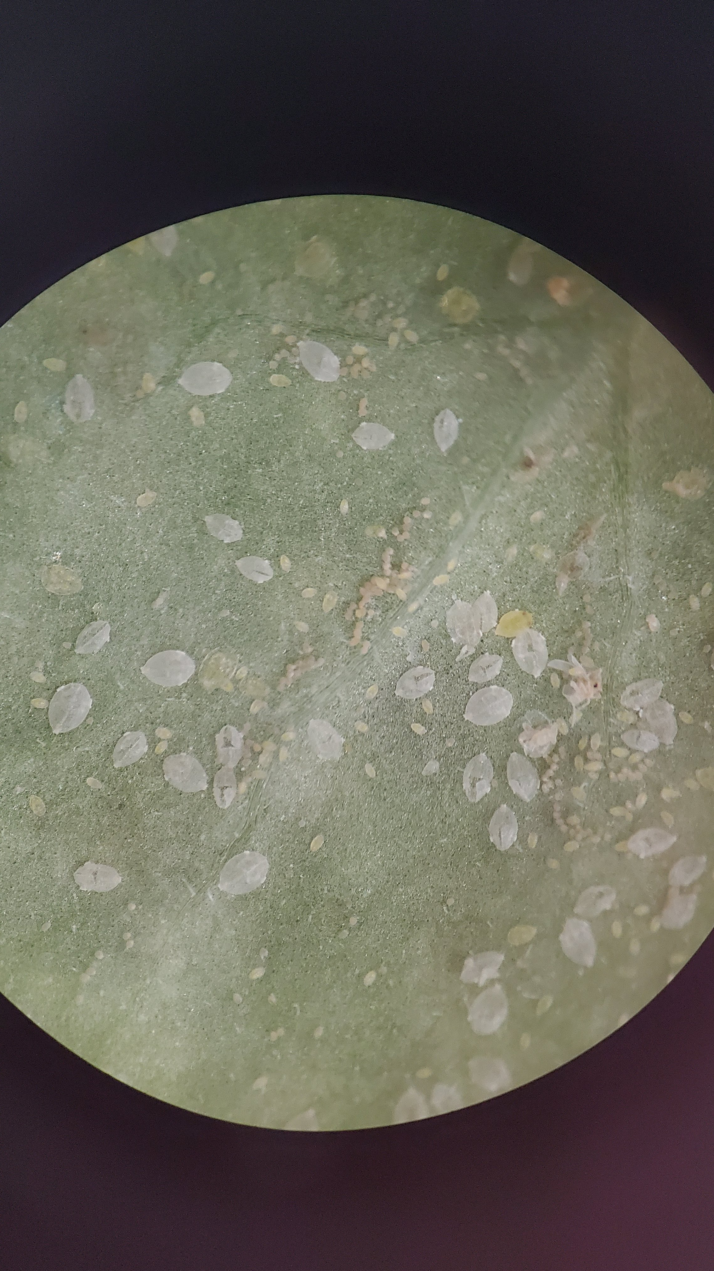
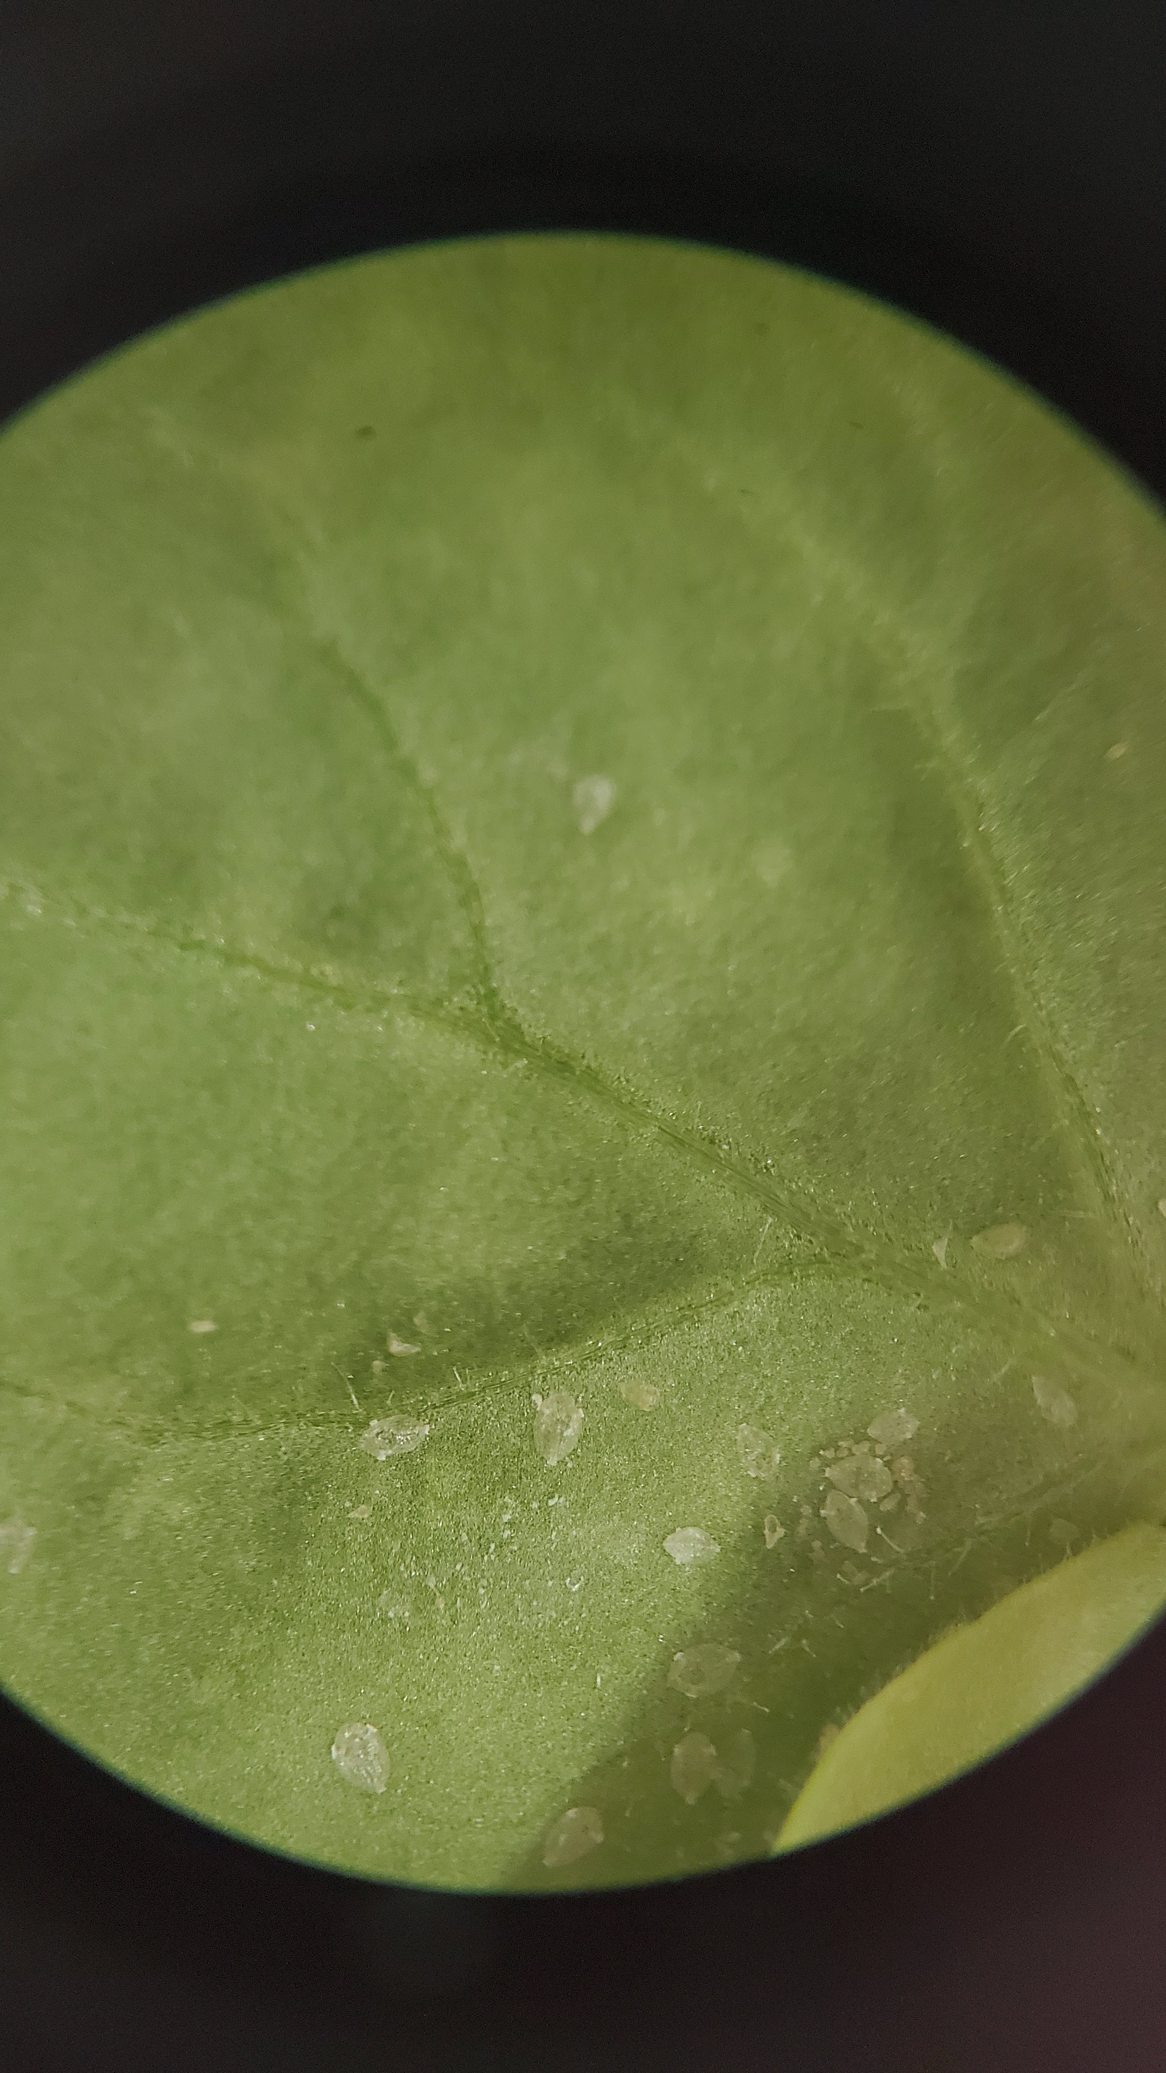
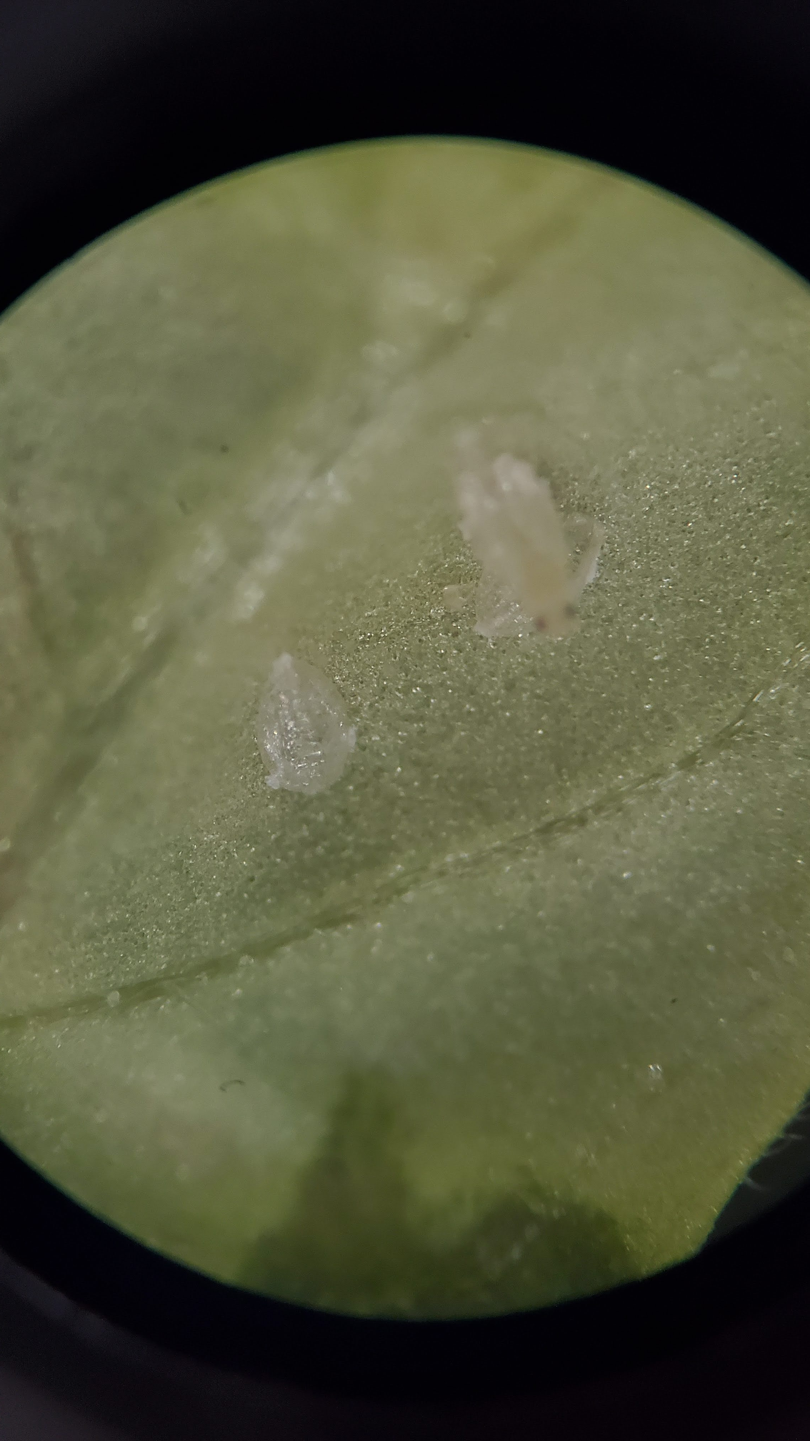
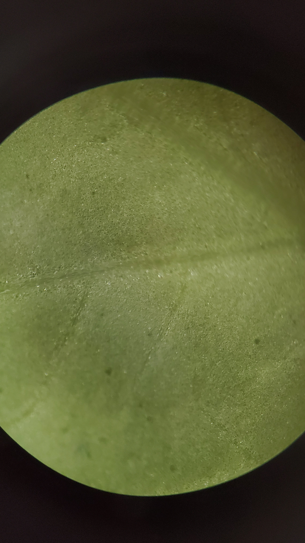
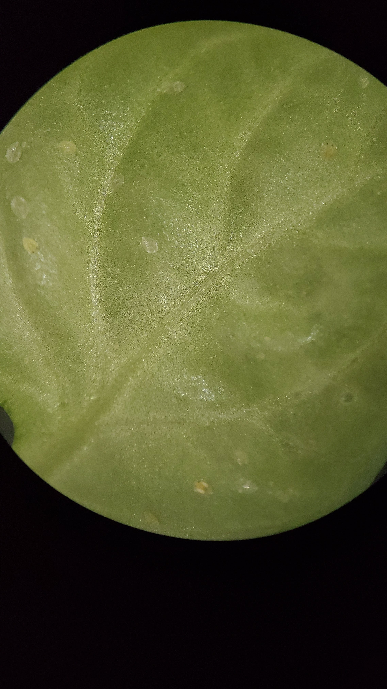
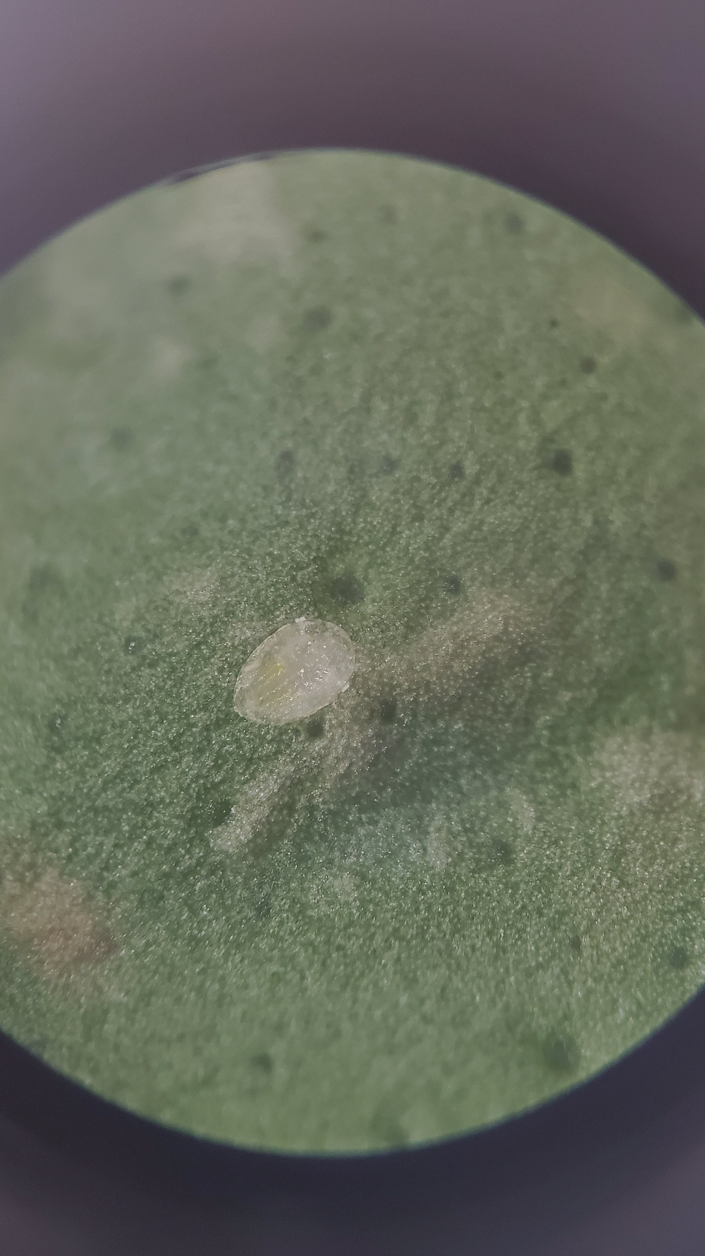
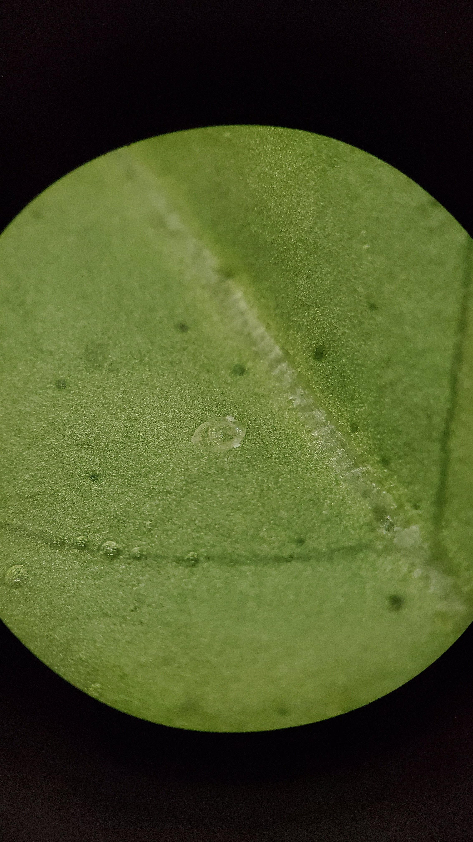
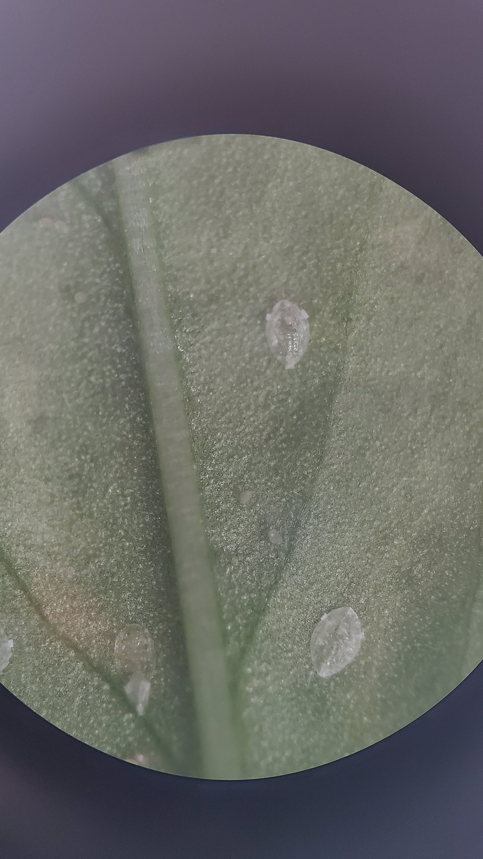
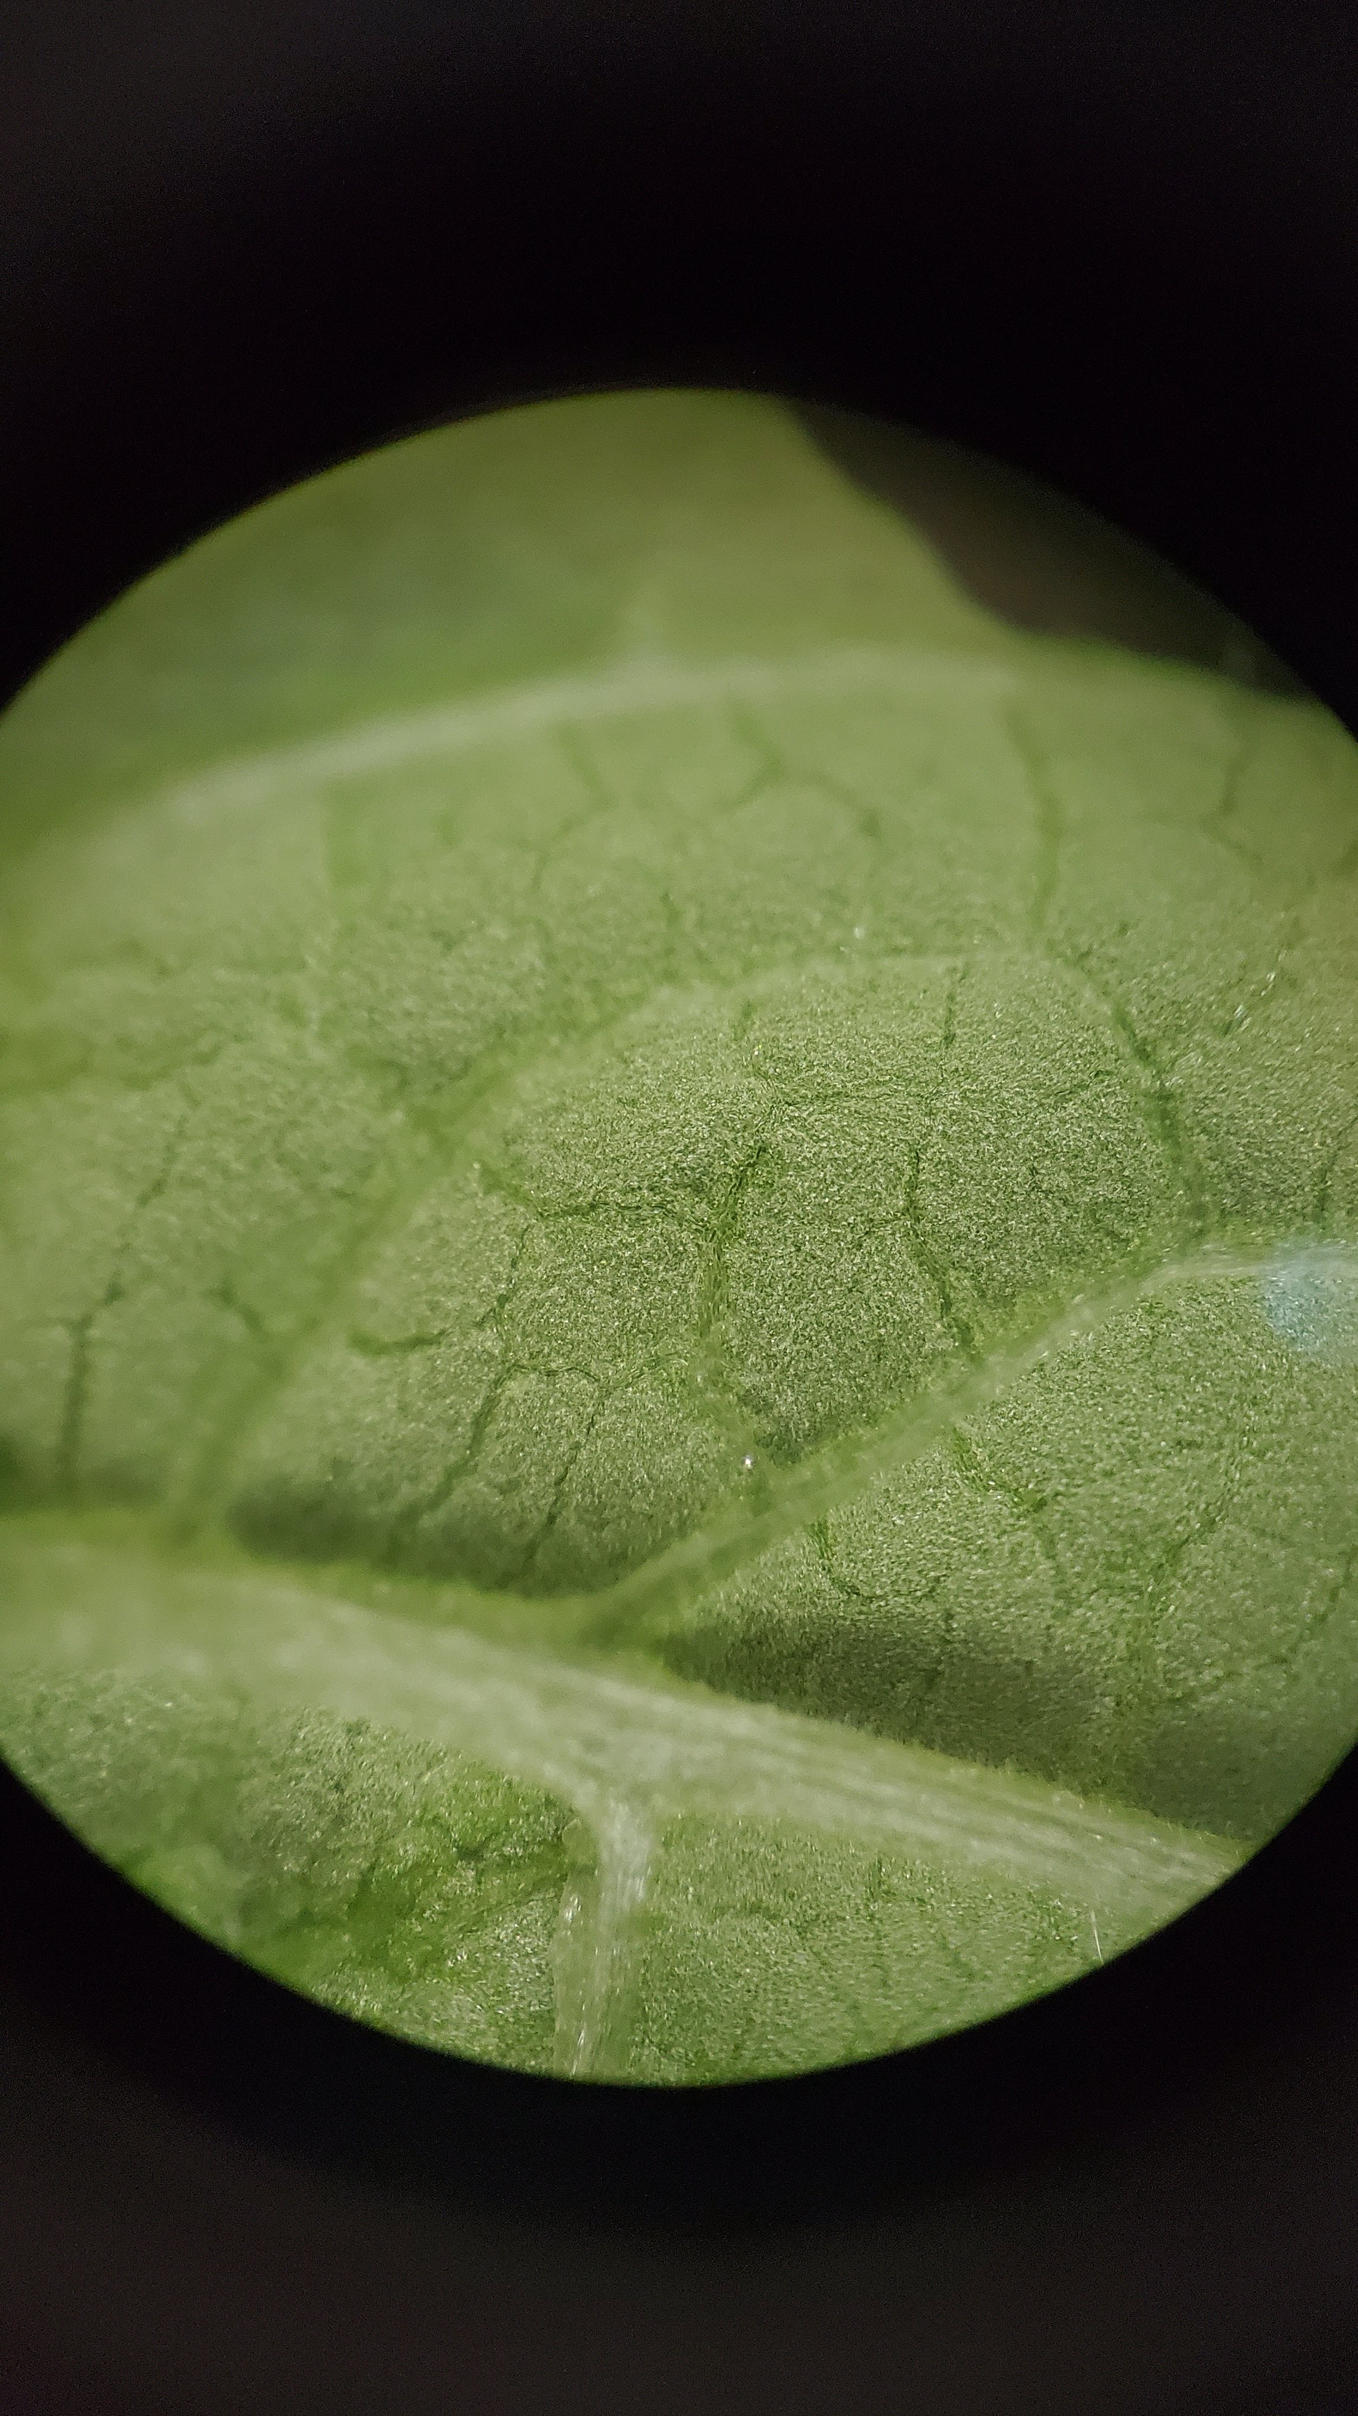
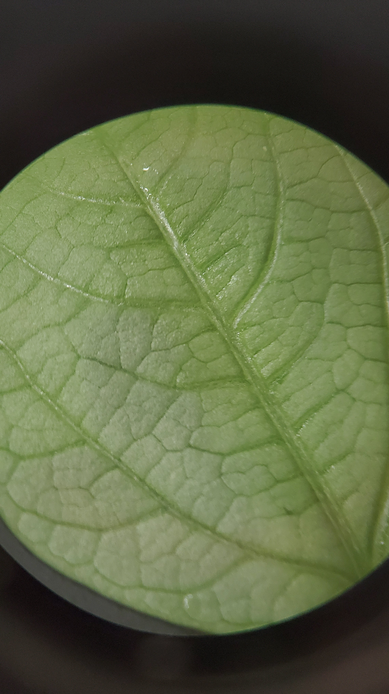
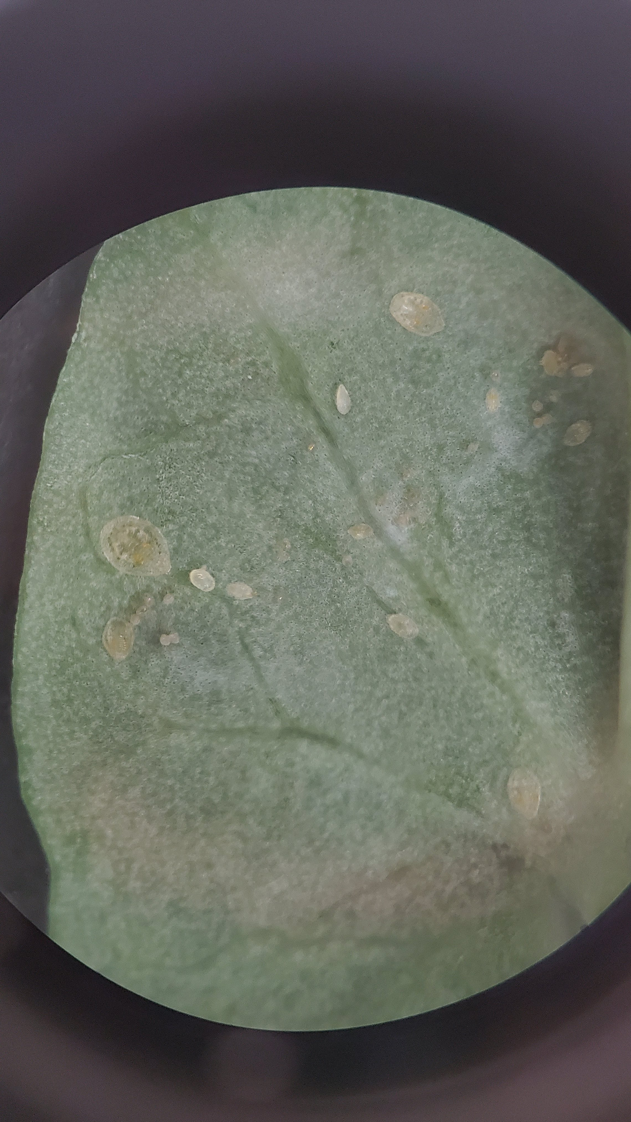
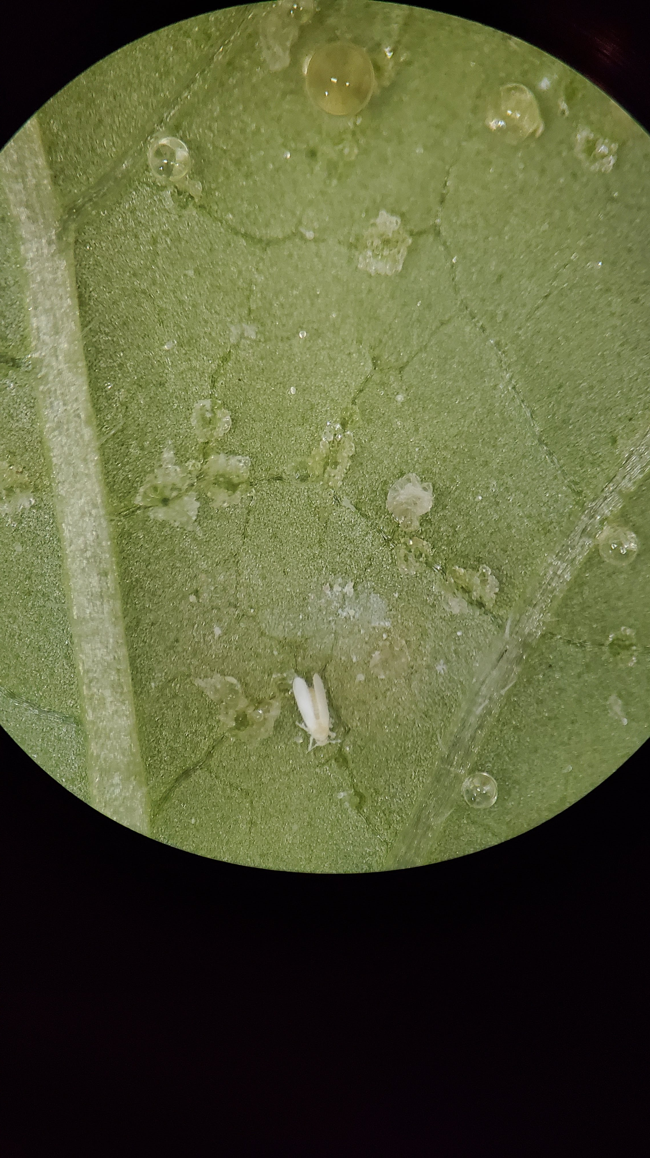
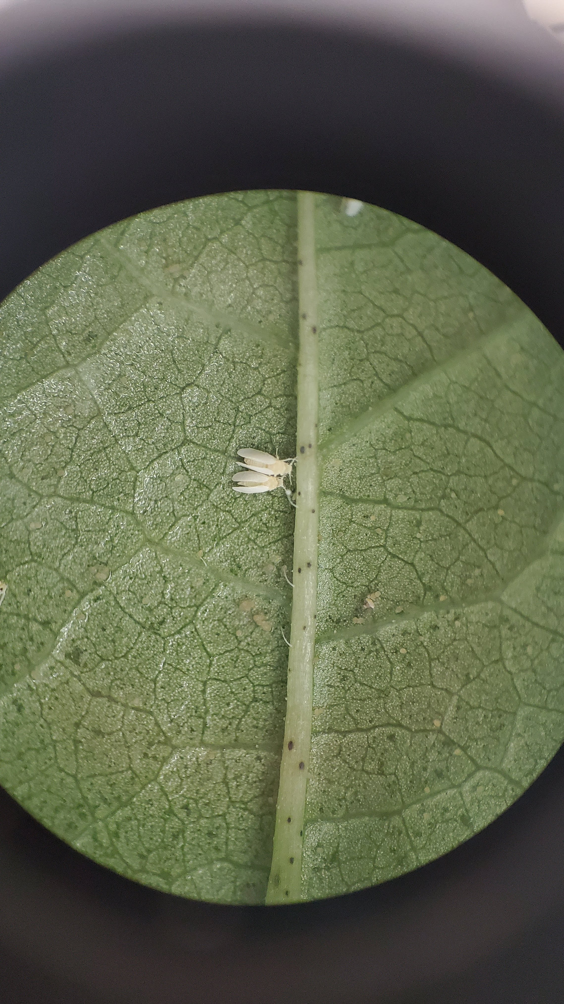
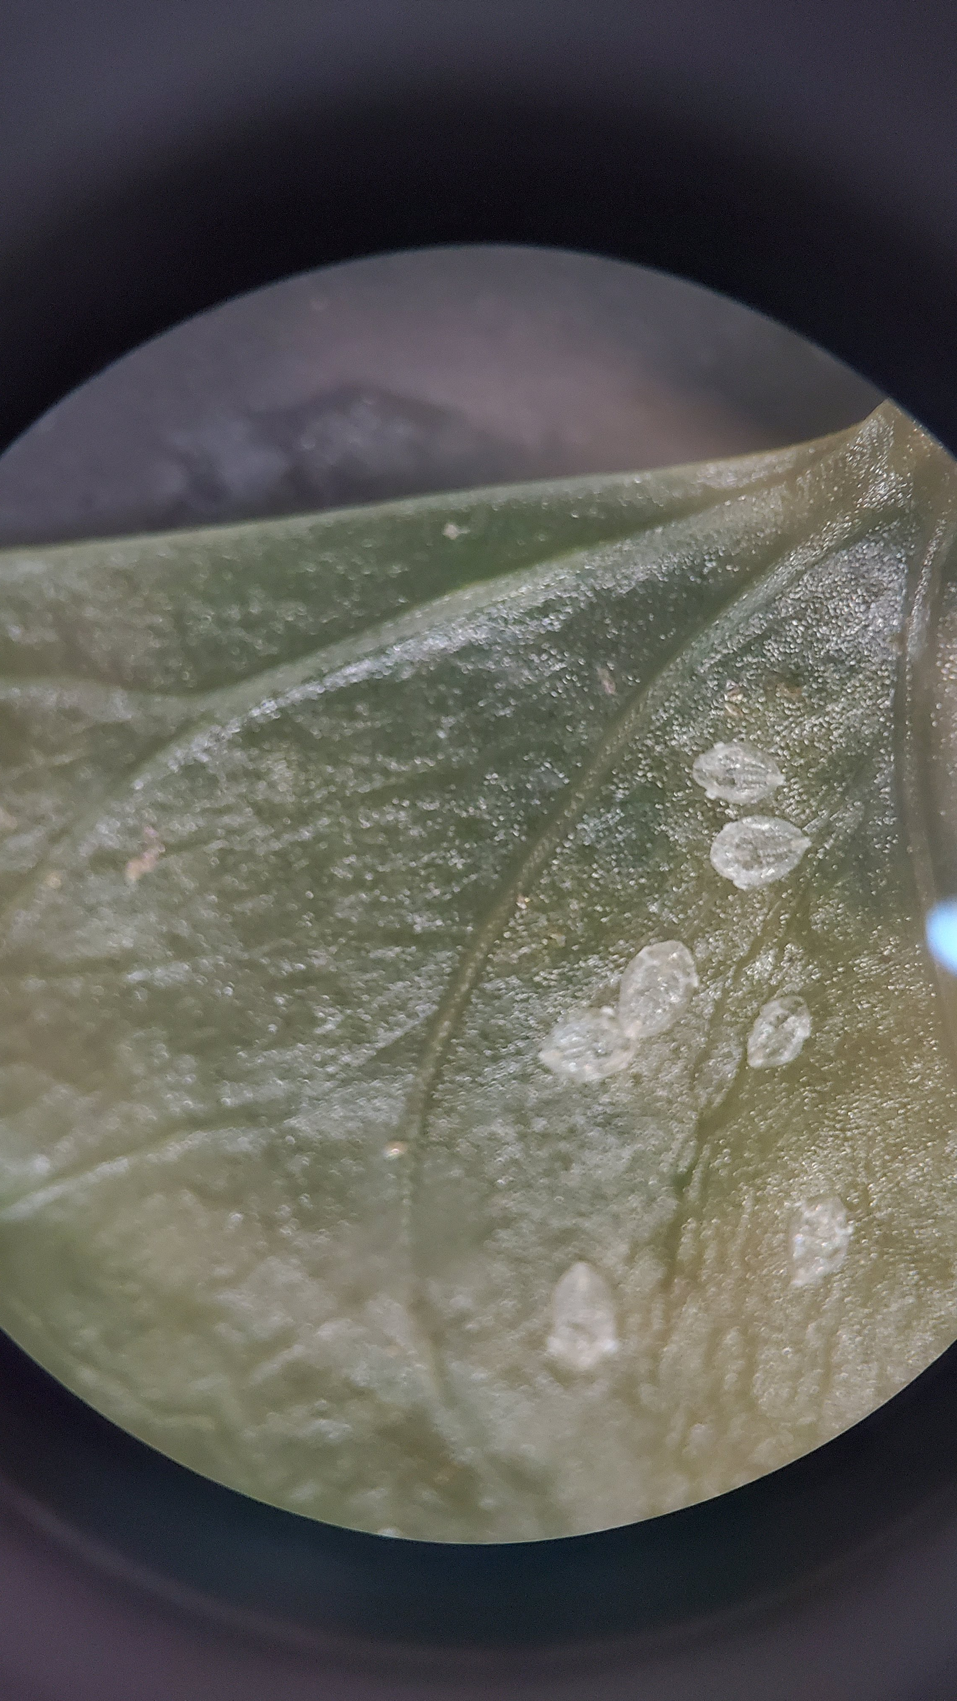
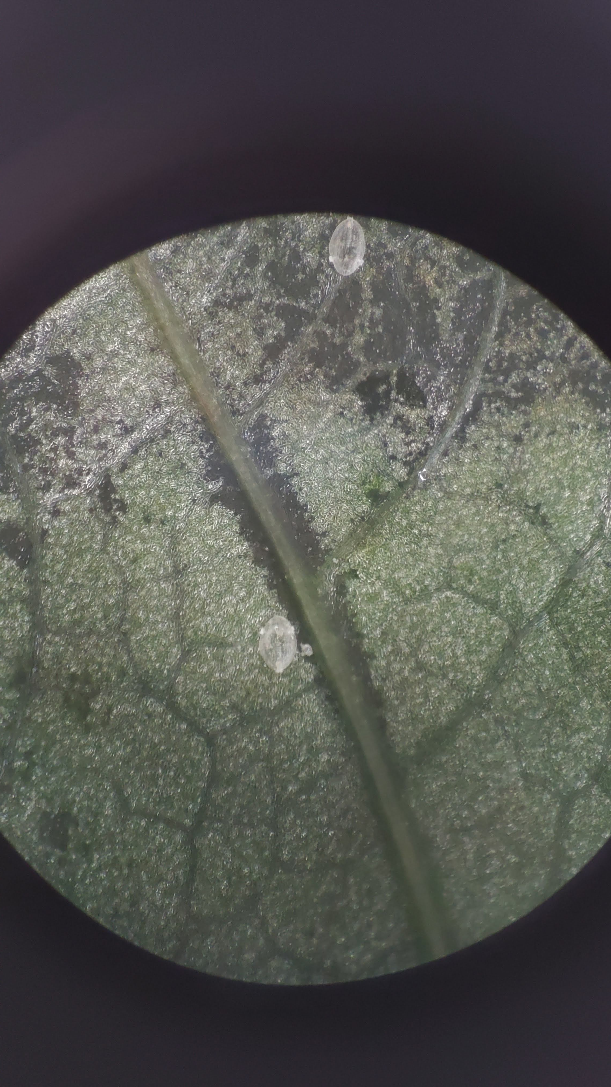
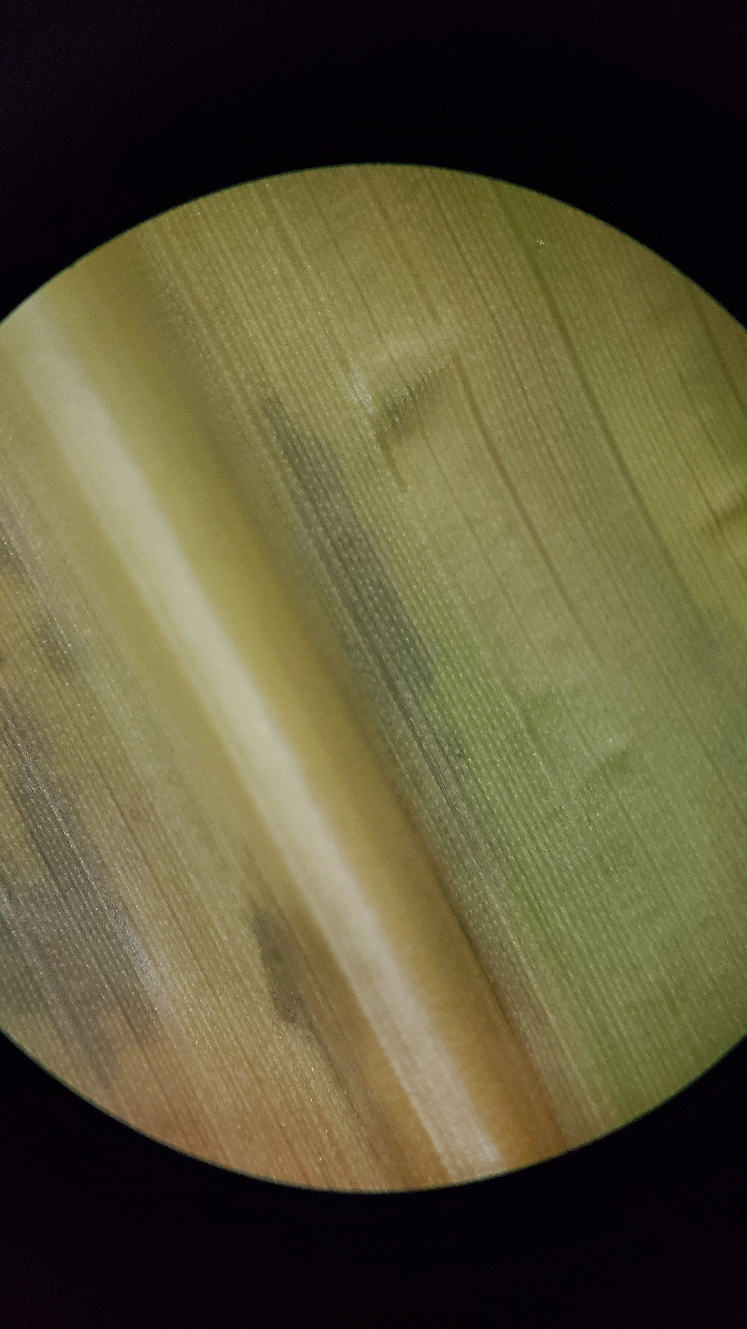
Radish
Broccoli
Cabbage
Arabidopsis
Acorn squash
Kabocha squash
Cucumber
Tobacco
ASKO
WT NB
Tomatillo
Tomato
Jalapeno
Bell Pepper
Orange
Grapefruit
Lemon
Pomegranate
String bean
Cow pea
Pea
Okra
Cotton
Sweet Potato
Cayenensis
Rotundata
Corn
Monocots
Fig. S4: Alternative Host Screen. Close-up shots of the 27 different plant species tested for whitefly proliferation

Slide 5
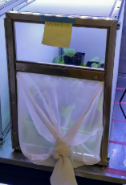
Fig. S5: Screened cage. Cage used to house our potted whitefly colony.

Slide 6
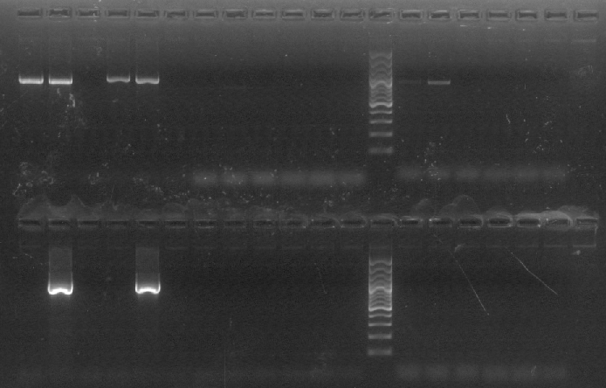
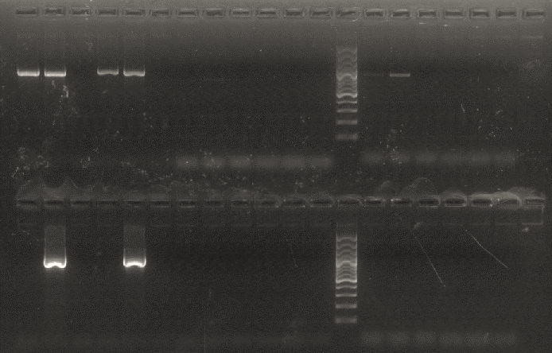
Rickettsia
Wolbachia
mtCOI
A
P
(-)
A
P
(-)
A
P
(-)
Portiera
Cardinium
Arsenophonus
A
P
(-)
A
P
(-)
A
P
(-)
Fig. S6. PCR screen for common whitefly endosymbionts in the axenic colony (axenic, A) and our non-axenic (potted, P) colony. Both colonies were negative for Wolbachia, Cardinium, and Arsenophonus. The potted colony contains Portiera but the axenic colony does not. They both contain Rickettsia and were positive for the “control” gene, mtCOI.

