Slide 1
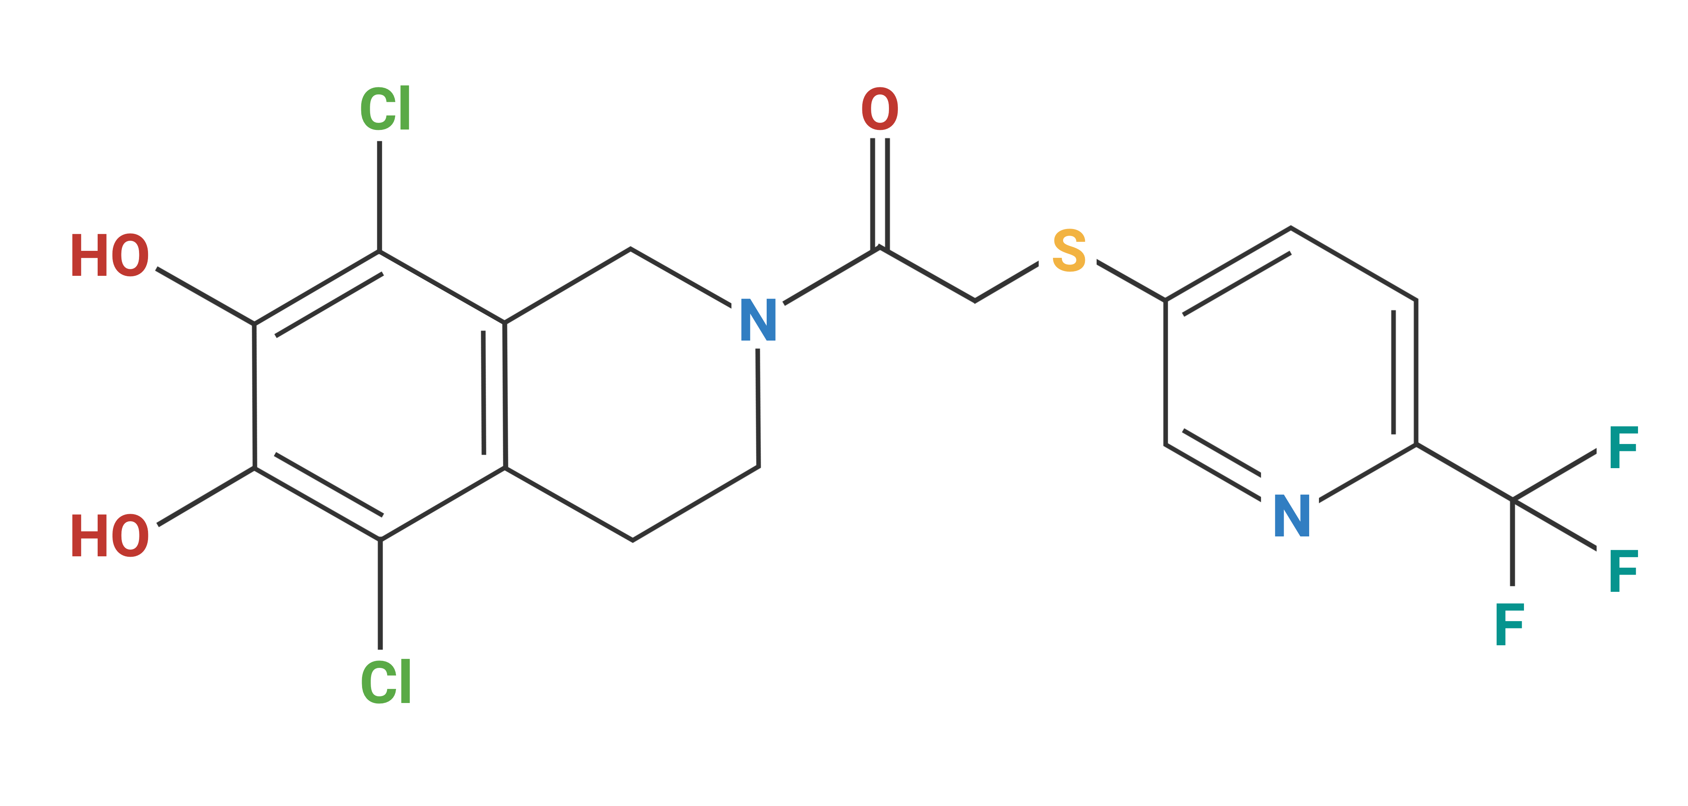
Supplementary Figure 1
Supplemental Figure 1. The molecular structure of RCD405.
Molecular weight: 453.26 g/mol.
Molecular formula: C₁₇H₁₃Cl₂F₃N₂O₃S
Chemical name (IUPAC):1-(5,8-Dichloro-6,7-dihydroxy-3,4-dihydroisoquinolin-2(1H)-yl)-2-
((6-(trifluoromethyl)pyridin-3-yl)thio)ethan-1-one

Slide 2
Lung homogenate
Supplementary Figure 2
Supplemental Figure 2. Effect from RCD405, showing individual graphs of all 23 cytokines measured in lung homogenates after OVA-induced airway inflammation. Differences in cytokine levels were compared using a one-way ANOVA followed by a Dunnett’s post-hoc test (**P<0.01, *P<0.05).

Slide 3
BALF
Supplementary Figure 3
Supplemental Figure 3. Effect from RCD405, showing individual graphs of all 23 cytokines measured in BALF after OVA-induced airway inflammation. Differences in cytokine levels were compared using a one-way ANOVA followed by a Dunnett’s post-hoc test (**P<0.01, *P<0.05).

Slide 4
Plasma
Supplementary Figure 4
Supplemental Figure 4. Effect from RCD405, showing individual graphs of all 23 cytokines measured in plasma after OVA-induced airway inflammation. Differences in cytokine levels were compared using a one-way ANOVA followed by a Dunnett’s post-hoc test (**P<0.01, *P<0.05).

Slide 5
Lung homogenate
Supplementary Figure 5
Supplemental Figure 5. Individual graphs of all 23 cytokines measured in lung homogenate after LPS-induced airway inflammation. Differences in cytokine levels were compared using a one-way ANOVA followed by a Dunnett’s post-hoc test (*P<0.05).

Slide 6
BALF
Supplementary Figure 6
Supplemental Figure 6. Individual graphs of all 23 cytokines measured in BALF after LPS-induced
airway inflammation. Differences in cytokine levels were compared using a one-way ANOVA followed
by a Dunnett’s post-hoc test (**P<0.01, *P<0.05).

Slide 7
Plasma
Supplementary Figure 7
Supplemental Figure 7. Individual graphs of all 23 cytokines measured in plasma after LPS-induced
airway inflammation. Differences in cytokine levels were compared using a one-way ANOVA followed by
a Dunnett’s post-hoc test (***P<0.001, *P<0.05).

Slide 8
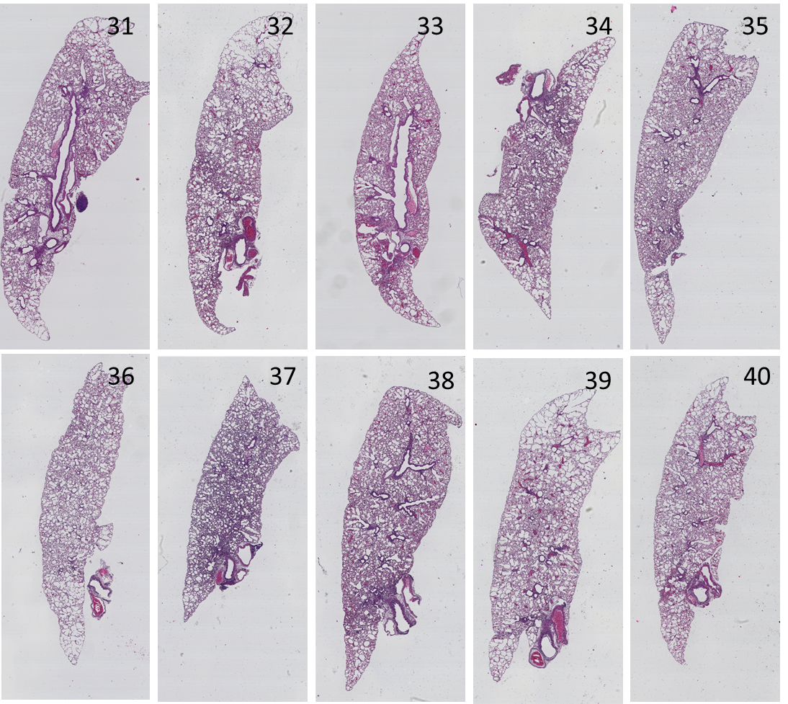
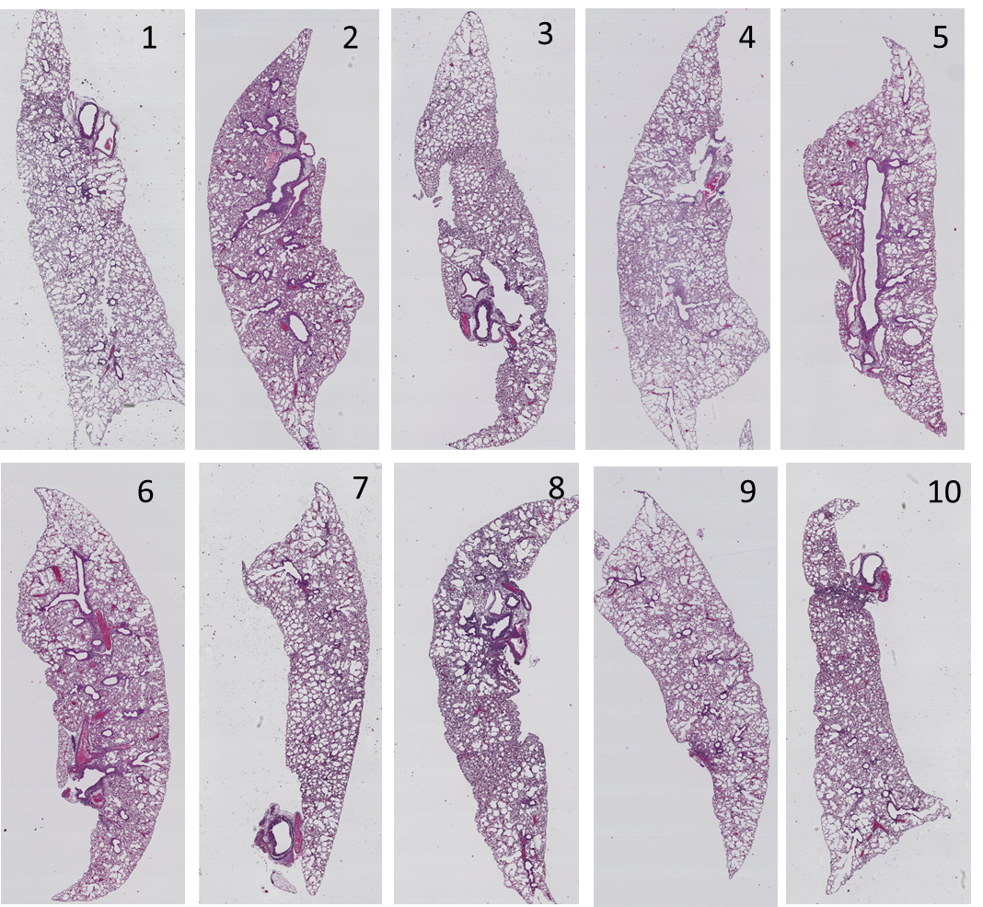
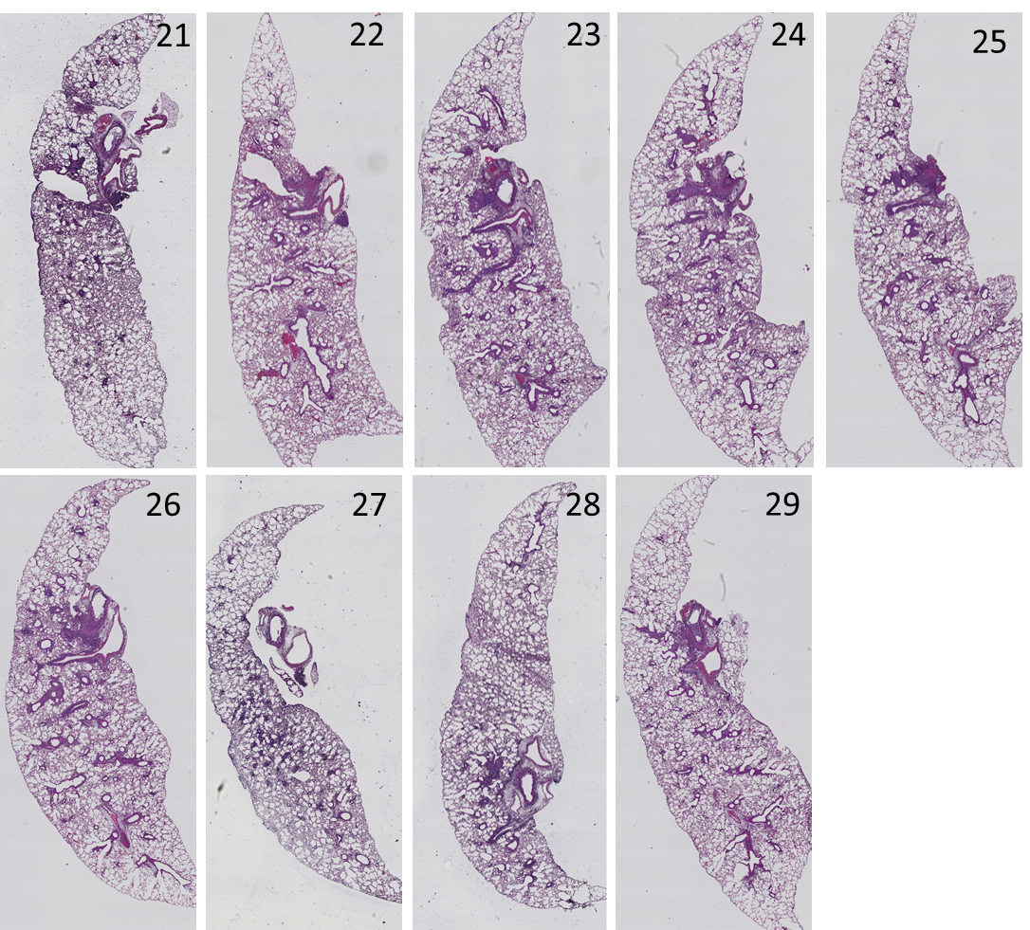
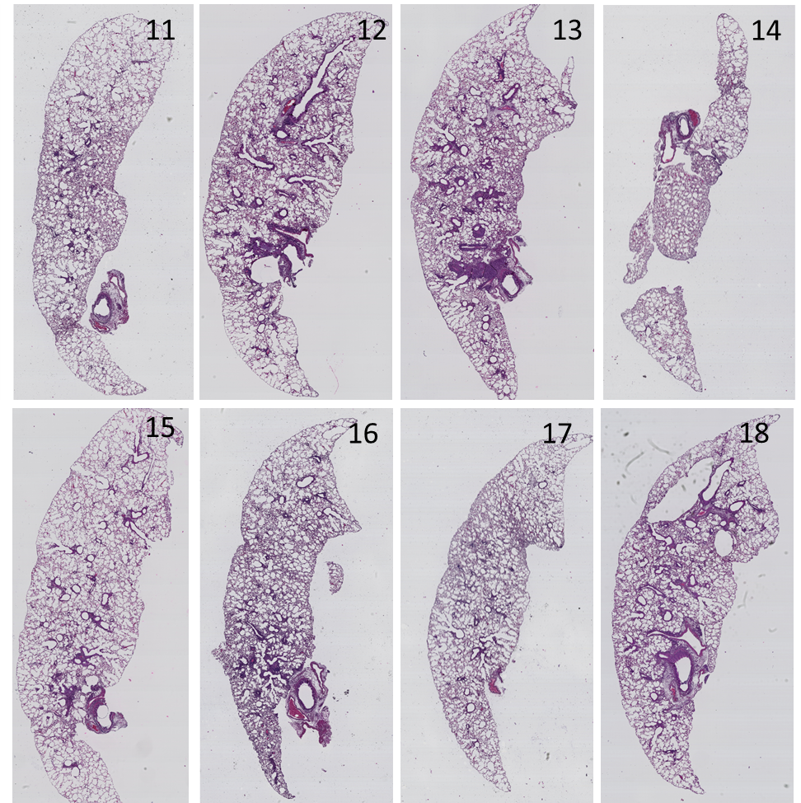
Supplementary Figure 8
H&E
Veh/PBS
RCD405/PBS
Veh/OVA
RCD405/OVA
Supplemental Figure 8. Whole slide scans of murine lungs after H&E staining. OVA-sensitized/PBS-challenged and treated with vehicle (Veh/PBS), OVA-sensitized/PBS challenged and treated with RCD405 (RCD405/PBS), OVA-sensitized/OVA-challenged and treated with vehicle (Veh/OVA), OVA-sensitized/OVA-challenged and treated with RCD405 (RCD405/OVA).

Slide 9
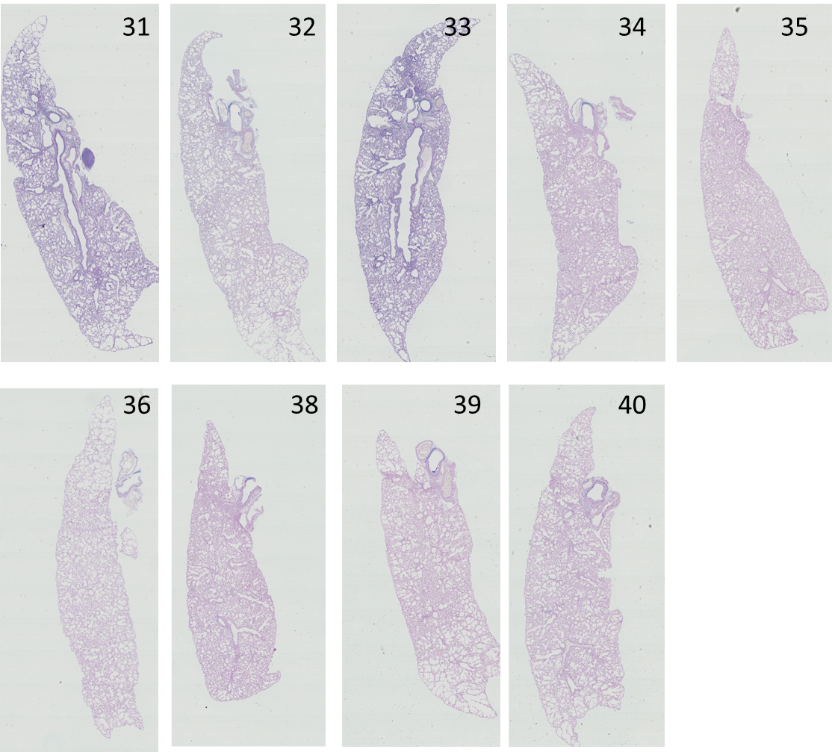
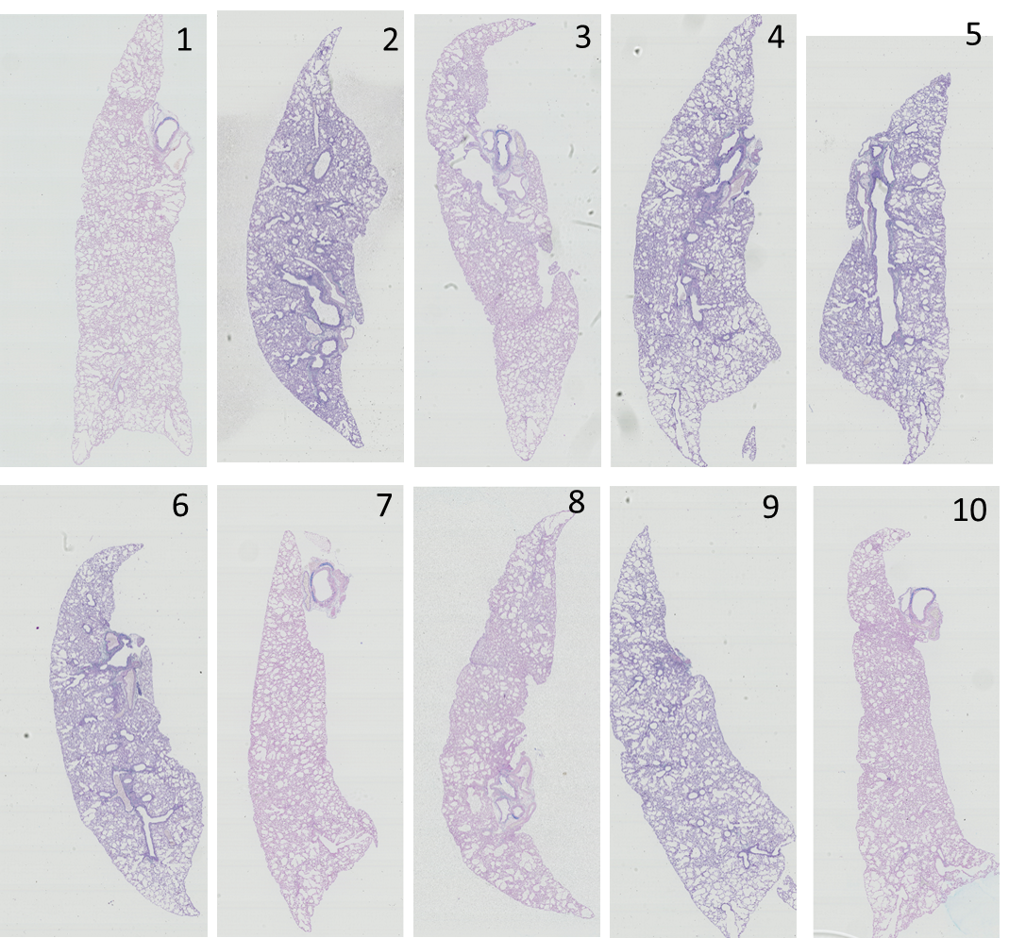
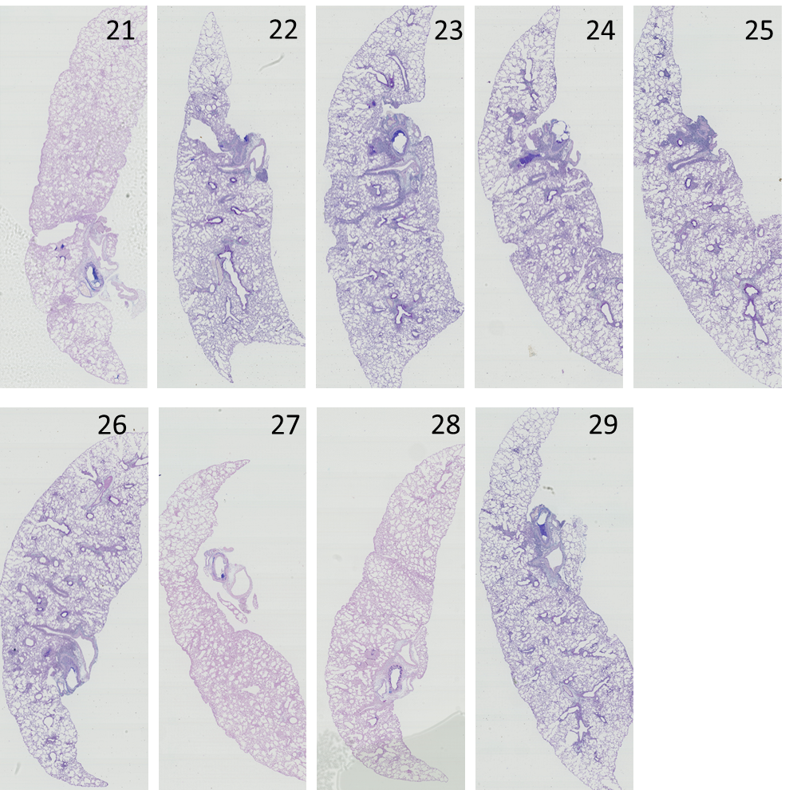
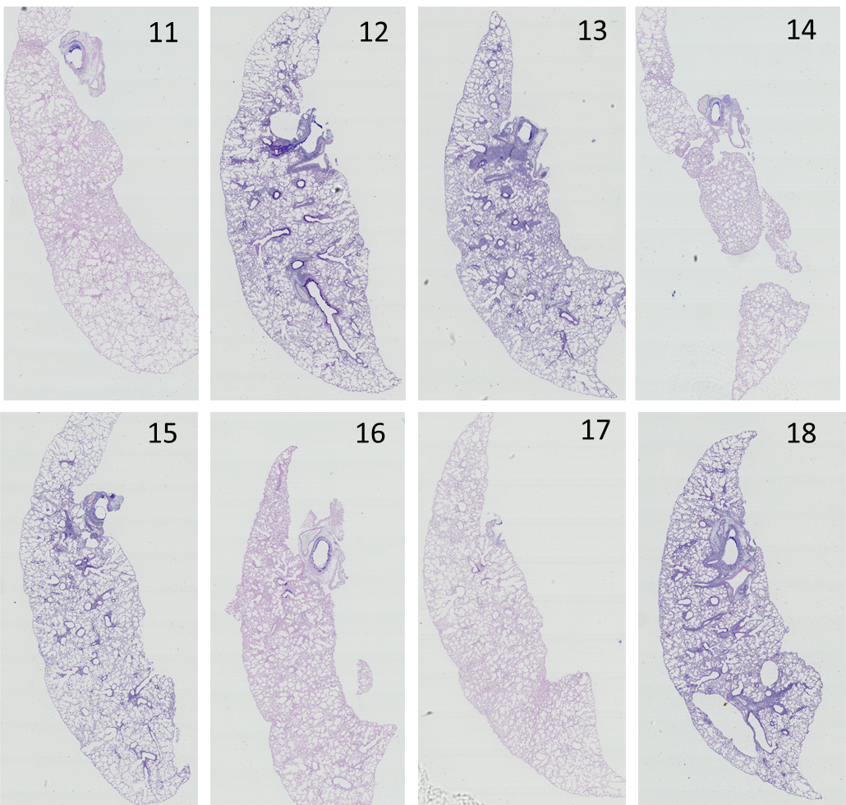
Supplementary Figure 9
AB/PAS
Vehicle/PBS
RCD405/PBS
Vehicle/OVA
RCD405/OVA
Supplemental Figure 9. Whole slide scans of murine lungs after AB/PAS staining. OVA-sensitized/PBS-challenged and treated with vehicle (Veh/PBS), OVA-sensitized/PBS challenged and treated with RCD405 (RCD405/PBS), OVA-sensitized/OVA-challenged and treated with vehicle (Veh/OVA), OVA-sensitized/OVA-challenged and treated with RCD405 (RCD405/OVA).

