Slide 1
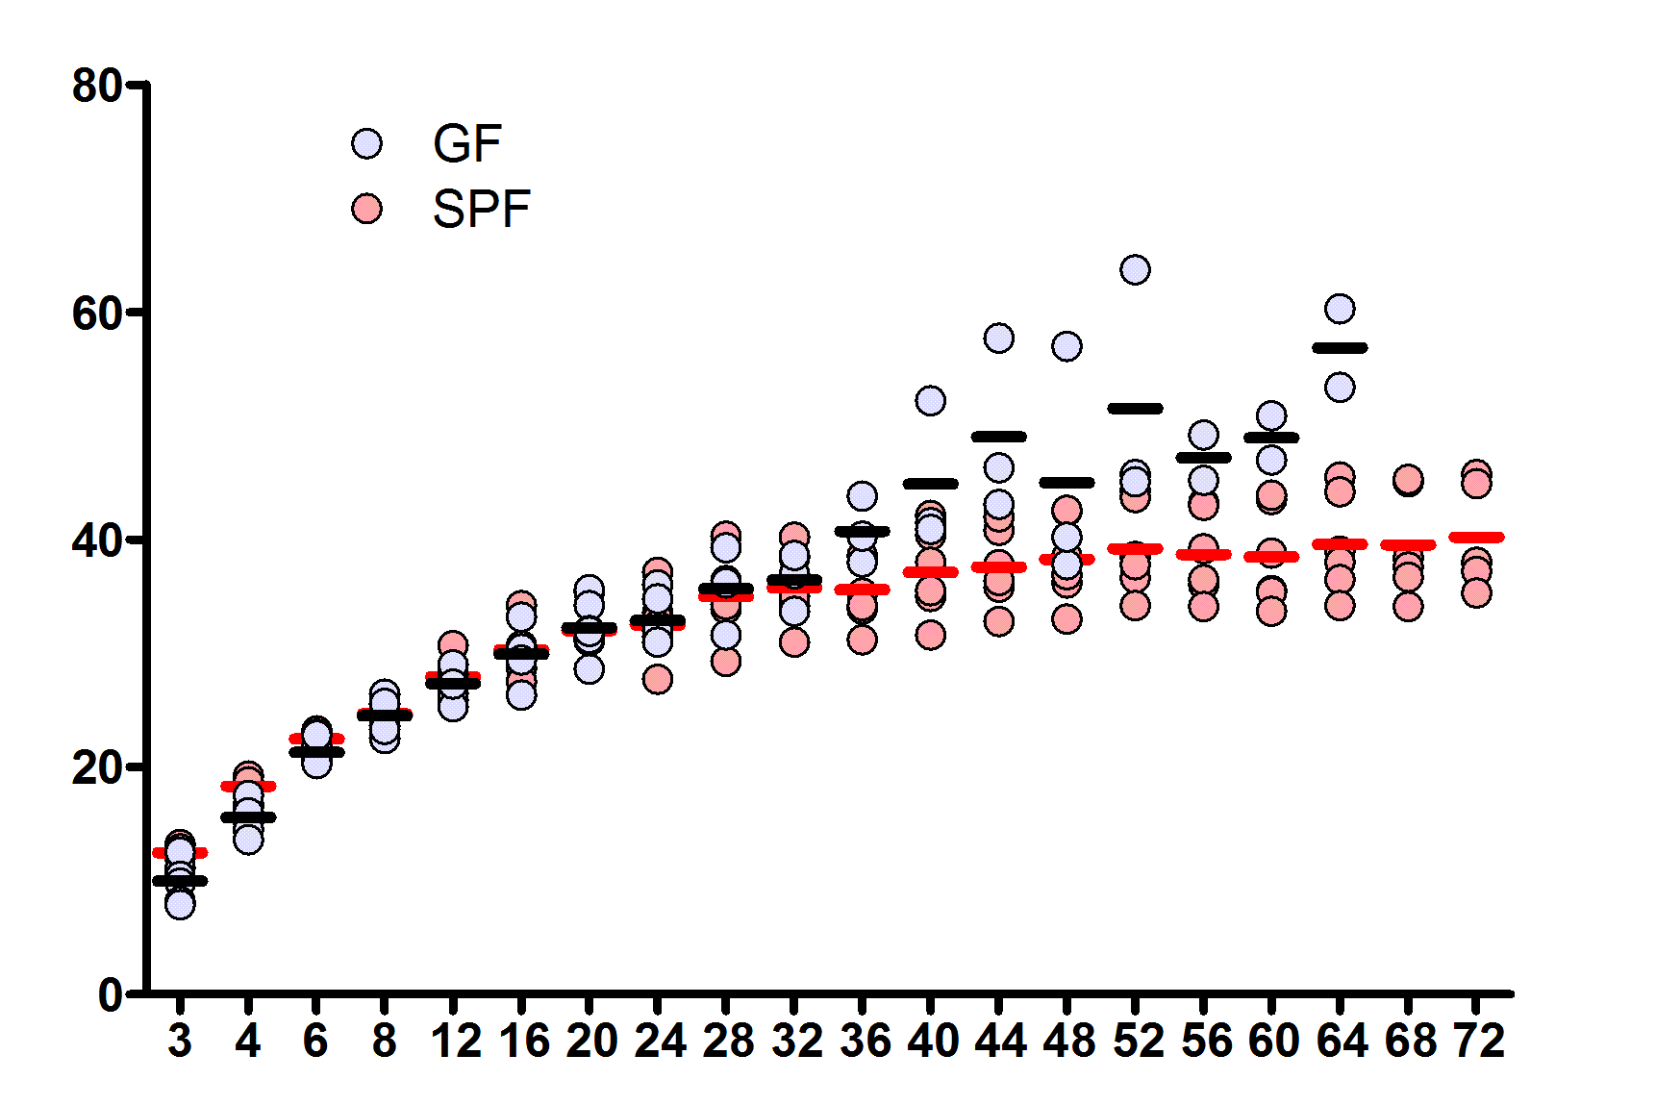
Body weight (g)
Age (weeks)
Supplementary Fig. 1. Body weight of GF and SPF mice during aging.
Body weight of GF and SPF mice was monitored throughout the indicated ages. Gray circles and red circles represent GF and SPF mice, respectively. The dots represent individual mice and the line within the dots is the mean value.

Slide 2
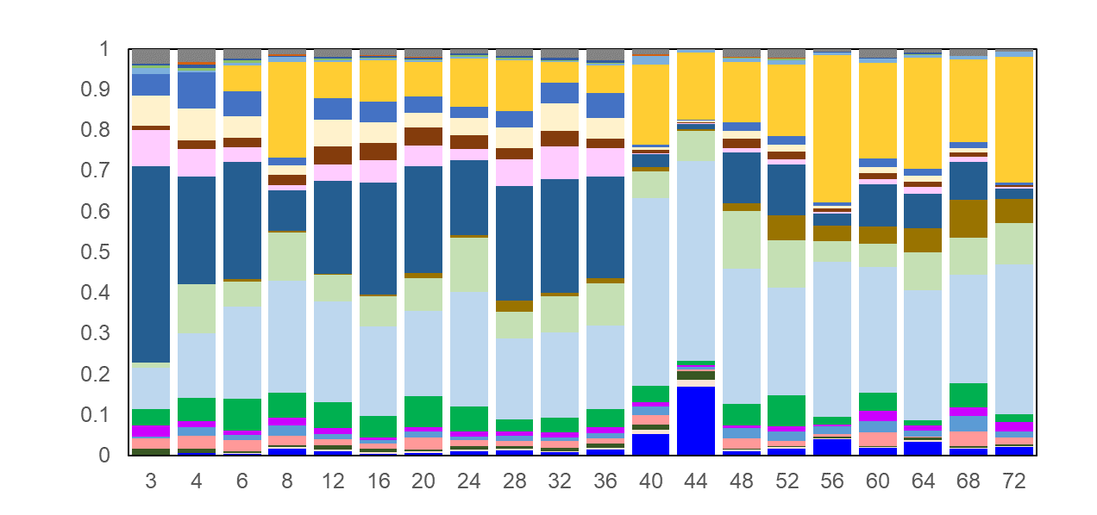
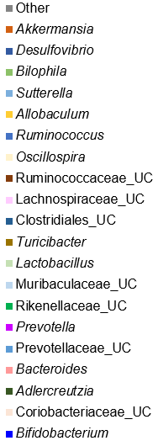
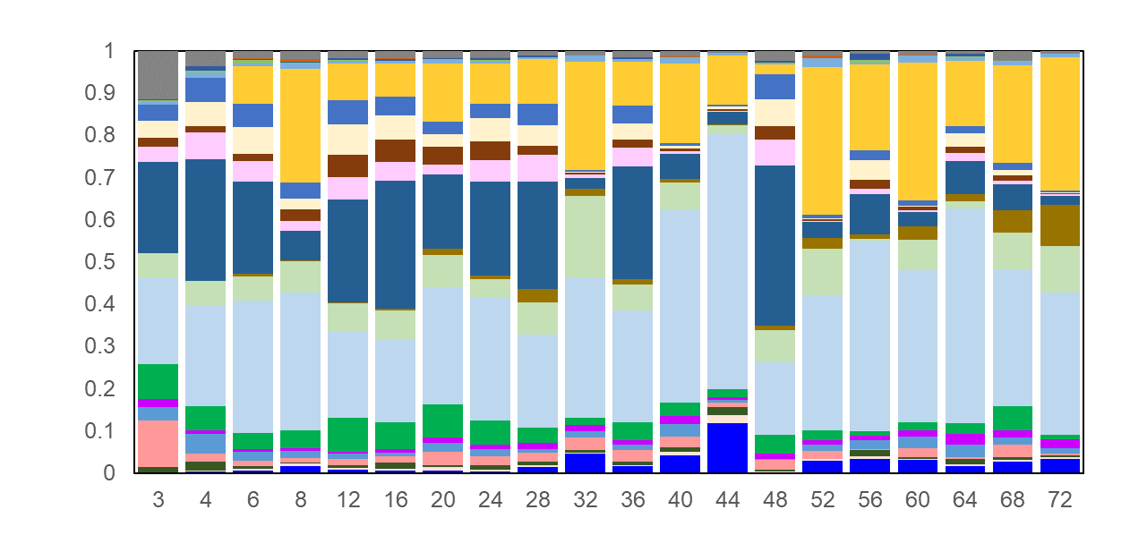
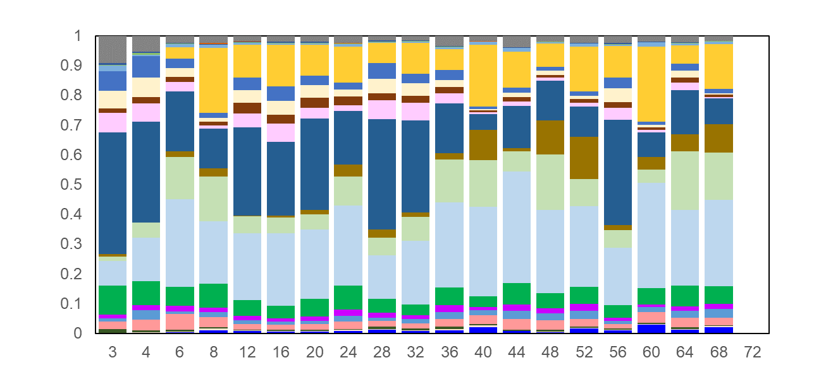
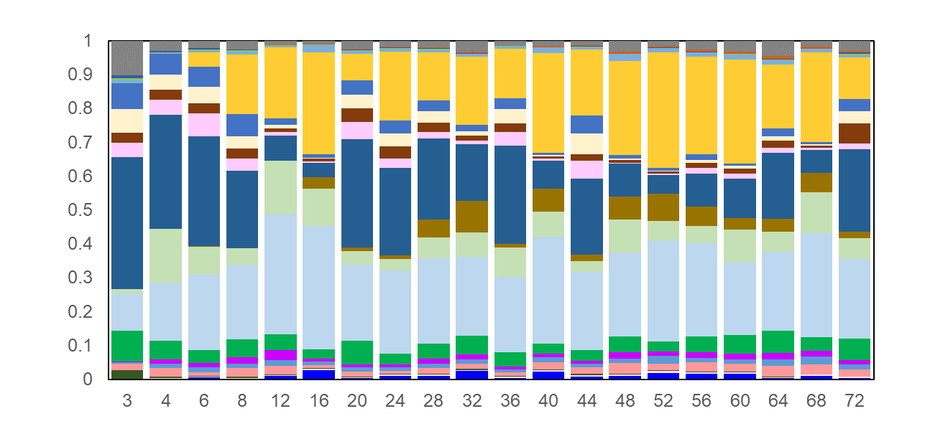
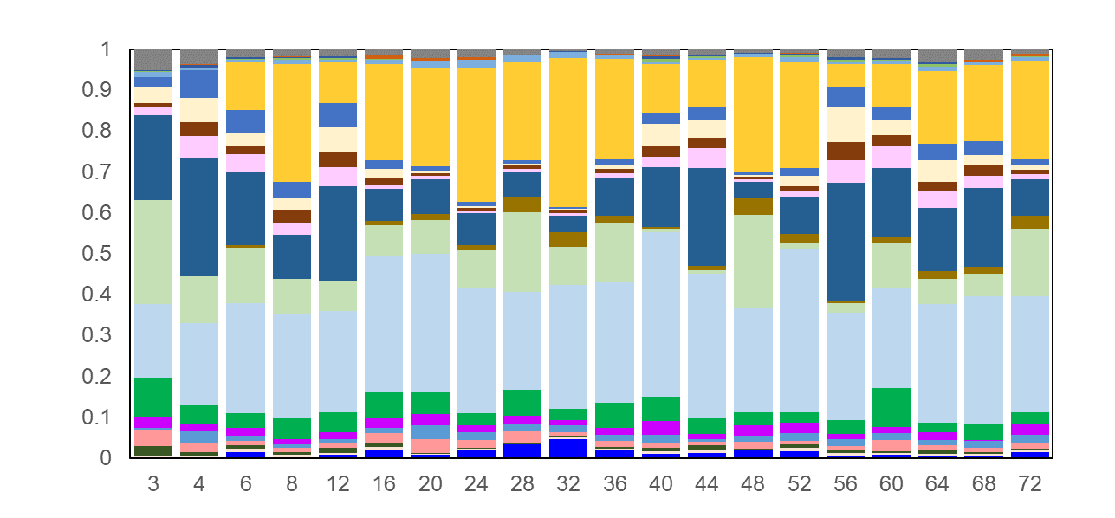
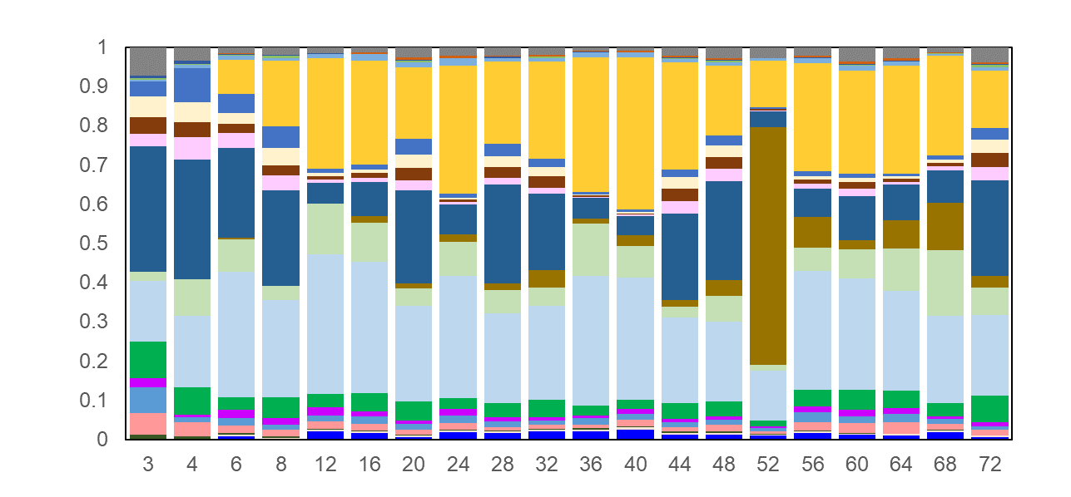
M1
M2
M3
Abundance of major genera
M4
M5
M6
Supplementary Fig. 2. Age-associated alterations in the fecal microbiota of individual SPF mice.
The distribution of genus-level taxa and relative abundance of fecal microbial communities in individual SPF mice. Values represent the average relative abundance across samples within the group at the indicated ages. Colors were assigned for the top 20 genera detected in total. M1 to M6 indicate the identification numbers of the mice.

Slide 3
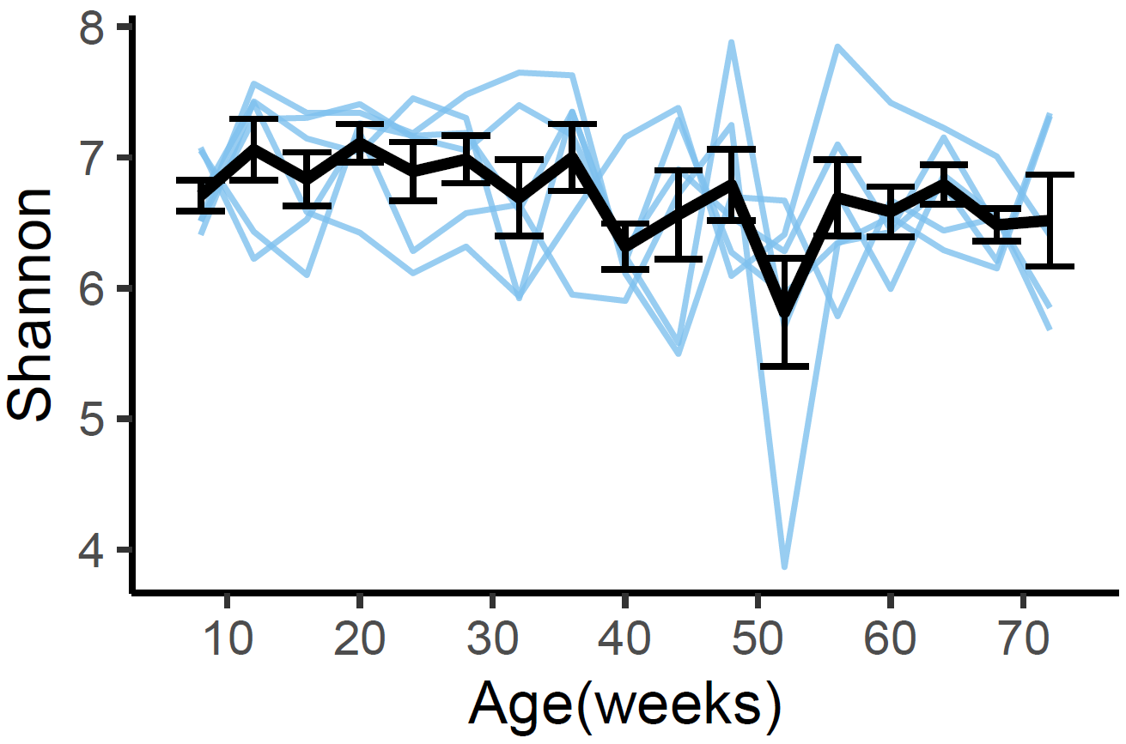
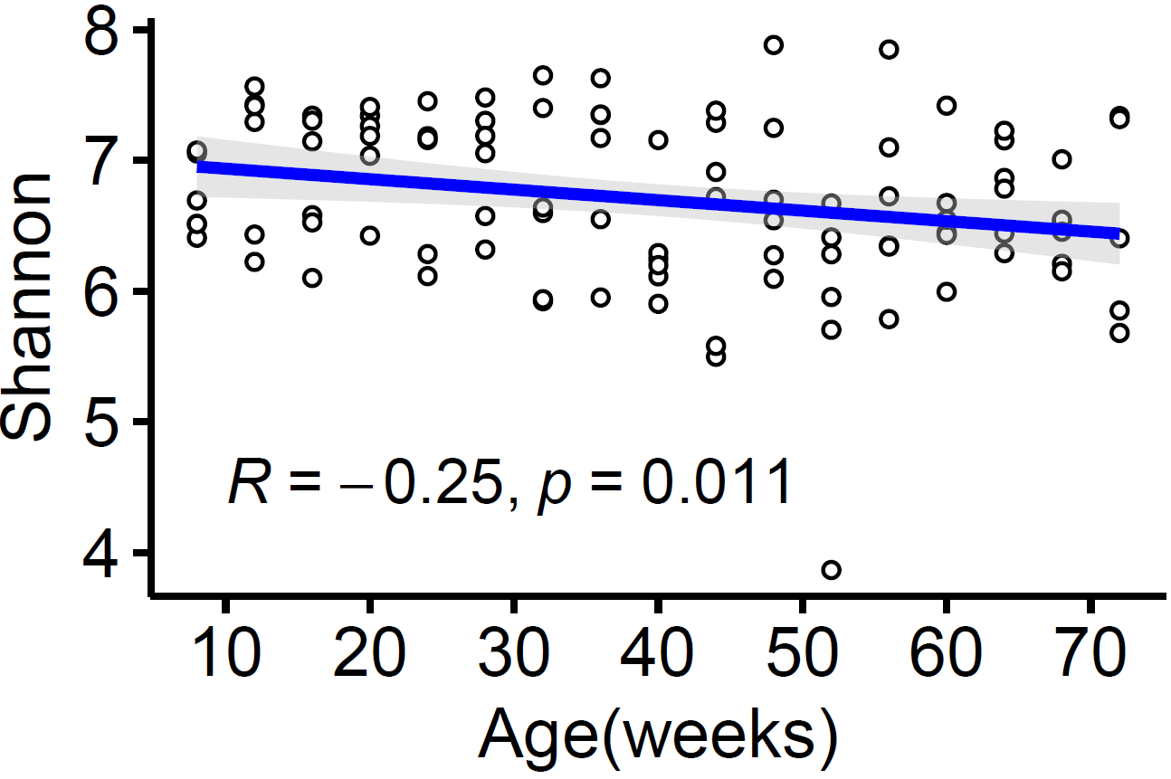
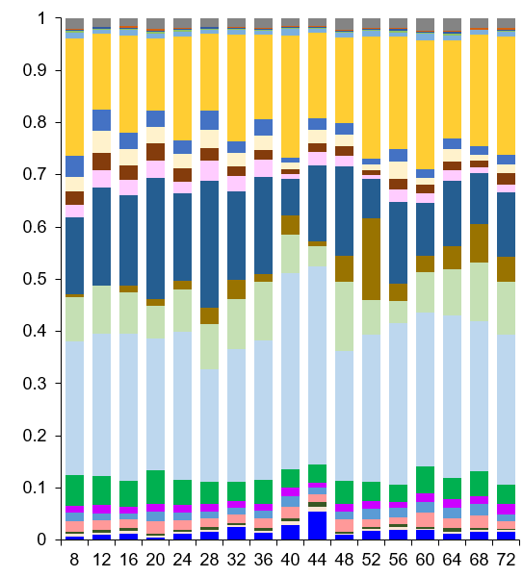
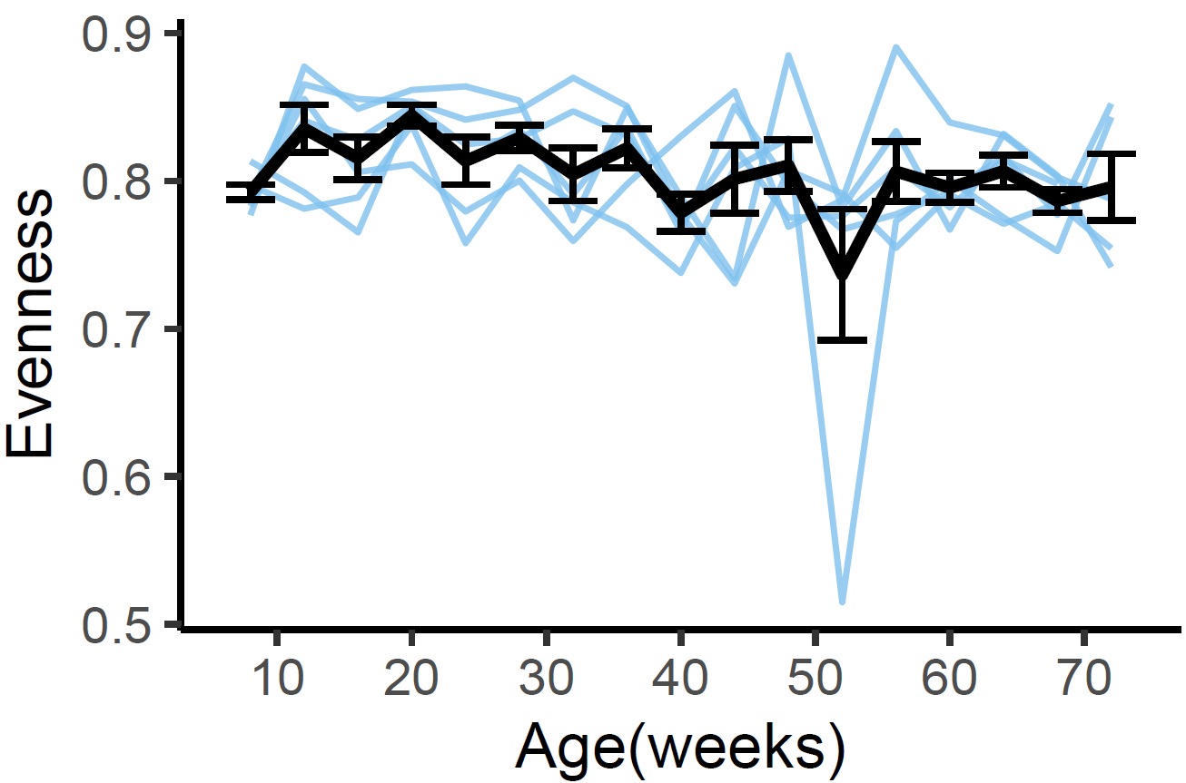
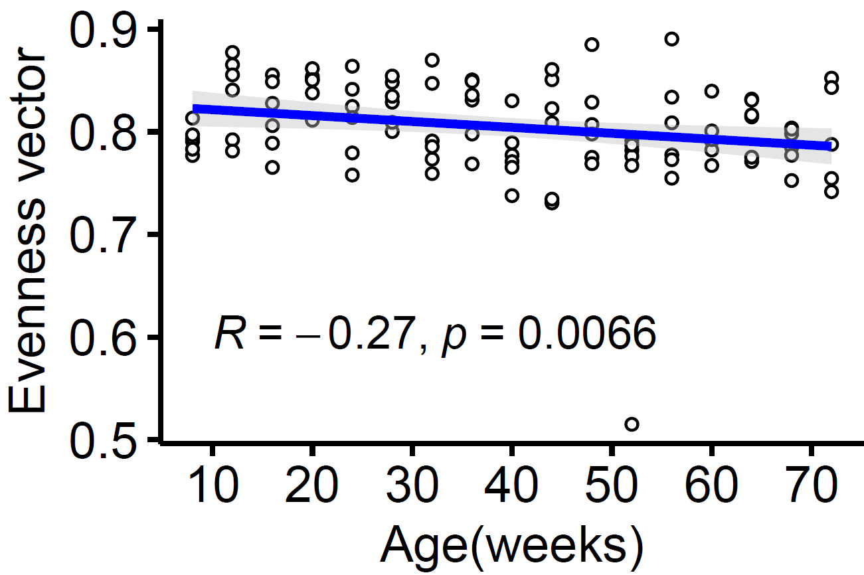
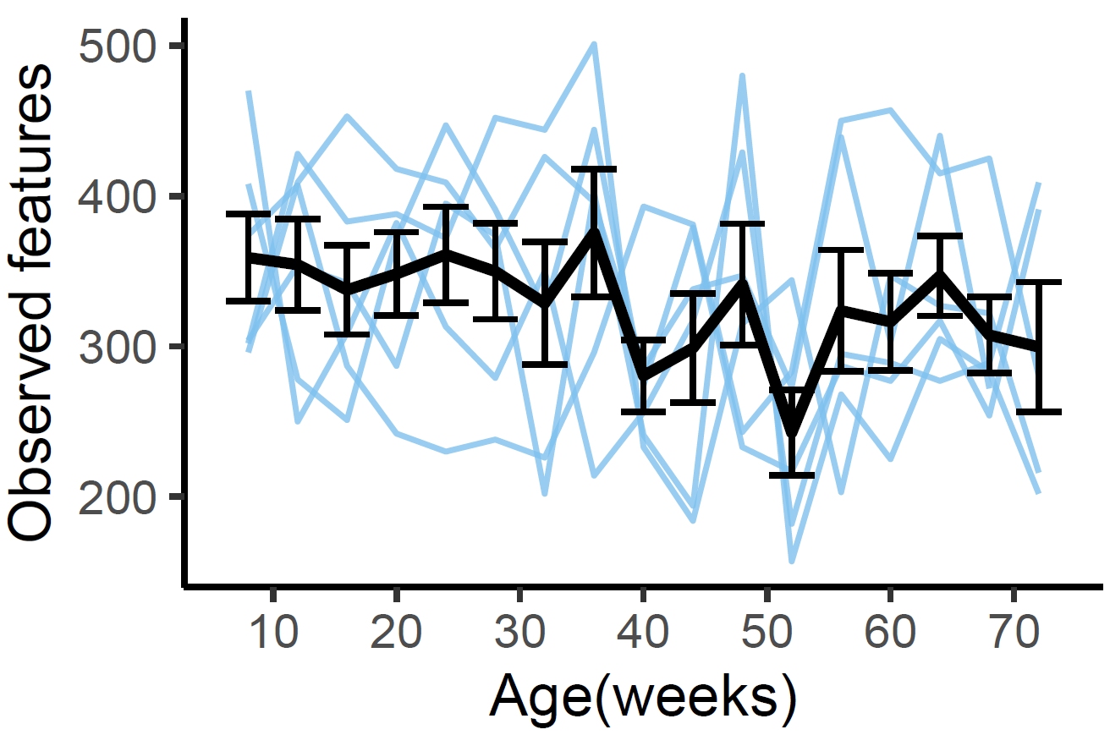
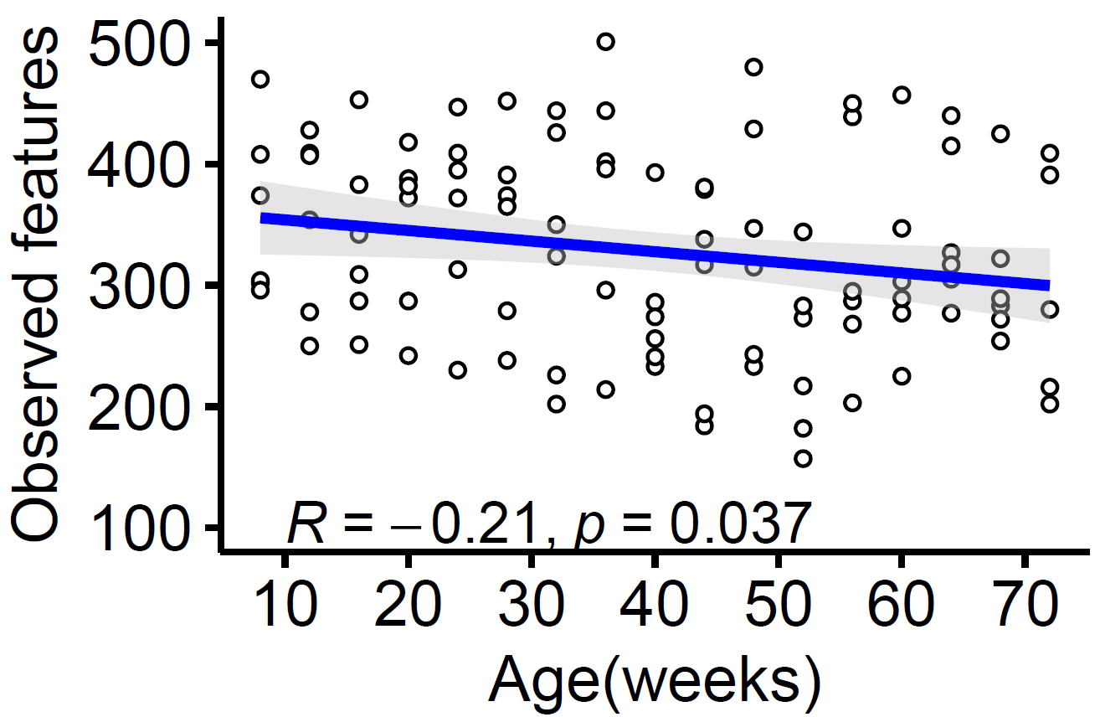
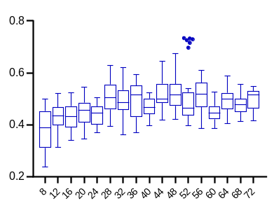
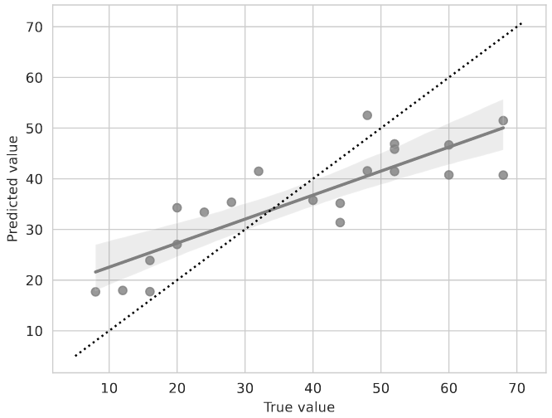
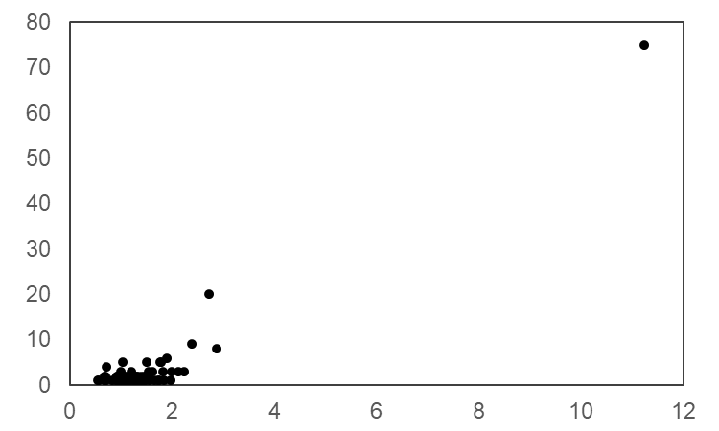
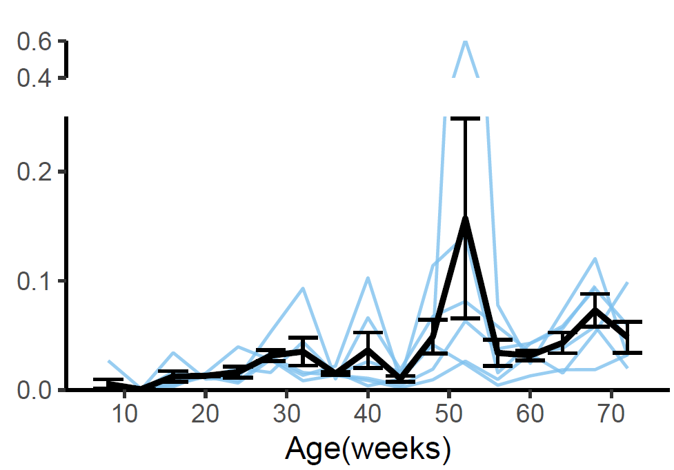
a
b
P = 0.0693
Abundance of major genera
P = 0.0220
Age (weeks)
c
P = 0.4159
PERMANOVA P<0.001
Age (weeks)
d
e
f
Turicibacter
R² = 0.72
P = 1.0E⁻⁰⁶
W
Turicibacter
Relative proportion of sequences
Clr
Supplementary Fig. 3. Age-associated alterations in the fecal microbiota from 8 to 72 weeks in SPF mice.
Left graph shows line plots of Shannon, evenness vector, and observed features of alpha-diversity (a). Bold line indicates mean and standard deviation at each week of age. Differences across time points were assessed with a repeated measures mixed-effects model. Right graph shows the correlation between alpha-diversity of fecal microbiota and age in SPF mice. Spearman’s coefficients (R) and P values are described in the graph. The line and grey zone show linear regression with 95% confidence interval. The distribution of genus-level taxa and relative abundance of fecal microbial communities in SPF mice (b). Values represent the average relative abundance across samples within the group at the indicated ages. Colors were assigned for the top 20 genera detected in total sequences. The distance of Bray-Curtis dissimilarity to the data of 8 weeks-old SPF mice (c). The data are presented as Tukey box plots. Statistical differences among age groups in SPF mice are evaluated by PERMANOVA. The result of accuracy displays the predictive accuracy of the regression model (d). Differentially abundant microbial genus-level taxa identified by ANCOM (e). The W value represents the strength of the ANCOM test for the tested number of taxa. The x-axis value represents the clr (centered log ratio) transformed mean difference in abundance of a given taxa between age groups. The taxa with reject null-hypothesis >70% are labelled. Line plots of the genera of Turicibacter selected by ANCOM (f). Bold line indicates mean and standard deviation at each week of age.

Slide 4
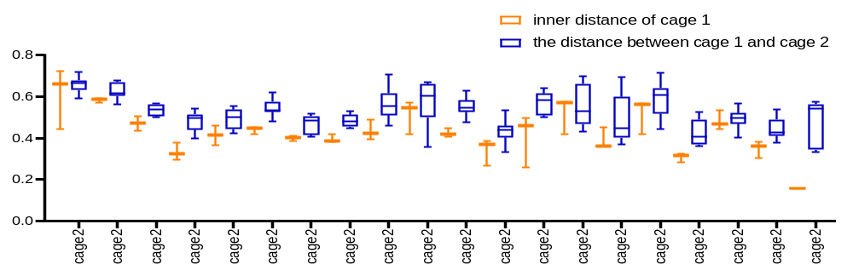
Distance
3 4 6 8 12 16 20 24 28 32 36 40 44 48 52 56 60 64 68 72
Age (weeks)
Supplementary Fig. 4. Evaluation of the cage effect by Bray-Curtis distance
We monitored 6 SPF mice, which were numbered M1 to M6. M1 to M3 mice were housed in cage 1, and M4 to M6 mice were housed in cage 2. The inner distance of cage 1 and the distance between cage 1 and cage 2 were analyzed using the distance of Bray-Curtis dissimilarity at each age in weeks. The data are presented as max-min box plots. Statistical differences among cage groups were evaluated by PERMANOVA. There were no significant differences between cage 1 and cage 2 at any of the time points.

Slide 5
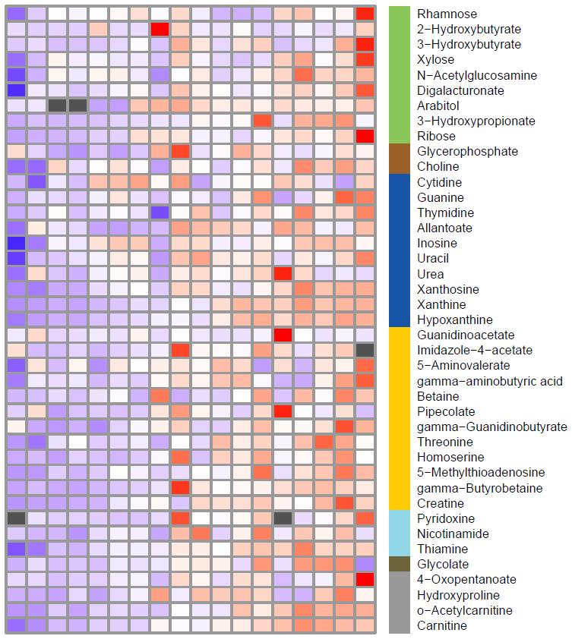
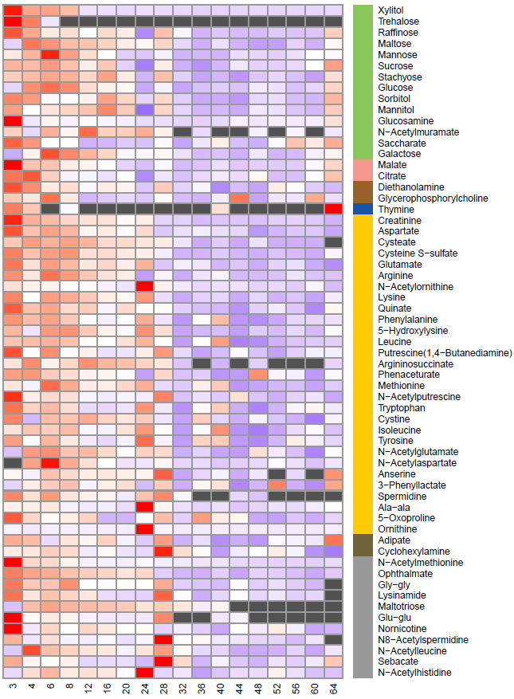
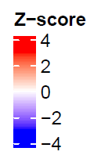
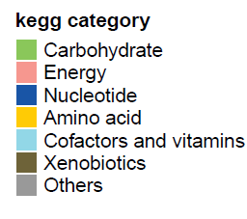
Positively correlated with age
Negatively correlated with age
Supplementary Fig. 5. A Heatmap of fecal metabolites significantly correlated with age in GF mice.
Columns correspond to the samples at different ages (in weeks); rows correspond to metabolites that were significantly correlated with age and separated by positive or negative correlation. The colors (red to blue) indicate the z-score values calculated at each week of age using the average of each age group of mice (n = 2-6).

Slide 6
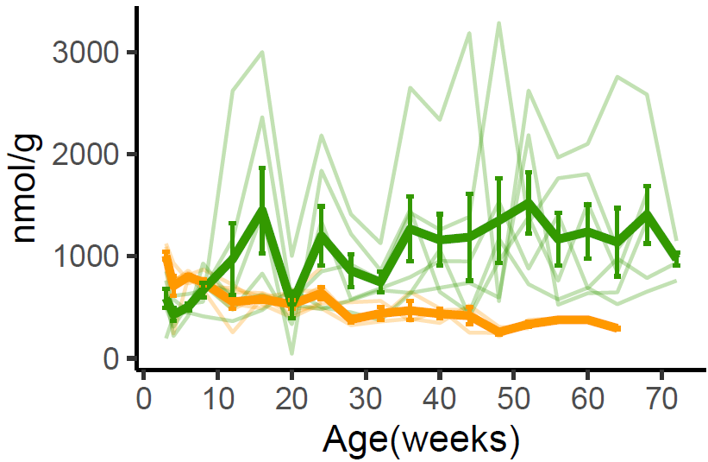
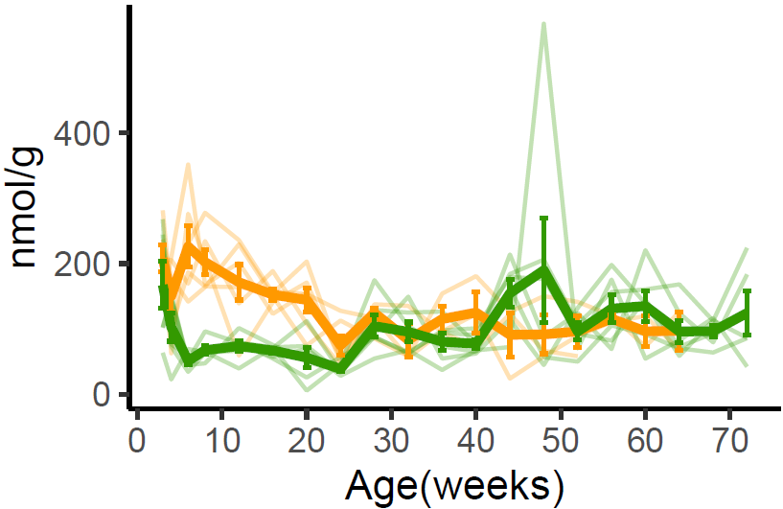
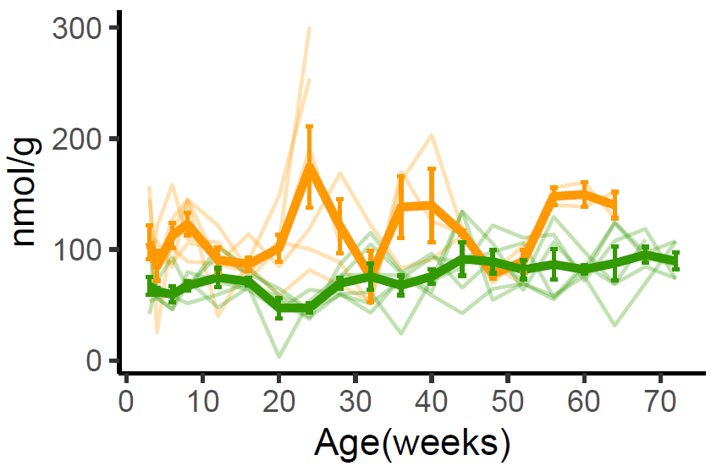
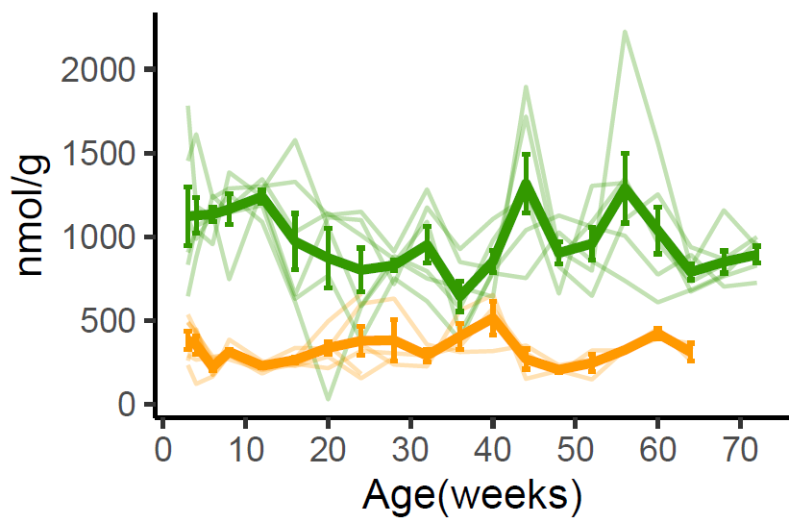
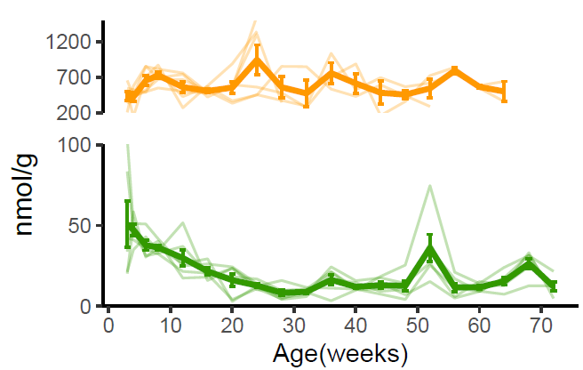
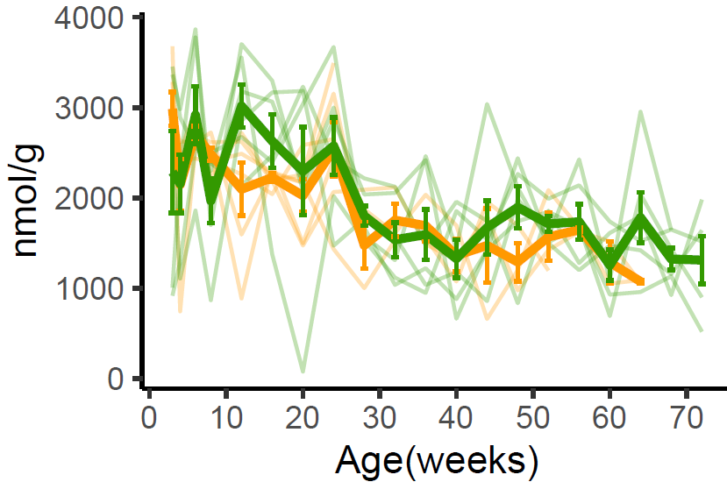
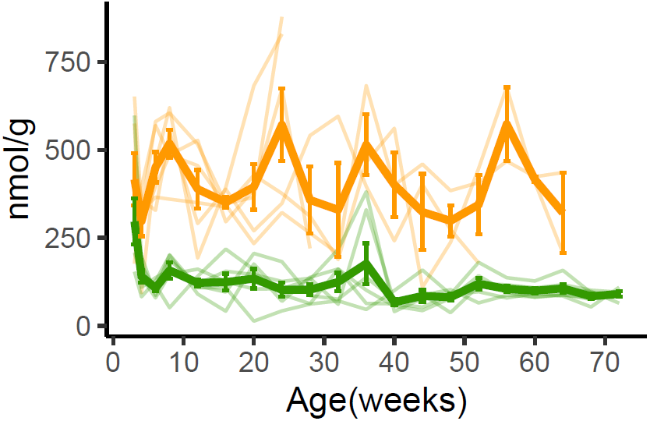
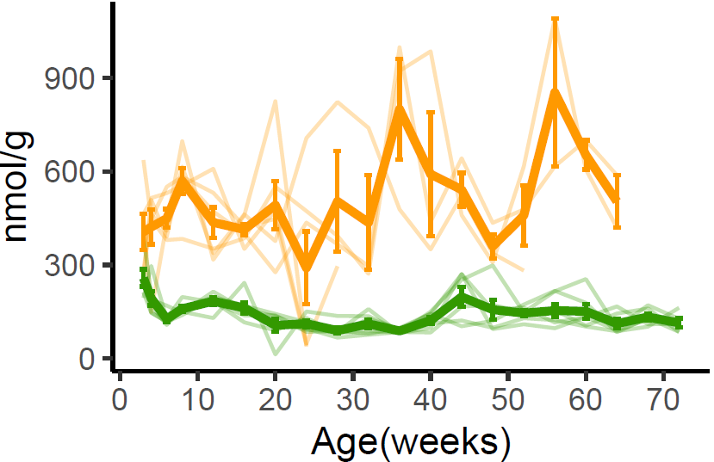
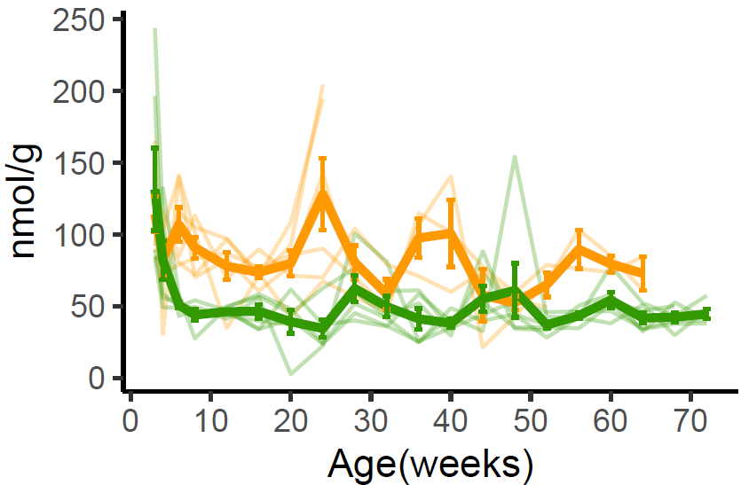
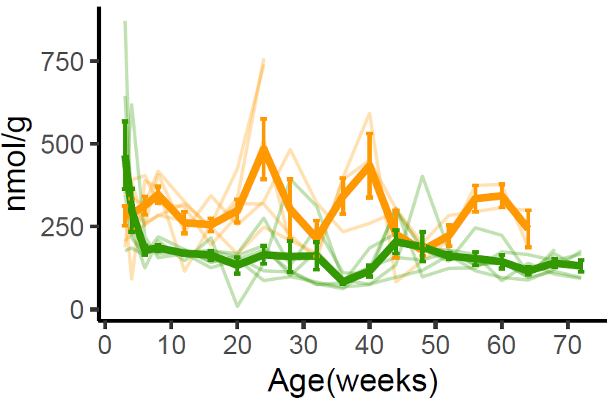
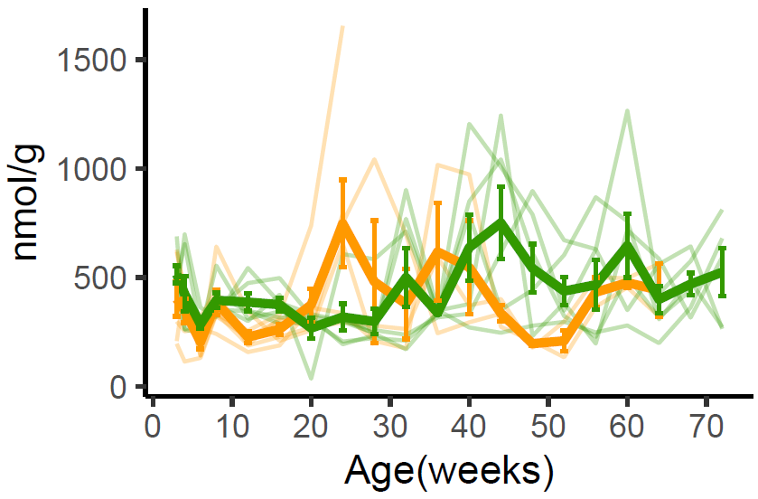
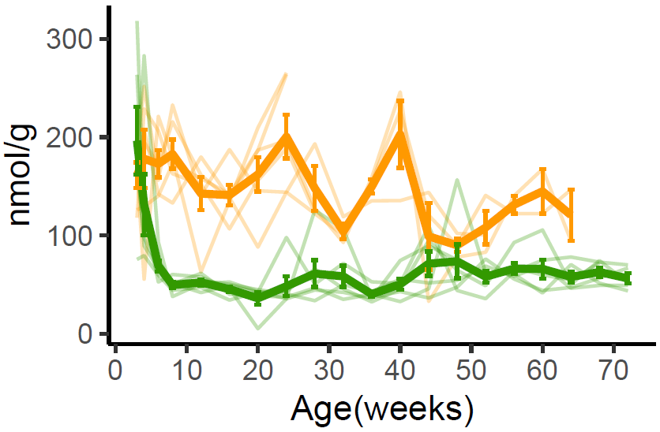
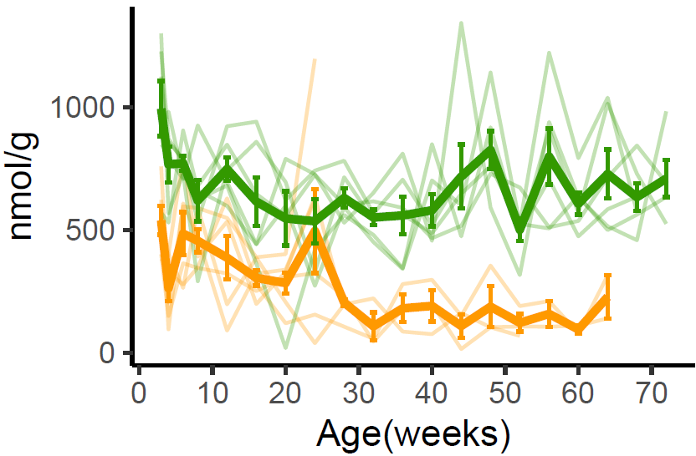
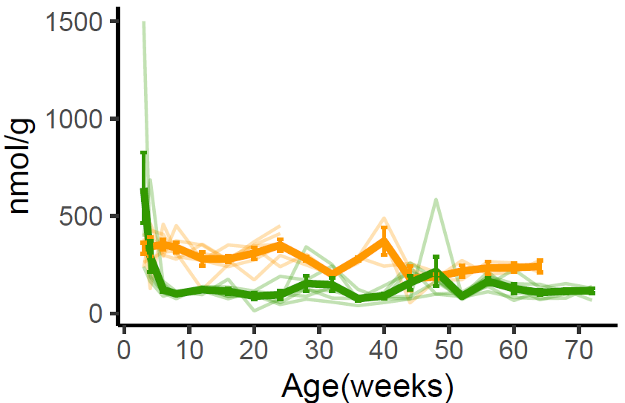
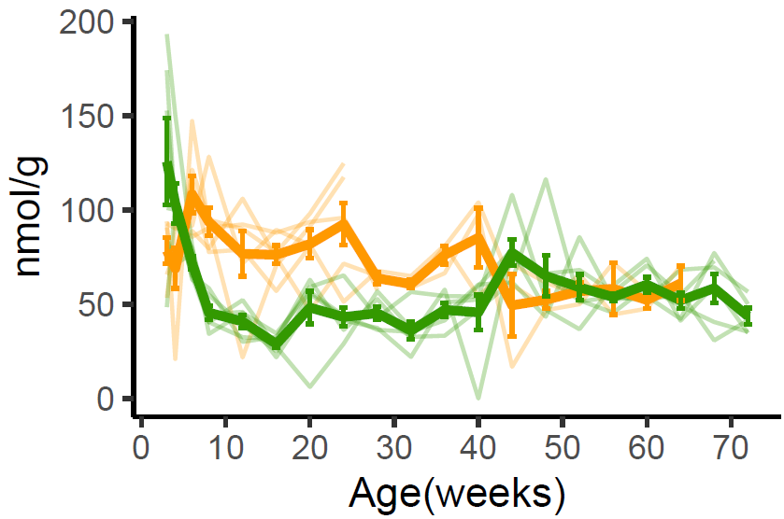
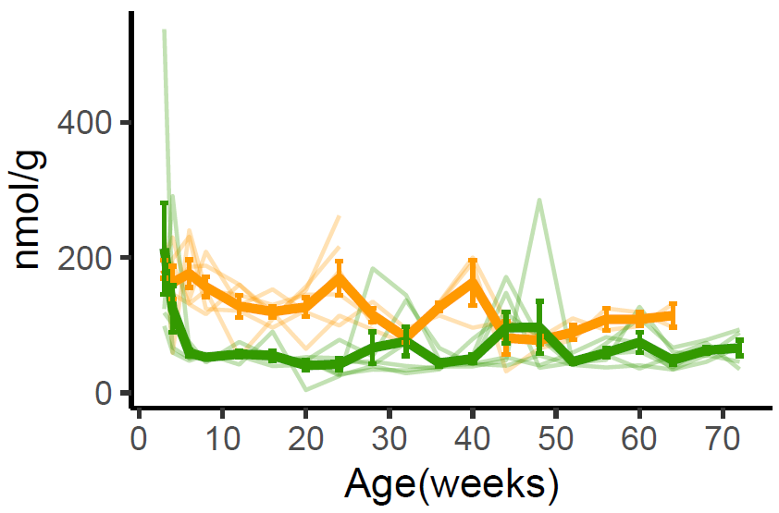
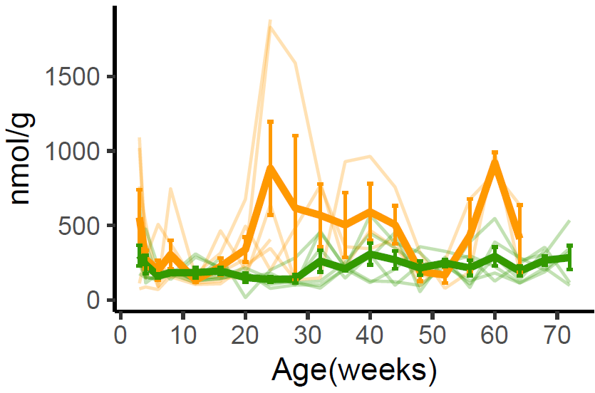
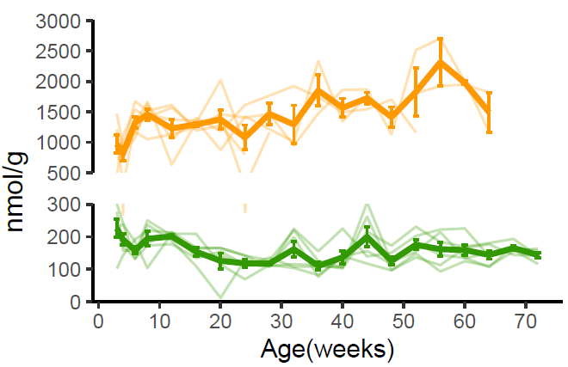
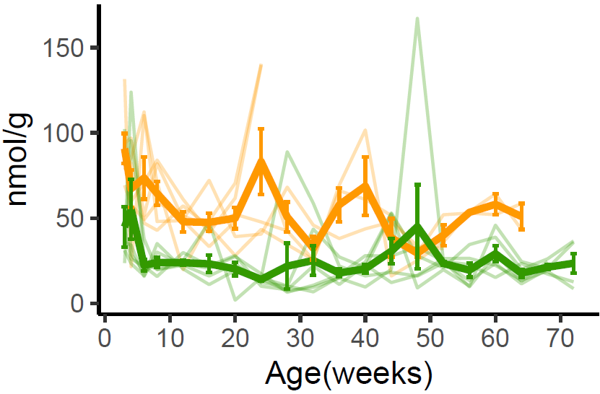
a. positively correlated with age
Histidine
Aspartate
Arginine
－ GF
－ SPF
b. negatively correlated with age
Alanine
Asparagine
Glutamate
Glutamine
Serine
Tyrosine
Valine
c. no correlation with age
Glycine
Isoleucine
Lysine
Leucine
Methionine
Proline
Phenylalanine
Threonine
Tryptophan
Supplementary Fig. 6. Concentration of fecal amino acids in GF and SPF mice.
The concentrations of fecal amino acids that were significantly positively (a) or negatively (b) correlated with the age in SPF mice. Fecal amino acids with no significant correlation with age are shown in (c). Bold lines indicate mean and standard deviation at each week of age.

Slide 7
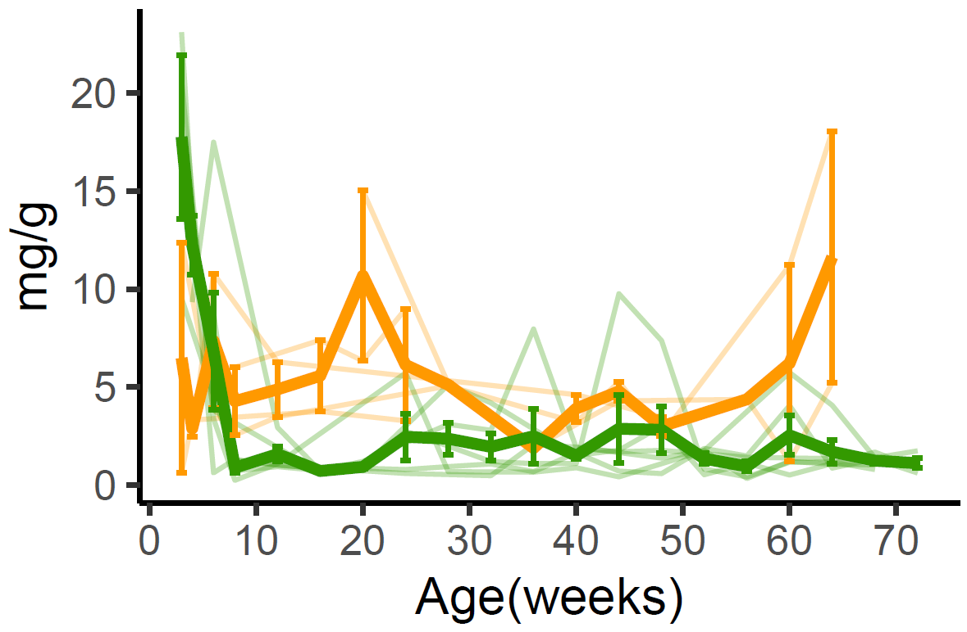
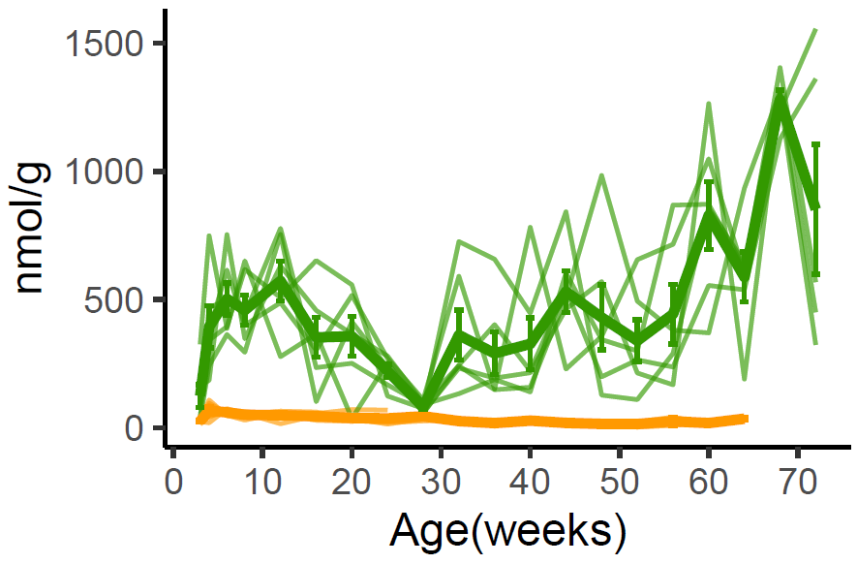
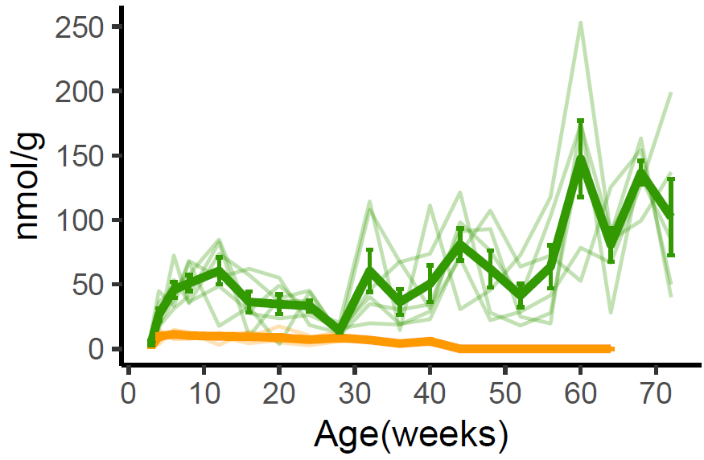
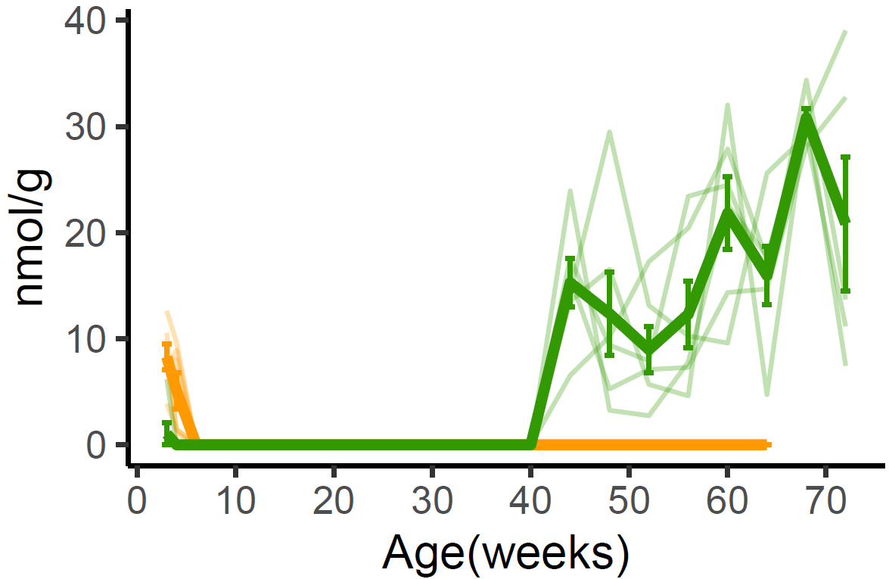
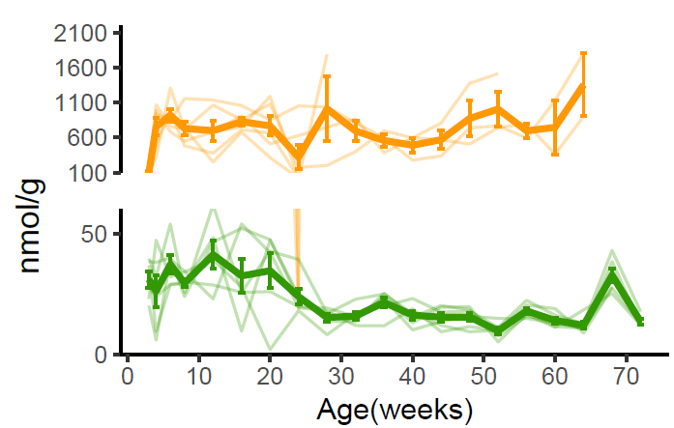
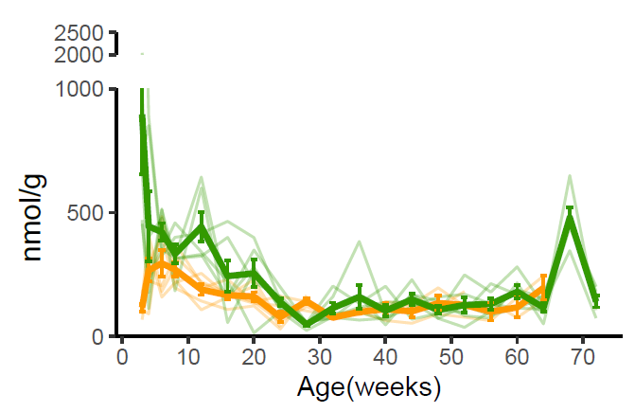
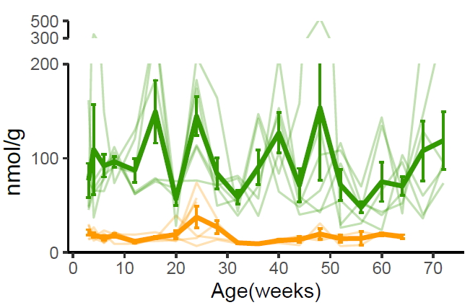







Starch
Maltose
Maltotriose
－ GF
－ SPF
Trehalose
Fructose
Glucose
Succinate
Sucrose
Pyruvate
Lactate
Propionate
Acetyl-CoA
Butyrate
Citrate
Oxaloacetate
Isocitrate
Malate
Oxalosuccinate
TCA cycle
2-Oxo-glutarate
Fumarate
Succinyl-CoA
Succinate
Supplementary Fig. 7. Age-related changes of fecal metabolites in sugar and energy metabolic pathways
Metabolites highlighted in red or blue show significantly positive or negative correlation with age, respectively.

Slide 8




a
M4, 44 weeks
b
M4, 44 weeks
M4, 44 weeks
c
M4, 44 weeks
M4, 44 weeks
Supplementary Fig. 8. The outlier in the plasma metabolome data of SPF mice.
PCA score plots of plasma metabolites of SPF mice (a). Each symbol represents the mean principal component (PC) score from all of the individual mice. The colors indicate the age of mice in weeks. The histogram and normal Q-Q plot of PC1 (b) and PC2 (c) scores indicate that mouse number 4 at 44 weeks is an outlier.

Slide 9


Positively correlated with age
Negatively correlated with age
Supplementary Fig. 9. A heatmap of plasma metabolites significantly correlated with age in GF mice.
Columns correspond to the samples of different ages (in weeks); rows correspond to metabolites that were significantly correlated with age and separated by positive or negative correlation. The colors (red to blue) indicate the z-score values calculated at each week of age using the average of each age group of mice (n = 2-6).

Slide 10



















a. positively correlated with age
Arginine
Asparagine
Aspartate
Glutamine
－ GF
－ SPF
Glutamate
Glycine
Histidine
Isoleucine
Leucine
Phenylalanine
Proline
Threonine
Tryptophan
Tyrosine
Valine
b. no correlation with age
Alanine
Lysine
Methionine
Serine
Supplementary Fig. 10 Concentration of plasma amino acids in GF and SPF mice.
The concentration of plasma amino acids in SPF mice that were significantly positively correlated with age (a). Plasma amino acids with no significant correlation with age are shown in (b). Bold line indicates mean and standard deviation at each week of age.

Slide 11







a
b
R = 0.7816, P < 0.001
R = 0.3442, P < 0.001
(weeks)
c
R = 0.353, P < 0.001
Supplementary Fig. 11 Scatter plots of generalized Procrustes analysis coordinates of Bray-Curtis dissimilarity and fecal metabolome and plasma metabolome
Procrustes analysis between Bray-Curtis dissimilarity and fecal metabolome (a), Bray-Curtis dissimilarity and plasma metabolome (b), and fecal metabolome and plasma metabolome (c) , respectively. The data are color coded by weeks of age. Each line connects the microbiome and metabolome data from individual mice. The R value reflects the correlation between the two ordination results. Significant correlations (P < 0.001, 999 permutations) were detected in all comparisons.

Slide 12












a
b
c
SSE
d
Number of clusters
Number of clusters
Number of clusters
PCo1
PCo2
PCo3
e
Age (weeks)
Age (weeks)
Age (weeks)
PC1
PC2
PC3
f
Age (weeks)
Age (weeks)
Age (weeks)
PC1
PC2
PC3
Age (weeks)
Age (weeks)
Age (weeks)
Supplementary Fig. 12. The break points of age-related changes in the fecal microbiome and metabolome.
Change point analysis (CPA) determined the break points of age-related changes in the fecal microbiome and fecal and plasma metabolome. The plots of sum of squared error (SSE) versus number of clusters for (a) fecal microbiome using scores of principal coordinate (PCo) 1 to 3 of Bray Curtis distance and (b) fecal and (c) plasma metabolome using scores of principal component (PC) 1 to 3. Data are shown as mean and standard deviation. Dot plots for scores of (d) PCo 1 to 3 of Bray-Curtis distance and PC 1 to 3 from (e) fecal metabolome and (f) plasma metabolome are plotted (data shown for 5 to 6 mice/time point). The dots indicate individual mice. Blue bar indicates the mean. The colored bars on the graph show clusters based on the entropy.

Slide 13



a
Allobaculum
Turicibacter
Ruminococcus
Family_Desulfovibrionaceae_unclasiified genus
AF12
Candidatus Arthromitus
Lactobacillus
Bifidobacterium
Order_Clostridiales_unclasiified genus
Family_F16_unclasiified genus
b
Lysinamide
Trehalose
Betaine
4-Oxopentanoate
O-Hydroxybenzoate
5-Aminolevulinate
Guanine
Tryptamine
Sucrose
Methionine
b
c
Benzoate
Xanthosine
Ectoine
Terephthalate
Hydroxyproline
Acetohydroxamate
Creatinine
Urate
Citramalate
Citraconate
Supplementary Fig. 13. Variable importance determined by the random forest analysis
Top 10 ranking feature variables selected by Random Forest and their mean decrease in Gini measure in discriminating the age-related break points in (a) the fecal microbiome metabolome, (b) the fecal metabolome, and (c) plasma metabolome.

Slide 14






a
b
Young SPF mice
Transplant
Young GF mice
ND
Body weight gain (%)
Aged SPF mice
Young GF mice
ND
-1 0 1 2 3 4
(weeks)
c
d
After ND feeding (day)
Glucose levels (mg/dl)
AUC
Time (min)
Young
into GF
Aged
into GF
f
e
Shannon index
Abundance of major genera
Aged
Aged
Aged
Young
Aged
Aged
Aged
Young
Young
Week after ND feeding
Young
Young
Young
Injection
0 1 2 3 4
Week after ND feeding
Supplementary Fig. 14. Body weight and fecal microbiota of recipient mice fed a normal diet
Schematic overview of fecal microbiota transplantation from young and aged SPF fecal microbiota into young GF mice (a). Body weight gain of recipient mice transplanted with young fecal microbiota (gray, n=3) and aged fecal microbiota (orange, n=5) and fed a normal diet (ND) for a month (b). OGTT glucose levels and area under the curve (AUC) of OGTT at 4 weeks after ND feeding (c and d). Fecal microbiota were analyzed by 16S rRNA gene sequencing (OTU cutoff, 97%) (e and f). Shannon diversity is shown for each recipient mouse for one month after ND feeding (e). The distribution of genus-level taxa and relative abundance of fecal microbial communities in recipient mice at 2 months after ND feeding (f). Values represent the average relative abundance across samples within the group at the indicated age ranges. Colors are assigned for the top 20 genera detected in total sequences with a relative abundance >1% in at least 75% of subjects. All data are presented as mean values ± SD and compared by using the two-way repeated ANOVA followed by the Benjamini and Hochberg method (b, c and e). The data in (d) were compared by using a t test with Welch’s correlation: **P < 0.01.

Slide 15


a
P = 0.30
P = 0.48
b
P = 0.31
Insulin levels (ng/ml)
WAT weight (g)
Aged into GF
Young into GF
Aged into GF
Young into GF
Young into GF
Aged into GF
Fasting
Feeding
Supplementary Fig. 15. Insulin levels and epididymal white adipose tissue weight in recipient mice transplanted with fecal microbiota.
Plasma insulin levels at fasting and feeding (a) and epididymal white adipose tissue (WAT) weight (b) of recipient mice transplanted with young and aged fecal microbiota at 4 weeks after HFD feeding. The data were compared by using a t test with Welch’s correlation.

Slide 16











a. Liver
Il-1β
Tnfα
Mcp-1
Lbp
Relative expression/Actb
b. WAT
Il-1β
Tnfα
Mcp-1
Relative expression/Actb
c. Small intestine
Il-1β
Tnfα
Mcp-1
P=0.061
Relative expression/Actb
Supplementary Fig. 16. Relative expression of inflammatory gene mRNA transcripts.
The expression level of inflammatory gene mRNA was analyzed by qPCR in liver tissue (a), epididymal white adipose tissues (WAT) (b) and small intestine (c) of recipient mice transplanted with young and aged fecal microbiota at 4 weeks after ND or HFD feeding. All data are presented as mean± SD and compared by using the one-way ANOVA followed by the Benjamini and Hochberg method.

