Slide 1
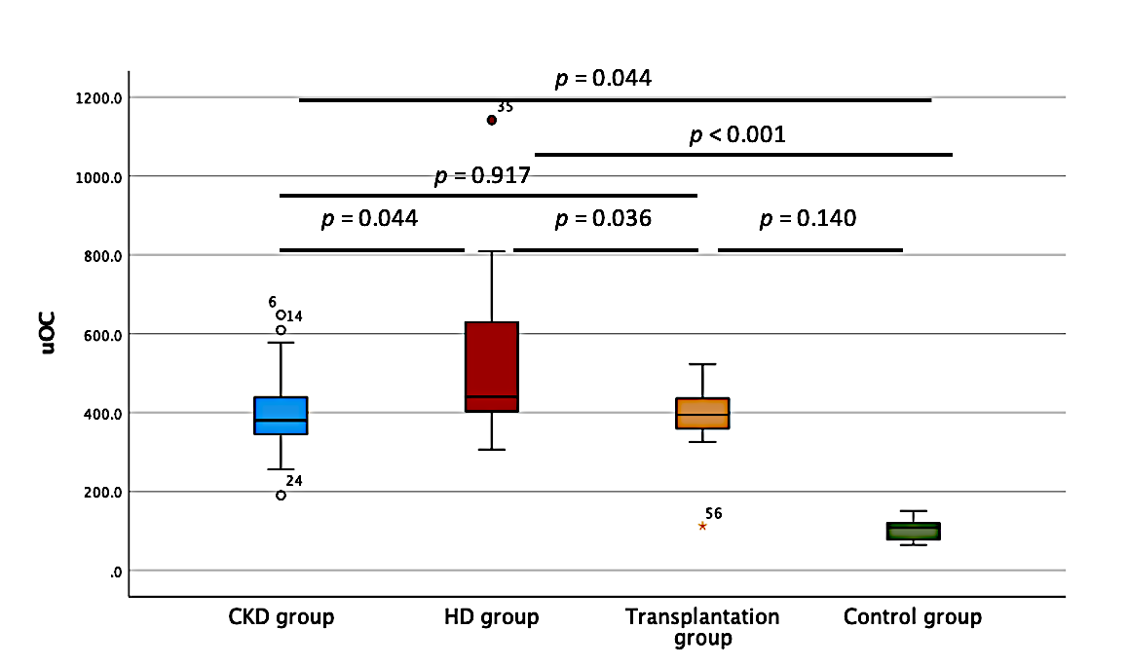
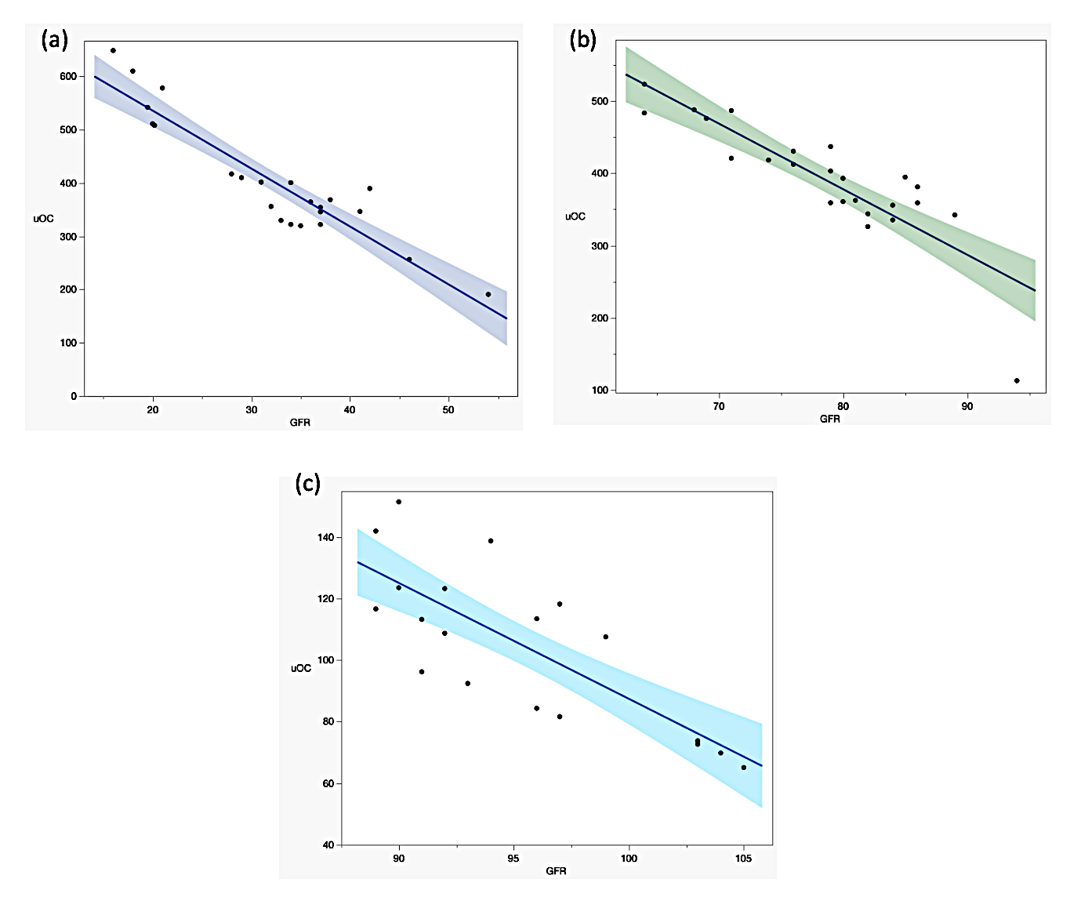
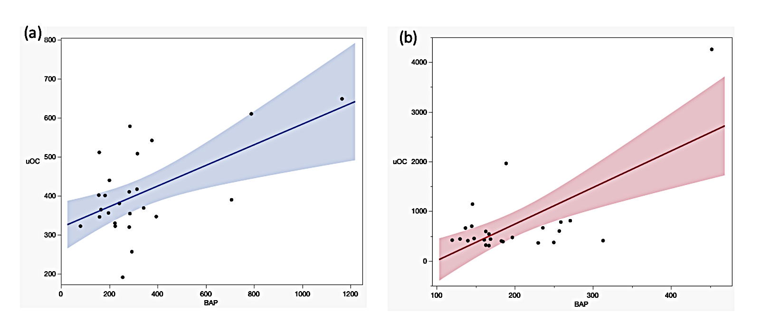
Assessment of Vitamin K 2 Status in Children with CKD
Objectives: To investigate vitamin K2 status in CKD children, and its relation to bone turnover by measuring BAP
CKD without KRT
CKD- G5D
Tx. recipients
Control
uOC in the different studied groups
Nutritional assessment of vit. K
and others
Measurement of uOC, BAP, Ca, P,
PTH and others
Correlations between uOC and GFR in (a) CKD group, (b) Transplantation group and (c) control group
Correlations between uOC and BAP in (a) CKD group and (b) HD group
Conclusion:
- High uOC levels were observed in CKD children and correlated with eGFR.
- uOC exhibited a notable association with heightened bone turnover status, as indicated by BAP levels
Sawires H. et al. 2023

