Slide 1
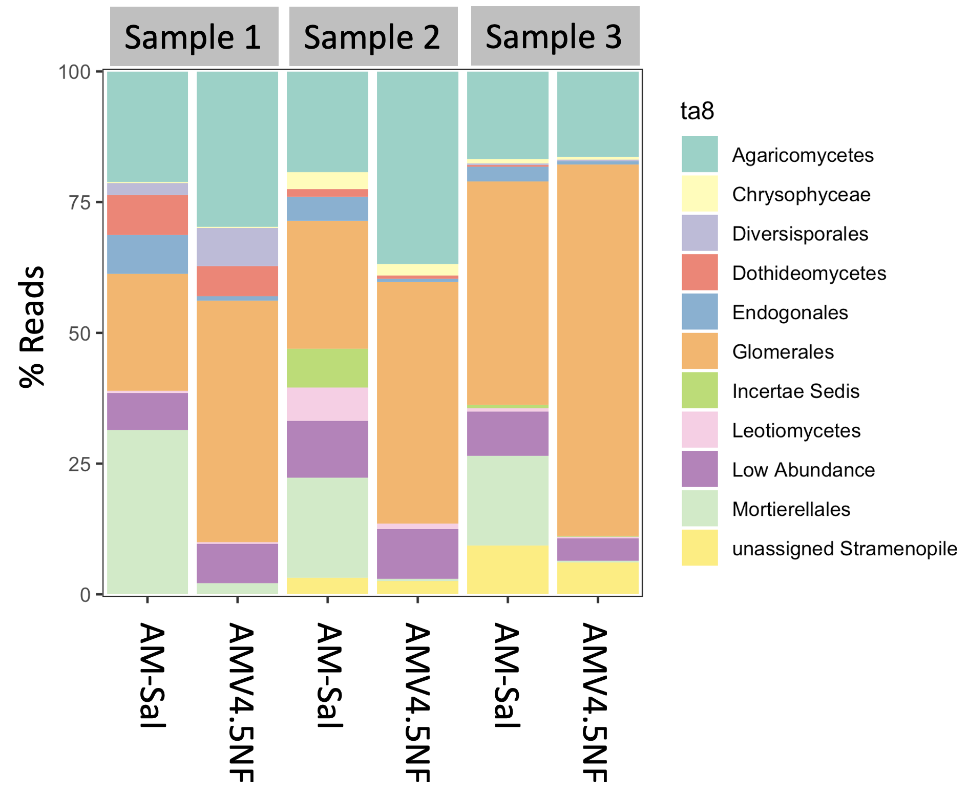
Fig. S1 Comparison of the taxonomic profile of fungal amplicons obtained using either AMV4.5NF or AM-Sal forward primers together with the AMDGR reverse primer. Samples represent 3 independent root samples collected from Boddington Meadow, Northamptonshire, UK.

Slide 2
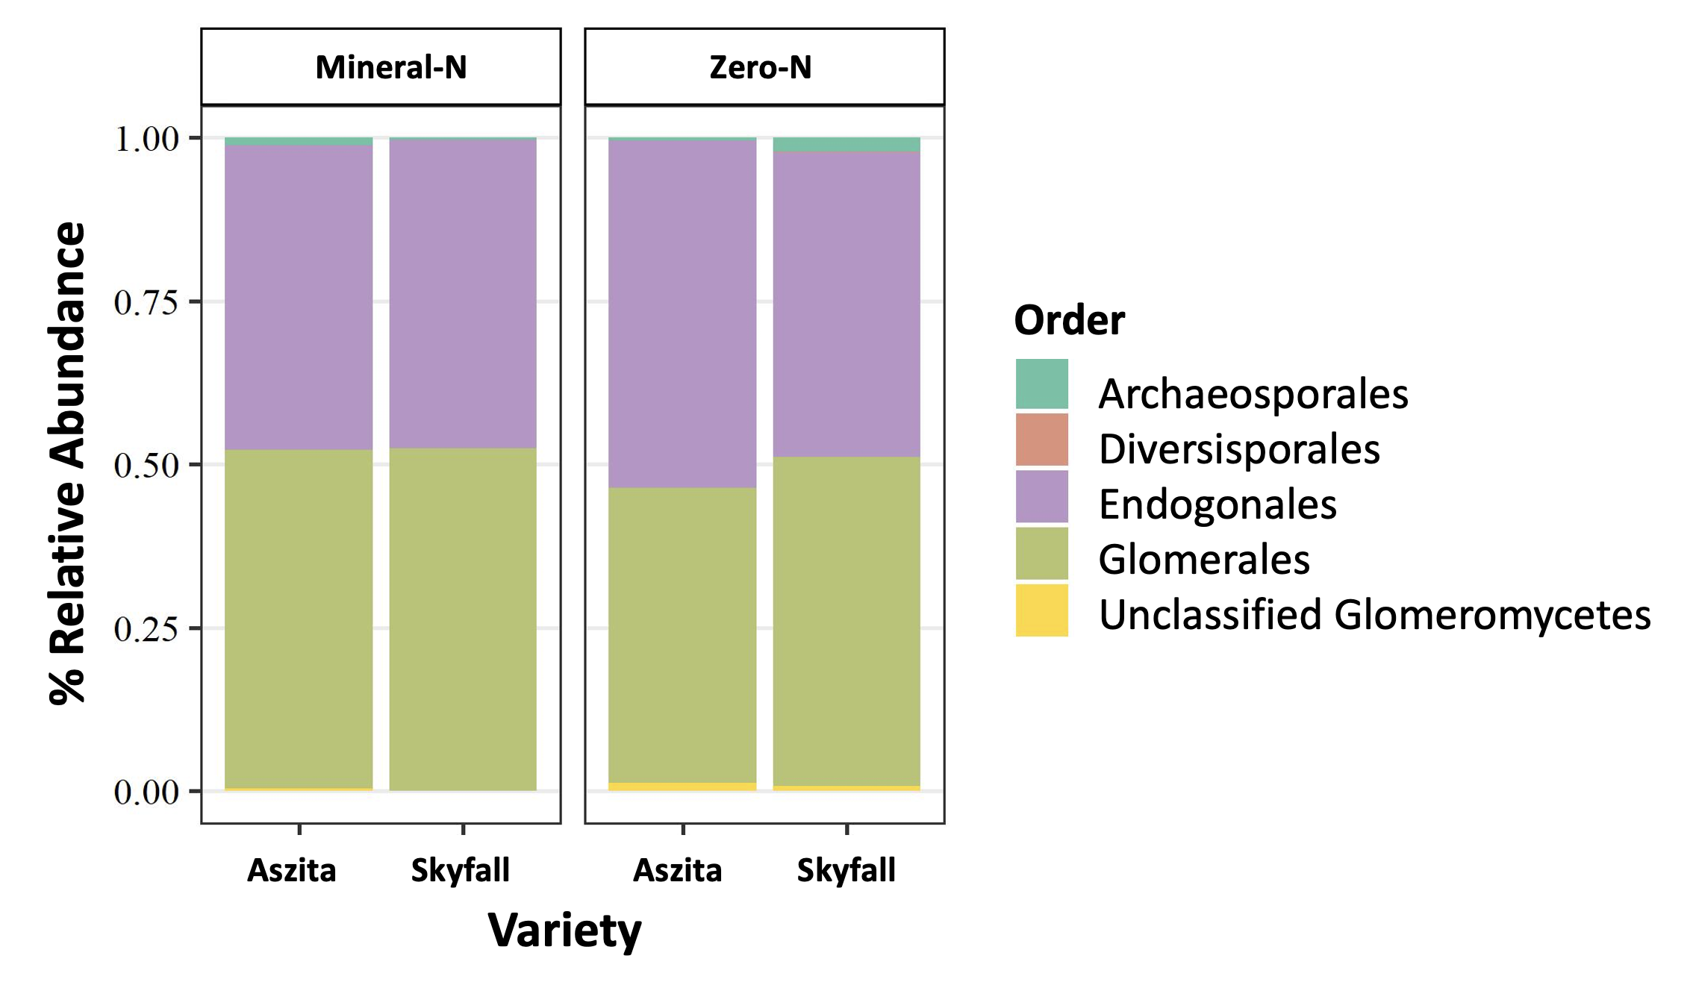
Fig. S2 Relative abundances of Glomeromycotina and Mucoromycotina orders in roots of Aszita and Skyfall wheat varieties in zero-N and mineral-N treatments. Data was obtained using AM primers (AM-Sal-F forward and AMDGR reverse primers).

Slide 3
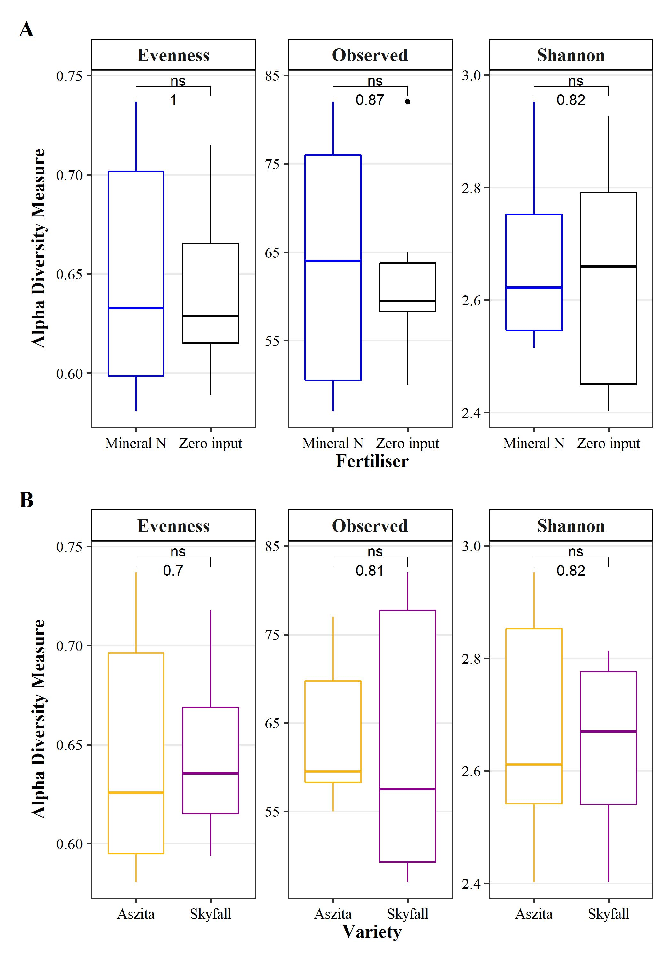
Fig. S3 Box plot showing ASV evenness, number of observed ASV and Shannon diversity index of combined Glomeromycotina and Mucoromycotina communities. Sequencing was performed using AM primers (AM-Sal-F forward and AMDGR reverse primers. A) Comparison of mineral-N and zero-N treatments B) Comparison of wheat variety. Numbers indicate p-values for pairwise comparison by Kruskal-Wallis test (ns = not significant, * ≤ 0.05, ** ≤ 0.01, *** ≤ 0.001).

Slide 4
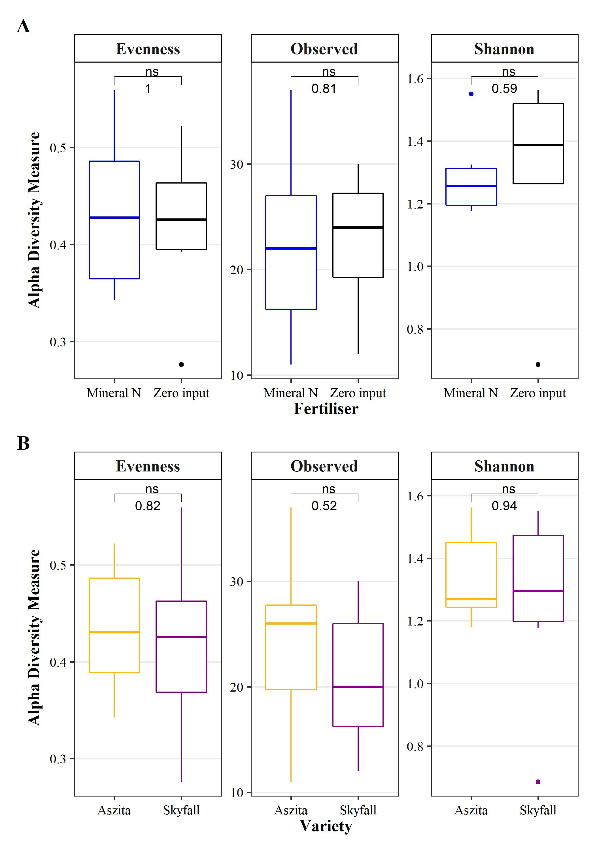
Fig S4 Box plot showing ASV evenness, number of observed ASV and Shannon diversity index of Glomeromycotina communities. Sequencing was performed using AM primers (AM-Sal-F forward and AMDGR reverse primers. A) Comparison of mineral-N and zero-N treatments B) Comparison of wheat variety. Numbers indicate p-values for pairwise comparison by Kruskal-Wallis test (ns = not significant, * ≤ 0.05, ** ≤ 0.01, *** ≤ 0.001).

Slide 5
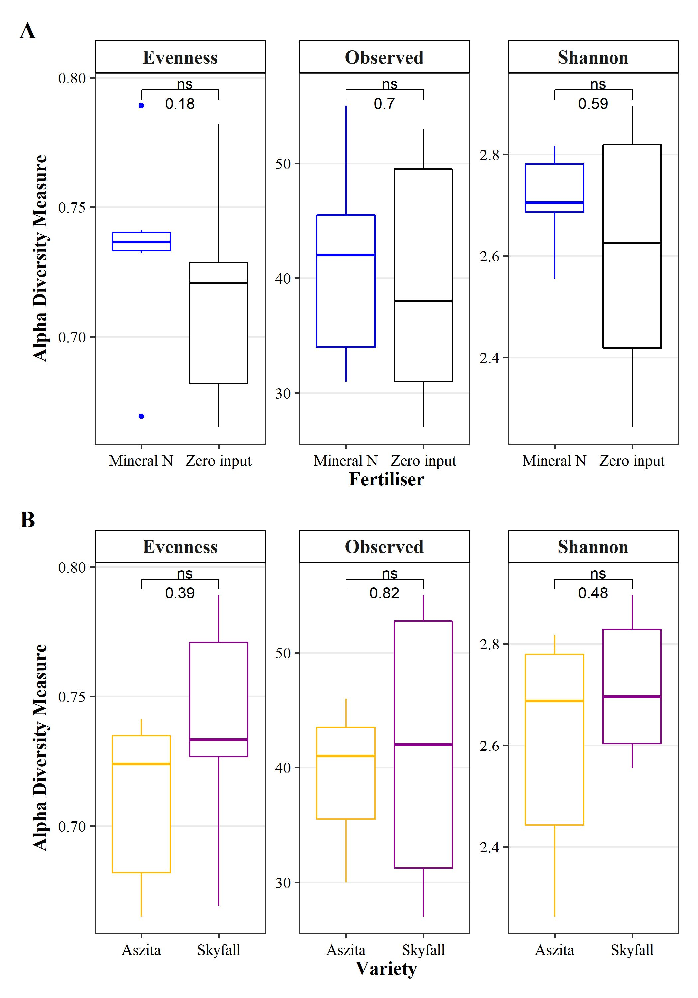
Fig S5 Box plot showing ASV evenness, number of observed ASV and Shannon diversity index of Mucoromycotina communities. Sequencing was performed using AM primers (AM-Sal-F forward and AMDGR reverse primers. A) Comparison of mineral-N and zero-N treatments B) Comparison of wheat variety. Numbers indicate p-values for pairwise comparison by Kruskal-Wallis test (ns = not significant, * ≤ 0.05, ** ≤ 0.01, *** ≤ 0.001).

