Slide 1
Supplementary Figure 1
A
B
C

Slide 2
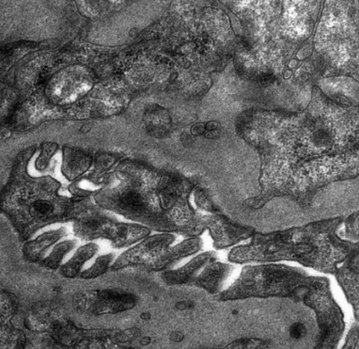
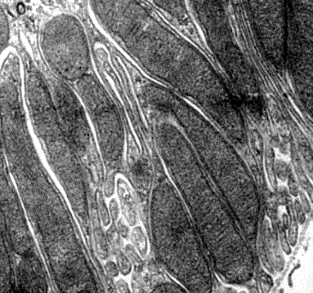
Supplementary Figure 2
WT | Akita+NS | Akita+Nam
A
F
HE
20μm
B
G
PAS
C
Masson
H
D
Glomerulus
I
E
Tubule
2μm

