Slide 1
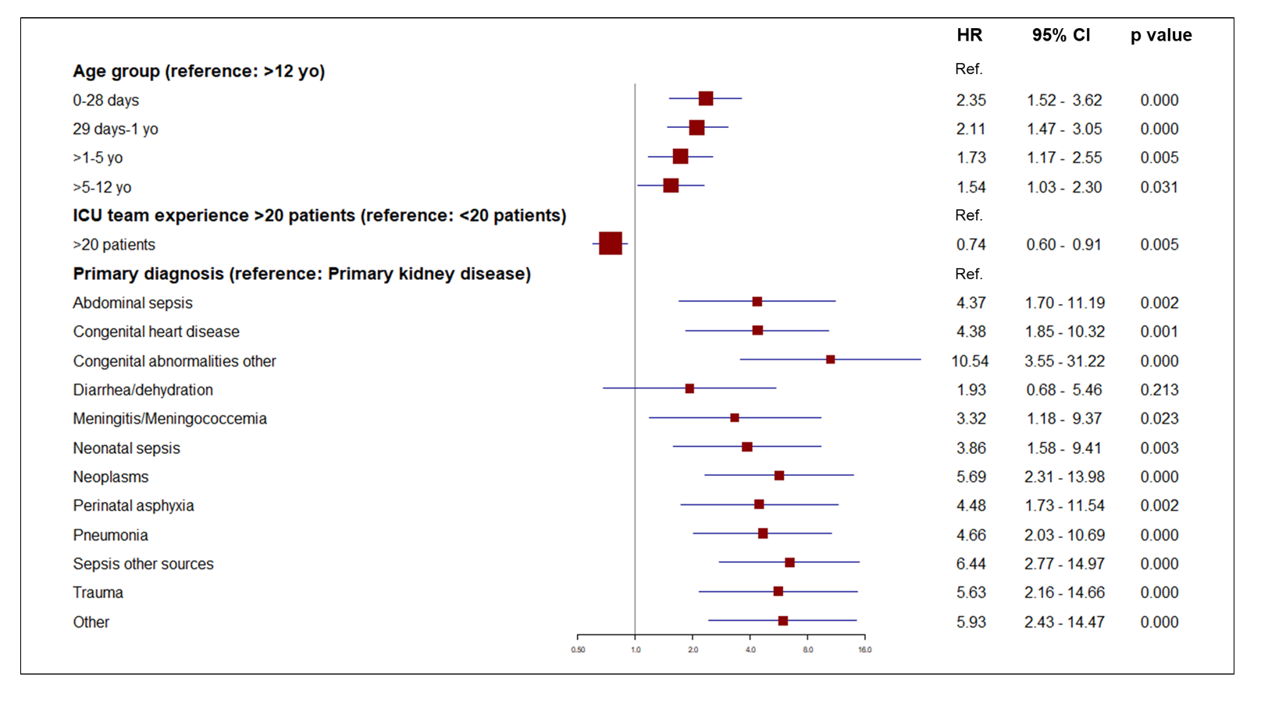
Acute kidney injury requiring dialysis in children: a multicentric, emerging country perspective.
HYPOTHESIS: Dialytic acute kidney injury is a condition associated with high mortality in children.
DESIGN & OUTCOMES:
Overall mortality rate: 65.2% (Neonates: 73.4%)
Retrospective analysis over 13 years
Factors associated with survival in the multivariate model
Median time between the start of therapy and death: 2 days
Primary kidney diseases:
most favorable outcomes
693 patients 0-18 years
Congenital abnormalities: higher mortality
CONCLUSION: The mortality rate associated with dialytic AKI in pediatric patients is high, notably among neonates. Early mortality may indicate late referral or futility of treatment.
Cleto-Yamane et al. 2023

