Slide 1
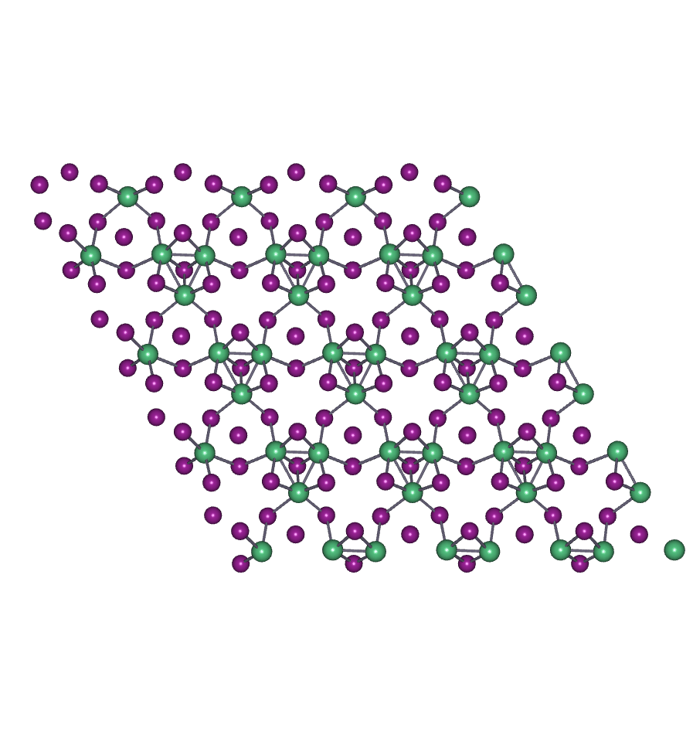
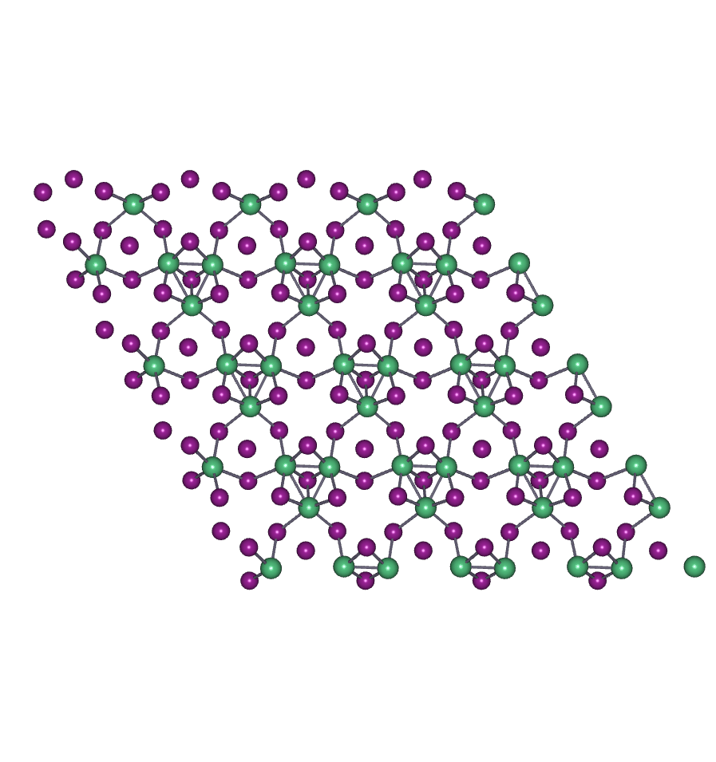
Animated videos of the circular motion of the chiral phonon mode $E_{g}^{3}$.
Left-handed
Right-handed

