Slide 1
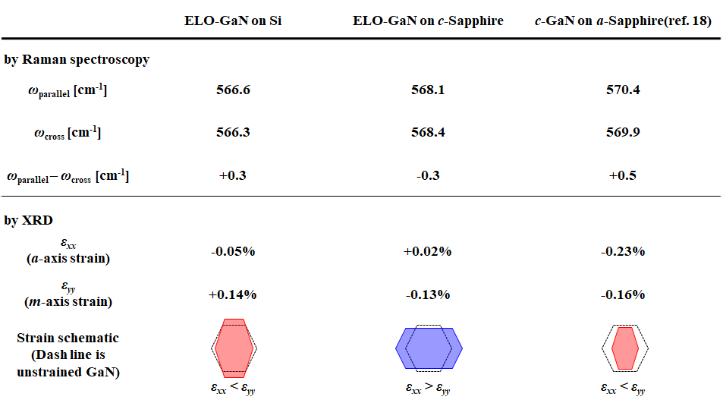
Tab. 1
Tab. 1 Polarized Raman and XRD strain measurements of ELO-GaN on Si, ELO-GaN on sapphire, and GaN on a-sapphire (ref. 18).

