Slide 1
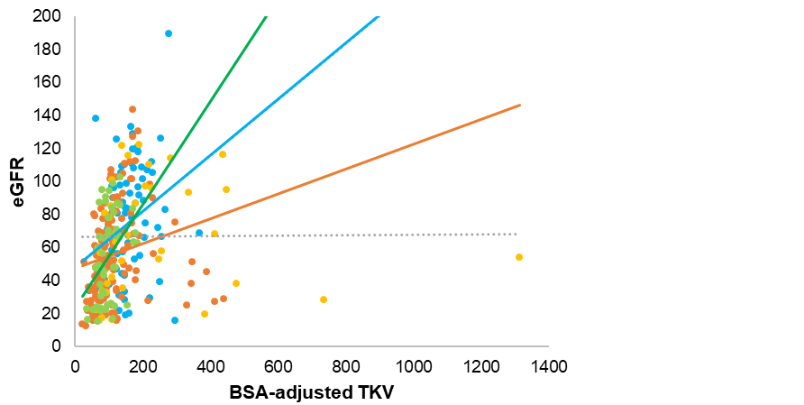
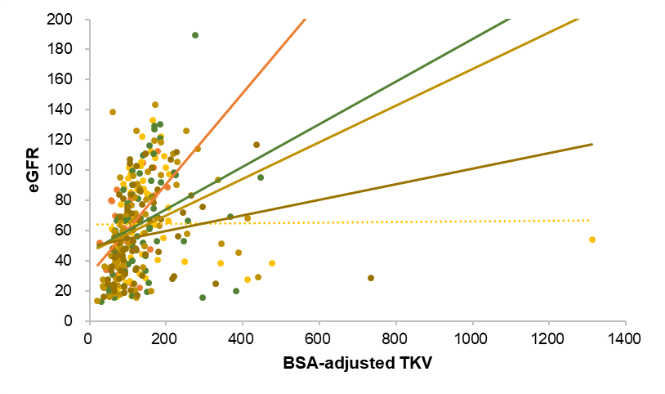

Ultrasonographically determined kidney volume and progression to end-stage kidney disease in pediatric chronic kidney disease:
data from the KNOW-Ped CKD study
HYPOTHESIS: BSA–adjusted TKV positively correlates with eGFR and asymmetricity associated with ESKD progression.
Others
Single kidney
DESIGN & OUTCOMES:
GN
Q2
KNOW-Ped CKD cohort
BSA–adjusted total kidney volume (TKV) vs. eGFR
Q3
CAKUT
Q4
Cystic KD
Q1
N=304, <18yrs
CKD stage 1-4
Q2 in CAKUT
Q1 in GN
0.06-fold odds (P=0.049) than single kidney
Kidney volume ratio quartiles vs. ESKD progression
CAKUT, GN,
Cystic KD, Others
7.1-fold odds (P=0.05) than single kidney
CONCLUSION: The relationship between eGFR and BSA–adjusted TKV with CKD was varied by etiology and asymmetricity. The kidney volume ratio could be a clinical indicator for predicting CKD progression in children.
Kim JH and Ahn YH et al. 2023

