Slide 1
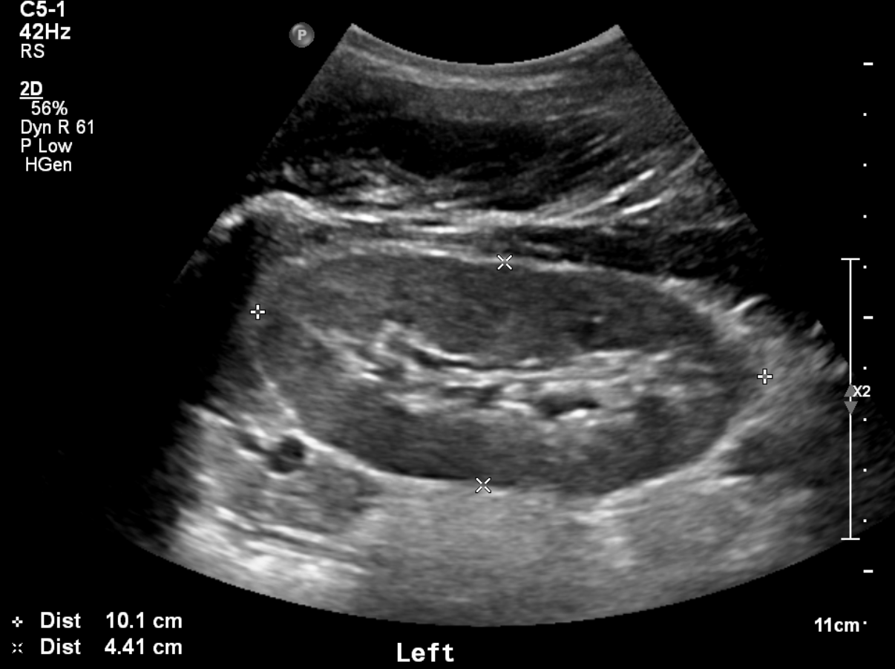
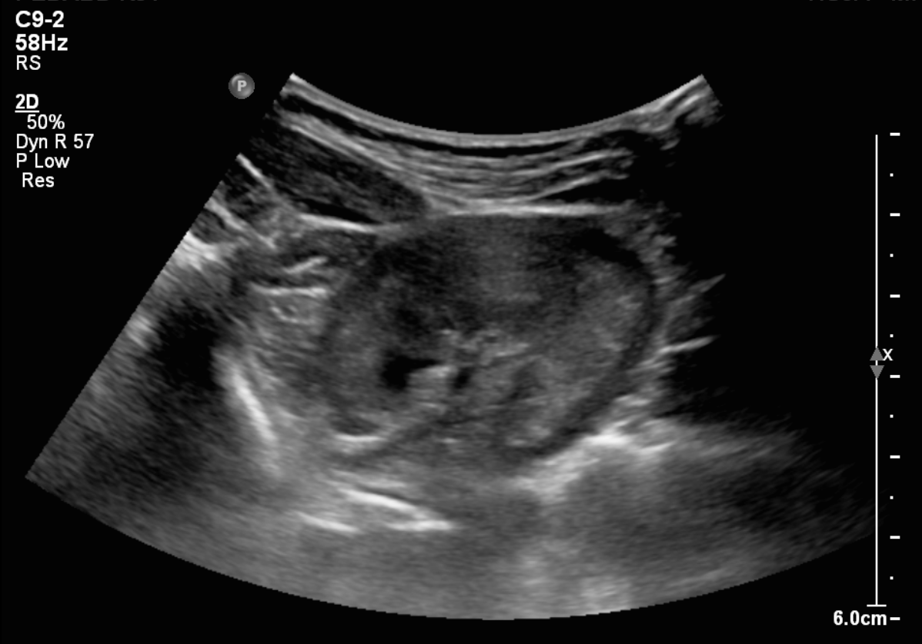
a
b
L
W
D
D
Notes:
Supplementary Fig 1 Measurement of kidney size by renal ultrasound.
(A) The length (L) and depth(D) of the kidney are measured at the longitudinal plane on the renal hilum. (B) The transverse width (W) and depth (D) of the kidney is obtained at the transverse plane passing through the center of hilum.

Slide 2
(a)
(b)
1.0
Age(year)
infants
toddlers
children
adolescents
1.0
kidney volume ratio
Q3
Q1, Q2, Q4
0.8
0.8
cumulative survival
cumulative survival
0.6
0.6
0.4
0.4
0.2
0.2
HR(adolescents vs. toddlers)=0.010
95%CI:0.000−0.597, P=0.027
HR(Q1,Q2,Q4 vs. Q3)=29.811
95%CI:1.510−588.405, P=0.026
0.0
0.0
(c)
0
2
4 6
duration (years)
8
10
(d)
0
2
4 6
duration (years)
8
10
1.0
CKD stage
I , II
IIIa or III b
IV
1.0
Sex
male
female
0.8
0.8
cumulative survival
cumulative survival
0.6
0.6
0.4
0.4
HR(I,II vs. IIIa,IIIb)=74.090
95%CI:1.241−4421.961, P=0.039
HR(I,II vs. IV)=28013.402
95%CI:40.222−19510635.677, P=0.002
HR(female vs. male)=37.729
95%CI:1.751−812.794, P=0.020
0.2
0.2
0.0
0.0
0
2
4 6
duration (years)
8
10
0
2
4 6
duration (years)
8
10
Notes:
Supplementary Fig 2
Cox proportional hazards regression model survival curves for the requirement of renal replacement therapy in cystic kidney disease
(a-d) cumulative survival according to age category, ratio of each kidney volume, CKD stage, or sex, respectively.
CKD, chronic kidney disease; HR, hazard ratio. Quartiles of ratio of each kidney volume; Q1 (≤25th), Q2 (26–50th), Q3 (51–75th), and Q4 (>75th).

Slide 3
(a)
(b)
1.0
Age(year)
infants
toddlers
children
adolescents
1.0
kidney volume ratio
Q1, Q2
Q3
Q4
single kidney
0.8
0.8
cumulative survival
cumulative survival
0.6
0.6
0.4
0.4
0.2
HR(infants vs. children)=35.803
95%CI:2.253−569.061, P=0.011
0.2
HR(Q1, Q2 vs. Q4)=24.282
95%CI:1.329−443.590, P=0.031
0.0
0.0
(c)
0
2
4 6
duration (years)
8
10
(d)
0
2
4 6
duration (years)
8
10
1.0
CKD stage
I, II, IIIa
IIIb, IV
1.0
UPCR
<0.5
0.5-1.99
≥2.0
0.8
0.8
cumulative survival
cumulative survival
0.6
0.6
0.4
0.4
0.2
HR(I,II,IIIa vs. IIIb,IV)=24.103
95%CI:1.554−373.865, P=0.023
0.2
HR(<0.5 vs. ≥2.0)=59.315
95%CI:0.751−4686.910, P=0.067
0.0
0.0
0
2
4 6
duration (years)
8
10
0
2
4 6
duration (years)
8
10
Notes:
Supplementary Fig 3
Cox proportional hazards regression model survival curves for the requirement of renal replacement therapy in other etiology
(a-d) cumulative survival according to age category, ratio of each kidney volume, CKD stage, or UPCR, respectively.
CKD, chronic kidney disease; HR, hazard ratio; UPCR, urine protein to creatinine ratio. Quartiles of ratio of each kidney volume; Q1 (≤25th), Q2 (26–50th), Q3 (51–75th), and Q4 (>75th).

