Slide 1
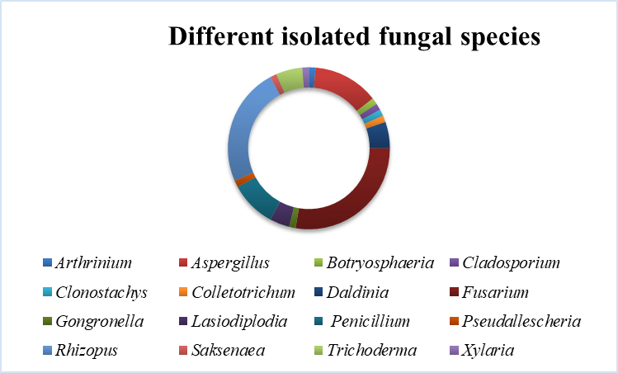
Figure S1. The relative abundances (%) of different fungal species isolates from P. volubilis plant materials and rhizosphere soil samples. Relative abundance was calculated as the percentage of total number of isolates within one species in total number of all isolates within all species.

Slide 2
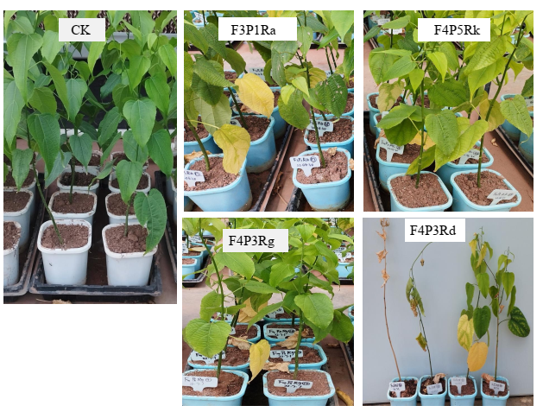
Figure S2. Images of foliage of seedlings treated with water (CK) resulted in zero symptoms, seedlings treated with F. proliferatum isolate F3P1Ra, F. graminearum isolate F4P5Rk, R. oryzae isolate F4P3Rg and R. oryzae isolate F4P3Rd resulted in moderate and severe leaf yellowing, leaf loss, wilting and death.

Slide 3
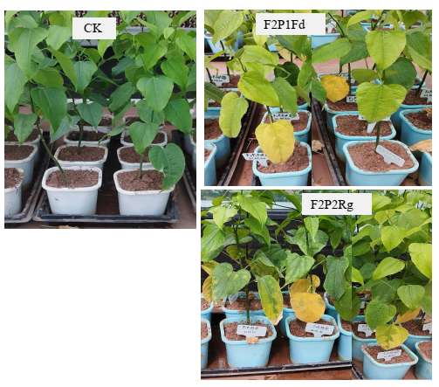
Figure S3. Images of foliage of seedlings treated with water (CK) resulted in zero symptoms, seedlings treated with F. solani isolate F2P1Fd and F. solani isolate F2P2Rg resulted in moderate and severe leaf yellowing, and leaf loss

Slide 4
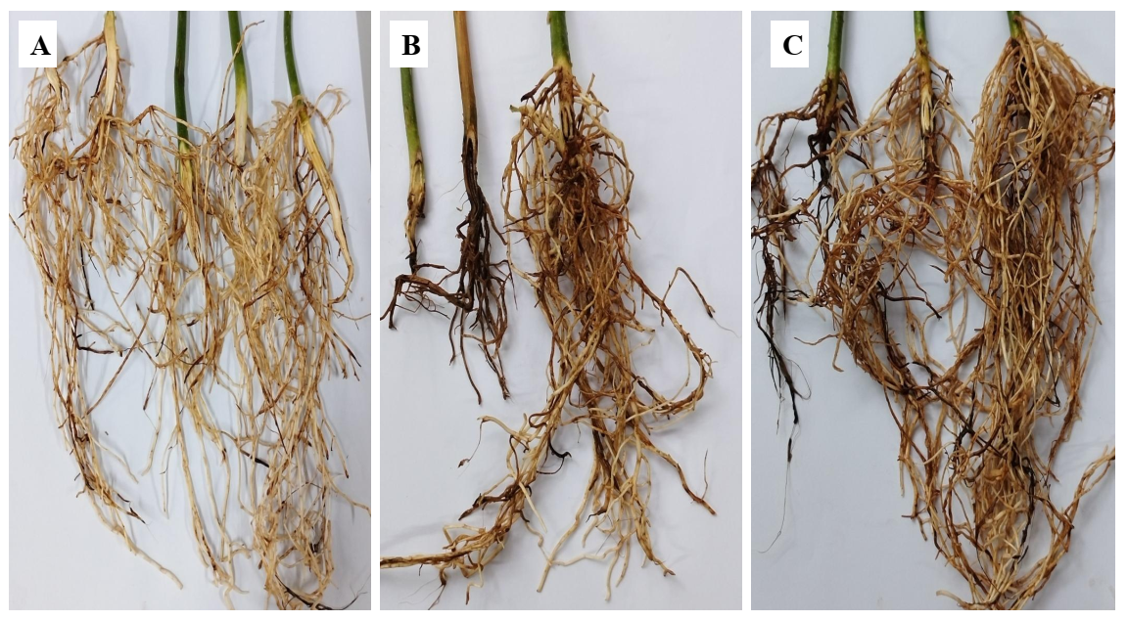
Figure S4. Representative images of roots of P. volubilis seedlings that have been treated with R. oryzae isolate F4P3Rd (B) and F. proliferatum (C) isolate F3P1Ra marked by black and brown lesions on both root internal and outside surface layers. Roots of seedlings that have been treated with water lack of lesions (A).

Slide 5
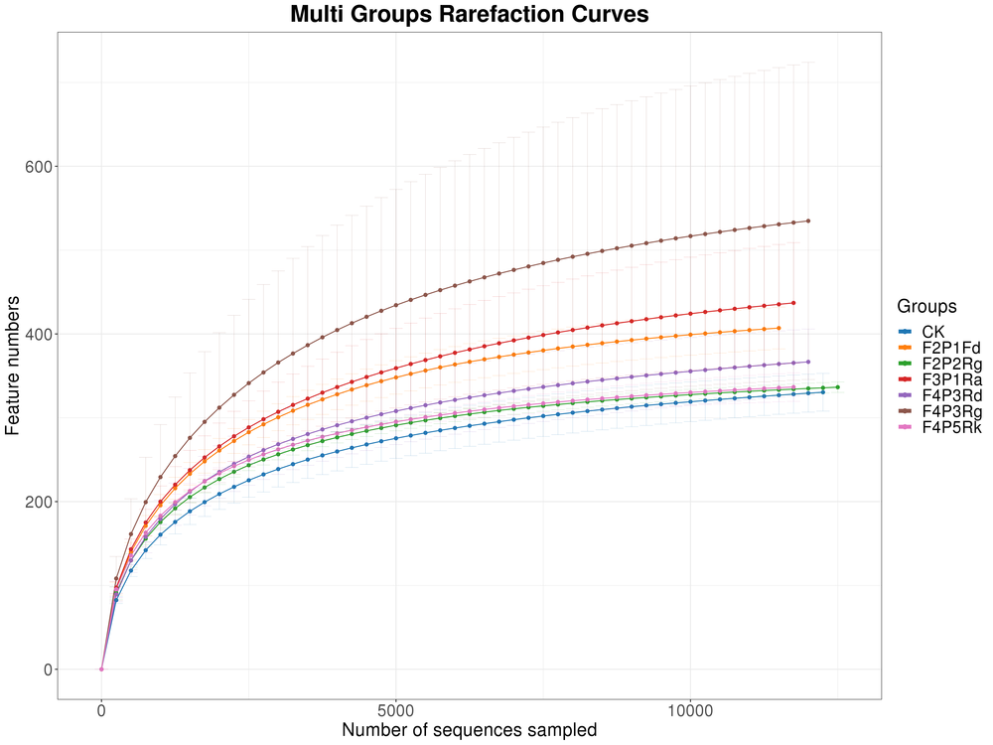
Figure S5. Rarefaction curves showing the relationship between sequence number per sample and observed OTUs for different treatment replicates. The length of the curve reflects sequencing depth (i.e., a longer curve indicates a greater depth), while the smoothness reflects the effect of sequencing depth on sample diversity.

Slide 6
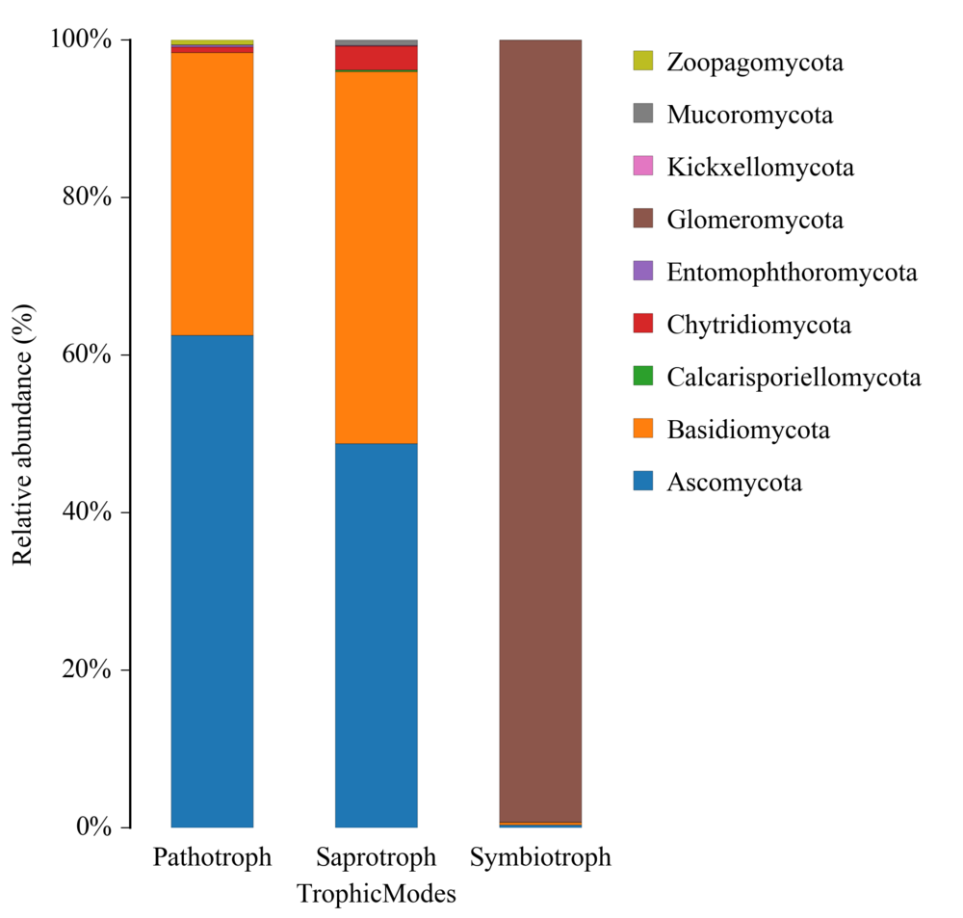
Figure S6. Stacked bar charts showing functional taxonomic composition of rhizosphere soil fungal community at phylum level

Slide 7
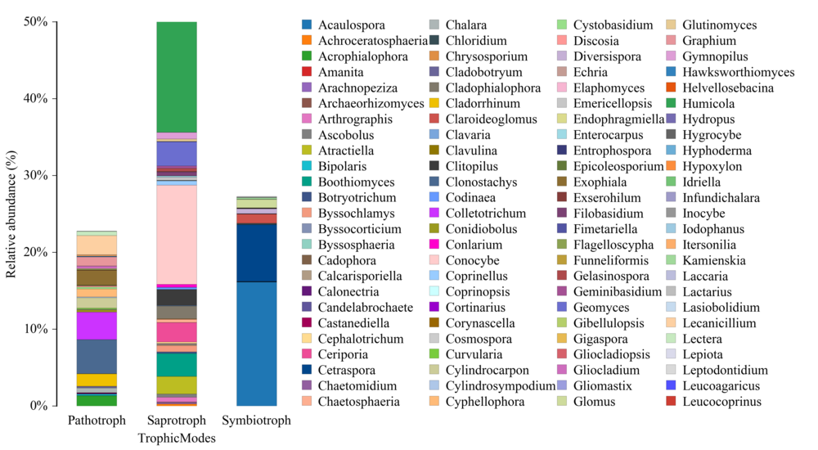
Figure S7. Stacked bar charts showing functional taxonomic composition of rhizosphere soil fungal communities at genus

