Slide 1
Antibody | Fluorochrome | Company | Cat. No. | Dilution
CD13 | APC | BD | 557454 | 1/50
CD14 | FITC | Caltag | MHCD1401 | 1/100
CD29 | FITC | eBioscience | 11-0298-42 | 1/100
CD34 | PerCP-eFluor710 | eBioscience | 46-0394-42 | 1/100
CD44 | FITC | BD | 555478 | 1/100
CD45 | APC-eFluor780 | eBioscience | 47-0459-42 | 1/100
CD49a | PE | BD | 559596 | 1/100
CD49b | FITC | BD | 555498 | 1/100
CD49c | PE | BD | 556025 | 1/100
CD49d | PE | BD | 555503 | 1/100
CD49e | APC | Miltenyi Biotec | 130-097-22 | 1/100
CD49f | FITC | BD | 555735 | 1/100
CD56 | APC | Miltenyi Biotec | 130-113-305 | 1/50
CD71 | FITC | Biolegend | 334104 | 1/100
CD73 | BV510 | BD | 563198 | 1/100
CD90 | PE-Vio770 | Miltenyi Biotec | 130-090-295 | 1/100
CD105 | APC | Miltenyi Biotec | 130-094-926 | 1/100
CD146 | FITC | R&D | FAB932F | 1/50
CD166 | PE | BD | 559263 | 1/50
CD271 | PE | BD | 557196 | 1/50
HLA-A,B,C | PE-Vio-770 | Miltenyi Biotec | 130-120-433 | 1/100
HLA-DP,CP,DQ | FITC | BD | 555558 | 1/100
Supplementary Table 1.

Slide 2
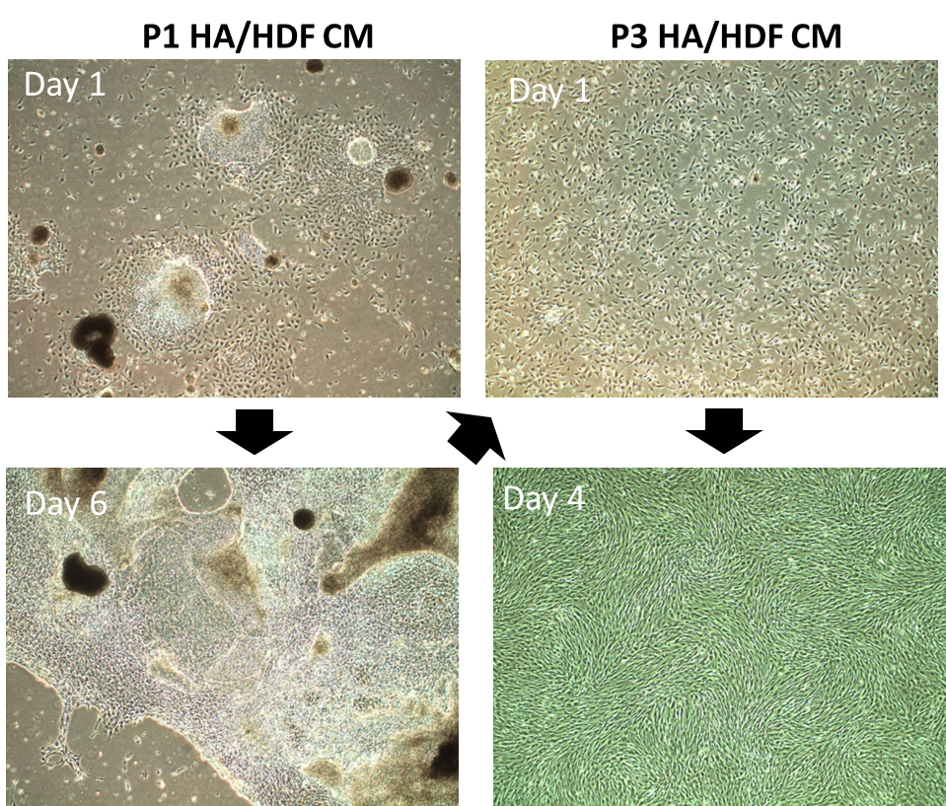
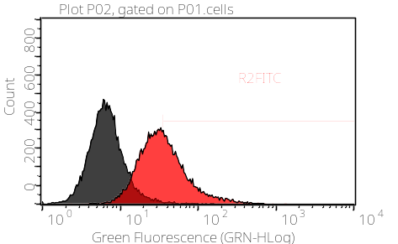
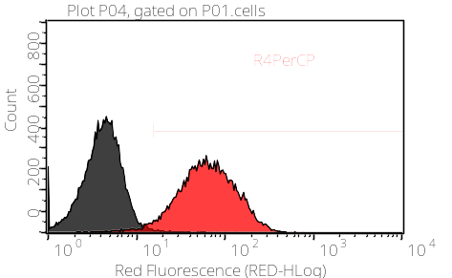
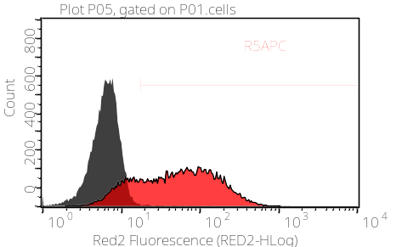
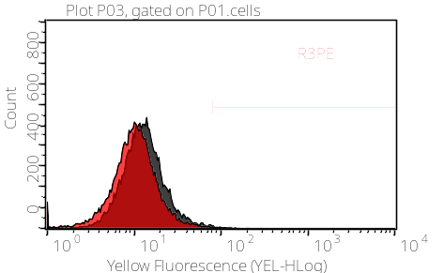
I
II
CD146
46%
CD105
CD146, 46%
96%
CD90
78%
CD45
CD90, 78%
0.2%
counts
fluorescence
Supplementary Figure 1.

Slide 3
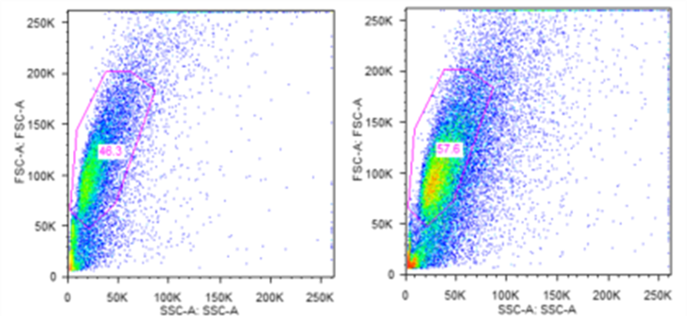
Experiment I
Experiment II
Supplementary Figure 2.

Slide 4
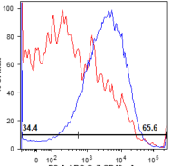
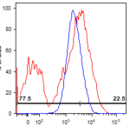
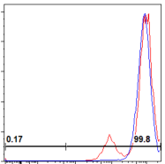
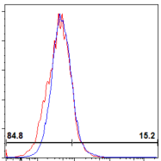
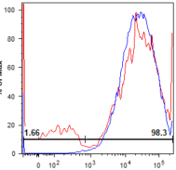
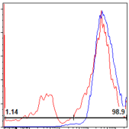
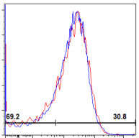
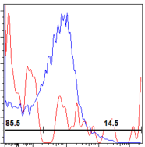
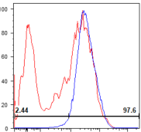
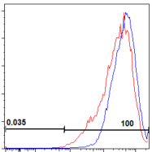
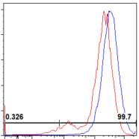
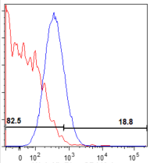
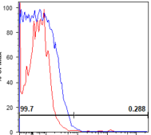
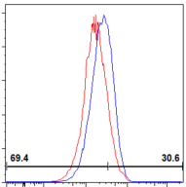
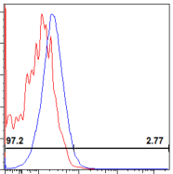
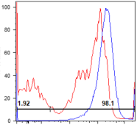
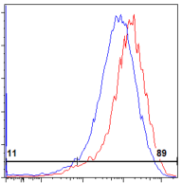
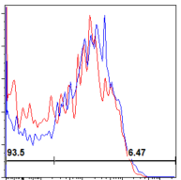
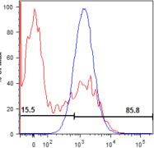
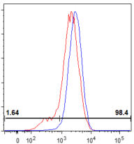
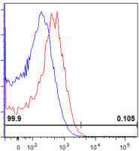
CD49a
CD29
CD44
CD71
CD49b
CD73
CD56
CD133
CD49c
CD13
HLA-I
CD146
% of Max
CD49d
CD105
HLA-II
CD49e
CD90
CD271
CD49f
CD166
CD34
Supplementary Figure 3.

Slide 5
Marker | Name | +ve Cell [% , Range]
CD49a | Integrin alpha 1 (ITGA1) | 25-66
CD49b | Integrin alpha 2 (ITGA2) | 70-98
CD49c | Integrin alpha 3 (ITGA3) | 52-89
CD49d | Integrin alpha 4 (ITGA4) | 0.4
CD49e | Integrin alpha 5 (ITGA5) | 67-98
CD49f | Integrin alpha 6 (ITGA6) | 27-63
CD29 | Integrin beta 1 (ITGB1) | 34-66
CD73 | Ecto-5’-nucleotidase (NT5E) | 68-98
CD13 | Alanyl Aminopeptidase N (ANPEP) | 99-100
CD105 | Endoglin | 13-76
CD90 | Thy-1 cell surface antigen | 76-95
CD166 | Activate Leukocyte Cell Adhesion Molecule (ALCAM) | 86-90
CD44 | Hyaluronan Receptor | 99-100
CD56 | Neural Cell Adhesion Molecule 1 (NCAM) | 29-39
HLA-I | Human Leukocyte Antigen Type I | 95-100
HLA-II | Human Leukocyte Antigen Type II | 0-4
CD271 | p75 Low Affinity Nerve Growth Factor Receptor | 6-8
CD34 | Transmembrane Glycoprotein | 0-1
CD71 | Transferrin Receptor (TFRC) | 6-12
CD133 | Prominin-1 | 0-13
CD146 | Melanoma Cell Adhesion Molecule (MCAM) | 1-9
Supplementary Figure 4.

Slide 6
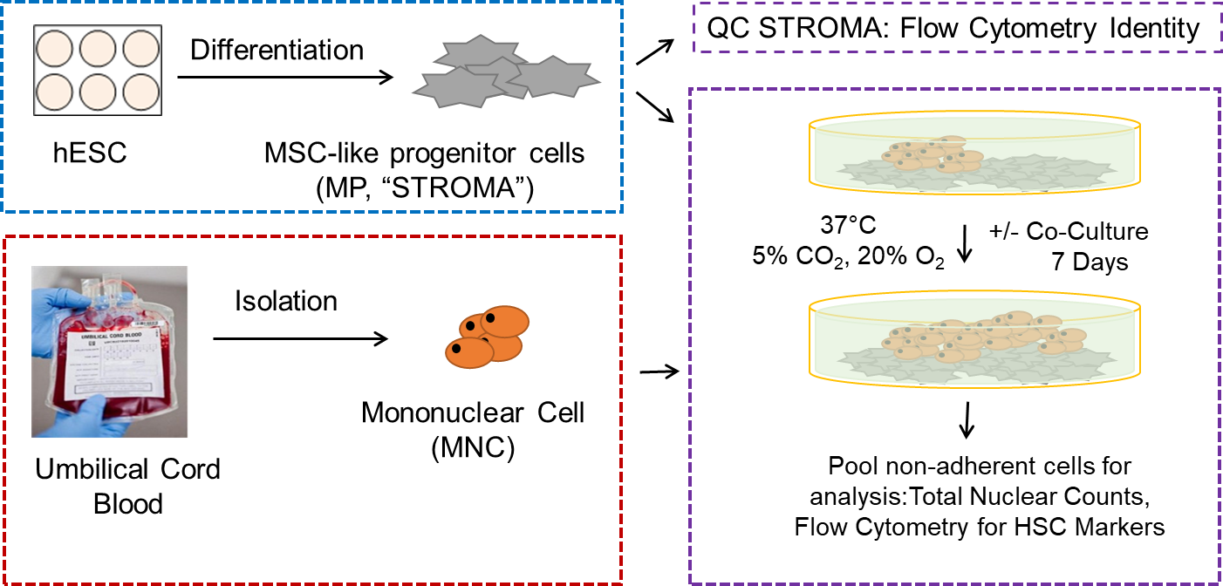
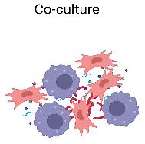
A.
B.
C
THP1
(RPMI+PMA)
THP1 Mɸ
24 hours
(RPMI w/o PMA)
D0 D3 D8
Assess for cytokines
LPS -/+
MSC-/+
Supplementary Figure 5.

Slide 7
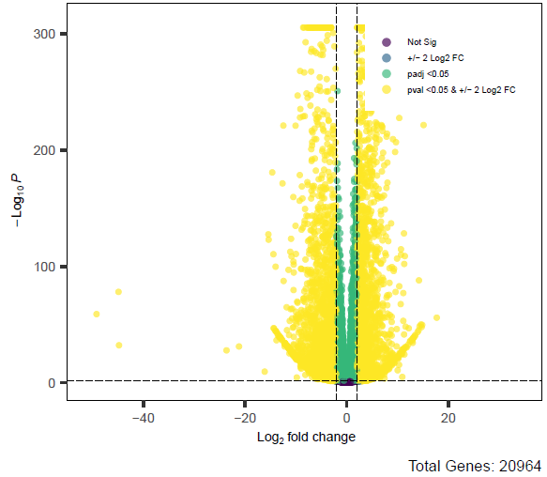
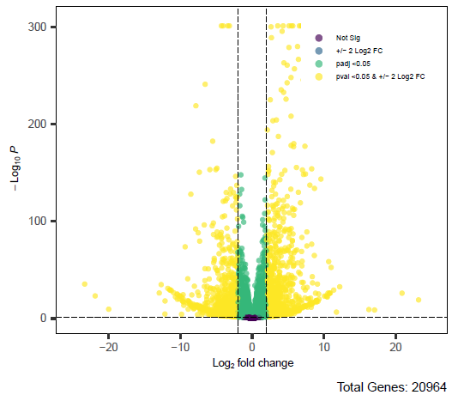
A.
hMS vs hESC
B.
hMS vs hBM MSC
Supplementary Figure 6.

Slide 8
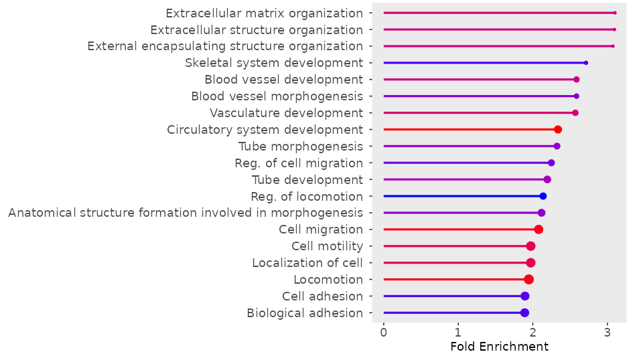
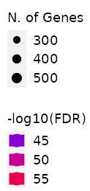
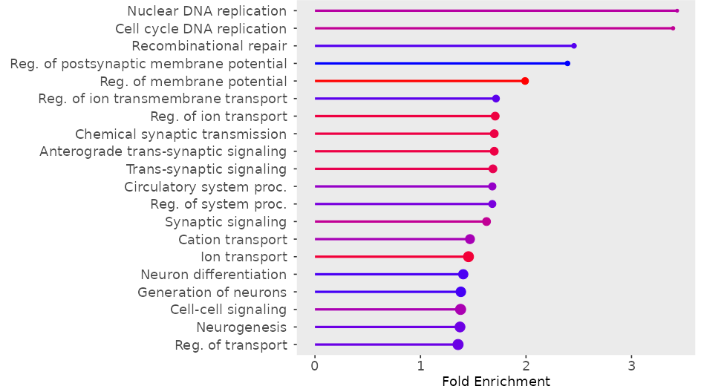
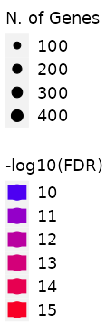
A.
hMS > hESC
B.
hMS < hESC
Supplementary Figure 7.

Slide 9
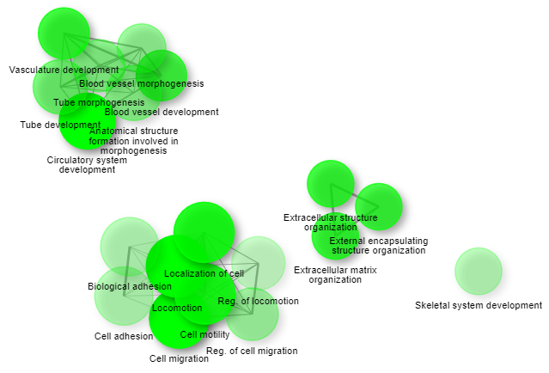
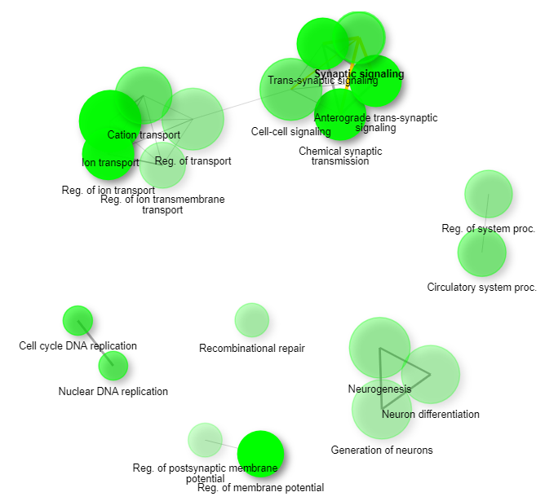
A.
hMS > hESC
B.
hMS < hESC
Supplementary Figure 8.

Slide 10
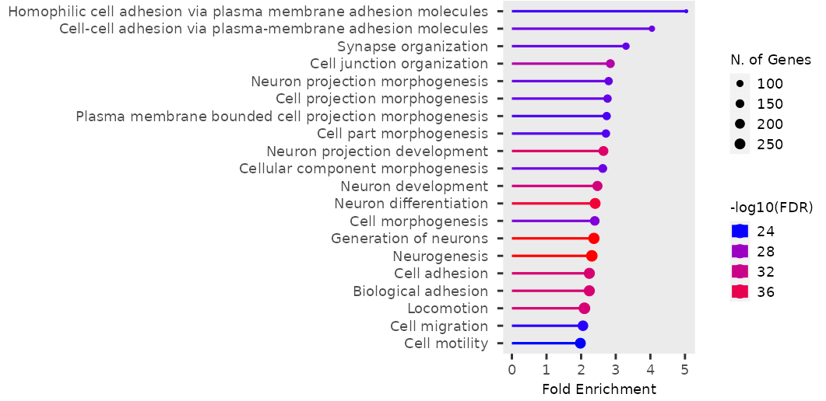
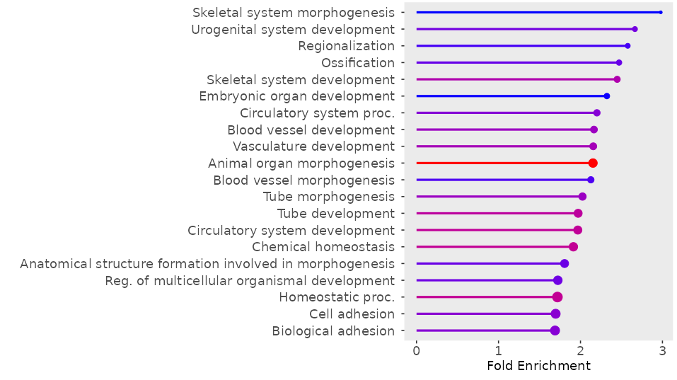
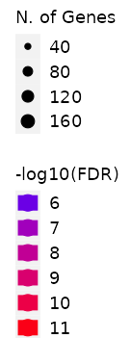
A.
hMS > hBM MSC
B.
hMS < hBM MSC
Supplementary Figure 9.

Slide 11
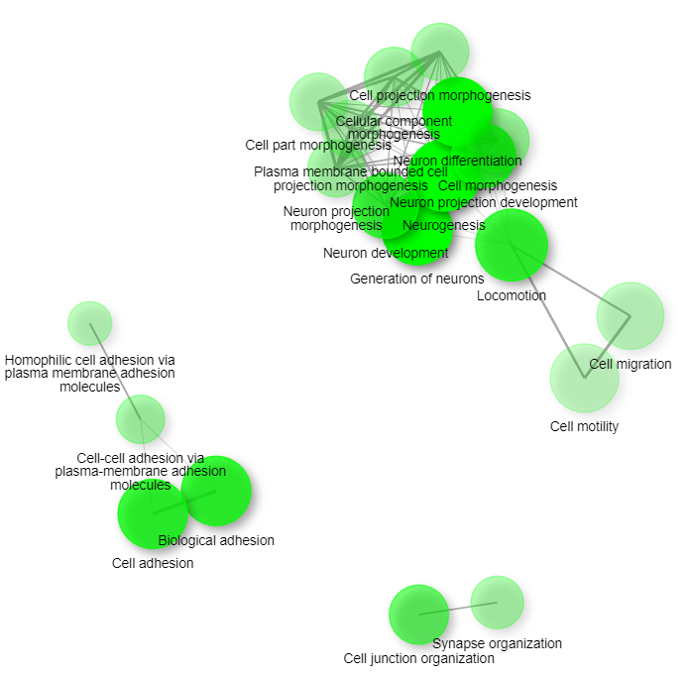
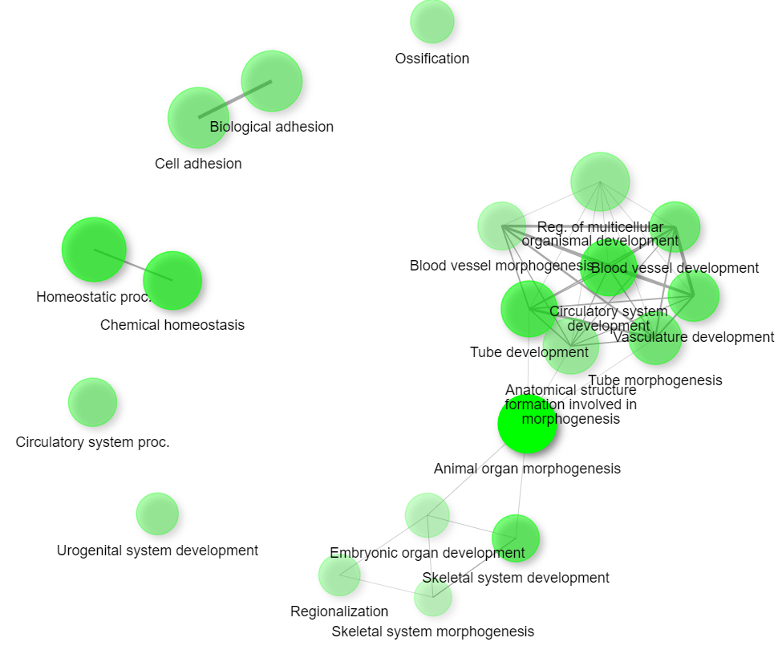
A.
hMS > hBM MSC
B.
hMS < hBM MSC
Supplementary Figure 10.

Slide 12
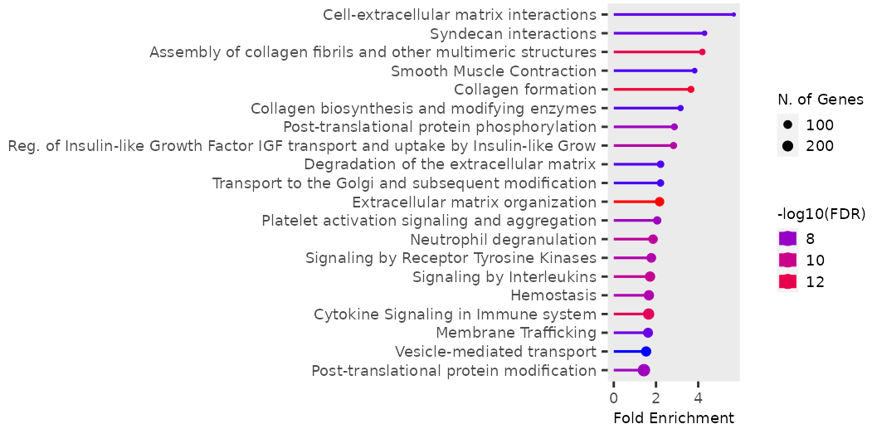
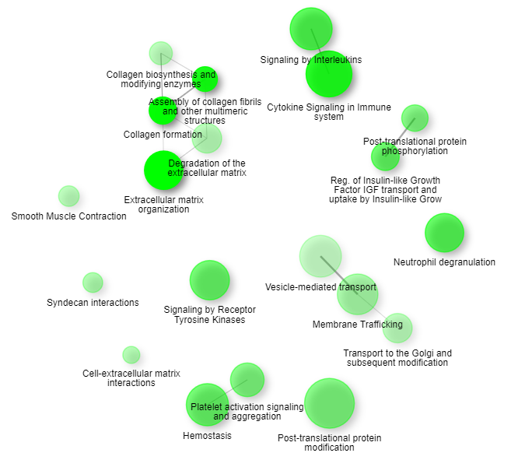
[hMS > hESC]
I.
II.
Supplementary Figure 11.

Slide 13
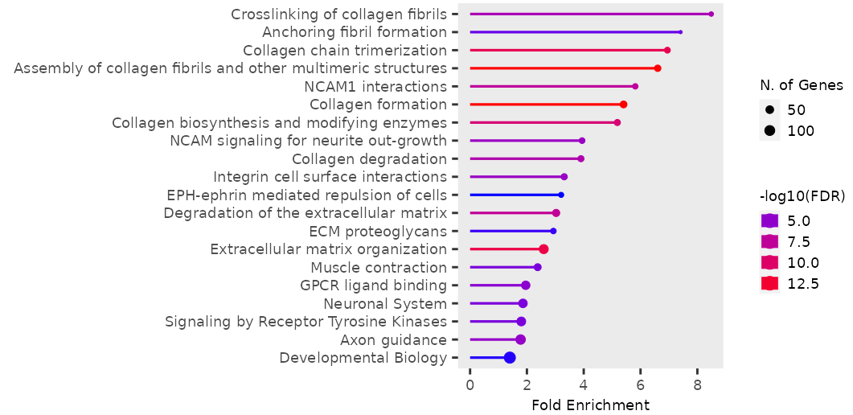
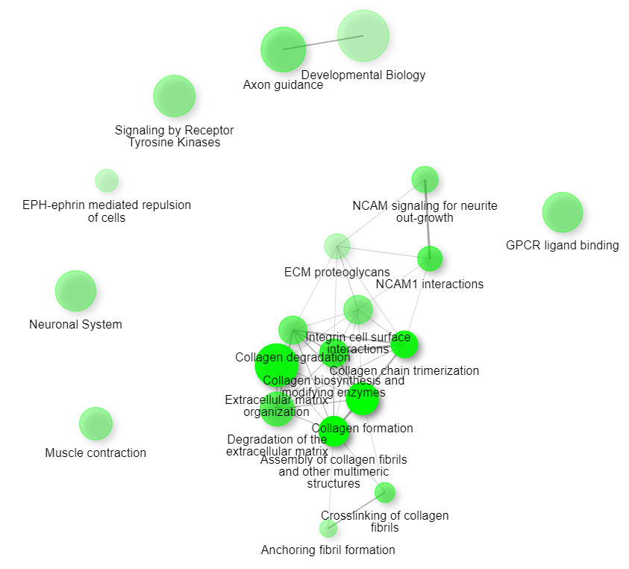
[hMS > hBM MSC]
I.
II.
Supplementary Figure 12.

Slide 14
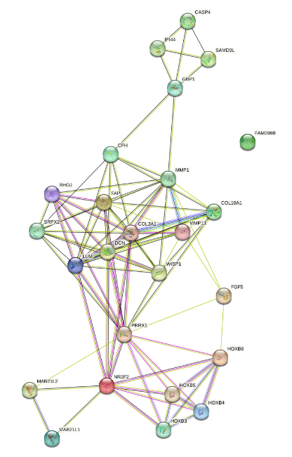
hMS > hESC Top 25 RNA
Proteins: 25
Interactions: 88
Expected Interactions: 15 (p=0)
Supplementary Figure 13.

Slide 15
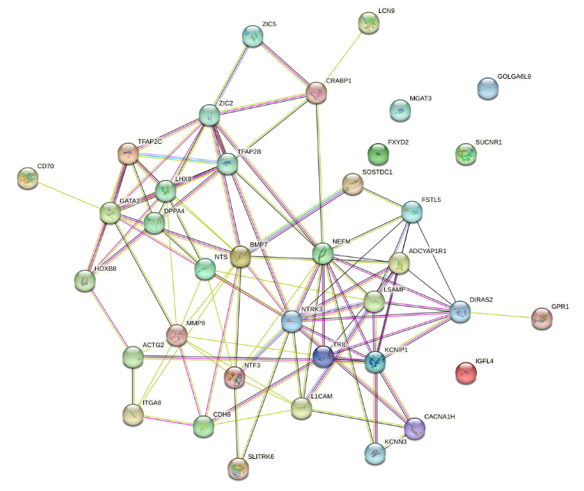
hMS > hBM MSC Top 50 RNA
Proteins: 37
Interactions: 99
Expected Interactions: 40 (p= 3.11e-15)
Supplementary Figure 14.

