Slide 1
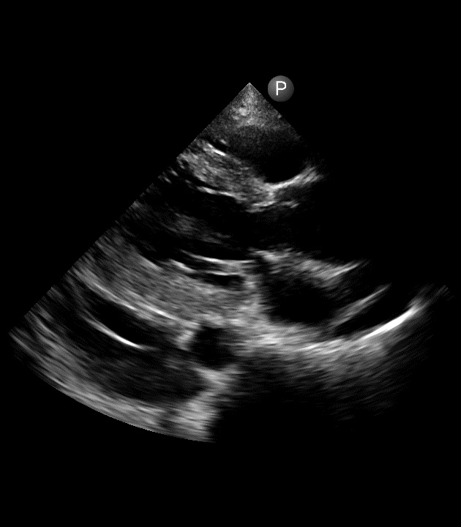
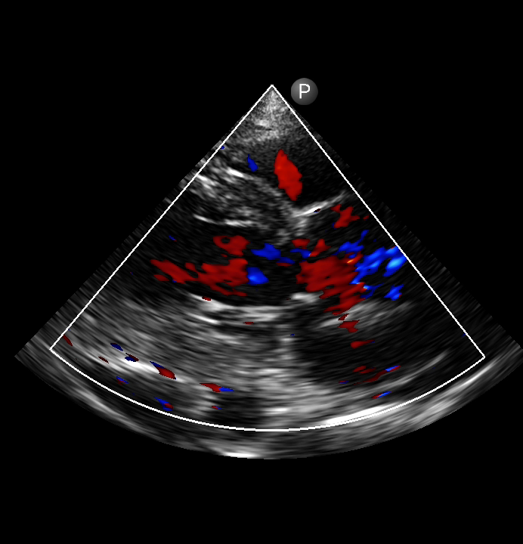
A
B
*
Supplementary movie S1. A) Parasternal long-axis view of bedside echocardiography revealed the suspected intimal flap (red arrow) and pericardial effusion (red asterisk). B) Color doppler imaging showed severe aortic regurgitation.

Slide 2
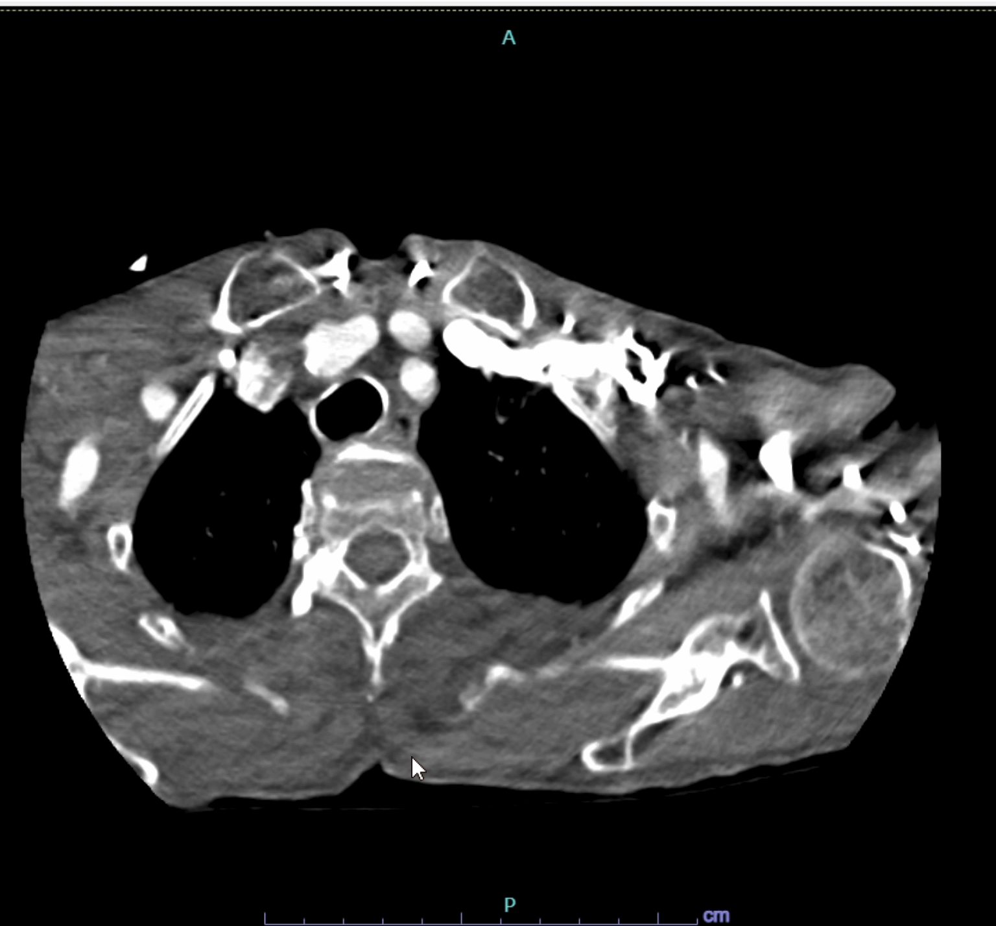
Supplementary movie S2. Cardiac CT revealed ascending aortic aneurysm, no presence of false lumen

