Slide 1
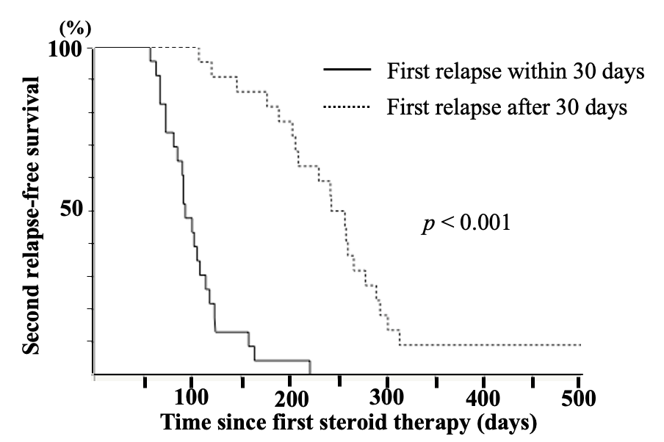
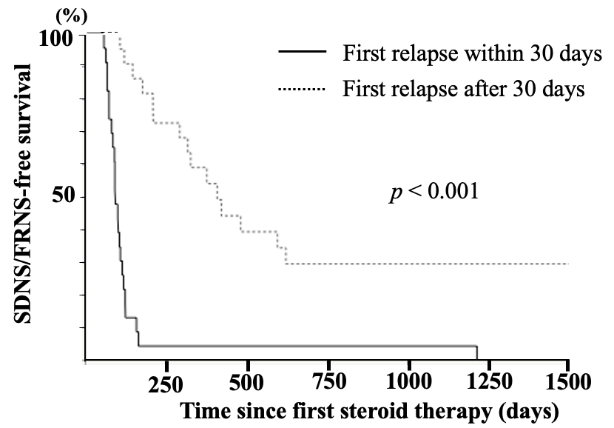
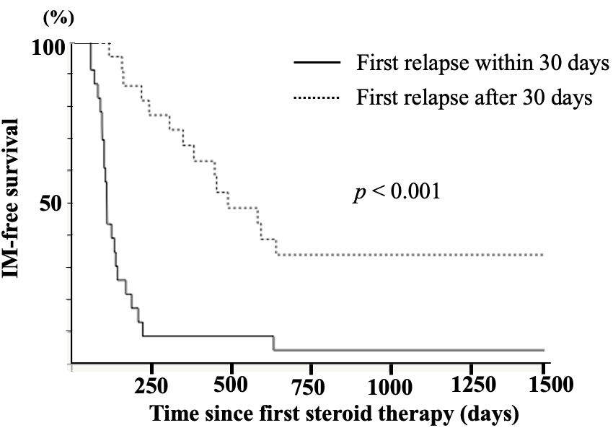
Association between the time of initial relapse and subsequent relapses in patients with childhood-onset idiopathic nephrotic syndrome
HYPOTHESIS: The earlier patients experience a first relapse, the earlier they suffer from the second relapse, developing SDNS/FRNS.
 | SDNS/FRNS development | initiation of immunosuppressive agents
23 patients with first relapse within 30 days | 96% / 96% | 83% /91%
22 patients with first relapse after 31 days | 18% / 41% | 14% / 27%
DESIGN & OUTCOMES:
45 patients with nephrotic syndrome with the first relapse within 6 month
(6 months / 12months)
Inoki et al. 2023
CONCLUSION: Most patients with a first relapse within 30 days after discontinuing initial steroid therapy developed SDNS/FRNS and were administered immunosuppressive agents within 6 months. Thus, it may be reasonable to start immunosuppression therapy in this group without waiting for the second relapse.
Notes:
(a) Kaplan–Meier curves for the time from the start of initial steroid therapy to the second relapse. (b) Kaplan–Meier curves for the time from the start of initial steroid therapy to SDNS/FRNS development. (c) Kaplan–Meier curves for the time from the start of initial steroid therapy to initiation of immunosuppression therapy.

