Slide 1
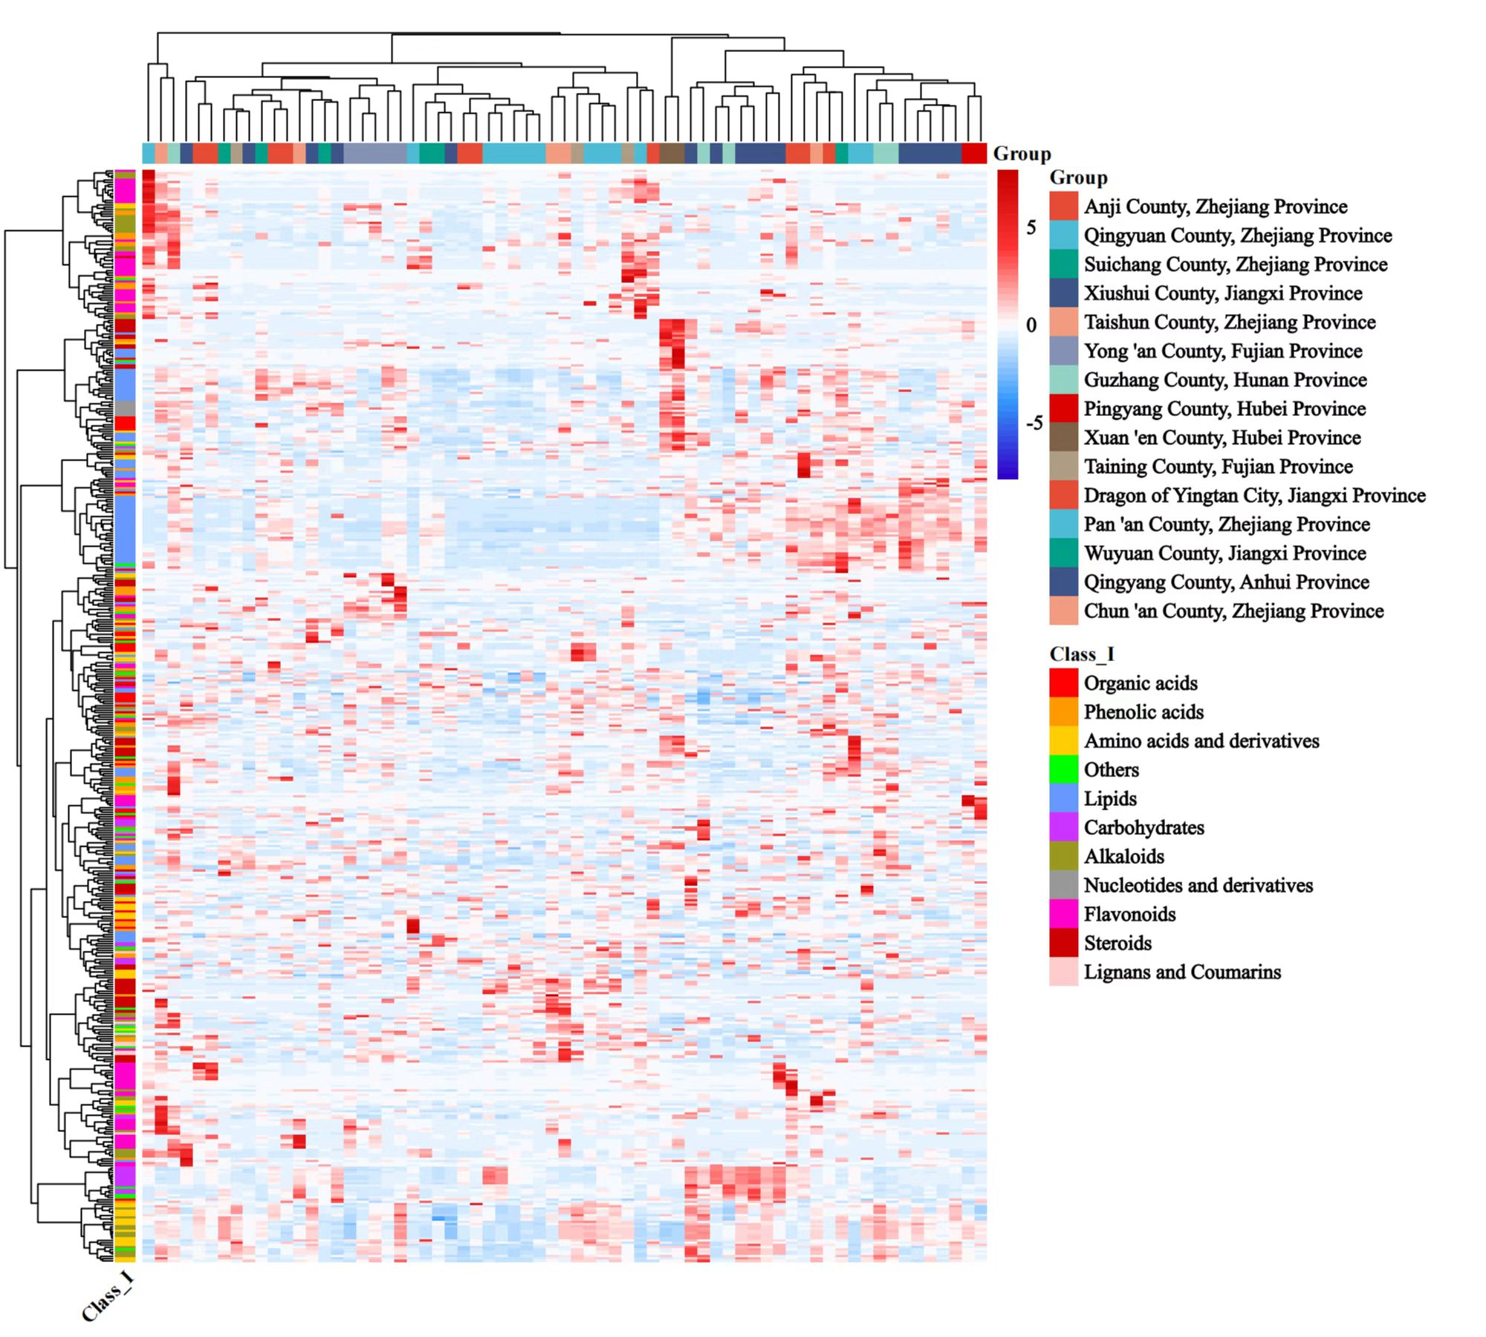
Fig. S1. Heatmap of cluster of 482 metabolites in P. cyrtonema of 67 genotypes from 15 regions.

Slide 2
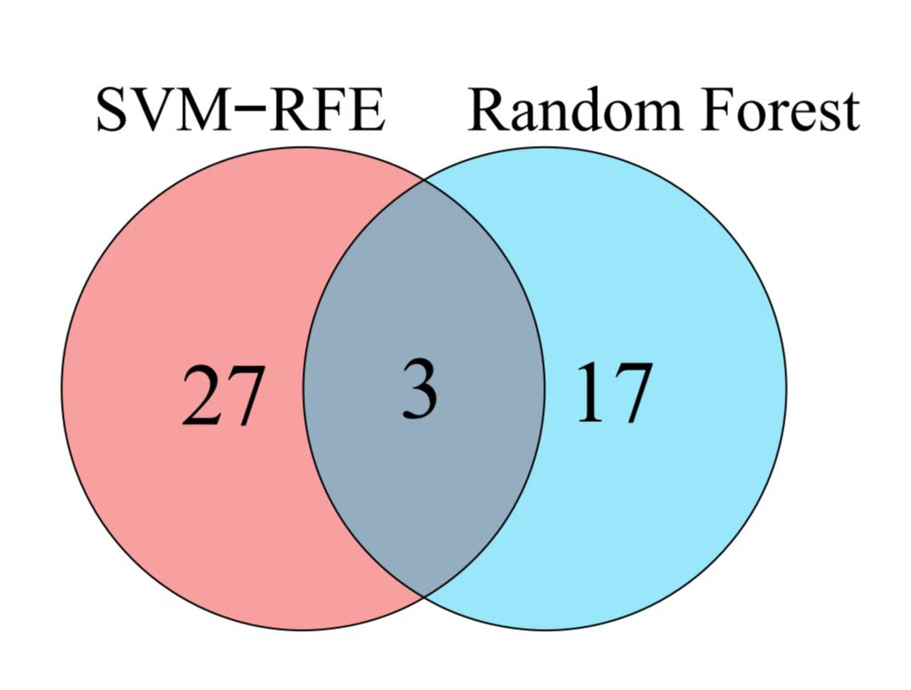
Fig. S2. Venn diagram showing overlapping feature secondary metabolites by SVM-RFE and random forest.

Slide 3
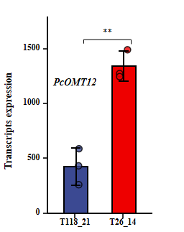
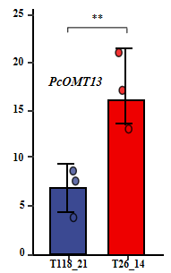

**
Fig. S3. Different transcript expression analysis of differentially expressed genes of PcOMT11 and PcOMT10 among genotypes T118_21 and T26_14.

Slide 4
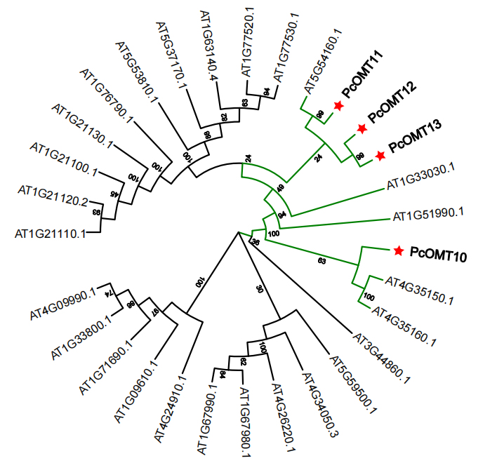
Fig. S4. Phylogenetic analysis of PcOMTs. PcOMT10/11/12/13 sequences in P. cyrtonema and the amino acid sequence of the known O-methyltransferase in Arabidopsis thaliana were aligned using CLUSTALO and the Neighbor-joining tree was constructed using MEGA7 software.

Slide 5
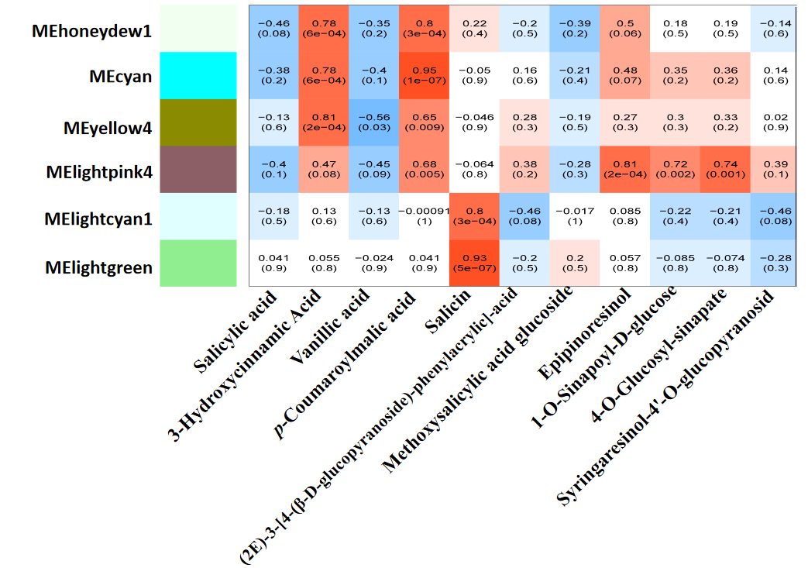
Fig. S5. Module-phenolic acids and lignans weighted correlation analysis.

