Slide 1
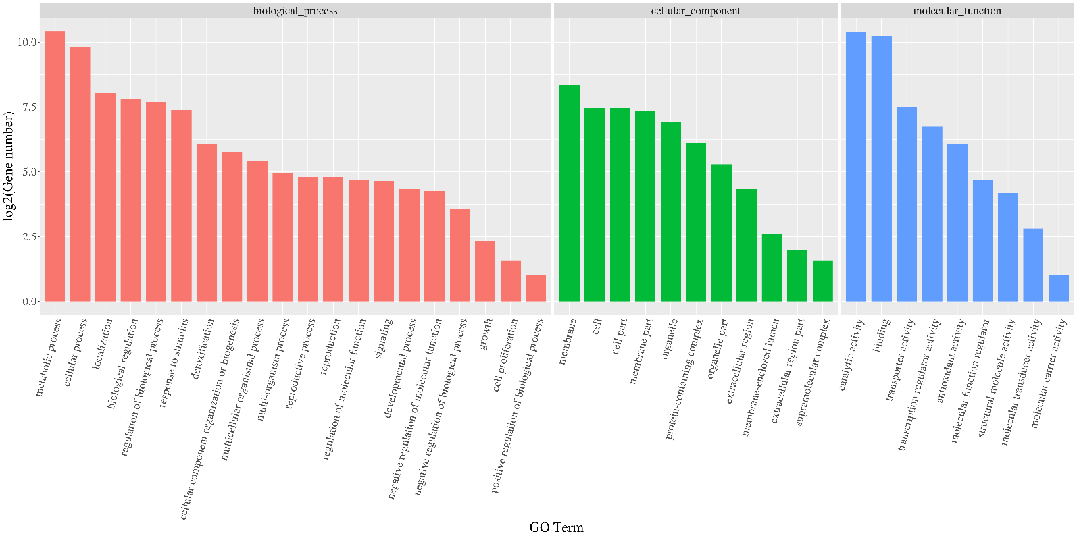
Supplementary Figure 1 GO terms statistics of DEGs enrichment.

Slide 2
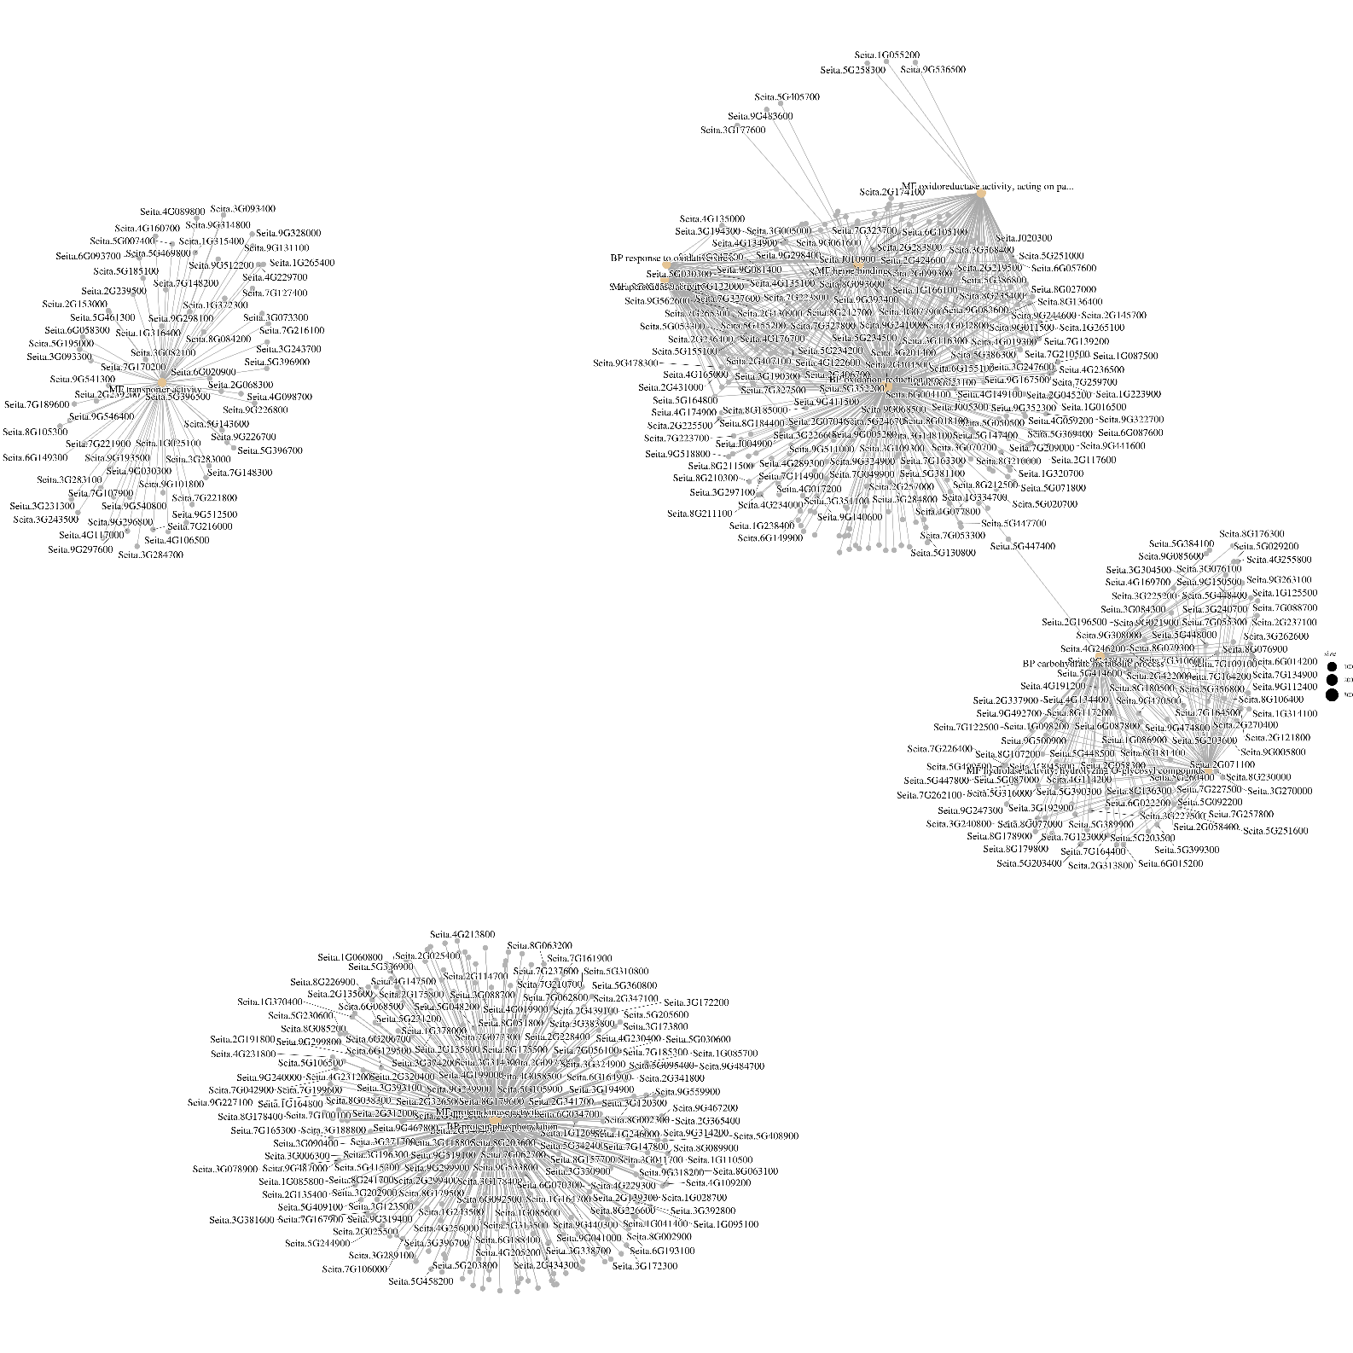
Supplementary Figure 2 GO enrichment network map of DEGs. All GO enrichment results were sorted according to q-value from the smallest to the largest, and the top 10 GO enrichment functions were selected to draw the network diagram.

Slide 3
Supplementary Figure 3 Number of DEGs in the top 10 KEGG
pathways.

Slide 4
Supplementary Figure 4 Expression level of SiSnRK2.6 in the wild-type (ZH11) and overexpression lines. Data are means ± SD (n = 3 biological replicates). SiActin7 was used as the internal control.

