Slide 1
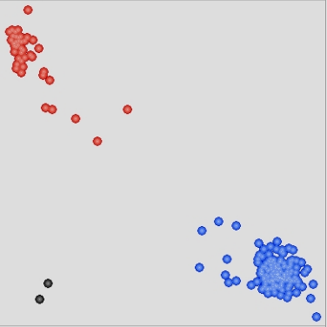
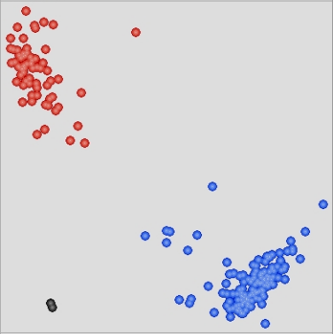
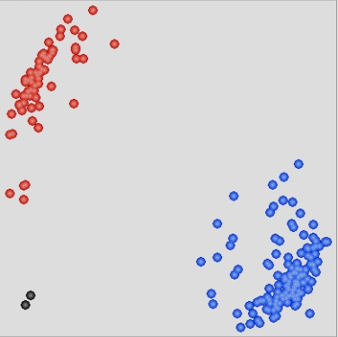
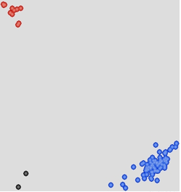
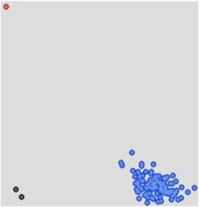
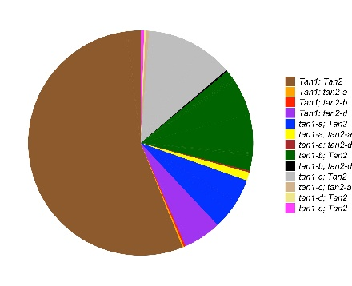
a
KASP-tan1-a
KASP-tan1-b
KASP-tan1-c
KASP-tan2-a
KASP-tan2-b
b
Supplementary Fig.1 (a) KASP assays for recessive tan1 and tan2 alleles in a sorghum diversity panel of 421 accessions collected mainly from East Asia and North America. Within each assay, there was clear separation between nontannin samples (red dots) which contain a recessive tan1 or tan2 allele and tannin samples (blue dots) which contain a wild-type Tan1 and Tan2 allele. Black dots correspond to water controls. (b) Distribution of the Tan1 and Tan2 genotypes in the 421 sorghum accessions.

