Slide 1
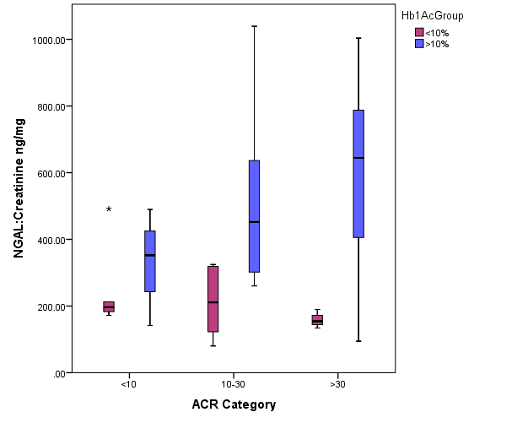
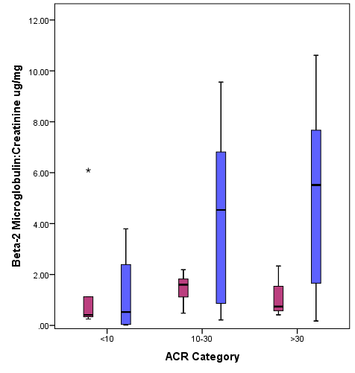
URINARY BIOMARKERS NGAL AND BETA-2 MICROGLOBULIN FOR DETECTION
OF DIABETIC NEPHROPATHY IN TYPE 1 DIABETES MELLITUS
DESIGN AND OUTCOMES: Children 2-18 year old diagnosed with Type 1 diabetes mellitus with minimum disease duration of 2 years compared with age matched non-diabetic controls. Blood sample and 24-hour timed urine sample analyzed.
HYPOTHESIS: Hyperglycemia causes tubular damage earlier than glomerular damage in diabetic nephropathy
CONTROLS
N=40
CASES
N=40
Mean HbA1C
8.9 g%
12.6 g%
eGFR ml/min/m² | 135.2 | 181.7
UACR µg/mg | 6.49 | 19.48
NGAL/Cr ng/mg | 190.5 | 352.4
β2M/Cr µg/mg | 2.12 | 1.7
n=13
n=27
Median values; ACR Albumin to creatinine ratio; β2M Beta- 2 microglobulin; GFR Glomerular filtration rate;
NGAL Neutrophil Gelatinase-Associated Lipocalin
Microalbuminuria 14/40 cases (35%)
 | UACR | eGFR
NGAL/ Cr | r= 0.38 | r= 0.38
β2M/Cr | r= 0.42 | r= 0.46
Correlation
(p<0.05 in all)
CONCLUSION: Urinary biomarkers NGAL and β2M showed a good correlation with ACR suggesting their role in screening of diabetic tubulopathy before overt glomerular damage in T1DM
Sachan et al. 2023

