Slide 1
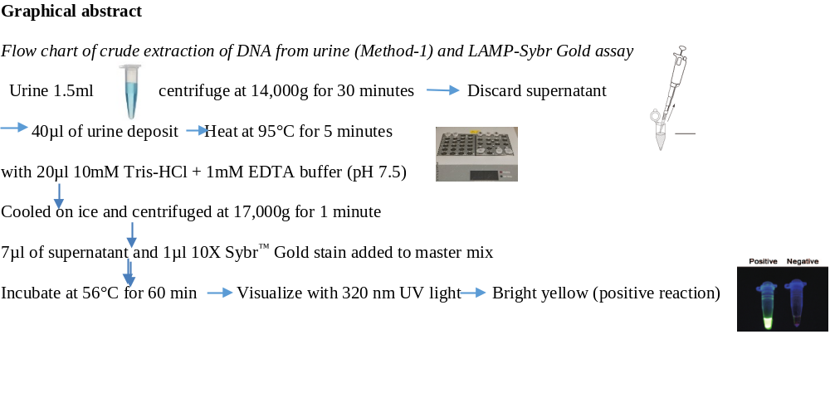
LAMP-Sybr Gold assay with crude extract (method 1)
Compared to a real time PCR, LAMP assay had sensitivity, specificity, positive predictive and negative predictive values of 71.4%, 99.7%, 96.2%, 96.7% respectively

