Slide 1
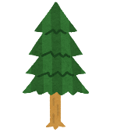

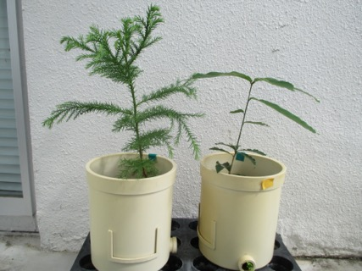
Cryptomeria
japonica
Quercus
serrata
(a)
(b)
Coniferous
forest soil
Broad-leaved
forest soil
Fig. S1

Slide 2
An initial full model
Soil
Fung
F/B
Soil
PC1
Bact
Pred&Omni
Root
biomass
Tree
Herb
Fig. S2

Slide 3
CC
CQ
QC
QQ
Fig. S3

