Slide 1
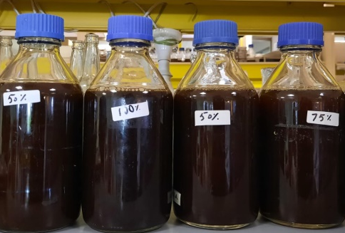
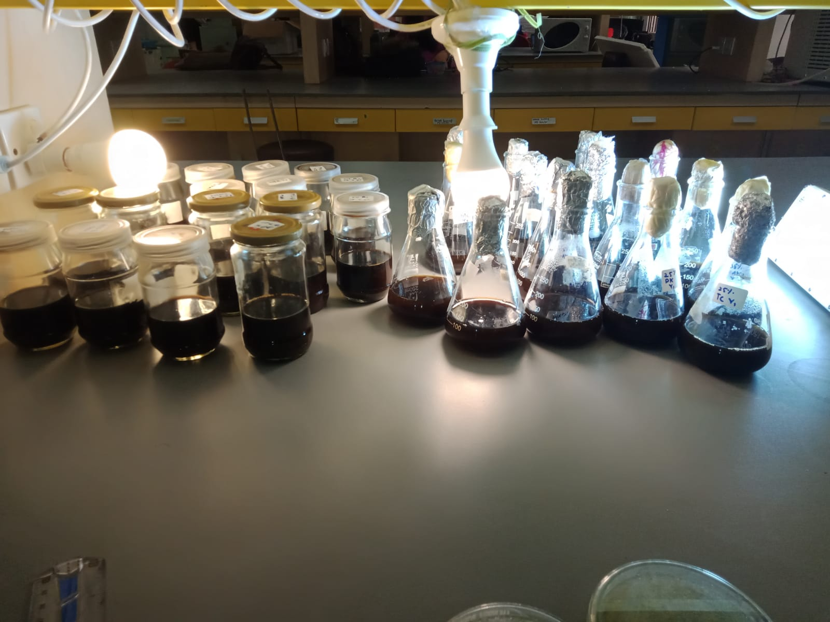

Cultivation of microalgal species in food-based brewery wastewater
COD, BOD, TN
Removal rates
Food-based industrial wastewater
Wastewater Treatment
Zn, Mn, Ni, Fe, Cr, Cd, Pb, Se, Al, Ba, As, Co and NO₃N
Removal rates
Bligh and Dyer Method
Total Lipid
Lipid Production
FAME:
GC-MS
Microalgal cultivation in FWW

