Slide 1
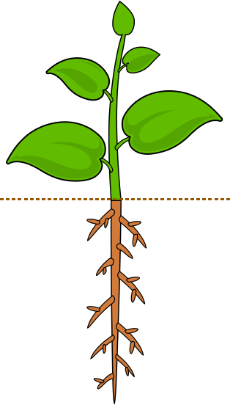
Non-stressed conditions
Under stressed conditions
Increasing
salt and high-temperature stress tolerance
Decreased MDA accumulation and membrane damages
Promoting plant growth
Reduced oxidative damage
Regulate stomata closure, antioxidant enzyme, Osmoregulation
ROS homeostasis
Protein stability
Proline accumulation modification
SOD/CAT regulation
HSP70 express regulation
BzaHS1
BzaHS1 VOCs

