Slide 1
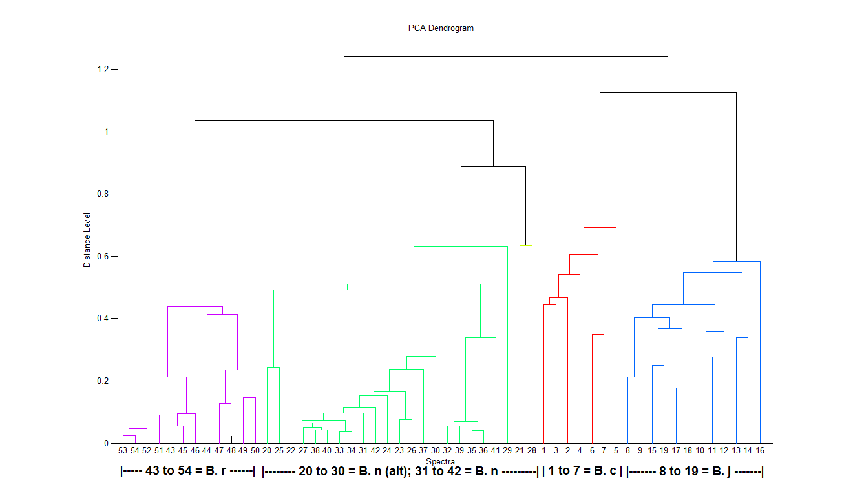
A
Additional File 1A. Clustering of protein spectra corresponding to four Brassica species. B. c (Brassica carinata), B. r (Brassica rapa), B. j (Brassica juncea), B. n (Brassica napus), alt = Winter variety.
Notes:
PCA creation: Bio Typer PCA Creation standard Method - 3-15kDa
PCA clustering: : Bio Typer PCA Creation standard Method hier - method: hierarchical, distance measure: euclidean, linkage algorithm: average, maximal cluster:4, maximal number of top level nodes: 0

Slide 2
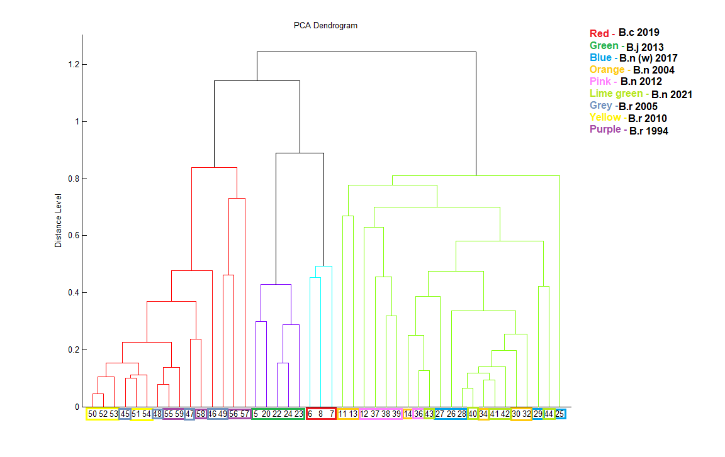
B
1
4
3
2
Additional File 1B. Clustering of protein spectra corresponding to four Brassica species including two species with accessions from different years. Cluster 1: Brassica rapa, 2: Brassica juncea, 3: Brassica carinata, 4: Brassica napus. Winter B. napus (w). Color legends show the year the accession was collected.

