Slide 1
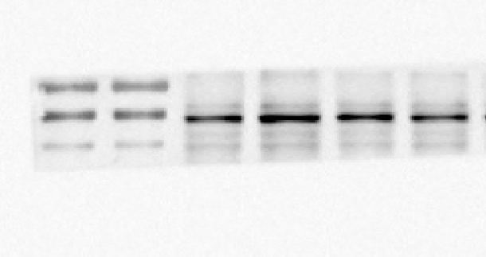
Fig 5A TLR4
Fig 5A RIPK3
Fig 5A GAPDH
Fig 5B MLKL

Slide 2
Fig 5B GAPDH
Fig 6C TLR4
Fig 6C RIPK3
Fig 6C MLKL

Slide 3
Fig 6C GAPDH

