Slide 1
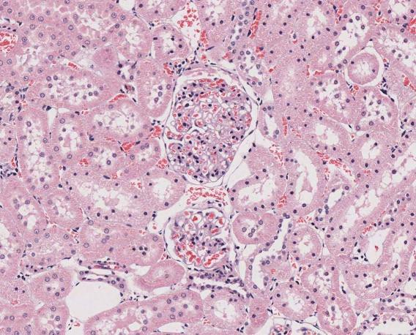
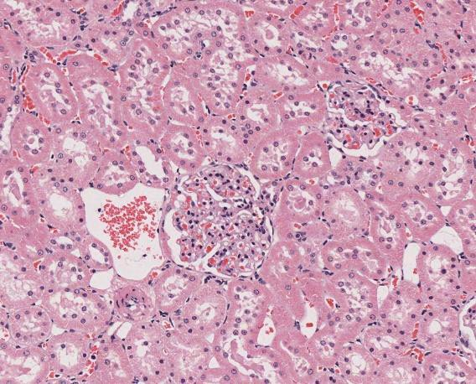
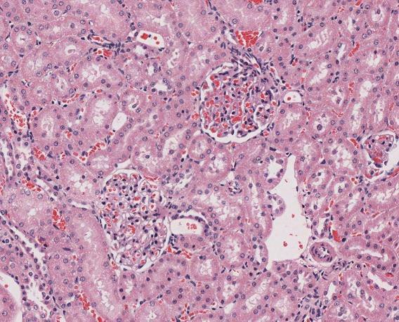
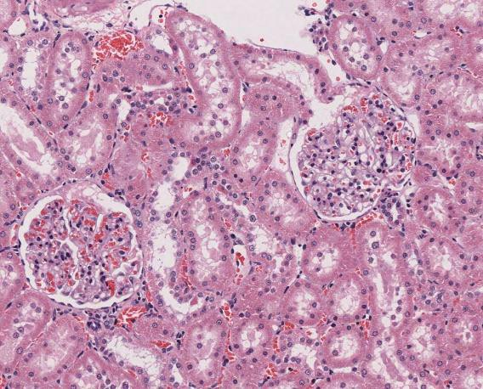
Supplementary Figure 1(A).
Control
1000 mg/kg/day
Male 50 μm |  | 50 μm
Female 50 μm |  | 50 μm

Slide 2
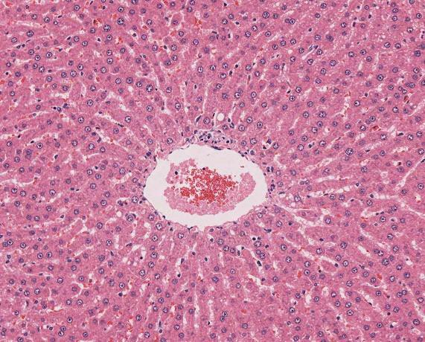
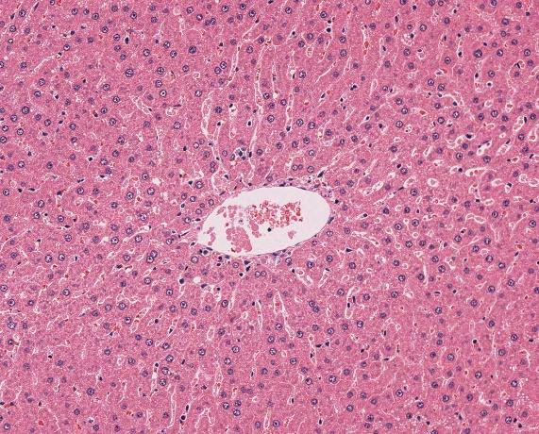
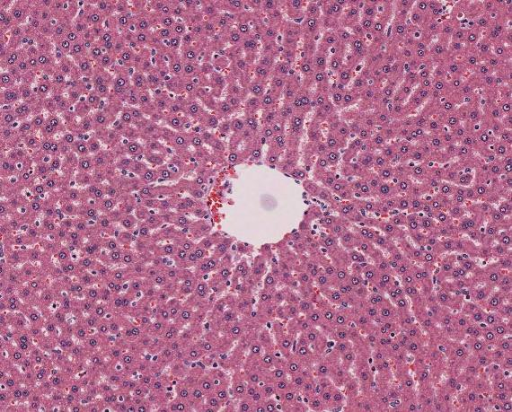
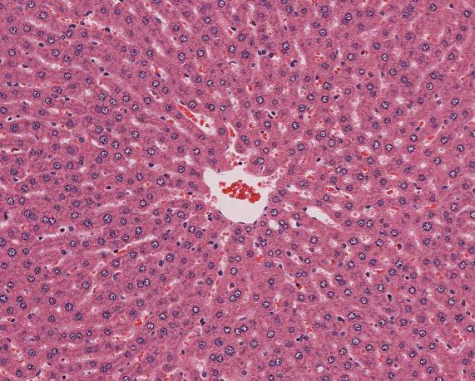
Supplementary Figure 1(B).
Control
1000 mg/kg/day
Male 50 μm | 50 μm
Female 50 μm | 50 μm

Slide 3
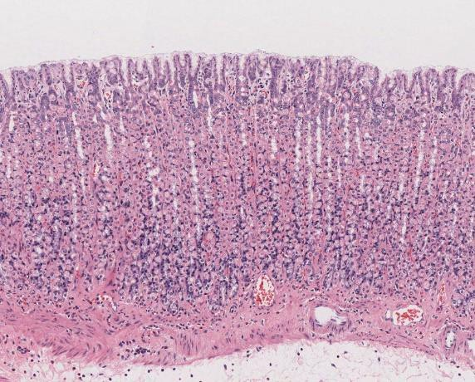
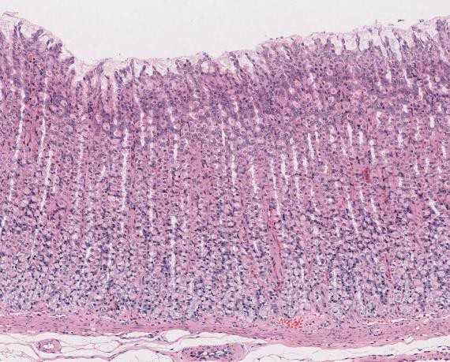
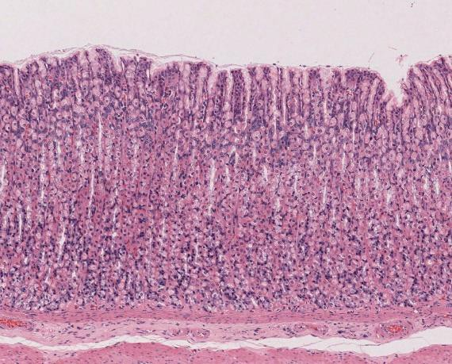
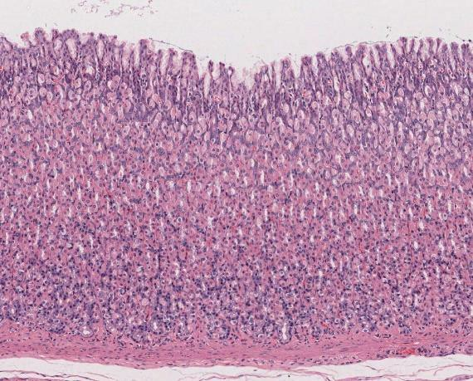
Supplementary Figure 1(C).
Control
1000 mg/kg/day
Male
100 μm
100 μm
Female
100 μm
100 μm

Slide 4
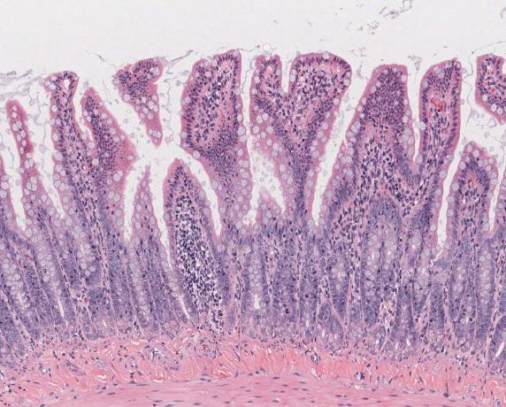
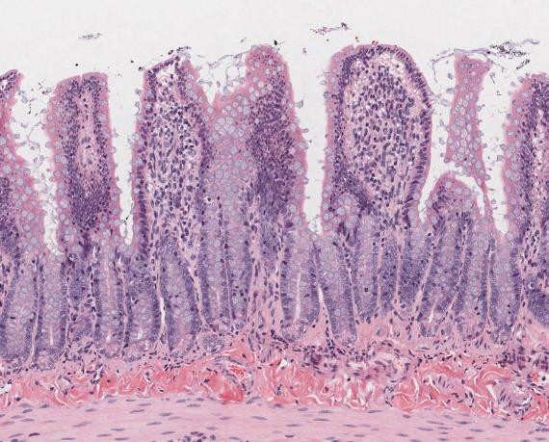
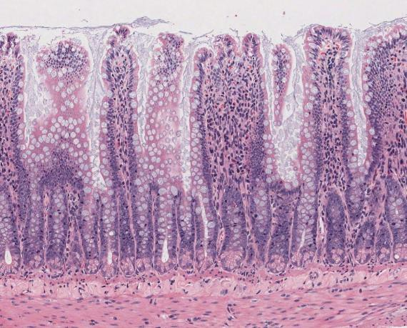
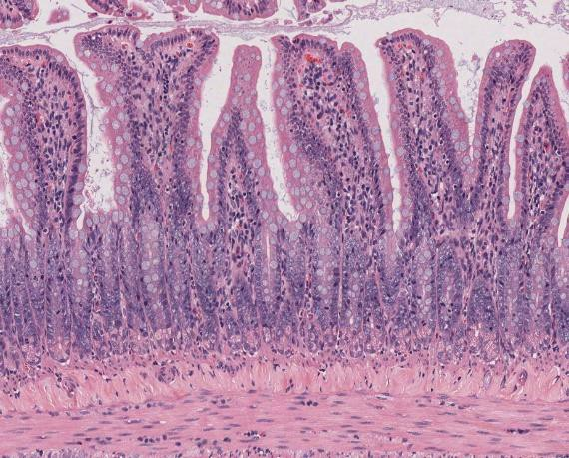
Supplementary Figure 1(D).
Control
1000 mg/kg/day
Male
50 μm
50 μm
Female
50 μm
50 μm

Slide 5
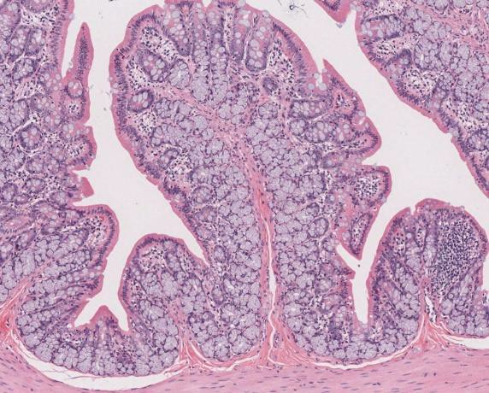
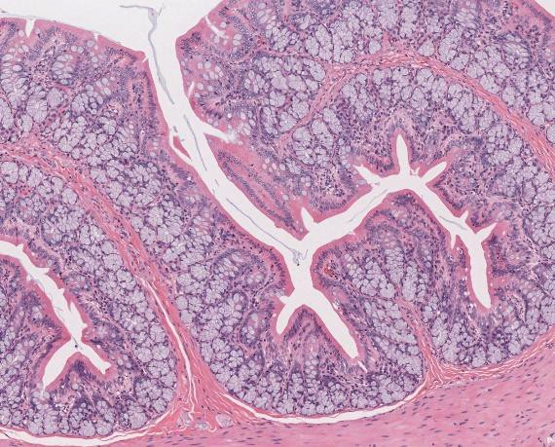
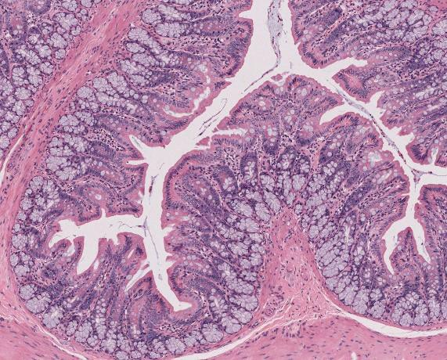
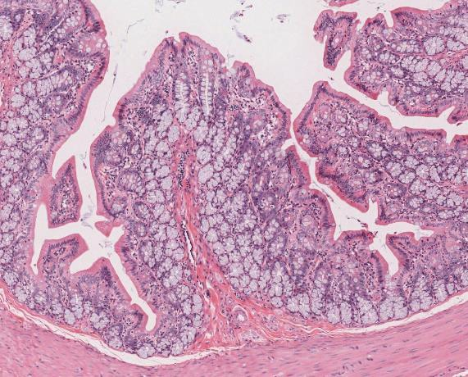
Supplementary Figure 1(E).
Control
1000 mg/kg/day
Male 100 μm | 100 μm
Female 100 μm | 100 μm

Slide 6
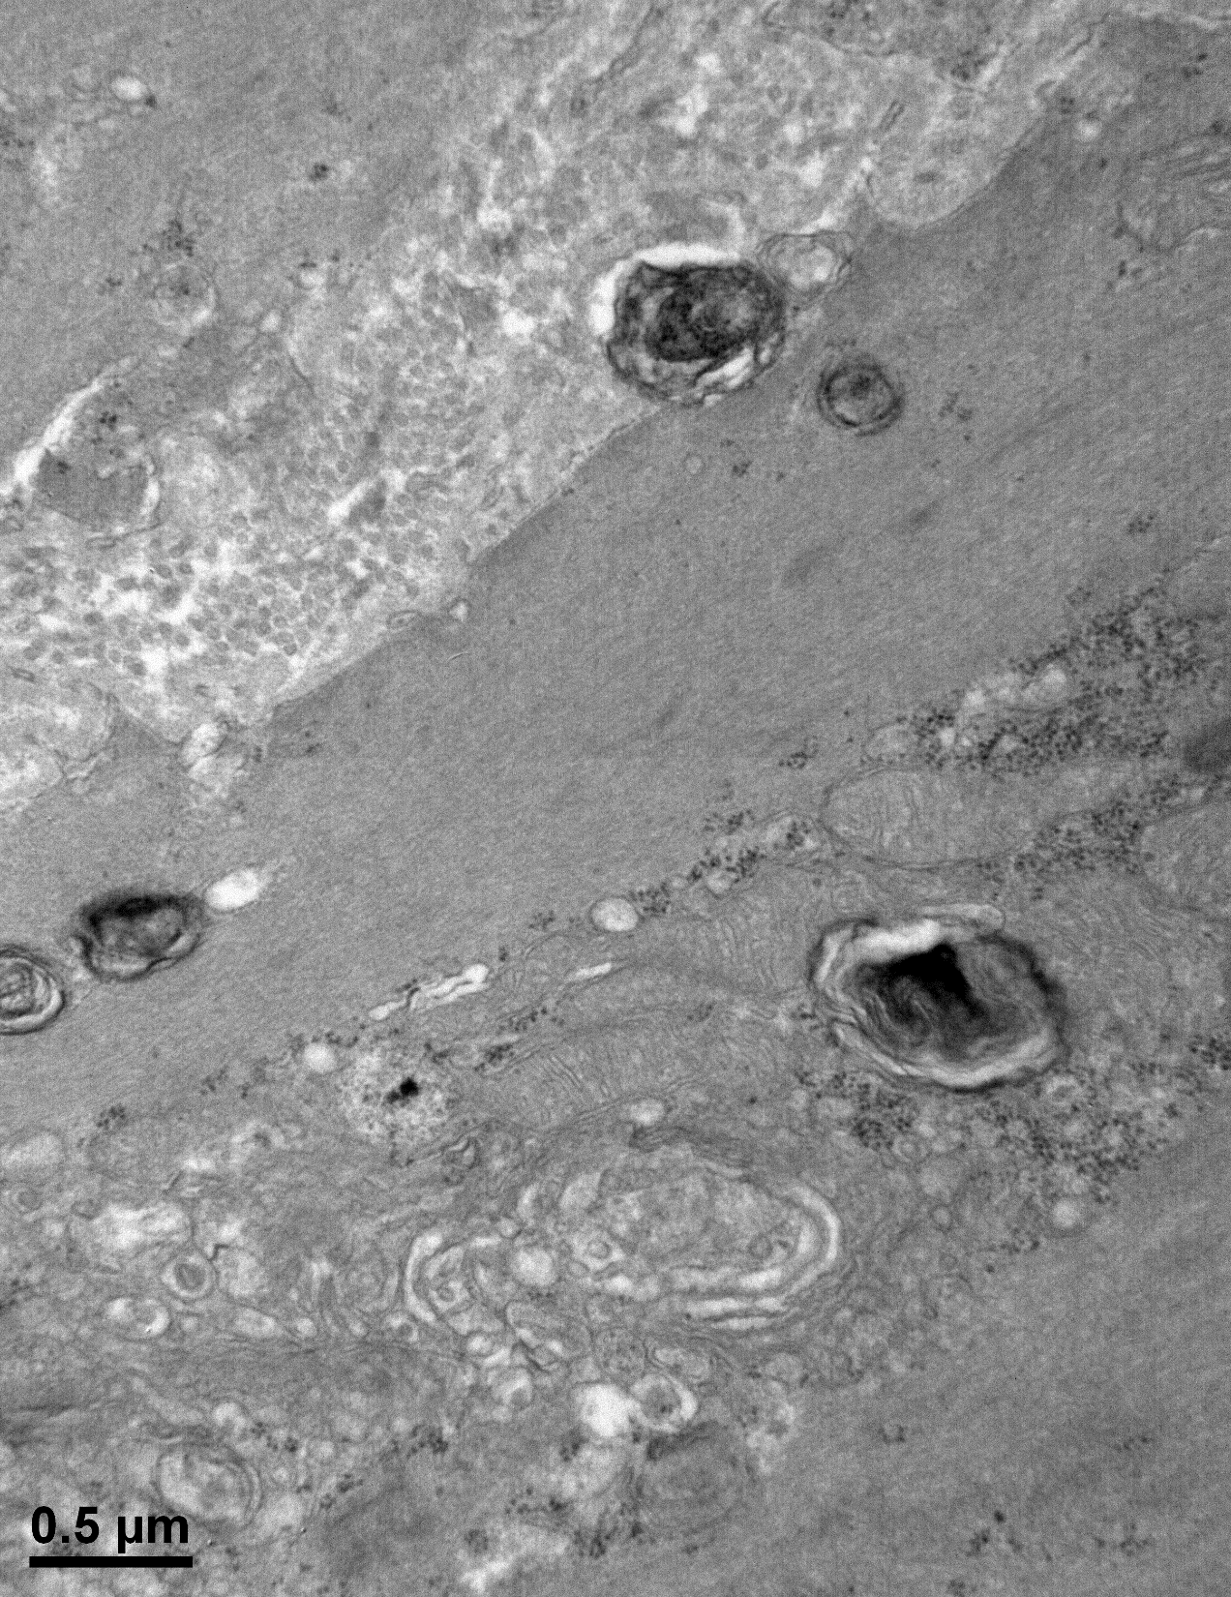
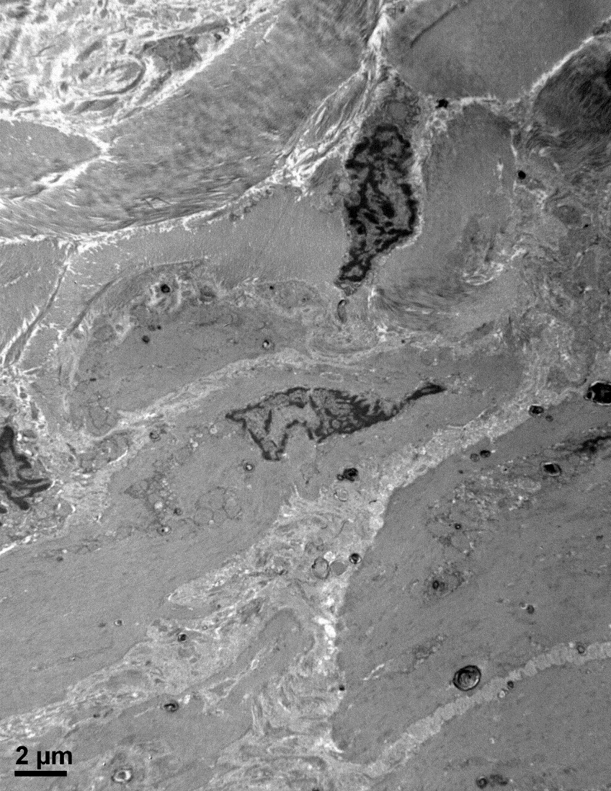
Supplementary Figure 2(A).
Lamella-like structures
Accumulation of E171

Slide 7
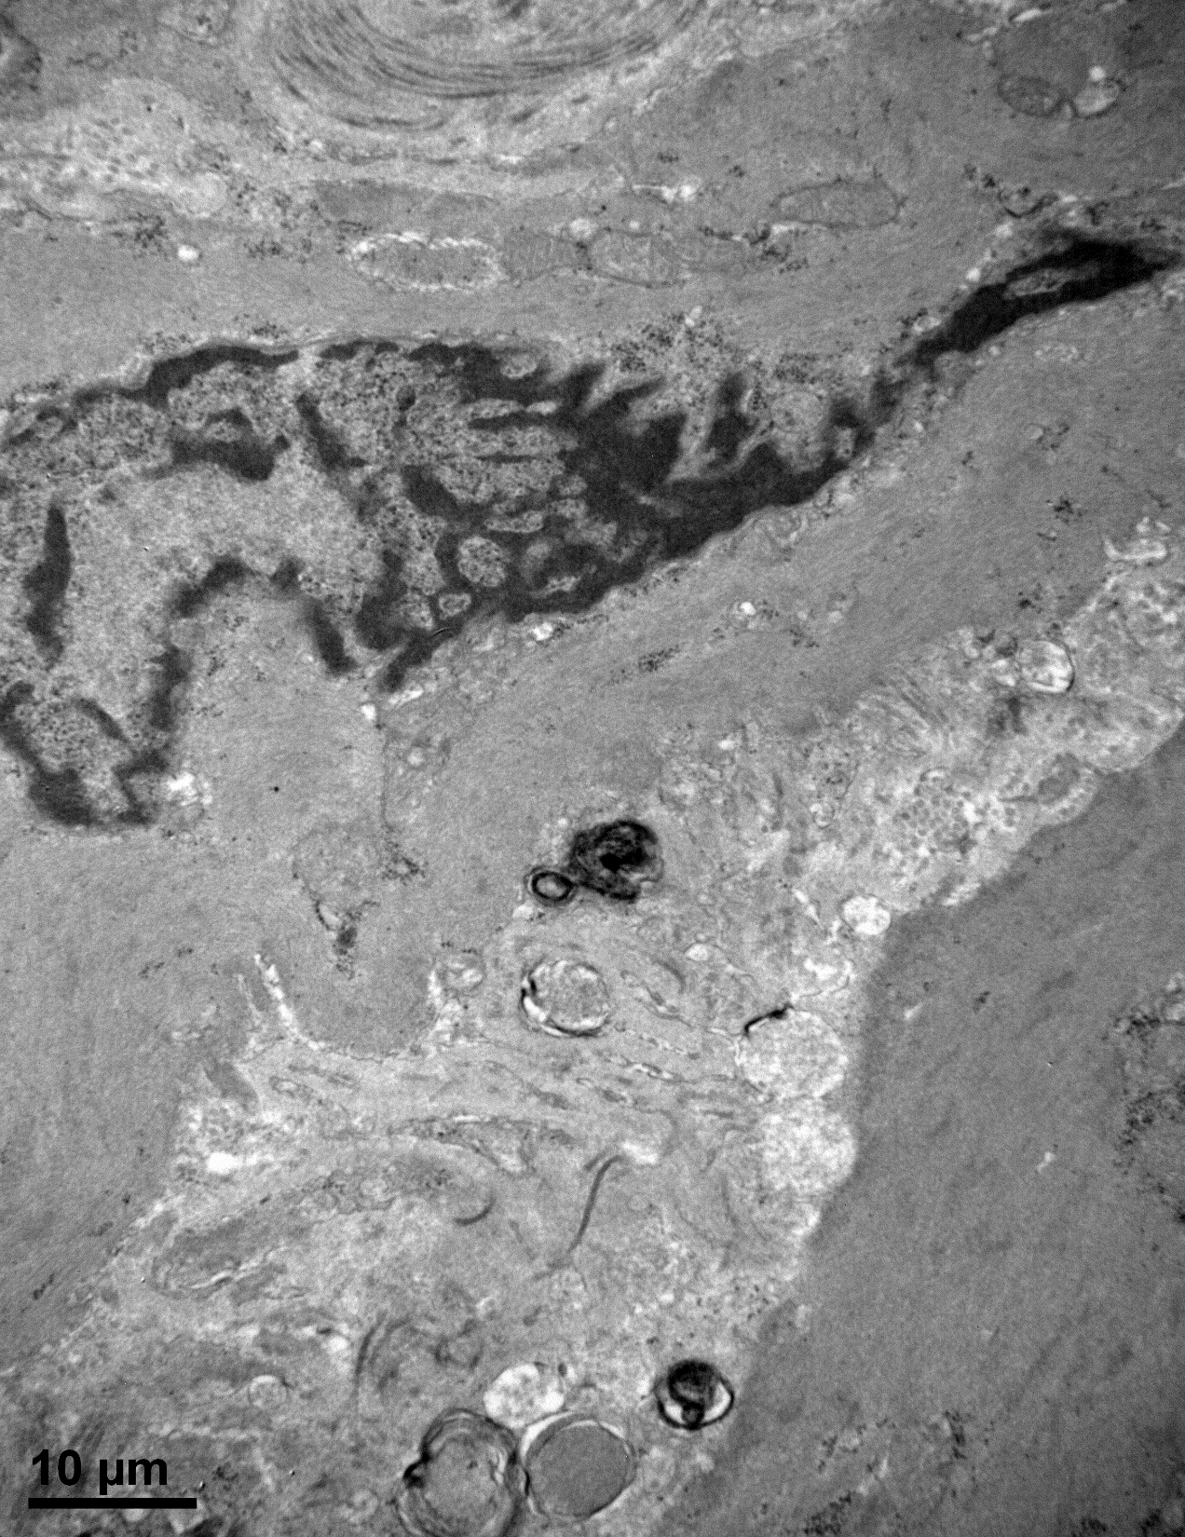
Supplementary Figure 2(B).
Lamella-like structures
Accumulation of E171

Slide 8
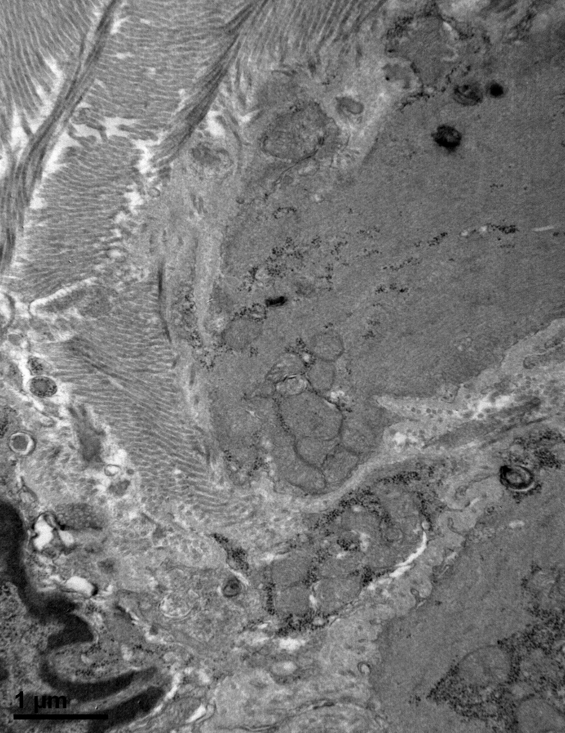
Supplementary Figure 2(C).
Lamella-like structures
Accumulation of E171

Slide 9
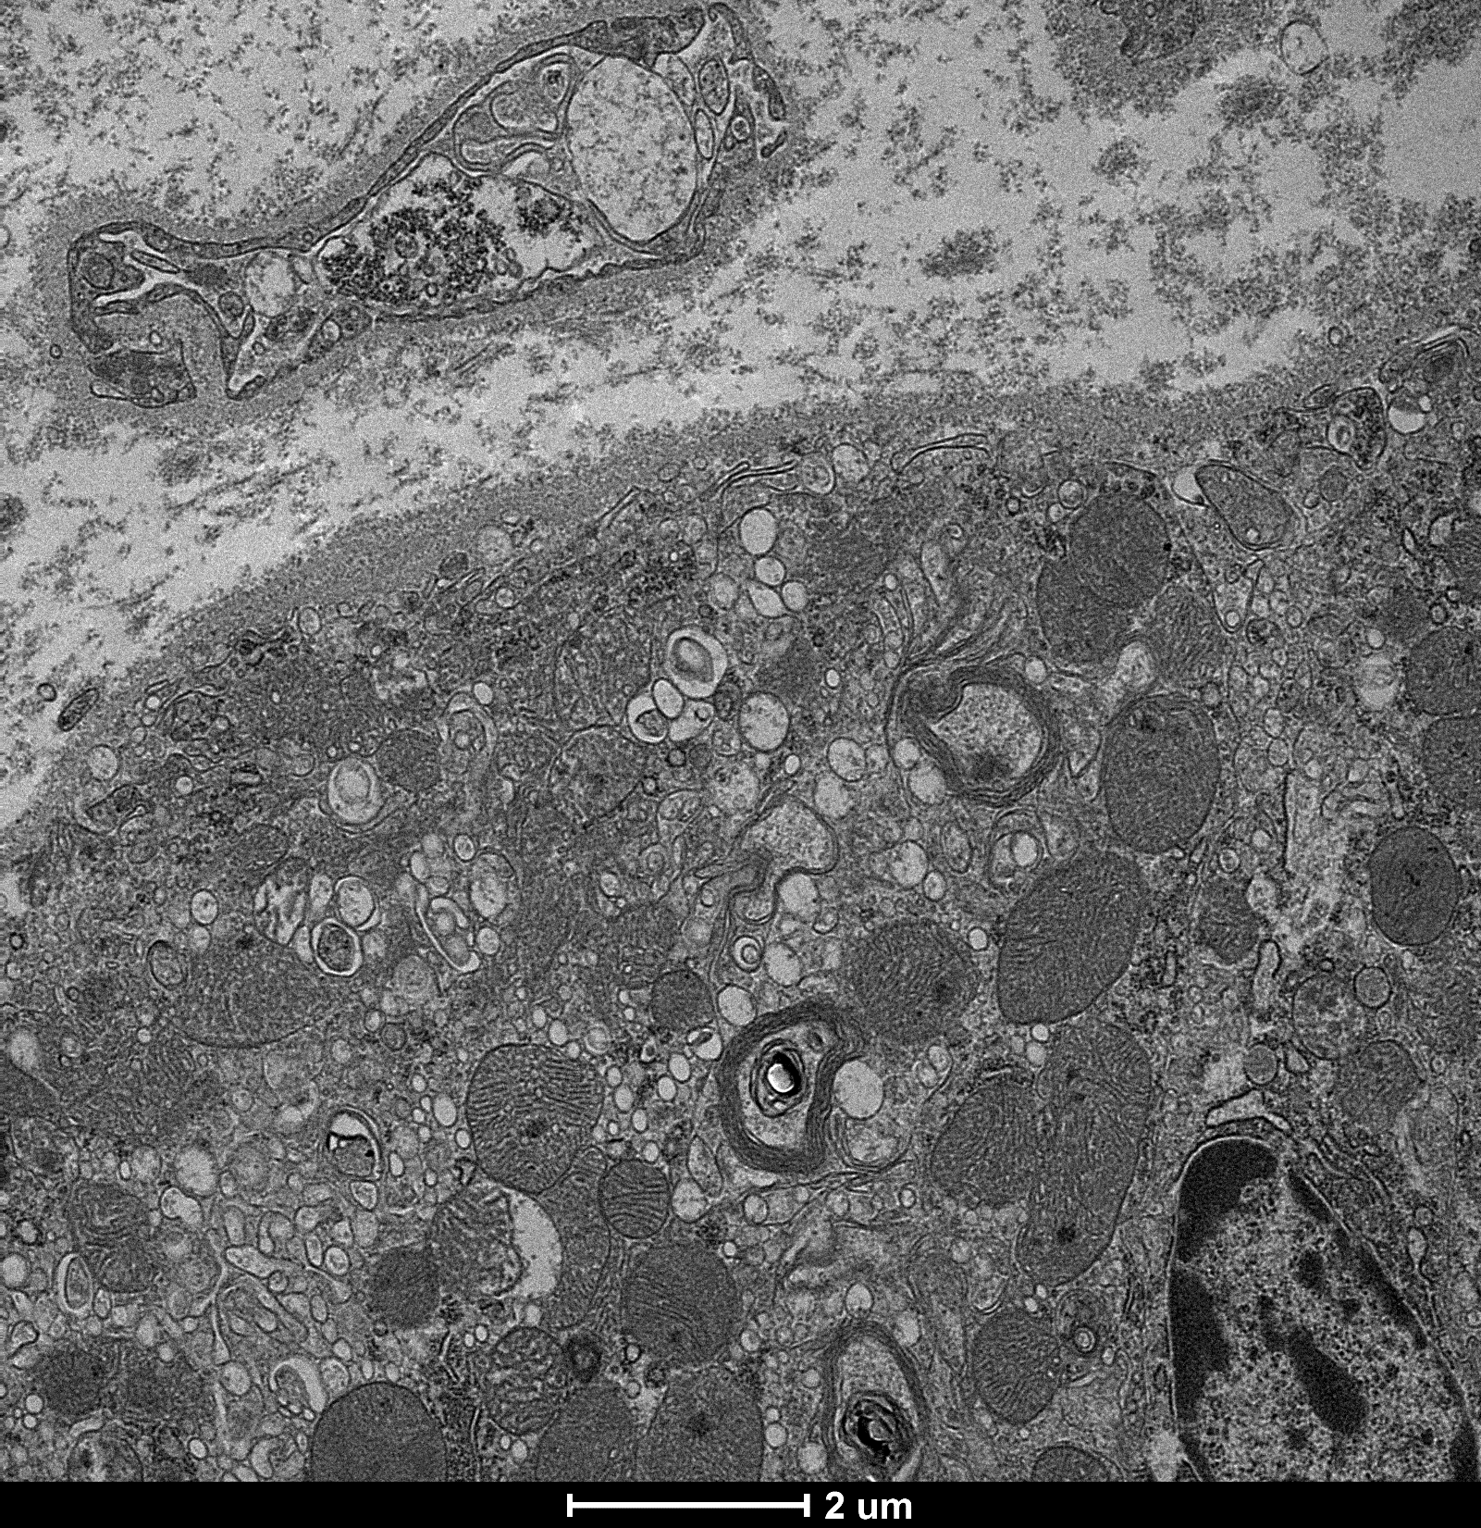
Supplementary Figure 2(D).
Accumulation of E171
Lamella-like structures

Slide 10
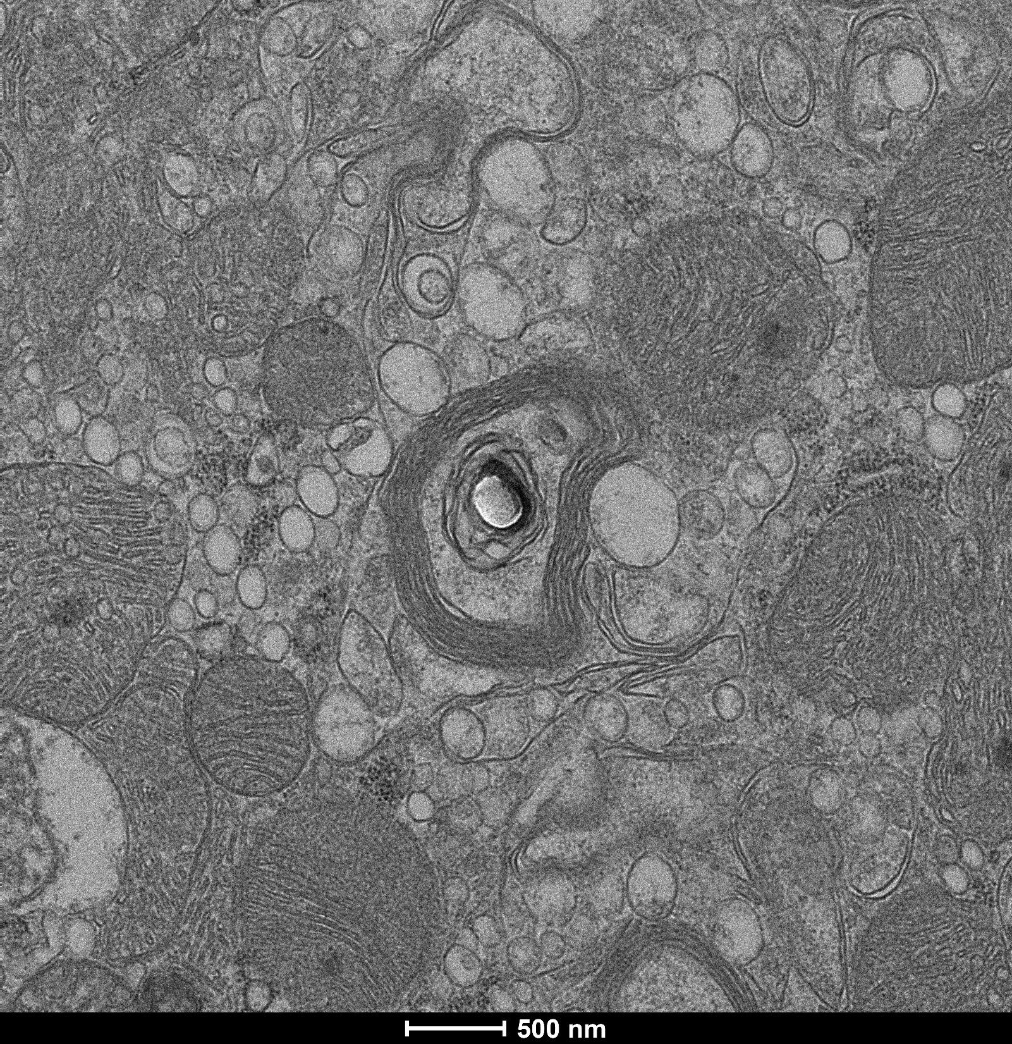
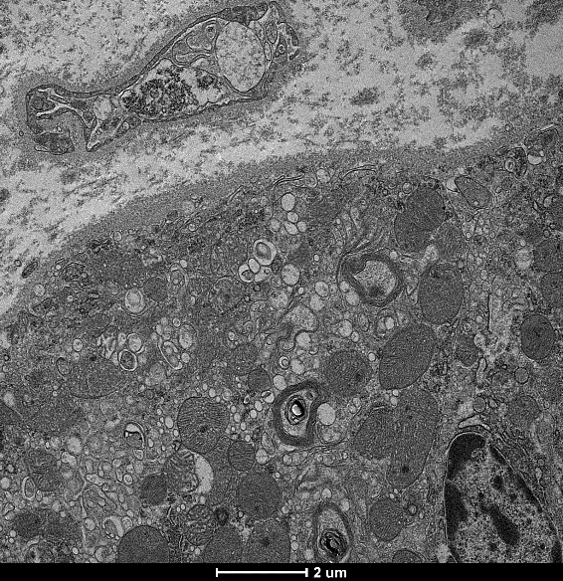
Supplementary Figure 2(E).
Lamella-like structures
Accumulation of E171

Slide 11
Supplementary Figure 2(F).
Lamella-like structures
Accumulation of E171

Slide 12
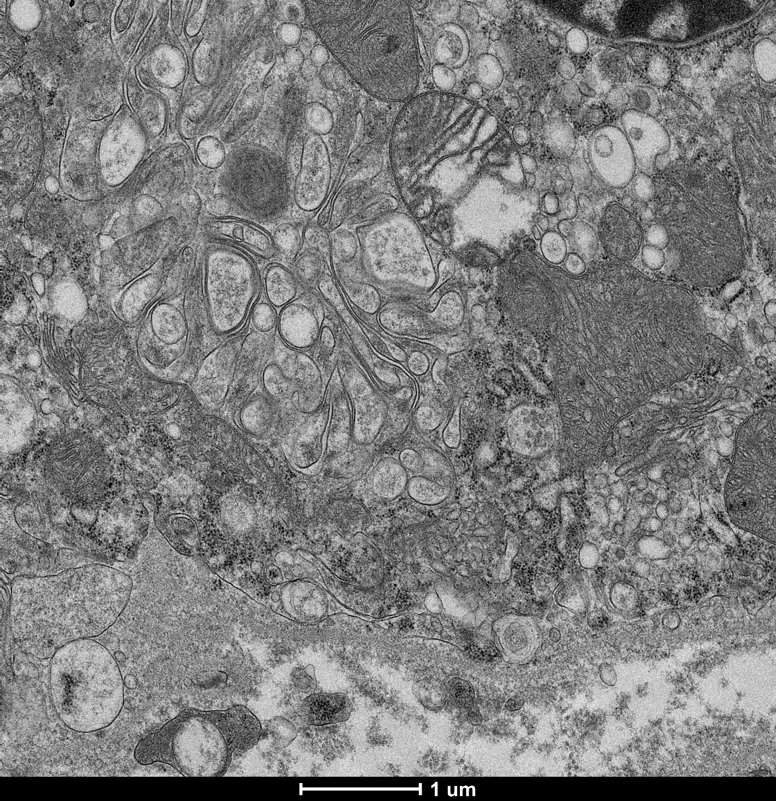
Supplementary Figure 2(G).
Accumulation of E171
Lamella-like structures

Slide 13
Ti
Cu
Zn
Mn
Fe
Al

