Slide 1
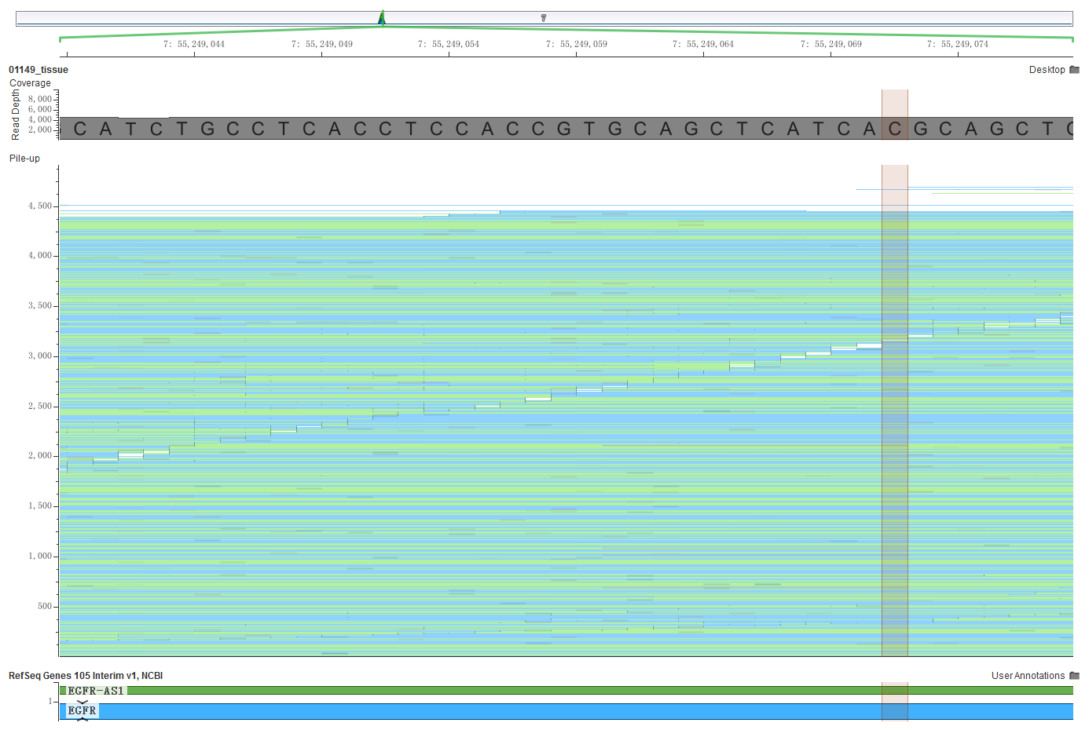
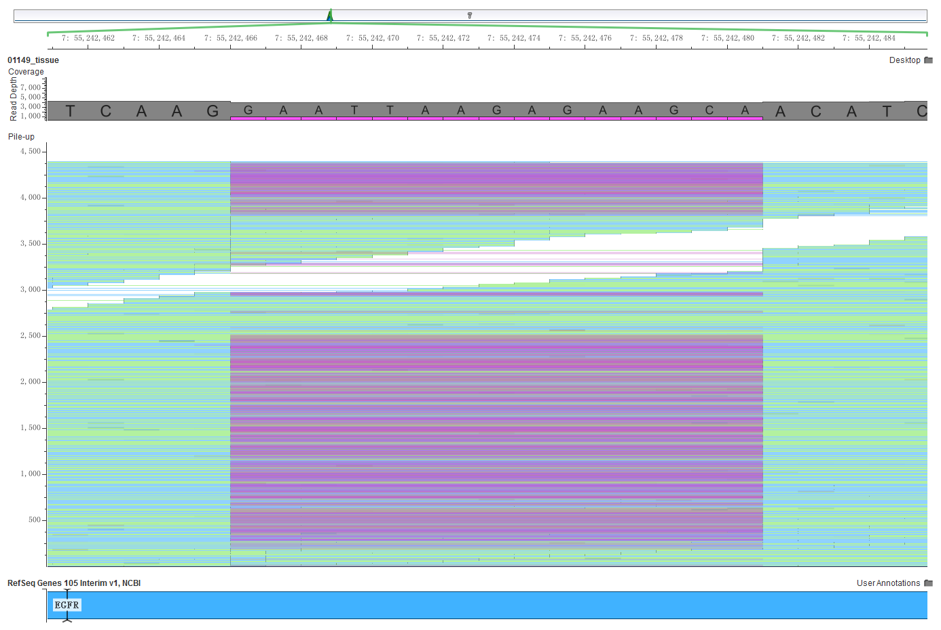
a
EGFR:c.2236_2250del15

Slide 2
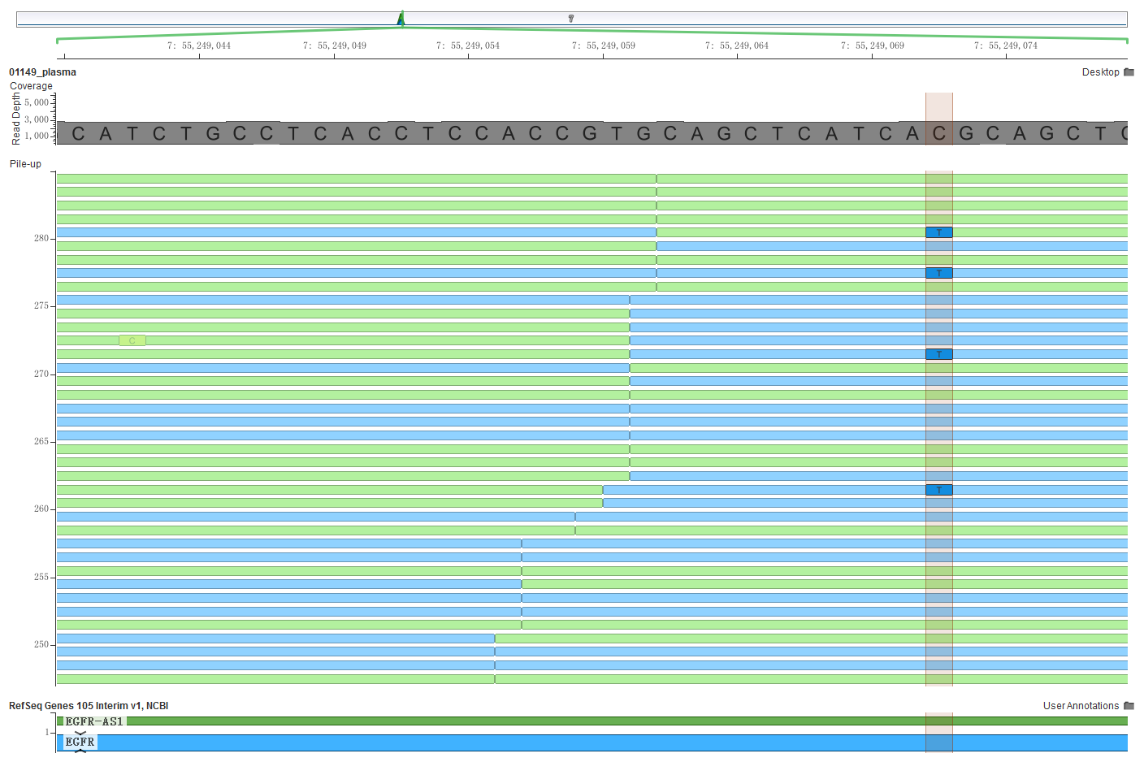
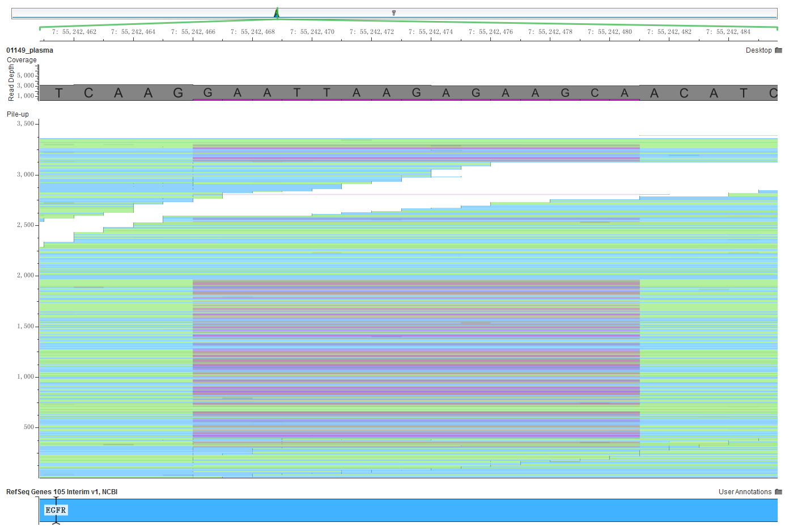
b
EGFR:c.2236_2250del15

Slide 3
Supplementary Fig. 1 Sequencing reads pile-up and mutation status of the EGFR gene in the tissue (a) and ctDNA (b) using GenomeBrowse (version 3.0.0) software (http://www.genome.jp/dbget-bin/www_bget?refseq; accession number NM_005228.3:exon19:c.2236_2250del:p.746_750del; accession number EGFR:NM_005228:exon20:c.C2369T:p.T790M)

