Slide 1
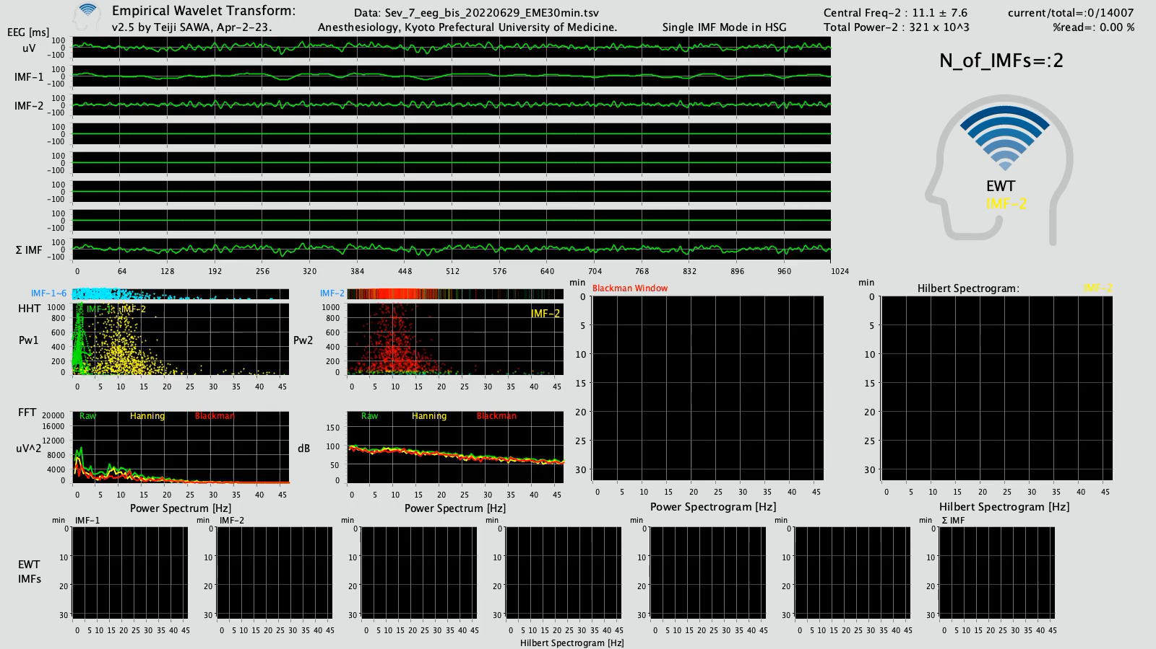
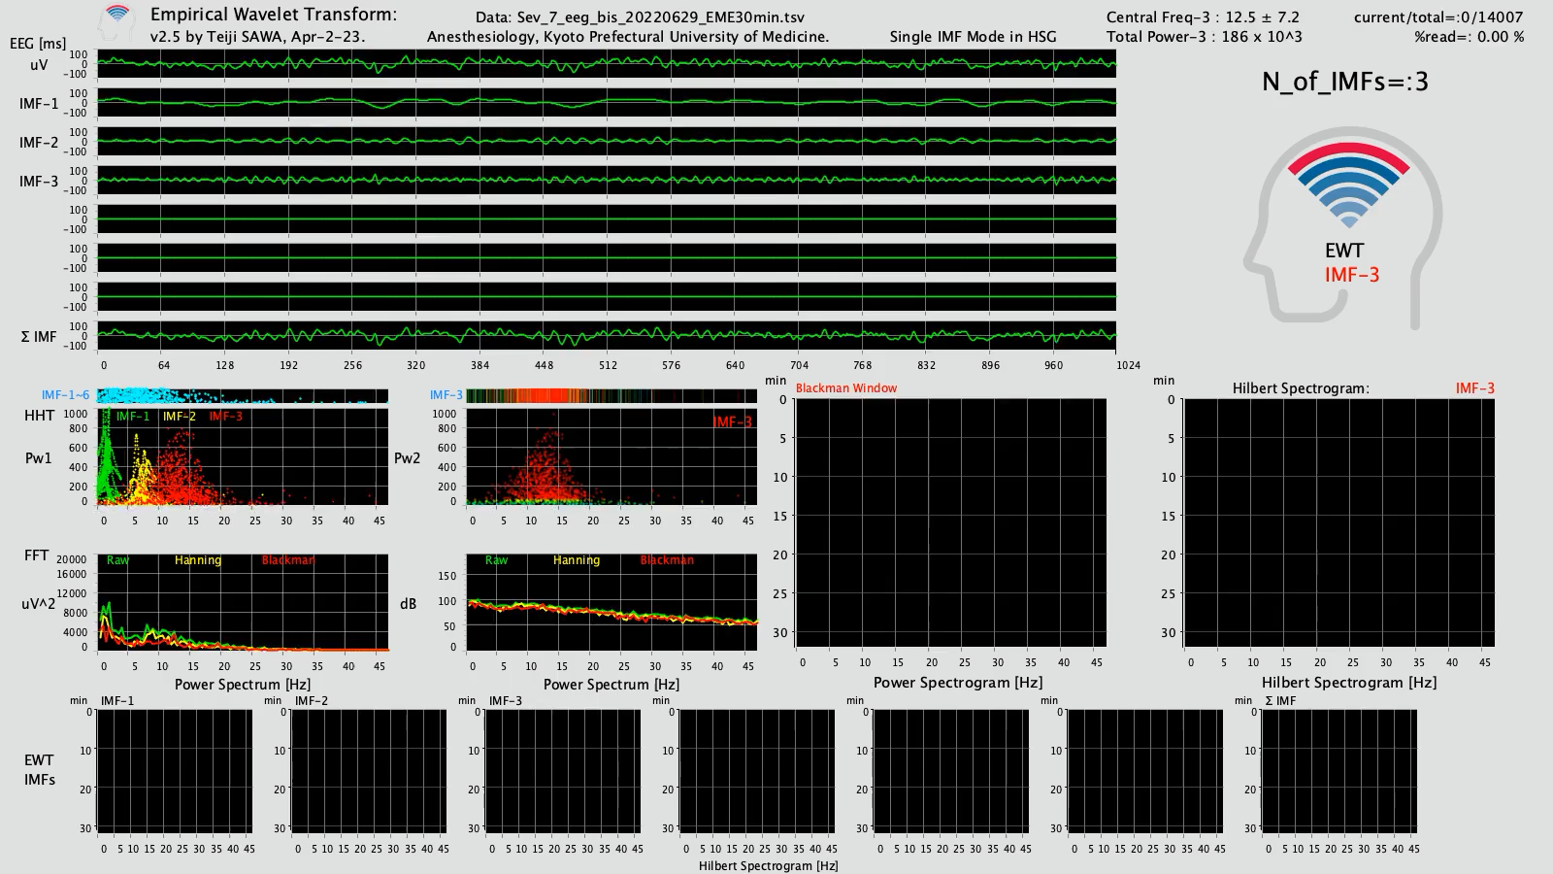
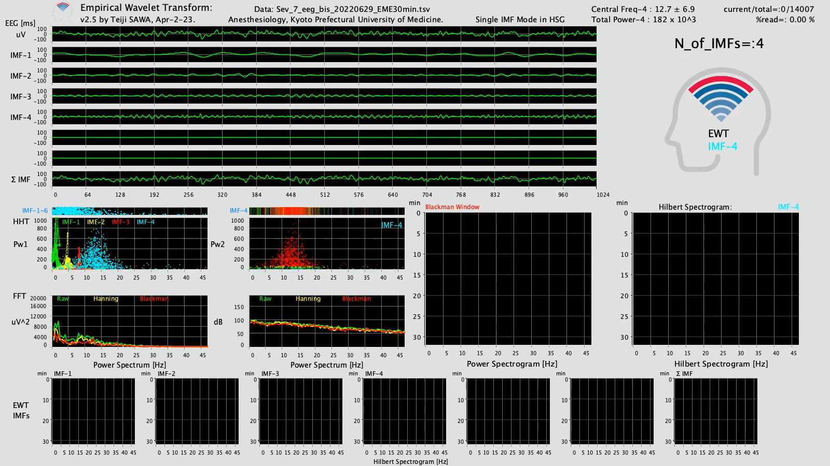
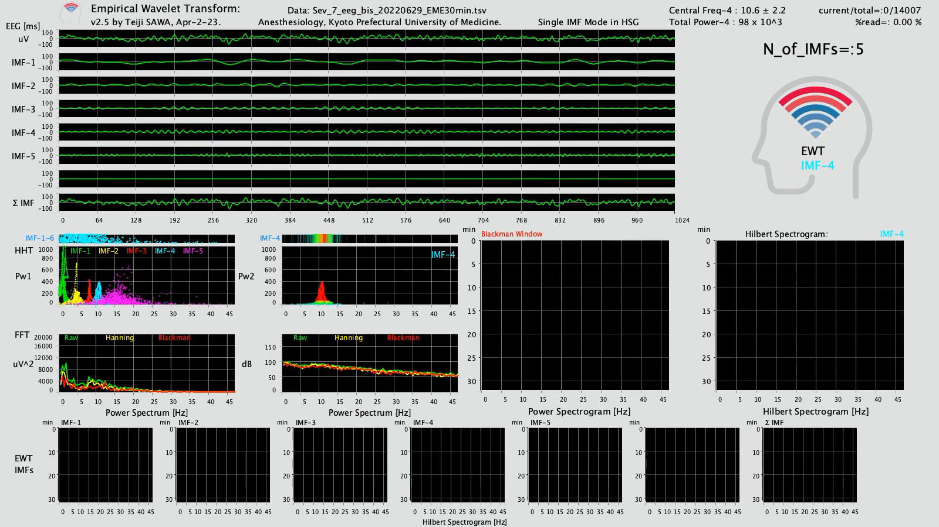
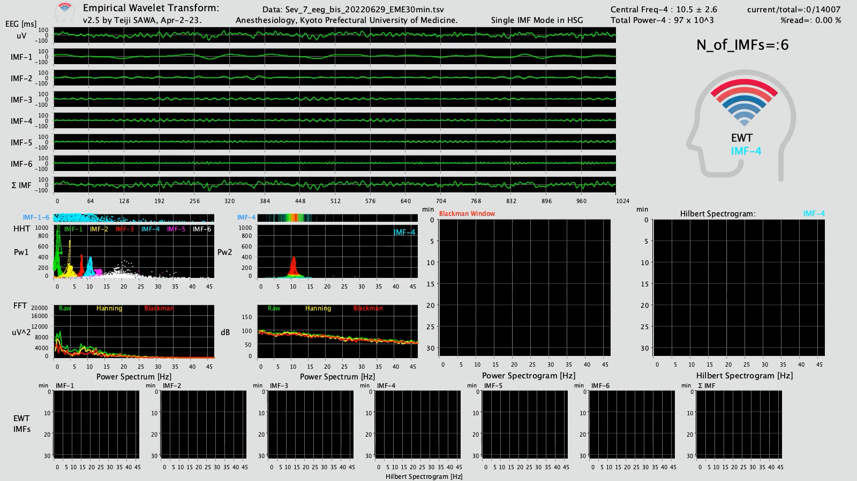
Empirical Wavelet Transform (EWT)
N of IMF = 2
N of IMF =3
A case (27F, Sevoflurane)
30 min to emergence
IMF-2
IMF-3
N of IMF =4
N of IMF =5
N of IMF =6
IMF-4
IMF-4
IMF-4

Slide 2
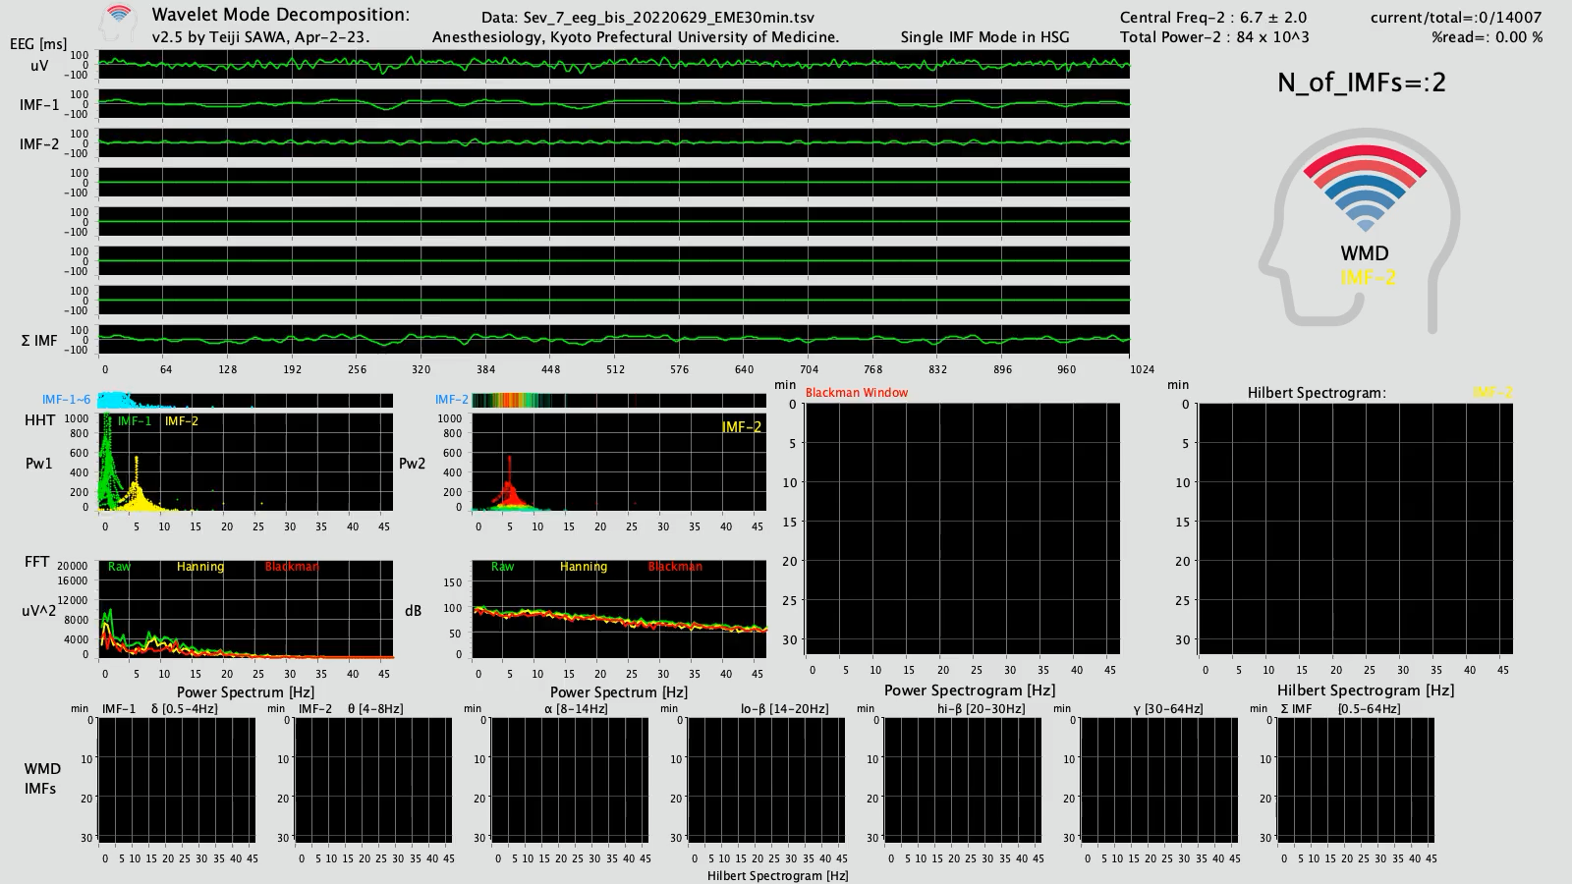



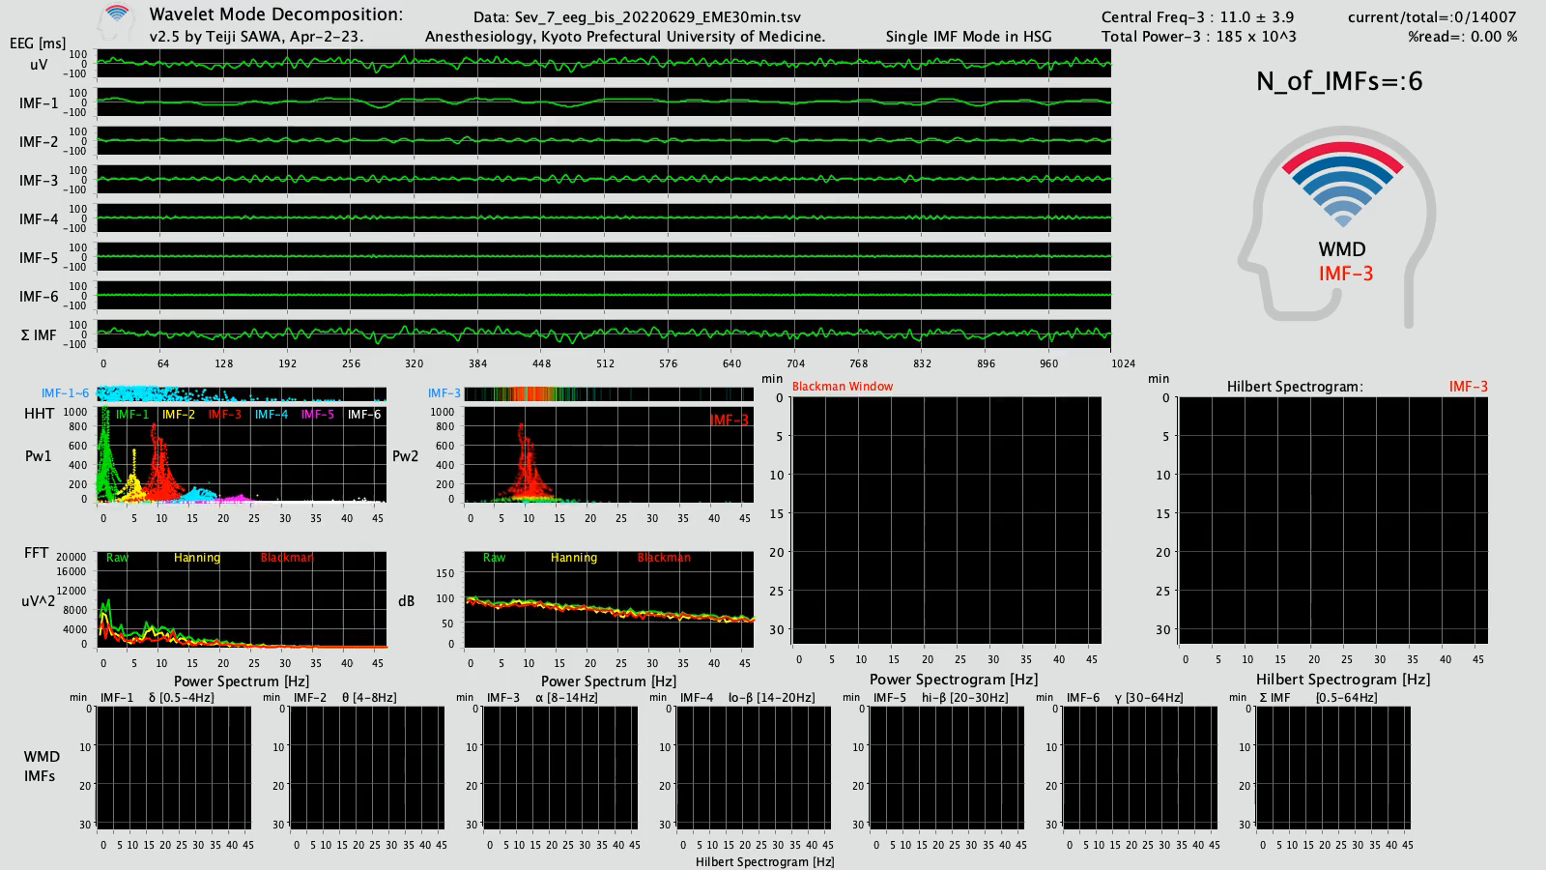
Wavelet Mode Decomposition (WMD)
N of IMF = 2
N of IMF =3
A case (27F, Sevoflurane)
30 min to emergence
IMF-2
IMF-3
N of IMF =4
N of IMF =5
N of IMF =6
IMF-3
IMF-3
IMF-3

Slide 3
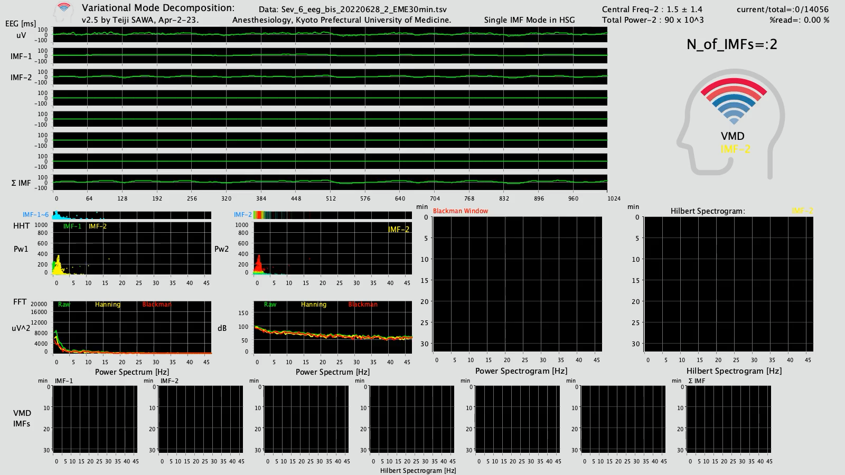


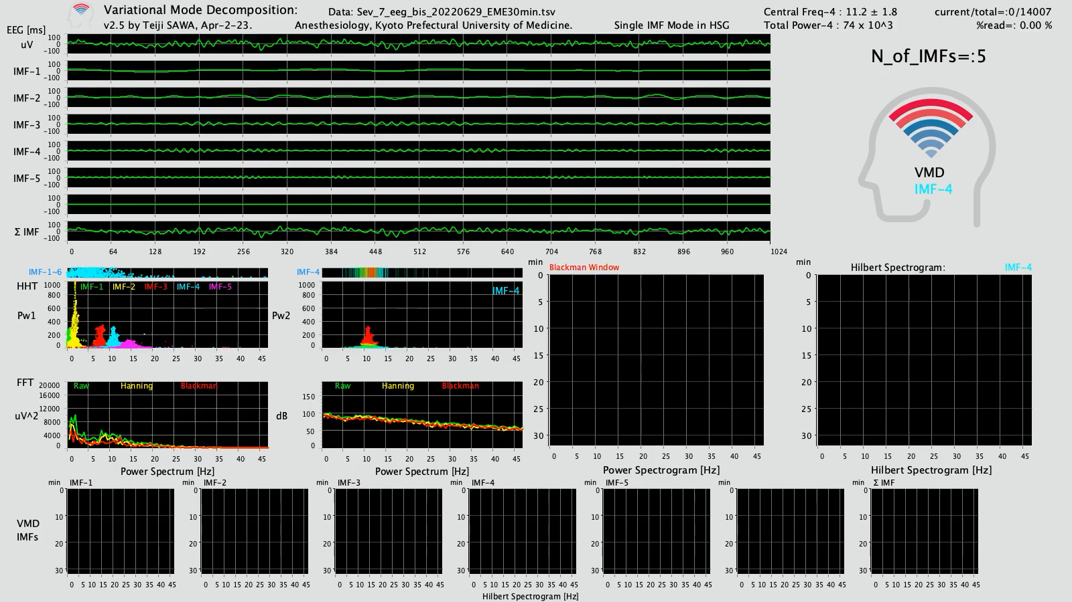
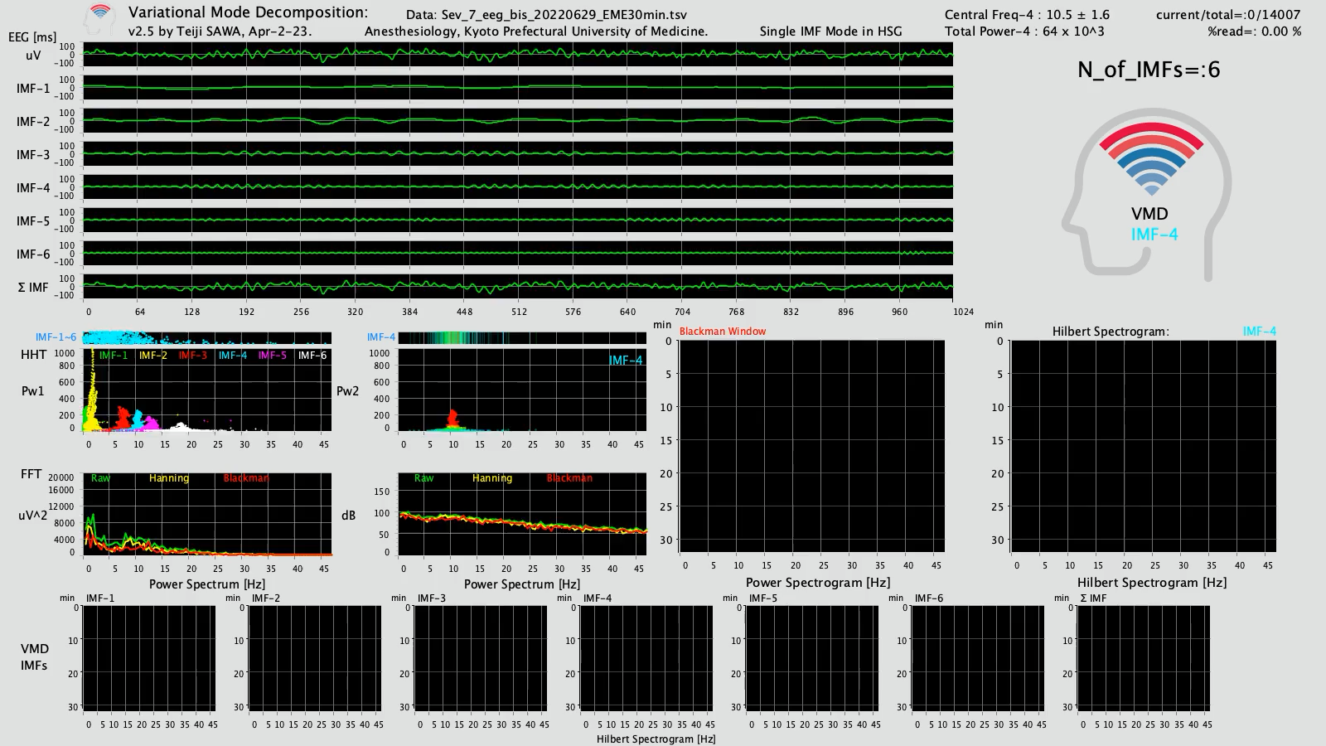
Variational Mode Decomposition (VMD)
N of IMF = 2
N of IMF =3
A case (27F, Sevoflurane)
30 min to emergence
IMF-2
IMF-3
N of IMF =4
N of IMF =5
N of IMF =6
IMF-4
IMF-4
IMF-4

