Slide 1
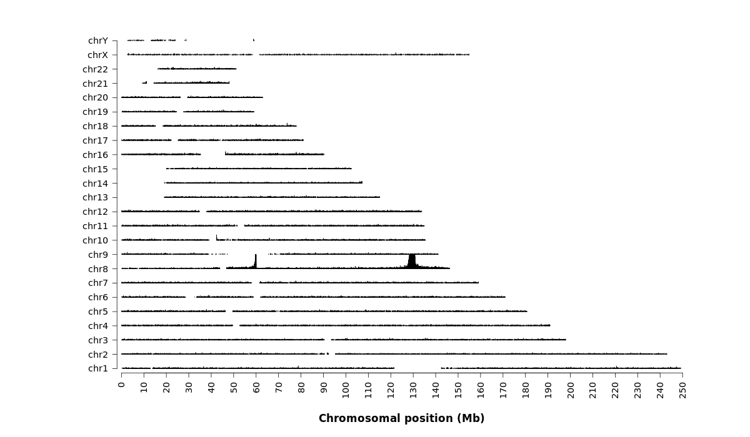
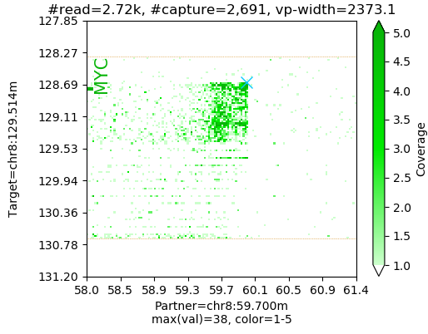
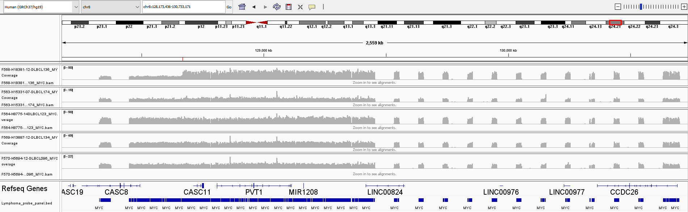
A)
TOX
MYC
TOX
B)
DLBCL-136
DLBCL-174
DLBCL-123
DLBCL-134
DLBCL-096
Supplementary Figure S1: Example of delineation of MYC translocation by TLC-NGS. This case (DLBCL-136) shows juxtaposition between the MYC and TOX loci (Panel A), and additionally MYC gene amplification as indicated by the increased sequence reads in comparison with other cases (Panel B). Red arrow indicates the breakpoint position (upstream of MYC)

