Slide 1
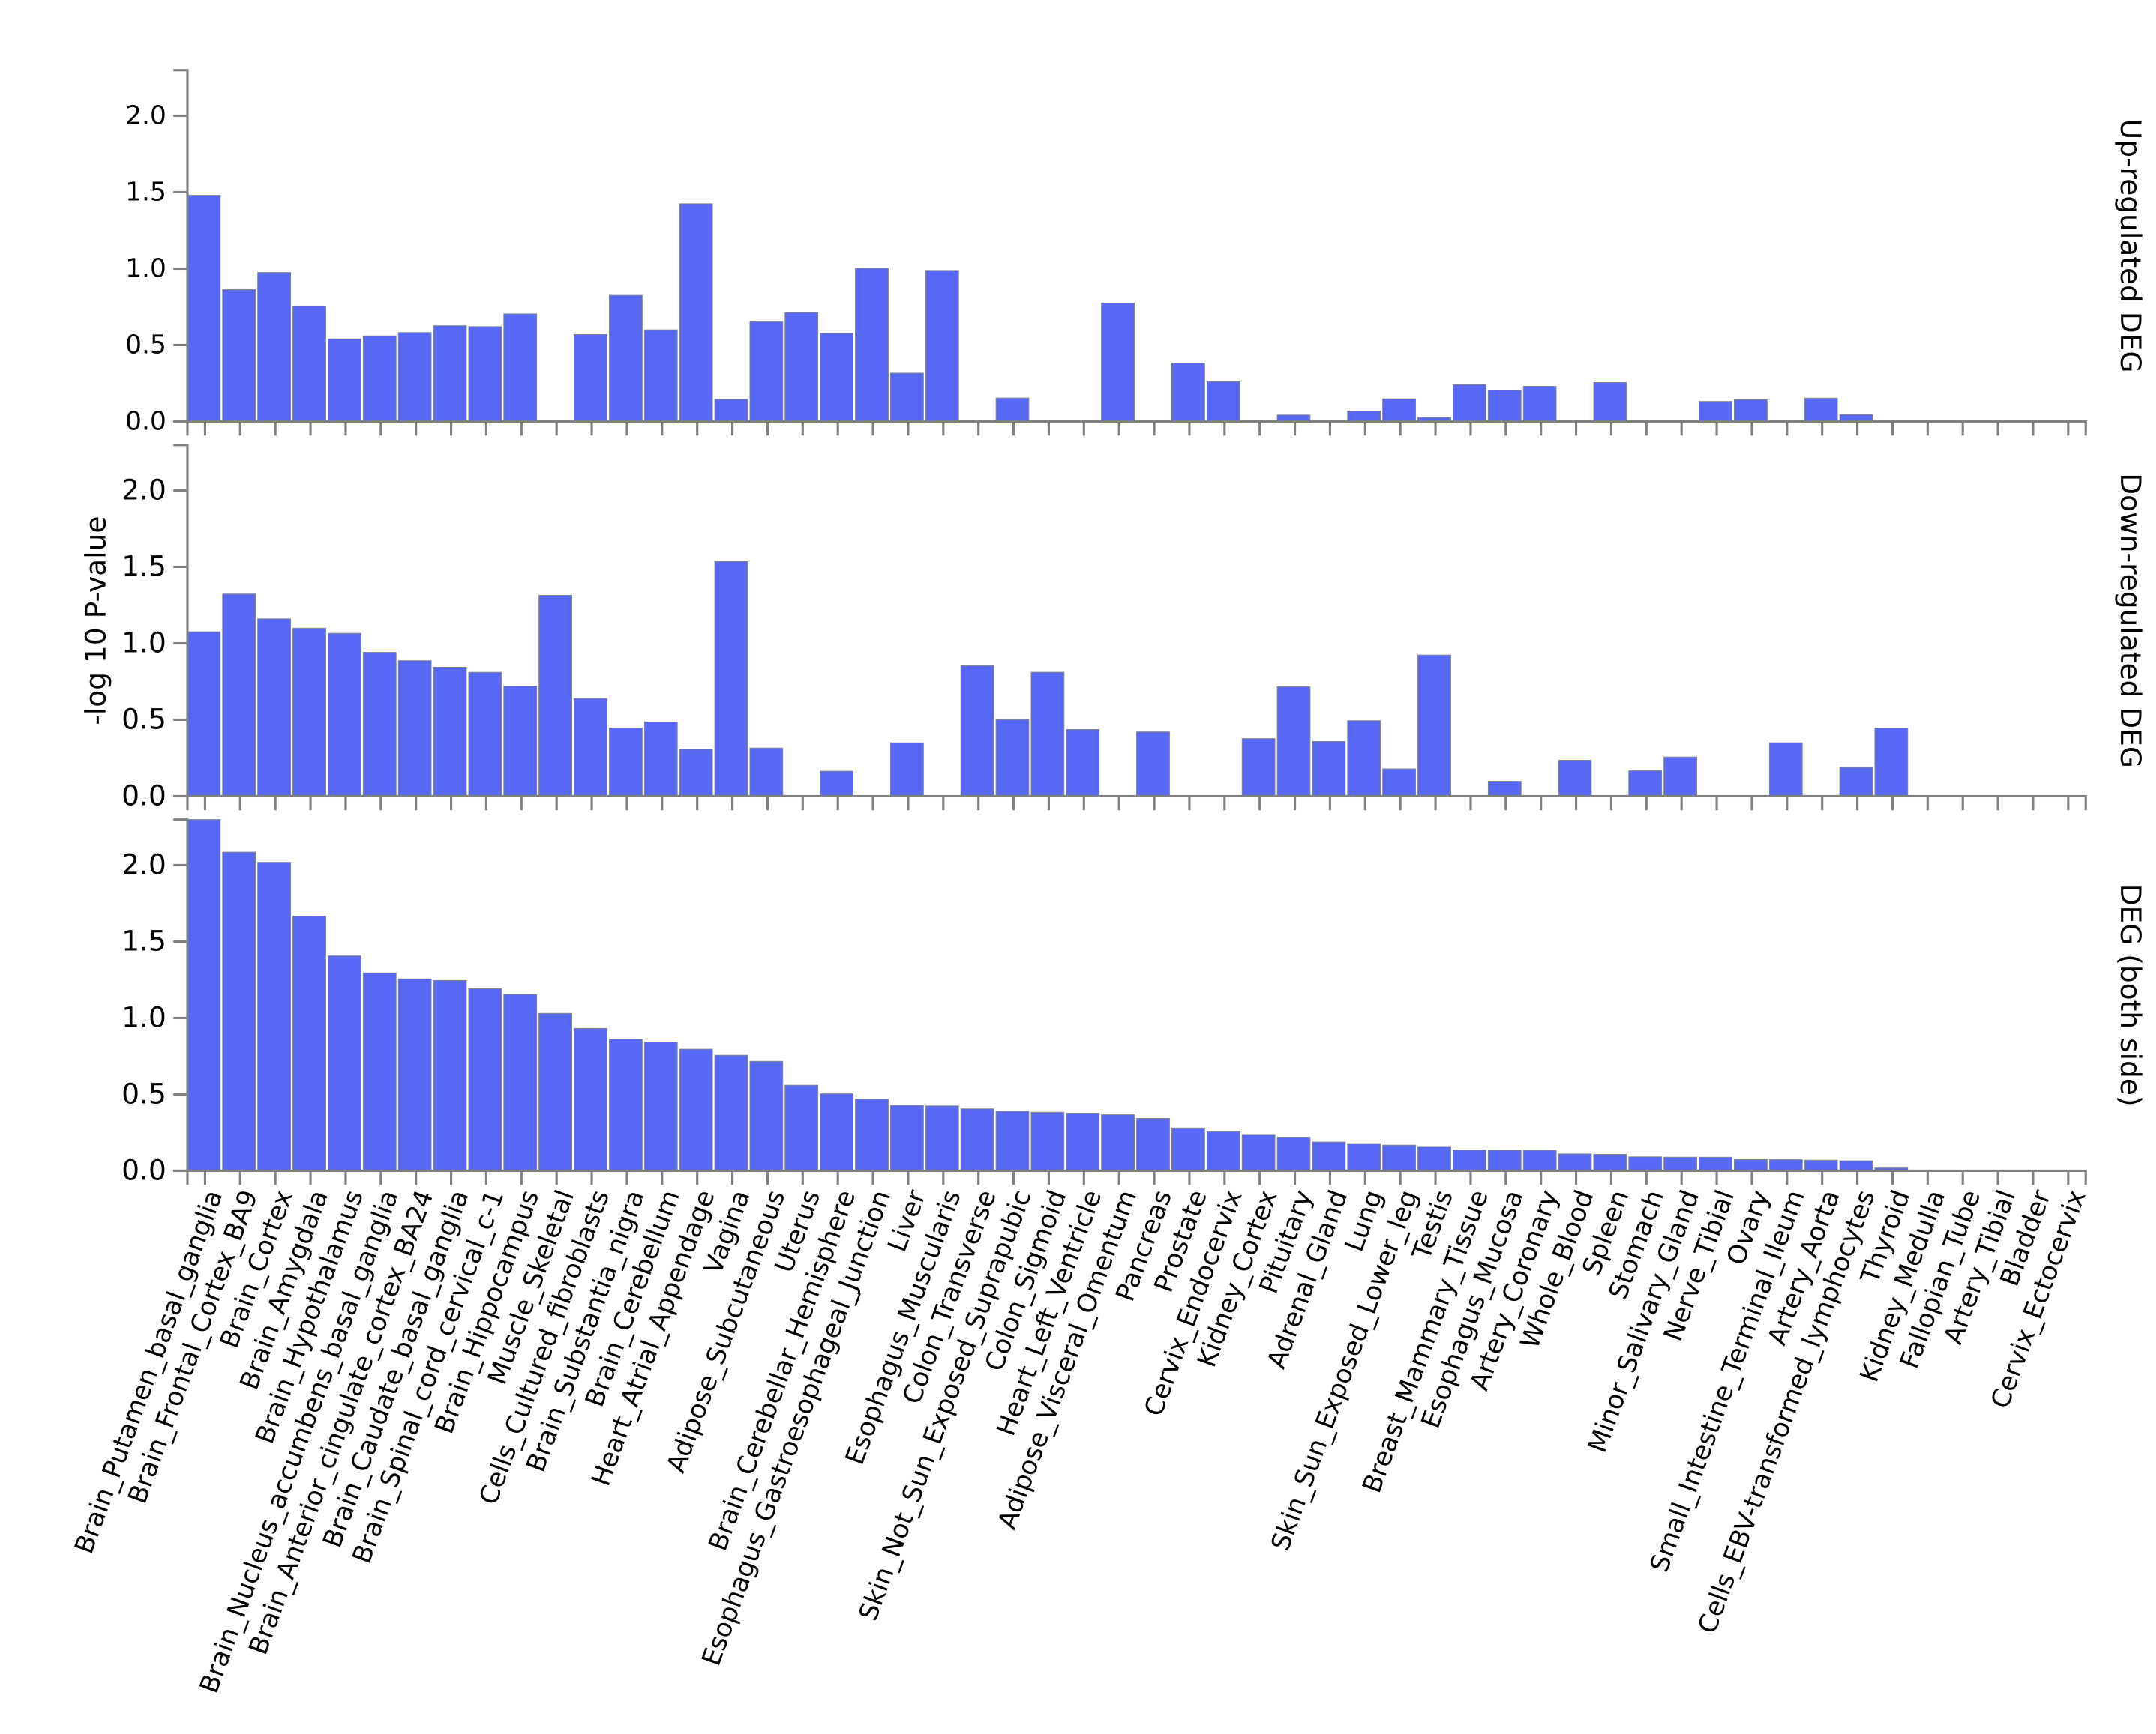
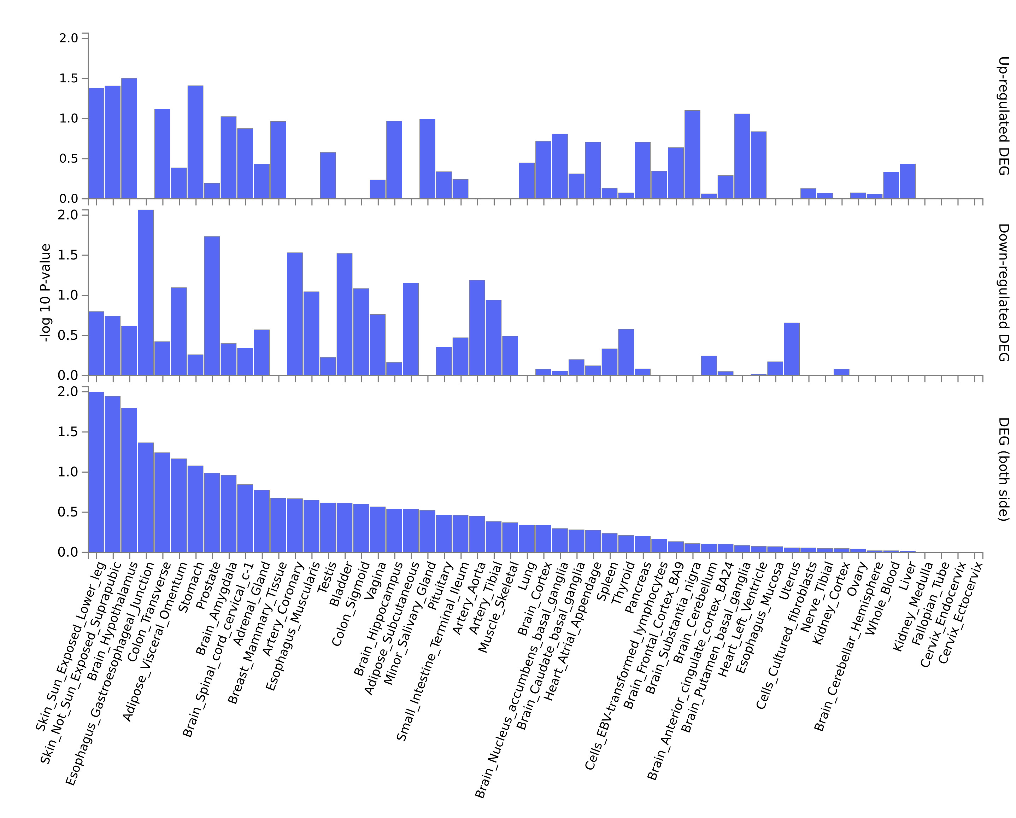
OCD_EWAS
Supplementary Figure S1
Case-Ctrl_neonates
Case-Ctrl_adolescens

Slide 2
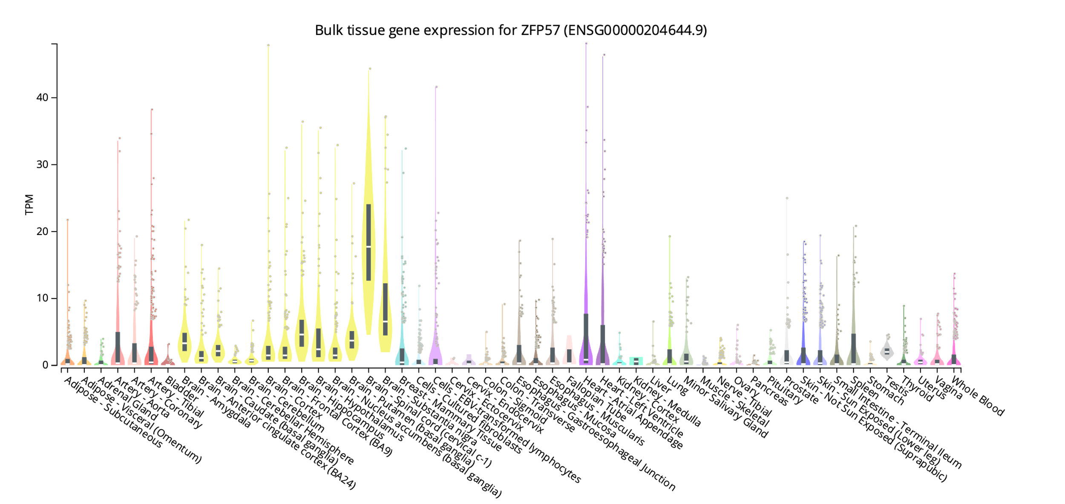
OCD_EWAS
Supplementary Figure S2

Slide 3
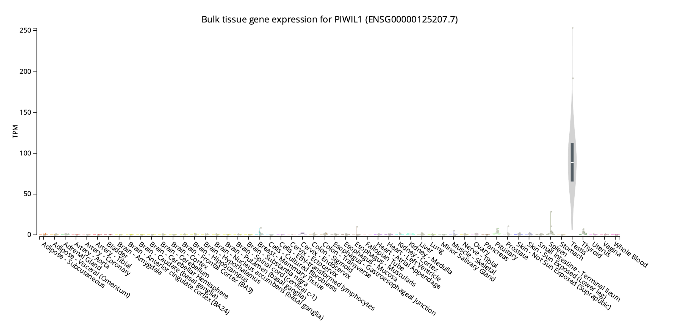
OCD_EWAS
Supplementary Figure S3

Slide 4
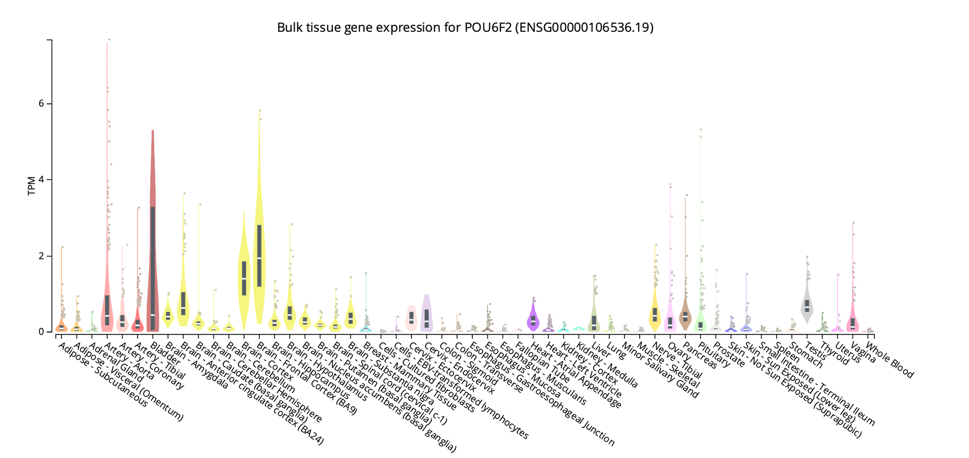
OCD_EWAS
Supplementary Figure S4

