Slide 1
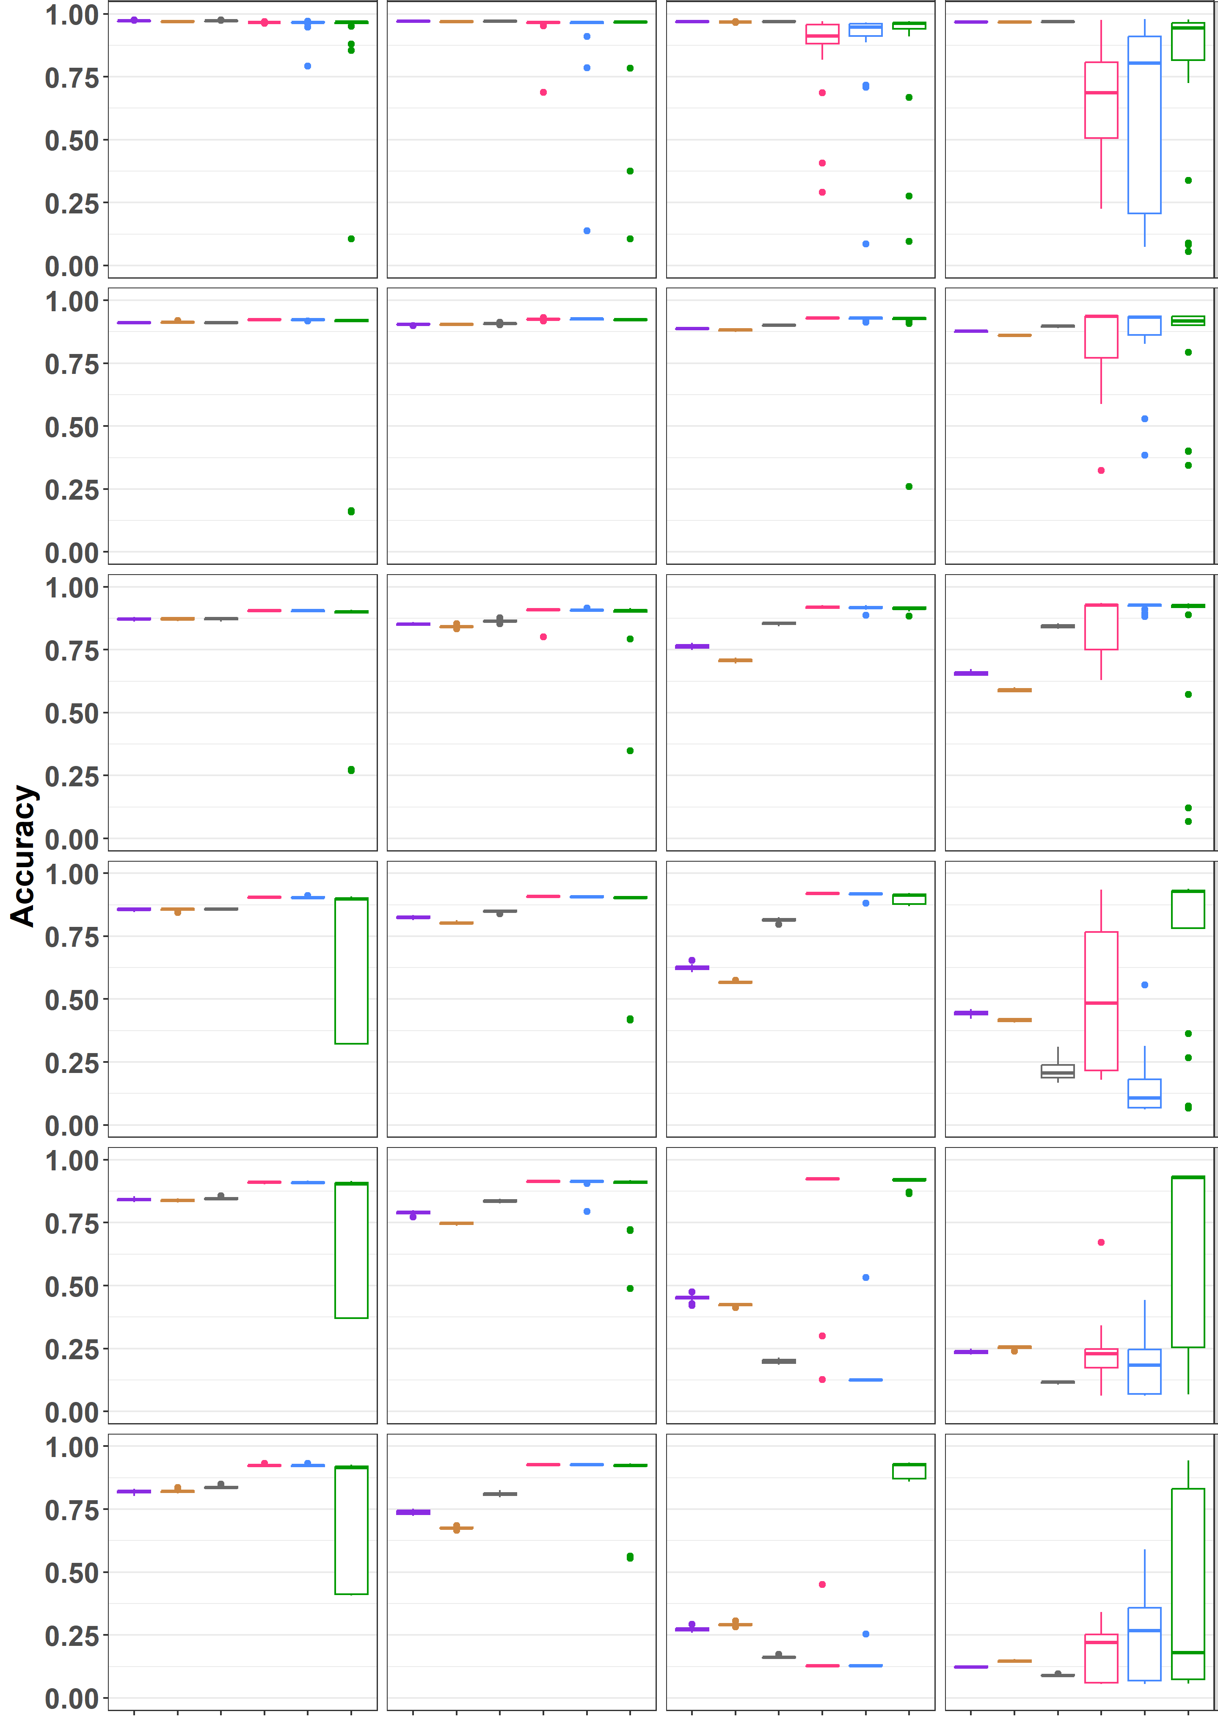
(a) N_{rep} = 3
P₁ = 0.5
P₁ = 0.7
P₁ = 0.9
P₁ = 1.0
P_{DEG} = 0.05
P_{DEG} = 0.25
P_{DEG} = 0.45
P_{DEG} = 0.55
P_{DEG} = 0.65
P_{DEG} = 0.75
edgeR
DESeq2
edgeR
DESeq2
edgeR
DESeq2
edgeR
MBCdeg1
DESeq2
MBCdeg2
MBCdeg3
MBCdeg1
MBCdeg2
TCC_DE
TCC_DE
MBCdeg3
MBCdeg1
MBCdeg2
MBCdeg3
MBCdeg1
MBCdeg2
TCC_DE
TCC_DE
MBCdeg3

Slide 2
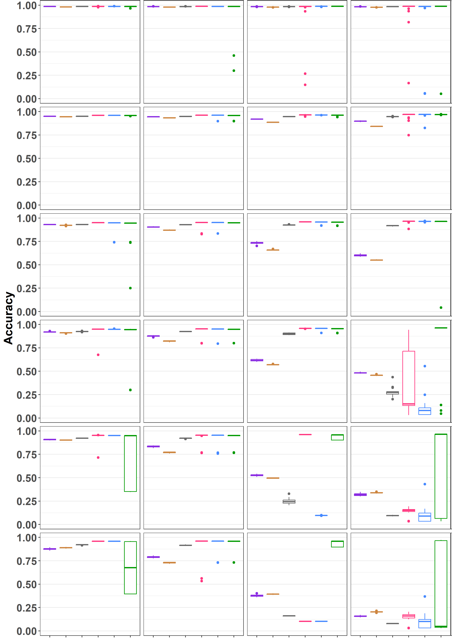
(b) N_{rep} = 6
P₁ = 0.5
P₁ = 0.7
P₁ = 0.9
P₁ = 1.0
P_{DEG} = 0.05
P_{DEG} = 0.25
P_{DEG} = 0.45
P_{DEG} = 0.55
P_{DEG} = 0.65
P_{DEG} = 0.75
edgeR
DESeq2
edgeR
DESeq2
edgeR
DESeq2
edgeR
MBCdeg1
DESeq2
MBCdeg2
MBCdeg3
MBCdeg1
MBCdeg2
TCC_DE
TCC_DE
MBCdeg3
MBCdeg1
MBCdeg2
MBCdeg3
MBCdeg1
MBCdeg2
TCC_DE
TCC_DE
MBCdeg3

Slide 3
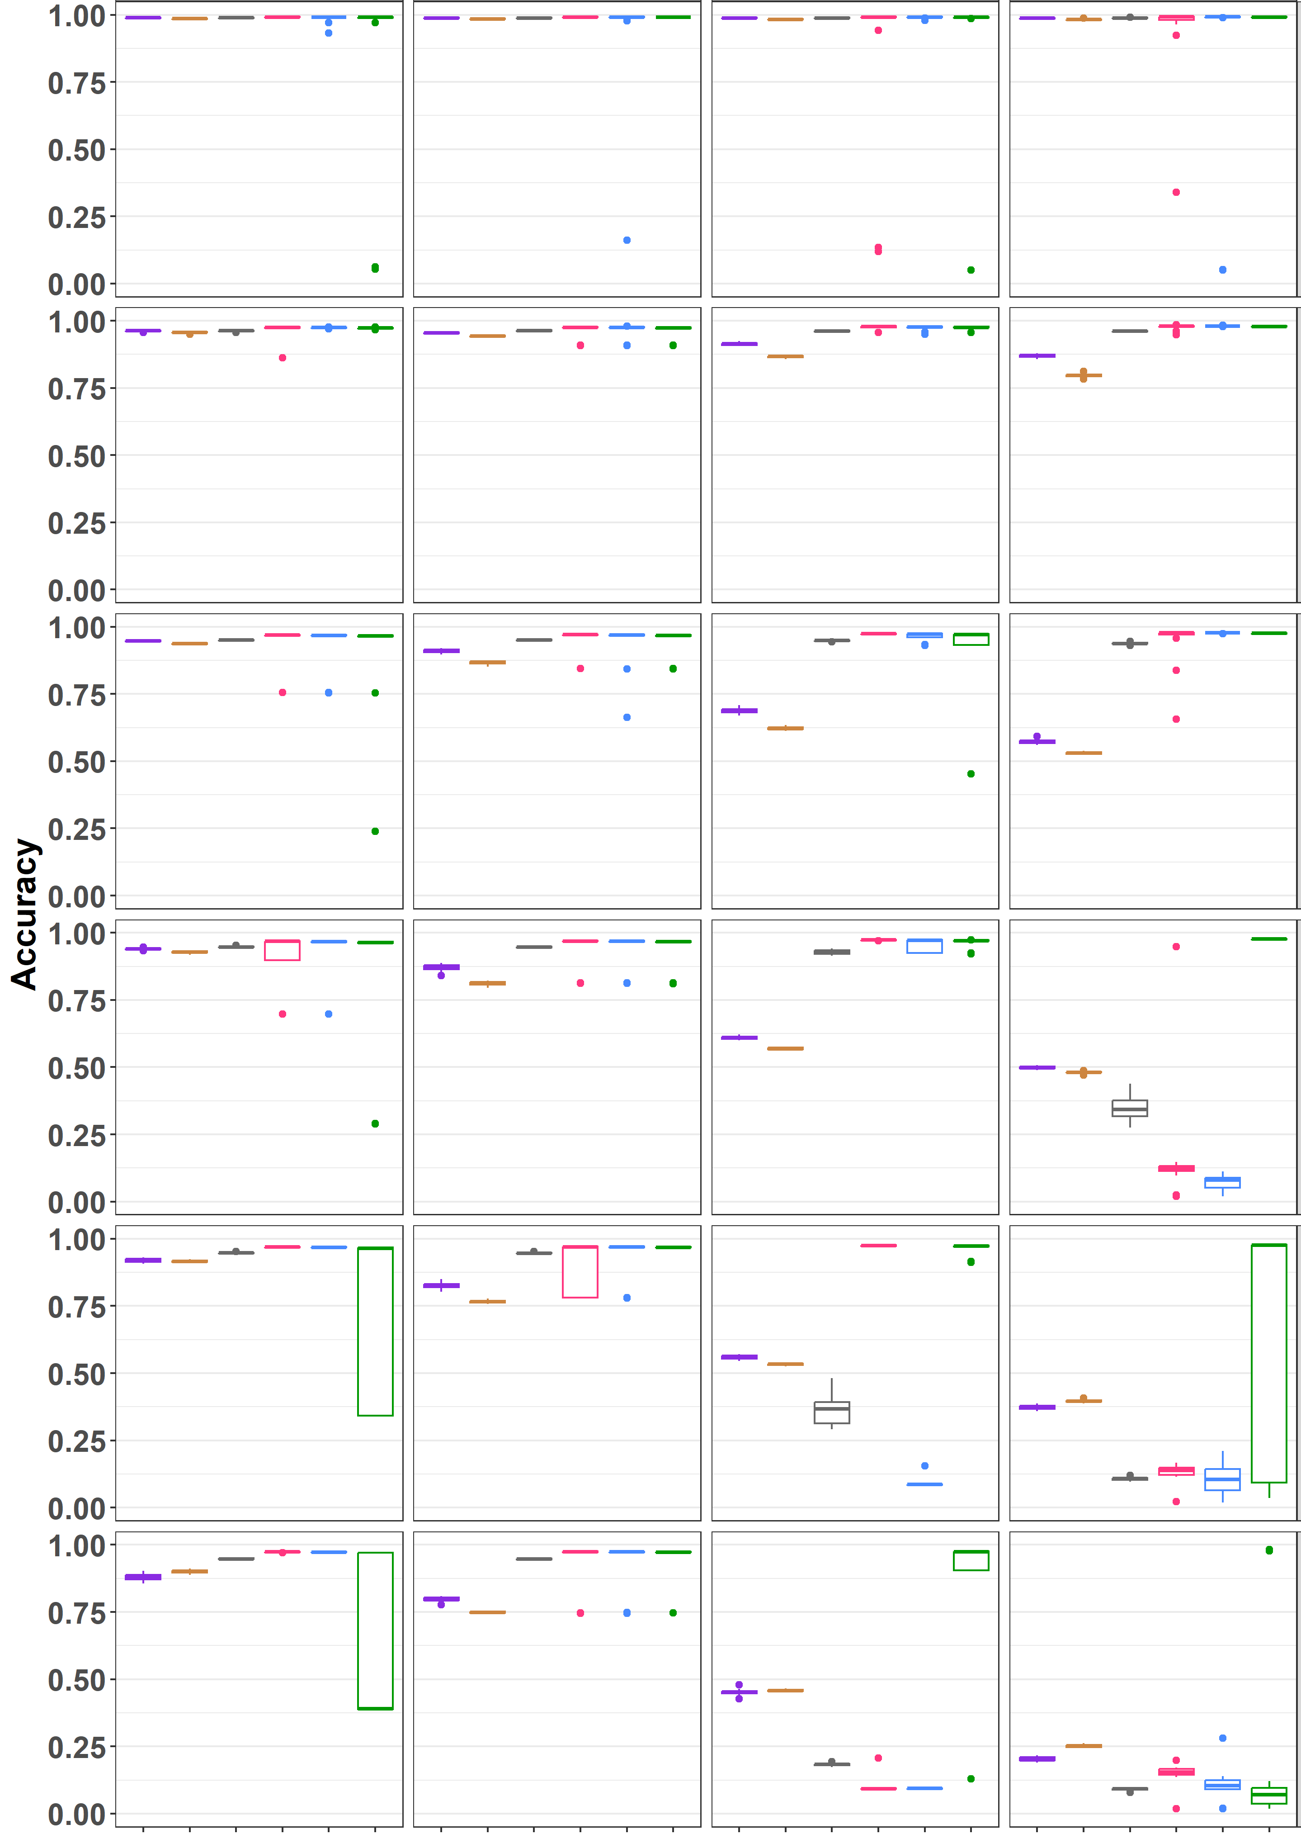
(c) N_{rep} = 9
P₁ = 0.5
P₁ = 0.7
P₁ = 0.9
P₁ = 1.0
P_{DEG} = 0.05
P_{DEG} = 0.25
P_{DEG} = 0.45
P_{DEG} = 0.55
P_{DEG} = 0.65
P_{DEG} = 0.75
edgeR
DESeq2
edgeR
DESeq2
edgeR
DESeq2
edgeR
MBCdeg1
DESeq2
MBCdeg2
MBCdeg3
MBCdeg1
MBCdeg2
TCC_DE
TCC_DE
MBCdeg3
MBCdeg1
MBCdeg2
MBCdeg3
MBCdeg1
MBCdeg2
TCC_DE
TCC_DE
MBCdeg3

Slide 4
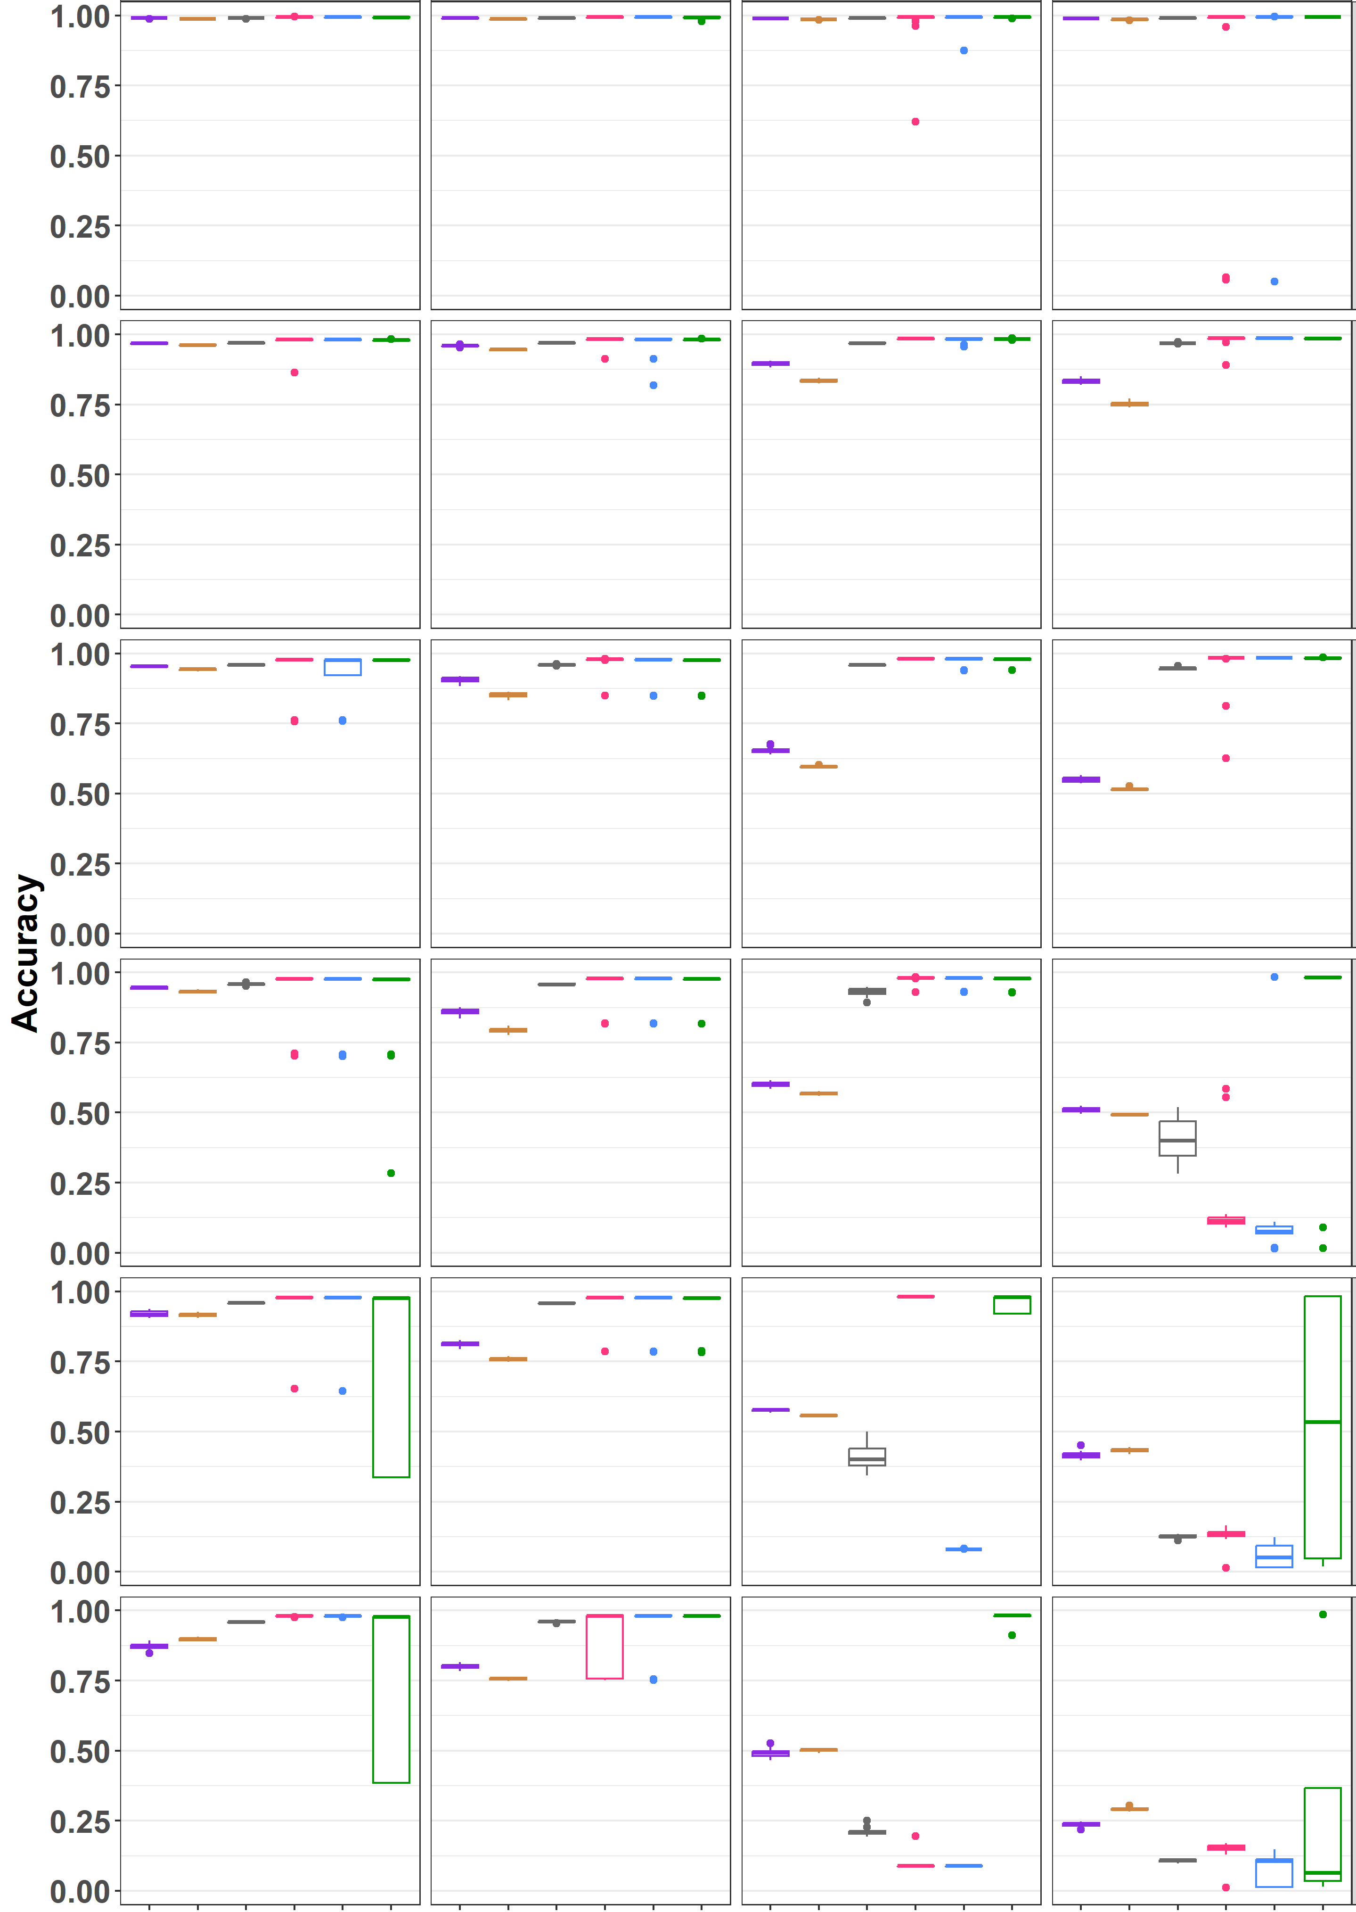
(d) N_{rep} = 12
P₁ = 0.5
P₁ = 0.7
P₁ = 0.9
P₁ = 1.0
P_{DEG} = 0.05
P_{DEG} = 0.25
P_{DEG} = 0.45
P_{DEG} = 0.55
P_{DEG} = 0.65
P_{DEG} = 0.75
edgeR
DESeq2
edgeR
DESeq2
edgeR
DESeq2
edgeR
MBCdeg1
DESeq2
MBCdeg2
MBCdeg3
MBCdeg1
MBCdeg2
TCC_DE
TCC_DE
MBCdeg3
MBCdeg1
MBCdeg2
MBCdeg3
MBCdeg1
MBCdeg2
TCC_DE
TCC_DE
MBCdeg3

