Slide 1
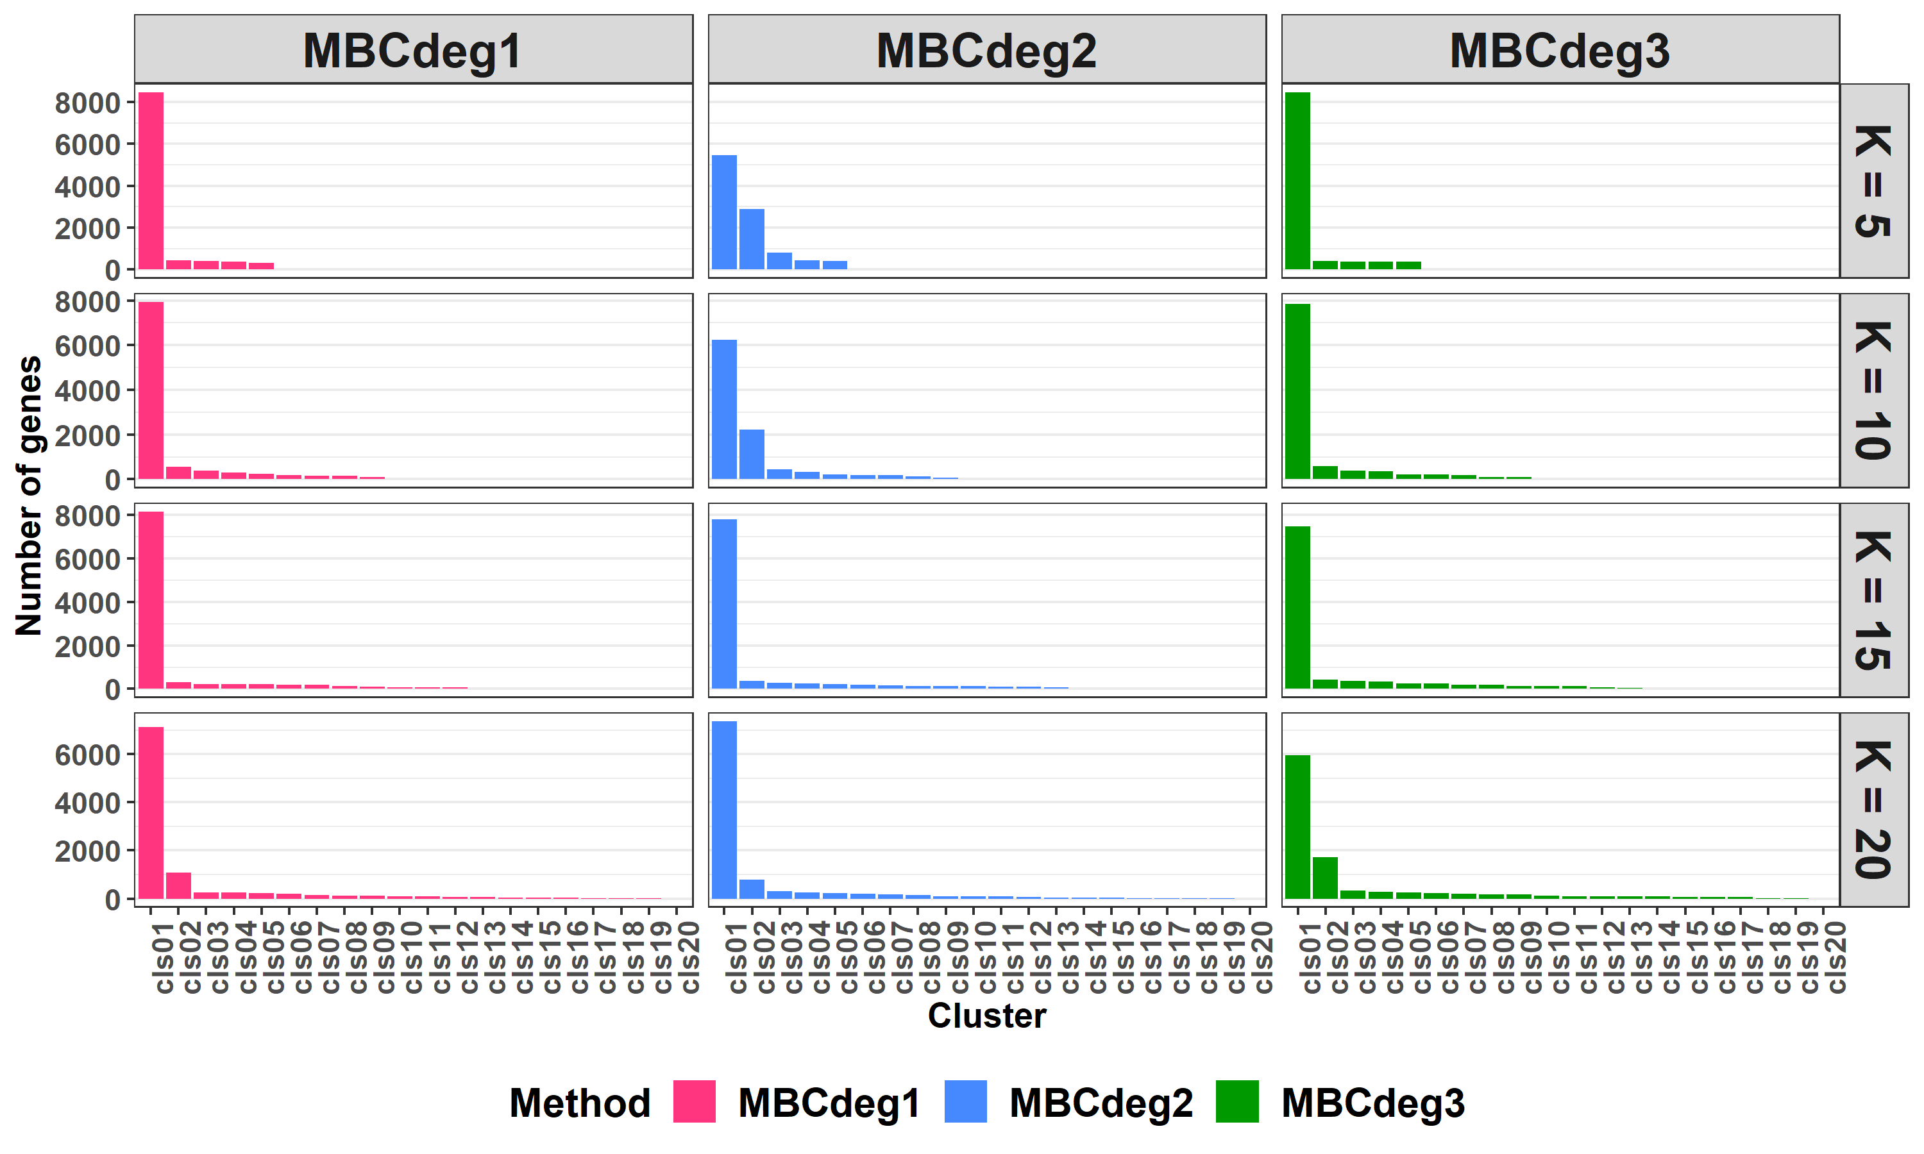
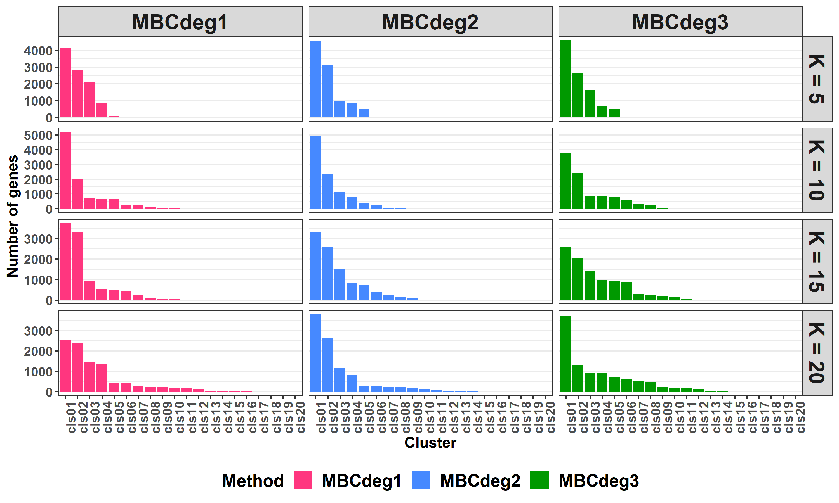
(a) P_{DEG} = 0.25 and P₁ = 0.5
(b) P_{DEG} = 0.65 and P₁ = 1.0

