Slide 1
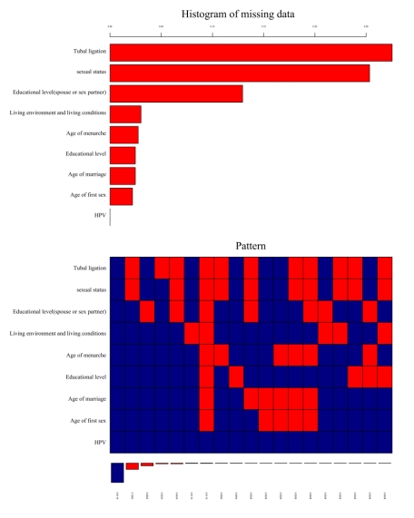
Figure S2. Proportion and type of missing data in the 60-65 years old group.

