Slide 1
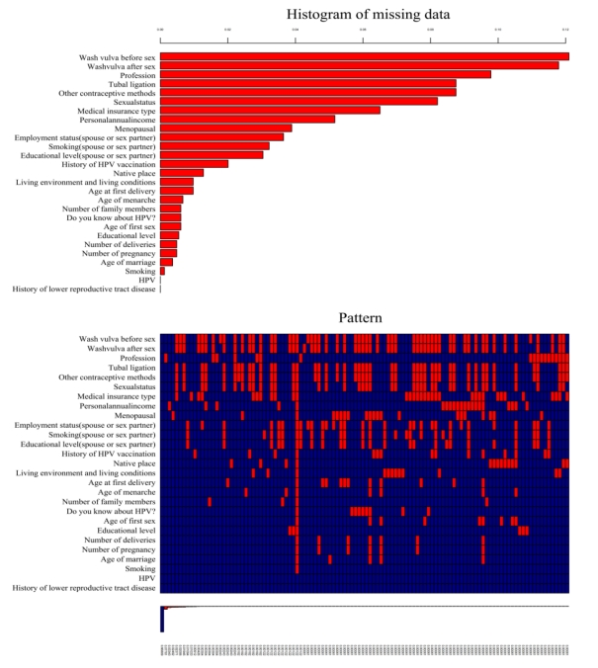
Figure S1. Proportion and type of missing data in the 40-59 years old group.

