Slide 1
Multiparametric influences of 3D-printed organo-mineral scaffolds on bone regeneration
TOUYA Nicolas¹, REISS Ségolène¹, ROUILLON Thierry¹, DUTILLEUL Maeva¹, VEZIERS Joelle¹, PARE Arnaud¹, BRASSET Ludmila¹, WEISS Pierre¹, CORRE Pierre¹, CHARBONNIER Baptiste¹
¹ Nantes Université, ONIRIS, CHU Nantes, INSERM, Regenerative Medicine and Skeleton, RMeS, UMR 1229, F-44000 Nantes, France
Supplementary Data

Slide 2
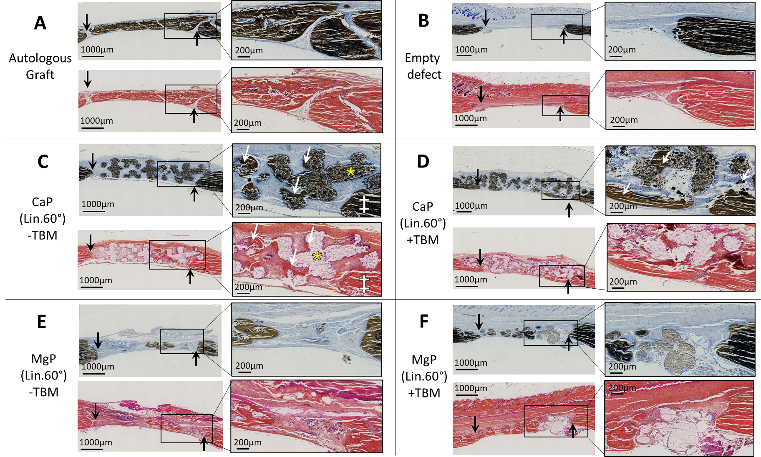
Published data (Figure 9)

Slide 3
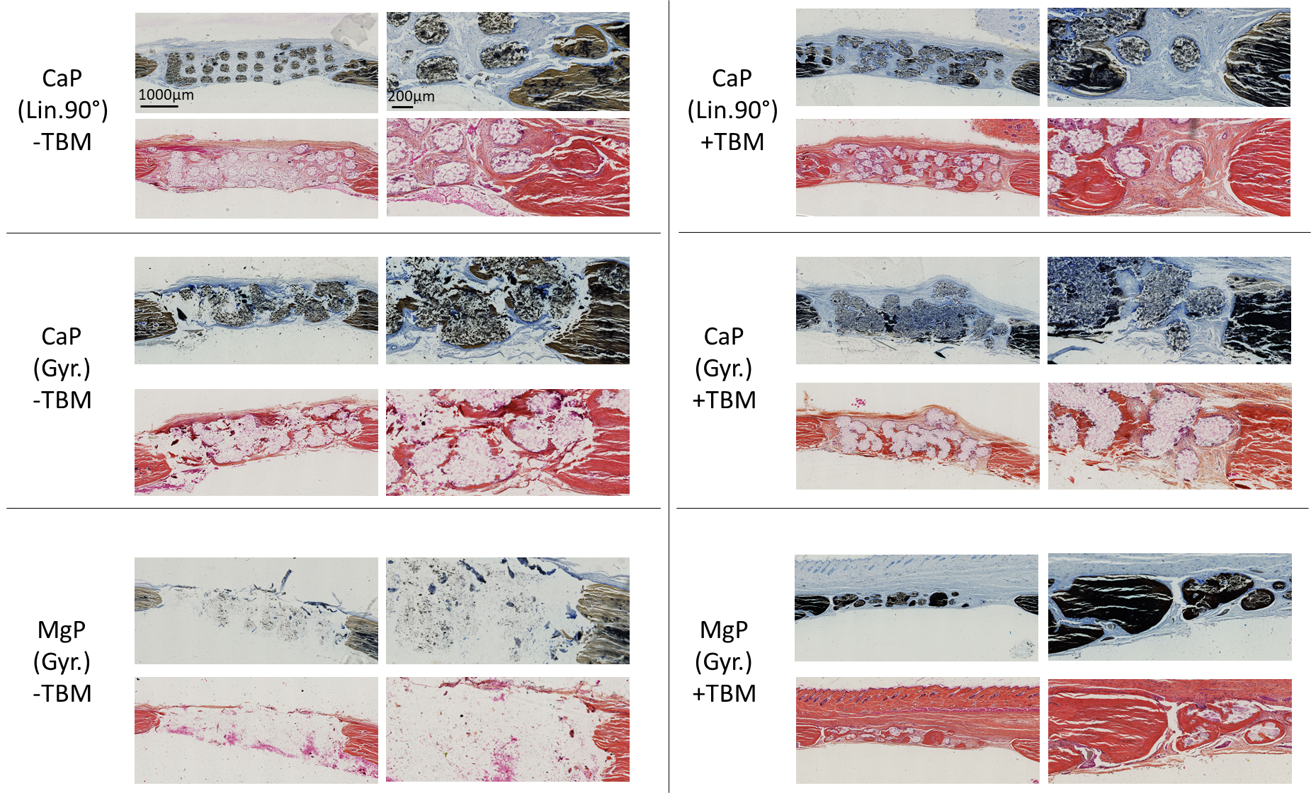
Non-published conditions

Slide 4
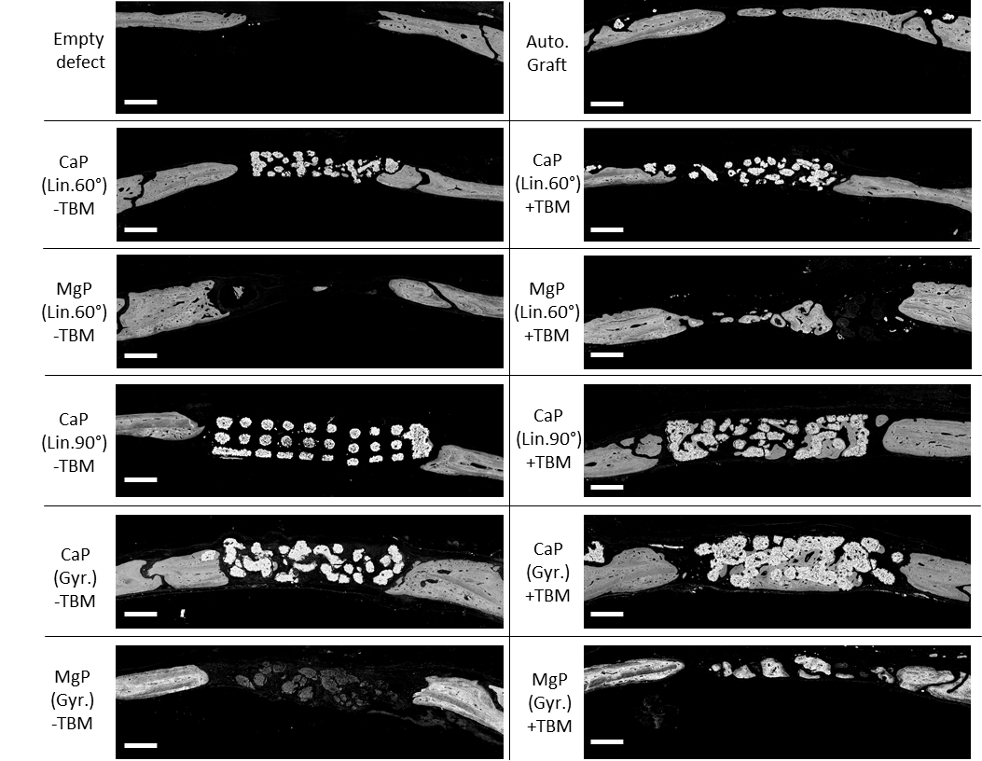
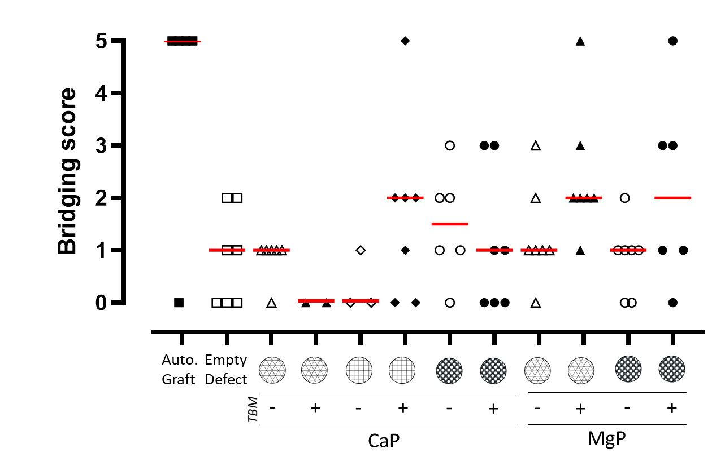
Published and additionnal data illustrating all conditions assessed (Figure 6)

