Slide 1
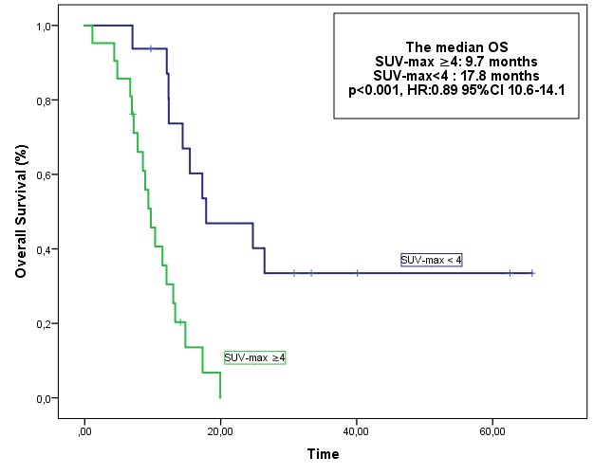
Lu-177 PSMA In Patients With Metastatic Castration-Resistant Prostate Cancer
Methods and Cohorts:
Metastatic CRPC (n=38)
Lu-177, 4.0 to 6.8 GBq, every 6/9 weeks, 1-6 cycles
2nd or later line treatment
Findings
Median PFS 5.8 m
Median OS* 12.3 m
ORR: 36.8%
For PFS
SUVmax value of <4 after treatment
For OS
ECOG PS , pre LU-177-PSMA ALP, post Lu-177 PSA Post Lu-177SUV max
Prognostic Markers
Lu-177-PSMA is an effective option with a good safety profile in second and later lines of treatment for patients with mCRPC.

