Slide 1
Supplementary data: Figure 1.
Figure 1: Spearman’s rank correlation analysis between PASI score and local clinical scores of analysed lesions. PASI scores of 30 psoriasis patients were correlated with local inflammation scores of skin thickness, scaling and redness, respectively. Statistical significances were verified with probability value (p-value). Relevant correlations are flagged with asterisk (* p < 0.05, ** p < 0.01, *** p < 0.001). Y- axis: PASI score. X-axis: thickness, scaling or redness of skin lesion in scale 0-4, respectively.

Slide 2
Supplementary data: Figure 2A.
Figure 2 A: Correlation analysis between FibroTx TAP measurements of IL-1 α, IL-1RA, CXCL-1/2 and hBD-1 on non-lesional skin of psoriasis patients combined with ultrasound measurements of epidermis-, dermis and SLEB- thickness at the same analysis site. Correlation between biomarker measurements and skin layer thickness of psoriasis patients (N = 30) was assessed using Spearman’s rank correlation analysis. Statistical significances were verified with probability value (p-value). Relevant correlations are flagged with asterisk (* p < 0.05, ** p < 0.01, *** p < 0.001) Y- axis: average apparent concentration of biomarker in ng/ml. X-axis: thickness of epidermis, dermis and SLEB in micrometres, respectively. Analysis of Spearman rank correlation and Spearman’s correlation coefficient’s as well as p-values between FibroTx TAP biomarker and ultrasound measurements is presented in Table 3A in paper.

Slide 3
Supplementary data: Figure 2B.
Figure 2 B: Correlation analysis between FibroTx TAP measurements of IL-1 α, IL-1RA, CXCL-1/2 and hBD-1 on lesional skin of psoriasis patients combined with ultrasound measurements of epidermis-, dermis and SLEB- thickness at the same analysis site. Correlation between biomarker measurements and skin layer thickness of psoriasis patients (N = 30) was assessed using Spearman’s rank correlation analysis. Statistical significances were verified with probability value (p-value). Relevant correlations are flagged with asterisk (* p < 0.05, ** p < 0.01, *** p < 0.001). Y- axis: average apparent concentration of biomarker in ng/ml. X-axis: thickness of epidermis, dermis and SLEB in micrometres, respectively. Analysis of Spearman rank correlation and Spearman’s correlation coefficient’s as well as p-values between FibroTx TAP biomarker and ultrasound measurements is presented in Table 3B in paper.

Slide 4
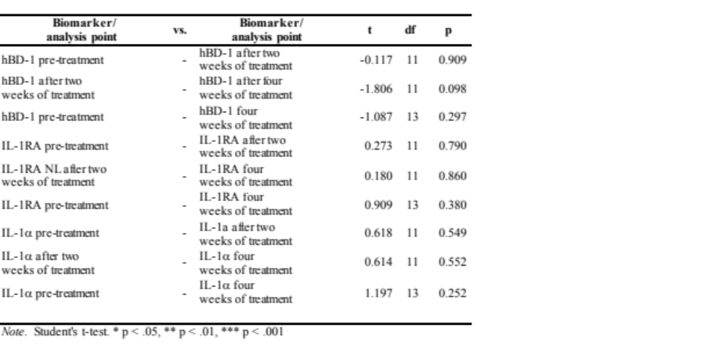
Supplementary data: Table 1A.
Table 1A. Paired sample student t-test analysis between FibroTx TAP biomarker measurements on non-lesional skin during narrow-band UVB treatment. For each biomarker detected on non-lesional skin a paired sample Student t-test was performed between the pre-treatment and after 2 weeks of treatment, between 2 weeks of treatment and after 4 weeks of treatment, between pre-treatment and 4 weeks of treatment. t - t statistic; - df - degrees of freedom; p- probability value. Statistical significance is marked with asterisk.

Slide 5
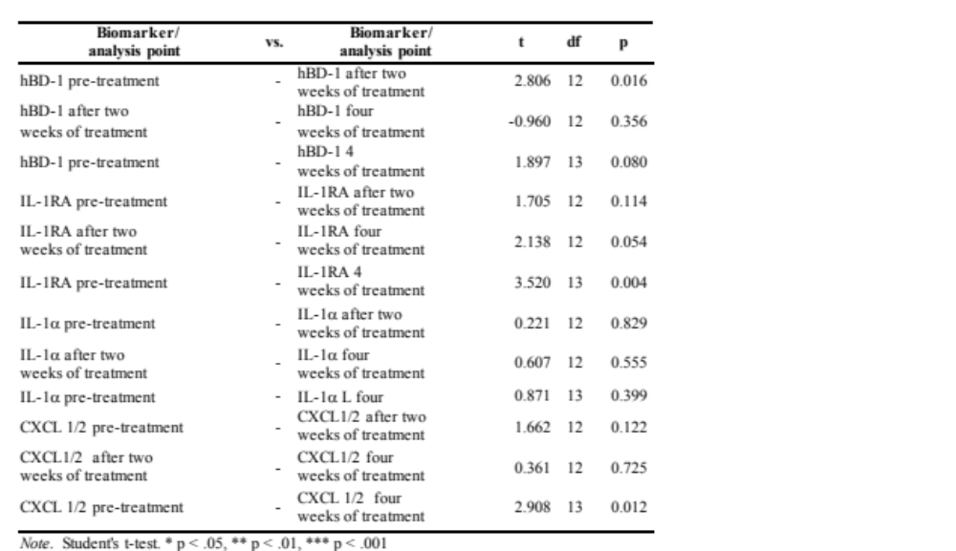
Supplementary data: Table 1B.
Table 1B. Paired sample student t-test analysis between FibroTx TAP biomarker measurements on lesional skin during narrow-band UVB treatment. For each biomarker detected on lesional skin a paired sample Student t-test was performed between the pre-treatment and after 2 weeks of treatment, between 2 weeks of treatment and after 4 weeks of treatment, between pre-treatment and 4 weeks of treatment. t - t statistic; - df - degrees of freedom; p- probability value. Statistical significance is marked with asterisk.

Slide 6
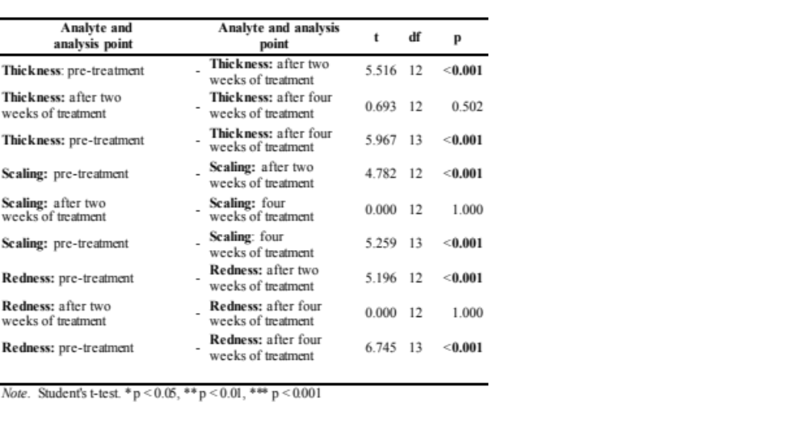
Supplementary data: Table 2.
Table 2. Paired sample student t-test analysis between inflammation scores measured during narrow-band UVB treatment on lesional skin. For each for each inflammation score a paired sample Student t-test was performed between the pre-treatment and after 2 weeks of treatment, between 2 weeks of treatment and after 4 weeks of treatment, between pre-treatment and 4 weeks of treatment. t - t statistic; - df - degrees of freedom; p- probability value. Statistical significance is marked with asterisk.

