Slide 1
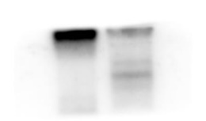
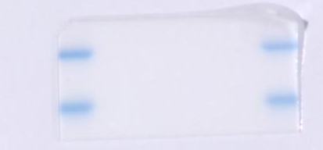
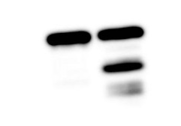
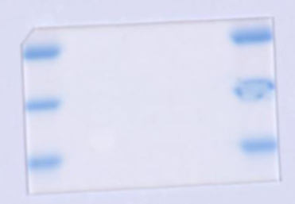
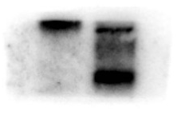
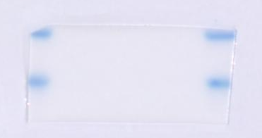
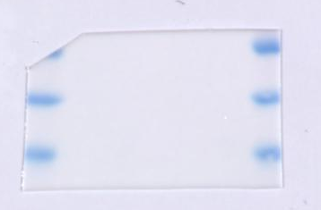
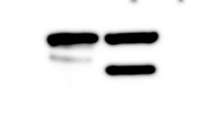
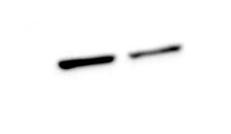
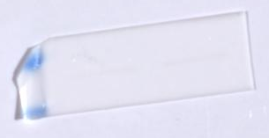
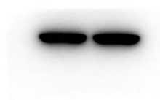
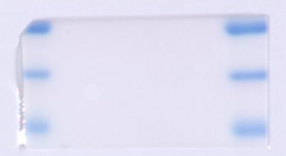
Tumor
Normal
Figure 1D-1
40kDa
PLEK2 40kDa
35kDa
β-actin 42kDa
55kDa
40kDa
35kDa
Figure 1D-2
40kDa
PLEK2 40kDa
35kDa
55kDa
β-actin 42kDa
40kDa
35kDa
Figure 1D-3
40kDa
PLEK2 40kDa
35kDa
55kDa
β-actin 42kDa
40kDa
35kDa

Slide 2
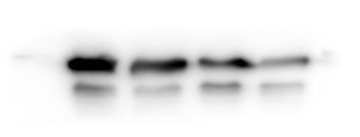
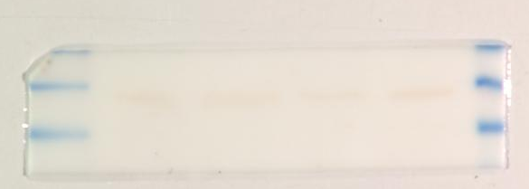
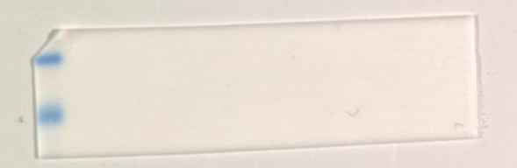
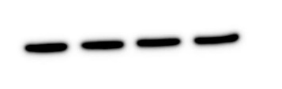
Figure 2B
shPLEK2-1
shPLEK2-2
shPLEK2-3
shCtrl
55kDa
PLEK2 40kDa
40kDa
35kDa
40kDa
GAPDH 36 kDa
35kDa

Slide 3
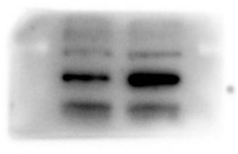
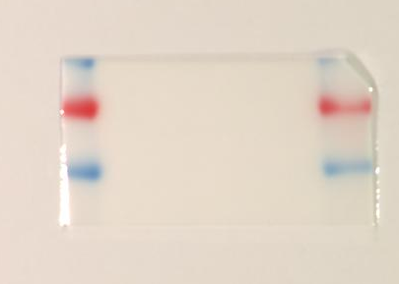
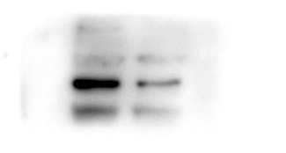
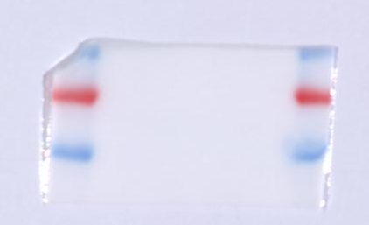
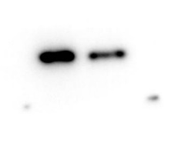
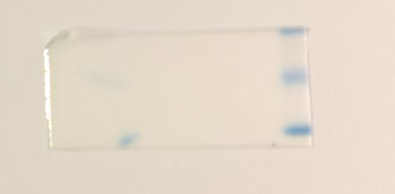
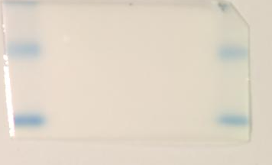
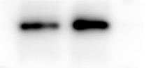
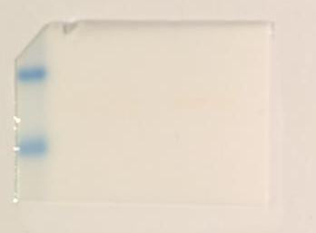

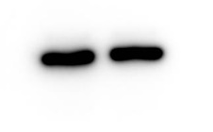
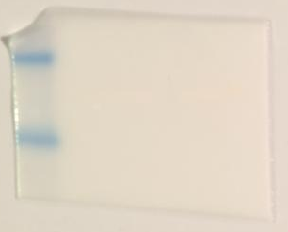
Figure 4F
Control
shPLEK2
PLEK2
shCtrl
50kDa
50kDa
40kDa
PLEK2 40kDa
40kDa
PLEK2 40kDa
35kDa
35kDa
25kDa
25kDa
SPC25 26kDa
SPC25 26kDa
15kDa
15kDa
GAPDH 36kDa
35kDa
GAPDH 36kDa
35kDa
25kDa
25kDa

Slide 4
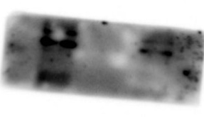
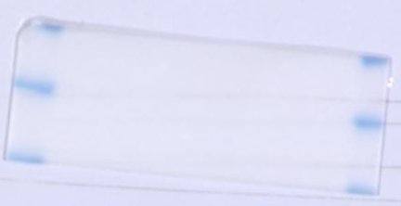
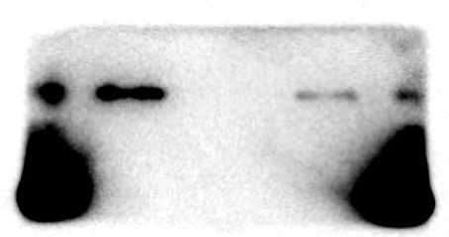
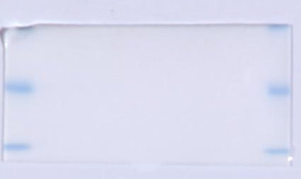
Figure 4G
Anti-PLEK2
IgG
Input
PLEK2 40kDa
40kDa
35kDa
35kDa
SPC25 26kDa
25kDa

Slide 5
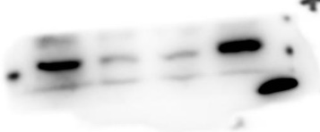
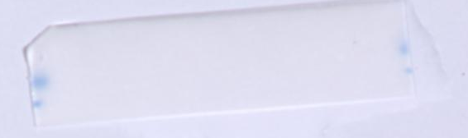
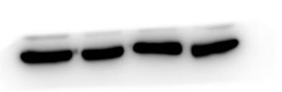
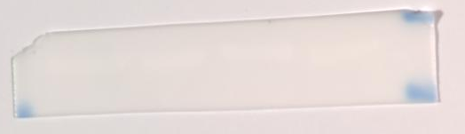
Figure 5B
shSPC25-1
shSPC25-3
shSPC25-2
shCtrl
25kDa
SPC25 26kDa
40kDa
GAPDH 36kDa
35kDa

Slide 6
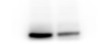
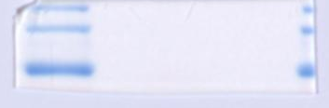
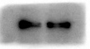
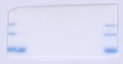
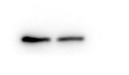
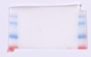
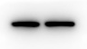
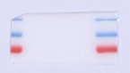
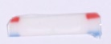
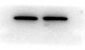
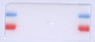
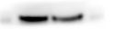
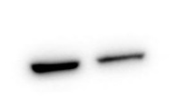
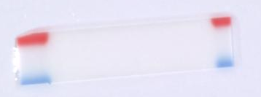
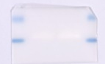







Figure 6A
shPLEK2
shCtrl
shPLEK2
shCtrl
180 kDa
130 kDa
PI3K 110kDa
100 kDa
180 kDa
JAK1 133kDa
130 kDa
100 kDa
180 kDa
130 kDa
p-PI3K 110kDa
130 kDa
100 kDa
100 kDa
Stat3 86kDa
70 kDa
AKT 56kDa
70 kDa
p-Stat3 86kDa
100 kDa
55 kDa
70 kDa
p-AKT 60kDa
70 kDa
55 kDa
25 kDa
Bax 21kDa
15 kDa
mTOR 289kDa
250 kDa
40 kDa
GAPDH 36 kDa
35 kDa
p-mTOR 289kDa
250 kDa

Slide 7












Figure 6B
shSPC25
shSPC25
shCtrl
shCtrl
70 kDa
PI3K 110kDa
180 kDa
p-AKT 60kDa
55 kDa
130 kDa
100 kDa
25 kDa
p-PI3K 110kDa
180 kDa
Bax 21kDa
15 kDa
130 kDa
100 kDa
40 kDa
AKT 56kDa
70 kDa
GAPDH 36kDa
35 kDa
55 kDa

Slide 8












Figure 6C
shSPC25
shCtrl
180 kDa
PI3K 110Da
130 kDa
100 kDa
p-PI3K 110kDa
180 kDa
130 kDa
100 kDa
AKT 56kDa
70 kDa
55 kDa
p-AKT 60kDa
70 kDa
55 kDa
25 kDa
Bax 21kDa
15 kDa
55 kDa
β-actin 43kDa
40 kDa

