Slide 1
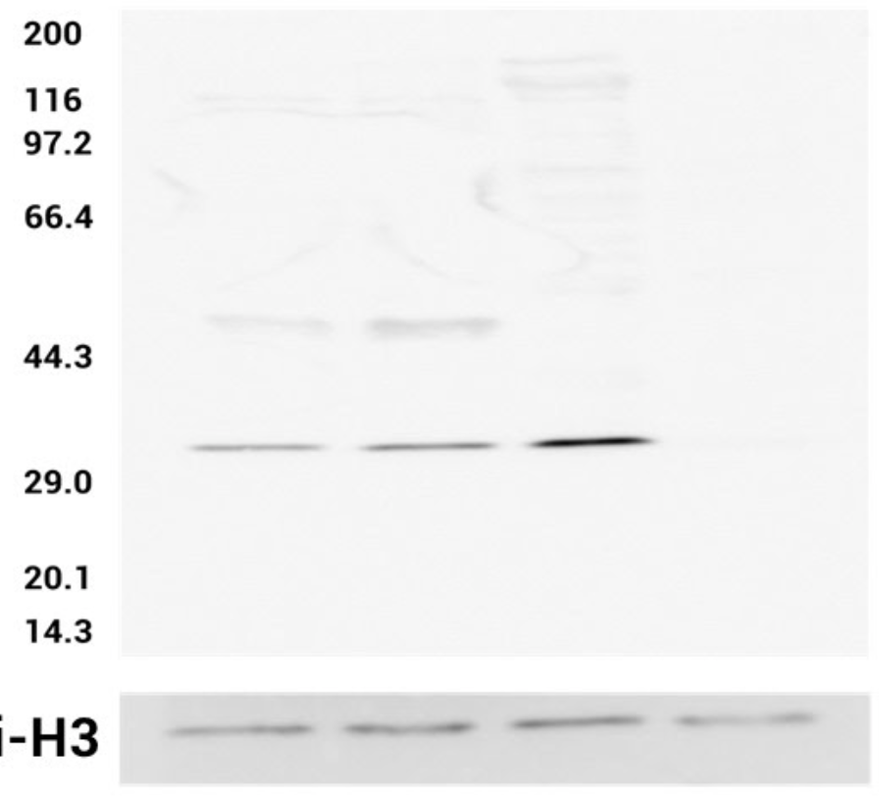
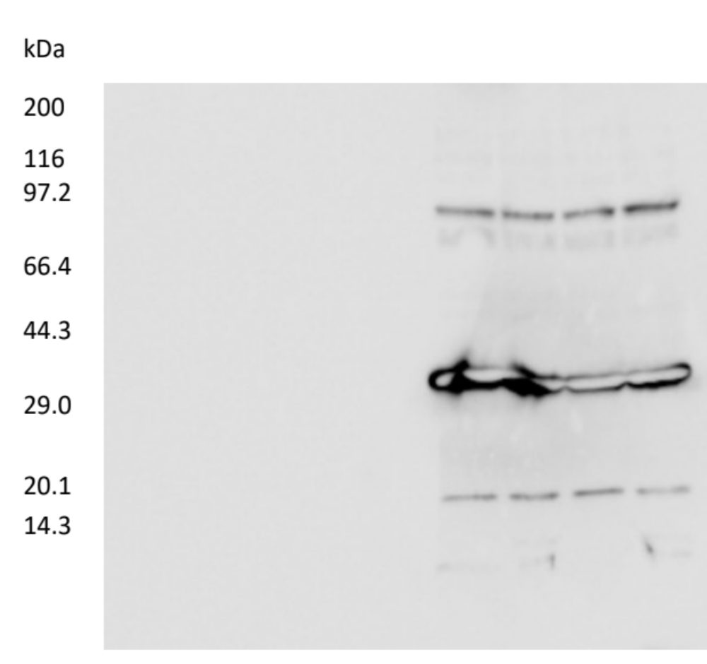
anti-DSX
anti-Histone H3
Bmdsx^{FΔ85/FΔ85}♀
Bmdsx^{FΔ85/FΔ85}♀
Bmdsx^{MΔ7/MΔ7}♂
Bmdsx^{MΔ7/MΔ7}♂
Bmdsx^{+/+} ♀
Bmdsx^{+/+} ♀
Bmdsx^{+/+} ♂
Bmdsx^{+/+} ♂
kDa
kDa
200.0
200.0
116.0
116.0
97.2
97.2
66.4
66.4
44.3
44.3
29.0
BmDSX
29.0
20.1
20.1
Histone H3
14.3
14.3
1 2 3 4
1 2 3 4

